Slide 1
CHAP 6 :
INPUT & OUTPUT
Presented by :
Herthik
Aleeya Syakila
Imran Hakim
Intan Marina
Lecturer’s name : Dr Aryati Bt Bakri
Date : 14/10/2019
Venue : BK3,N28

Slide 2
INPUT
Input is any data or instructions used by a computer.
Input or user input is sent to a computer using an input device.

Slide 3
INPUT DEVICES
Input devices convert what we understand into what the system unit can process.

Slide 4
Keyboard
•Inherited from the invention of the typewriter.
•Christopher Latham Sholes in 1869 patented the first practical modern typewriter, the known QWERTY layout.
•Mid 1800s breakthroughs in keyboard technology was the invention of the teletype machine.
•Modern computer keyboards were based on teletype keyboards.

Slide 5
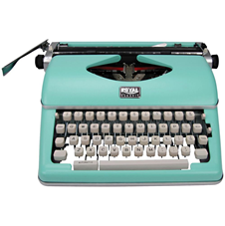
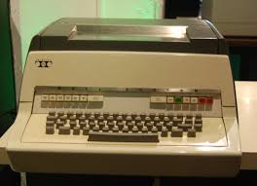
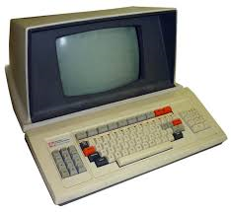
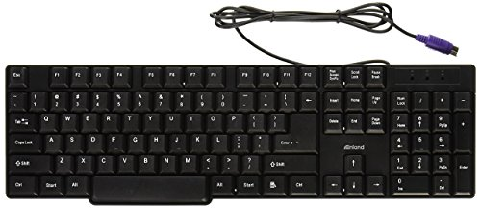
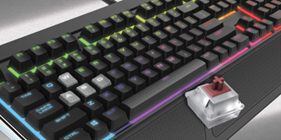

Slide 6
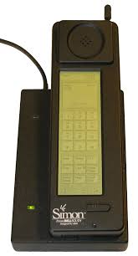
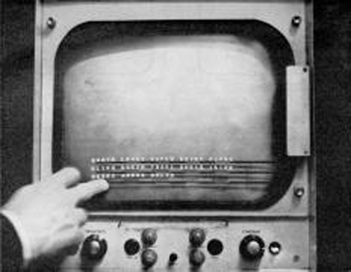
TOUCH SCREEN
invented by E.A. Johnson in 1965 at United Kingdom which was capacitive.
In 1970 first resistive touch screen was invented.
First cellphone with touch screen Technology was invented by IBM in 1993.

Slide 7
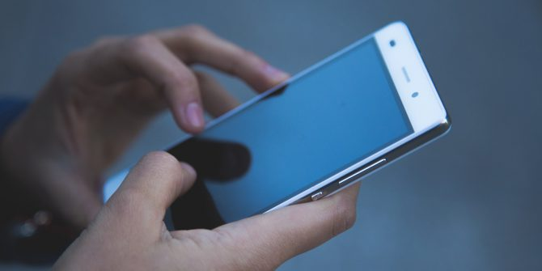
TYPES OF SENSOR : CAPACITIVE
uses the conductive touch of a human finger or a specialized device for input.
Unlike resistive and surface wave panels, which can sense input from either fingers or simple styluses, capacitive touch screen panels must be touched with a finger or a special capacitive pen or glove.
Mostly used in smartphones

Slide 8
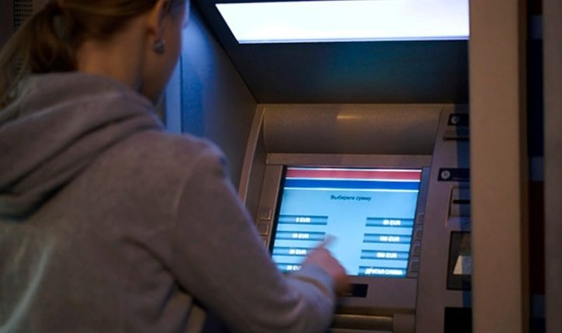
TYPES OF SENSOR : RESISTIVE
These screens literally “resist” your touch
if you press hard enough you can feel the screen bend slightly.
This is what makes resistive screens work
Mostly used in ATM machine, supermarkets

Slide 9
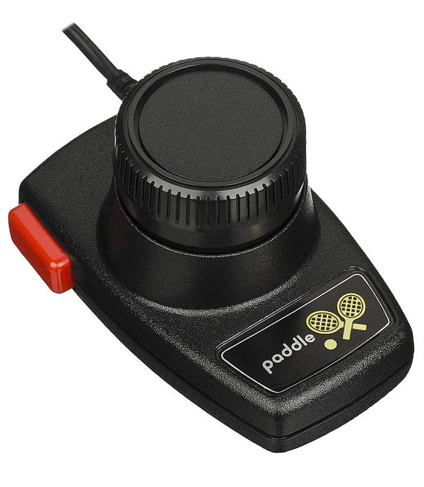
GAMING CONTROLLER
to control an object or character in the game
The first gaming controller was the paddle, it was invented in 1972 by ATARI

Slide 10
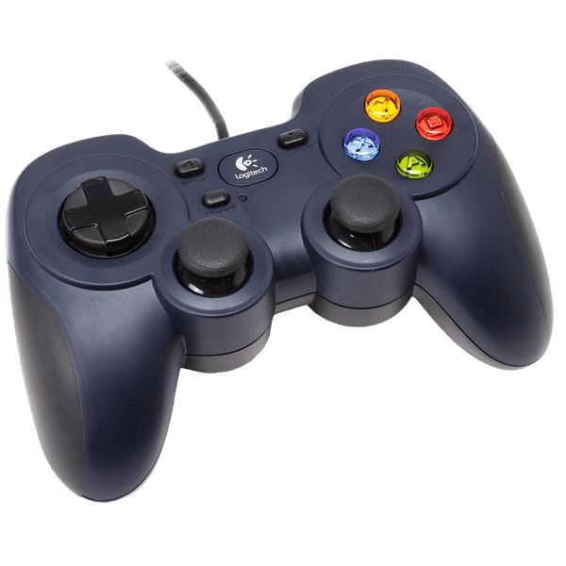
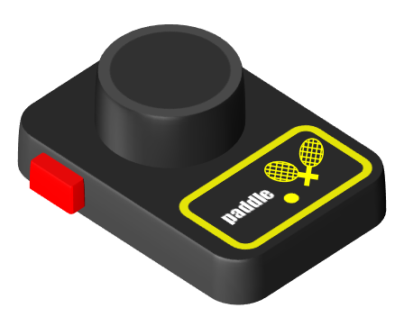
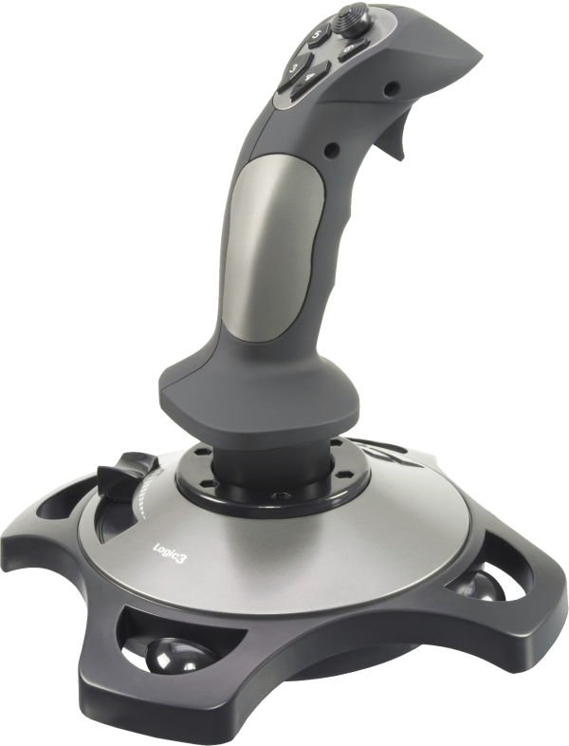
TYPES OF GAMING CONTROLLER
GAMEPAD
held in both hands with thumbs and fingers used to provide input
PADDLE
a controller that features a round wheel and one or more fire buttons
JOYSTICK
consists of a handheld stick that can be tilted around
Mostly for flight simulators

Slide 11
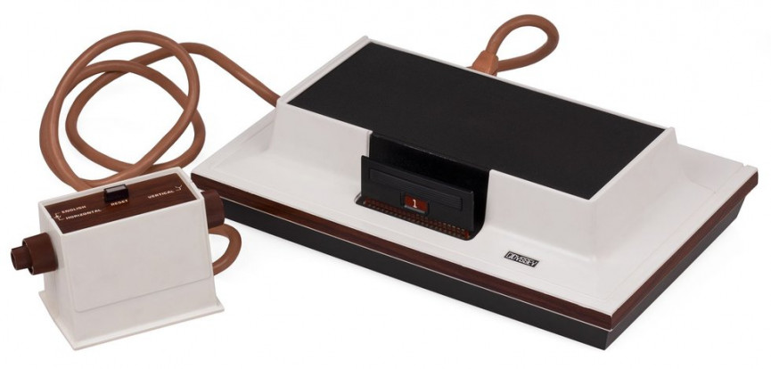
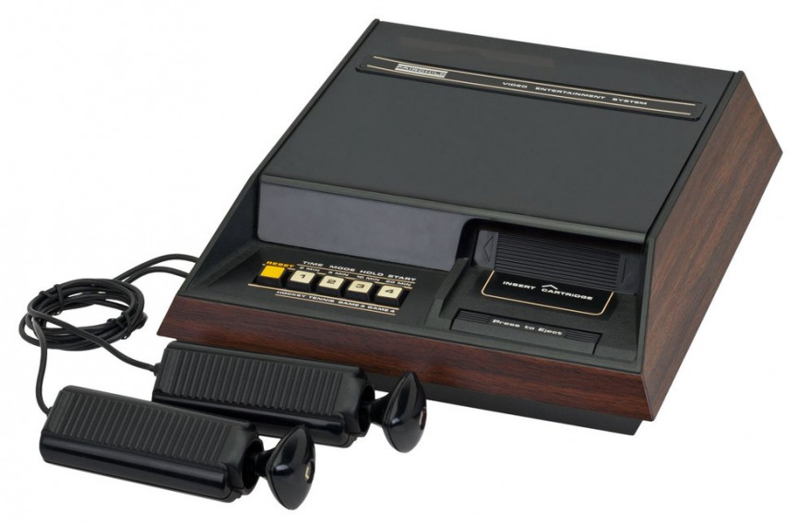
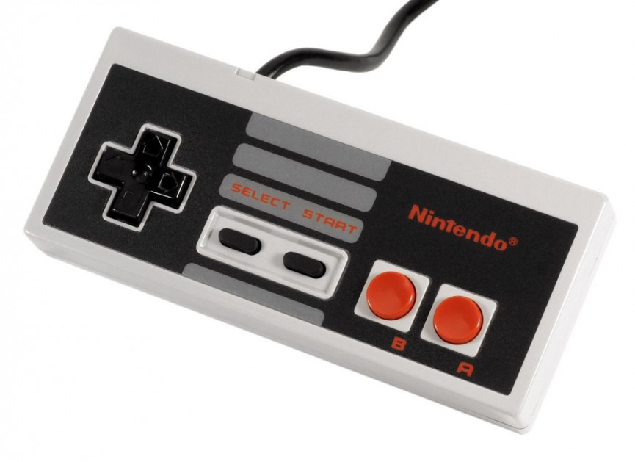
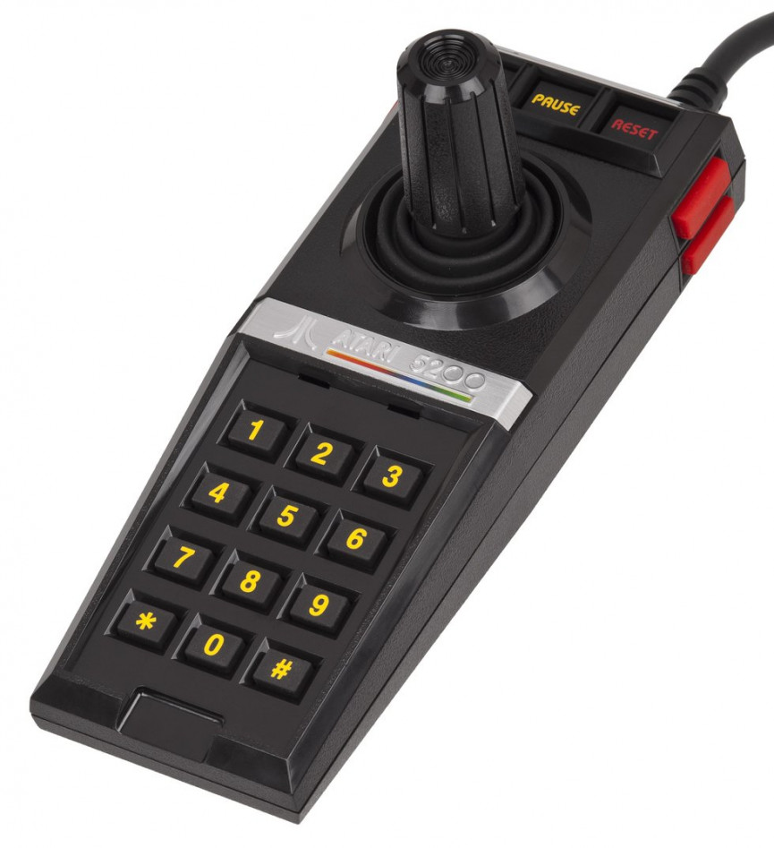
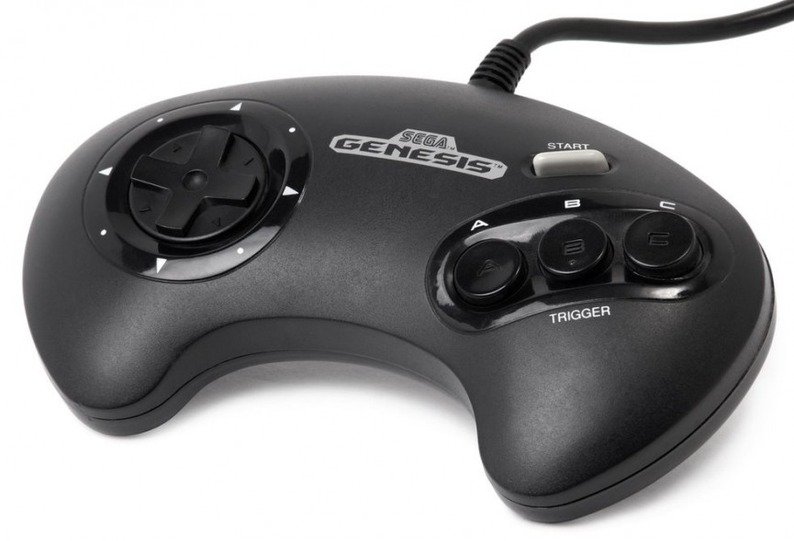
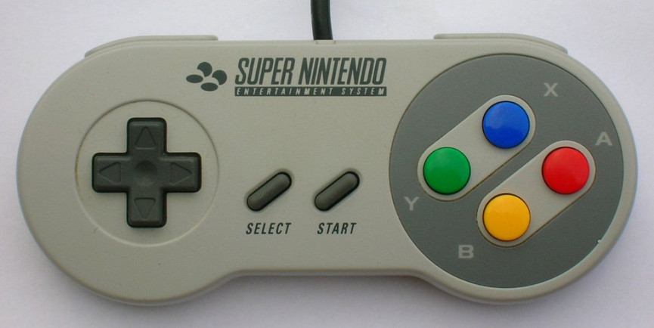
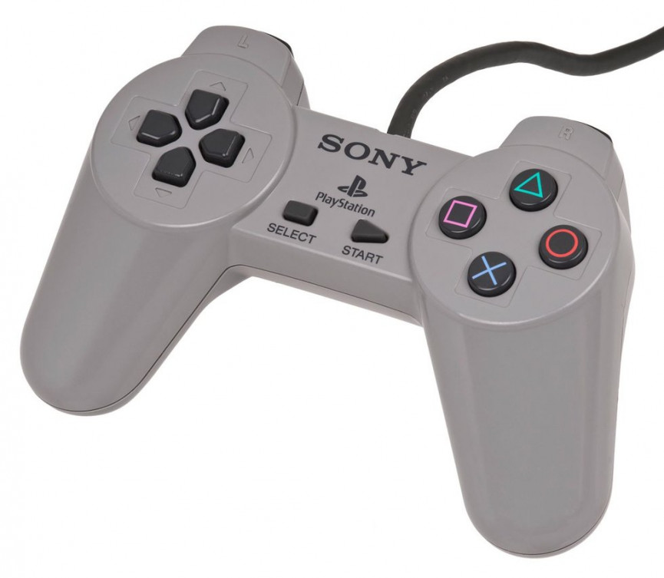
GAMING CONTROLLER (THEN)
1972
1976
1982
1983
Magnavox Odyssey 100
Fairchild Channel F
Atari 5200 SuperSystem
Nintendo Entertainment
System
1988
1990
1994
Sega Genesis
Super Nintendo
Sony PlayStation

Slide 12
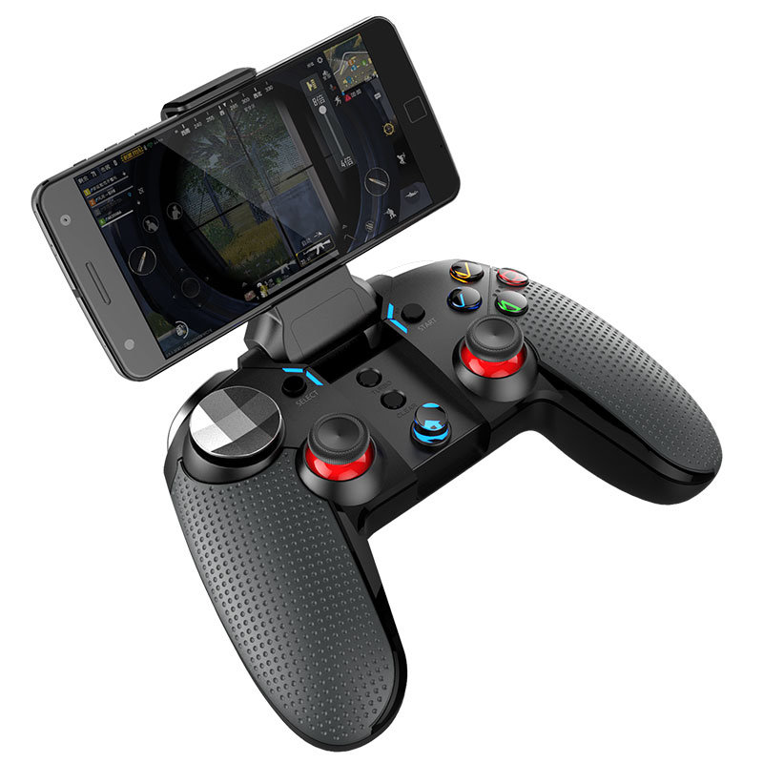
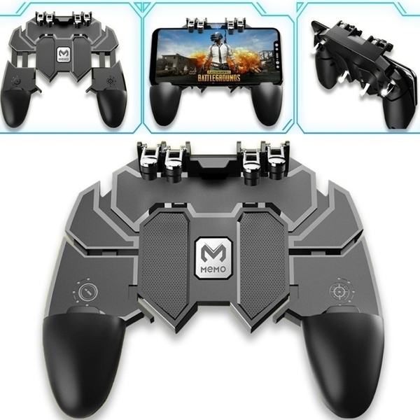
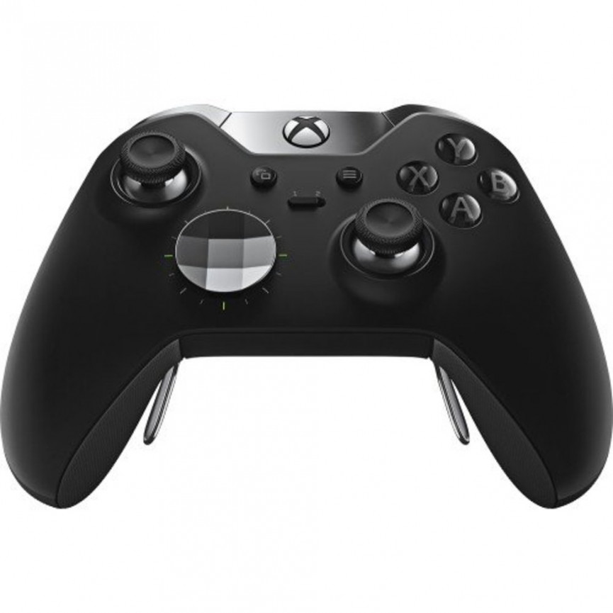
GAMING CONTROLLER (NOW)

Slide 13
SCANNING DEVICES
Optically scans images, printed text, handwriting or an object and converts it to a digital image

Slide 14
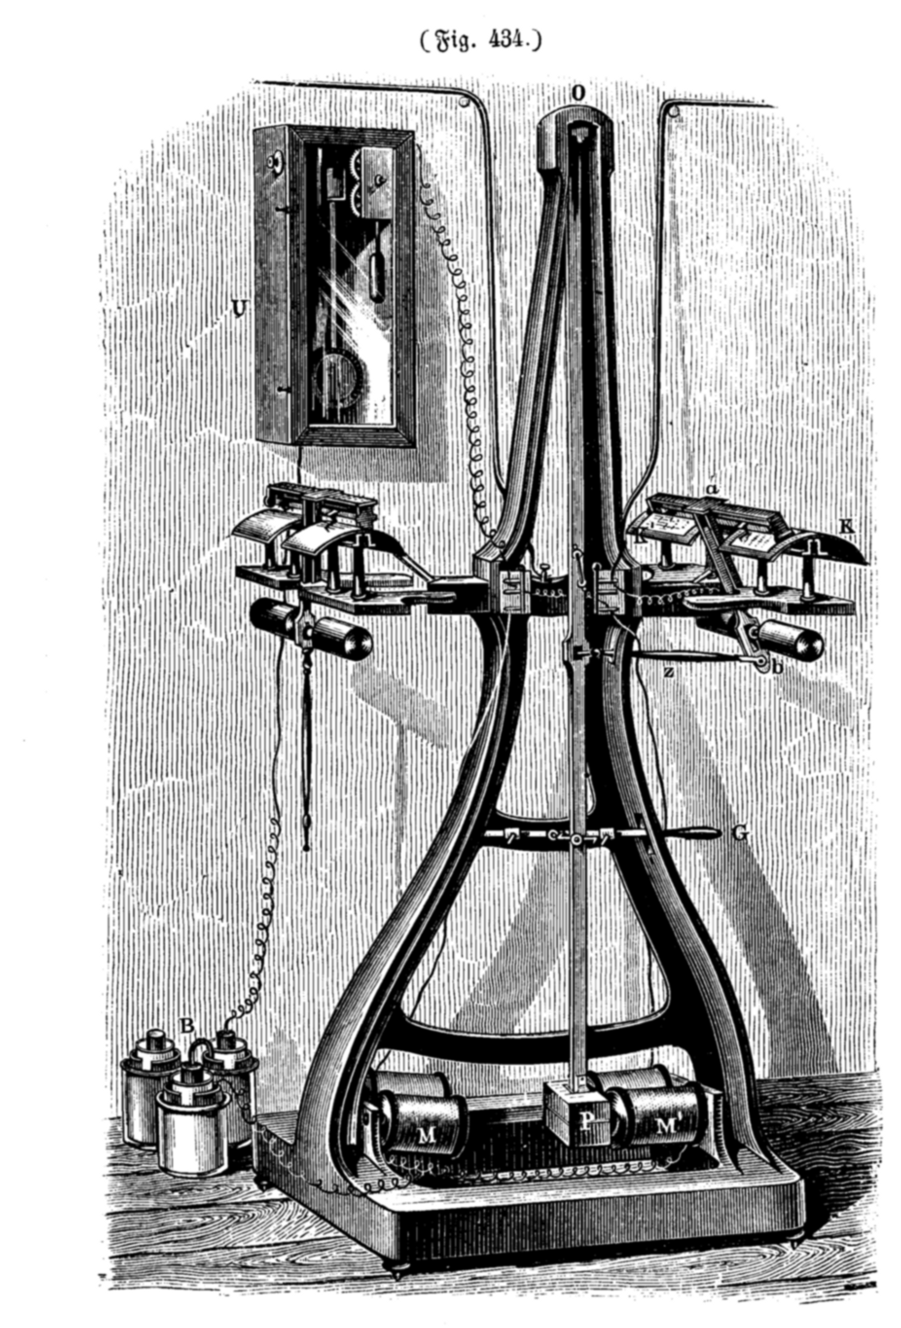
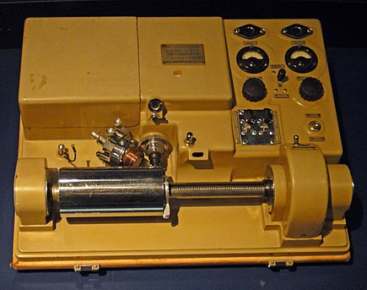
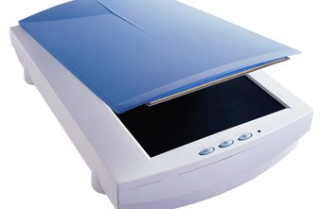
SCANNING DEVICE (THEN)
PANTELEGRAPH
developed by Giovanni Caselli (1860)
could transmit handwriting, signatures, or drawings within an area of up to 150 × 100 mm
WIREPHOTO
Invented by Édouard Belin (1920)
FLATBED SCANNERS
developed by Ray Kurzweil (1970)
for the purpose of turning printed material into digitized text

Slide 15
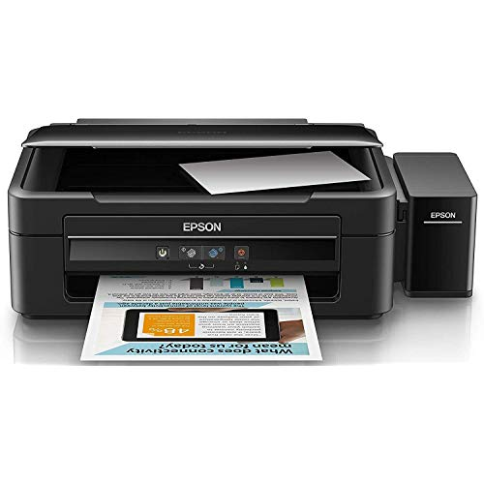
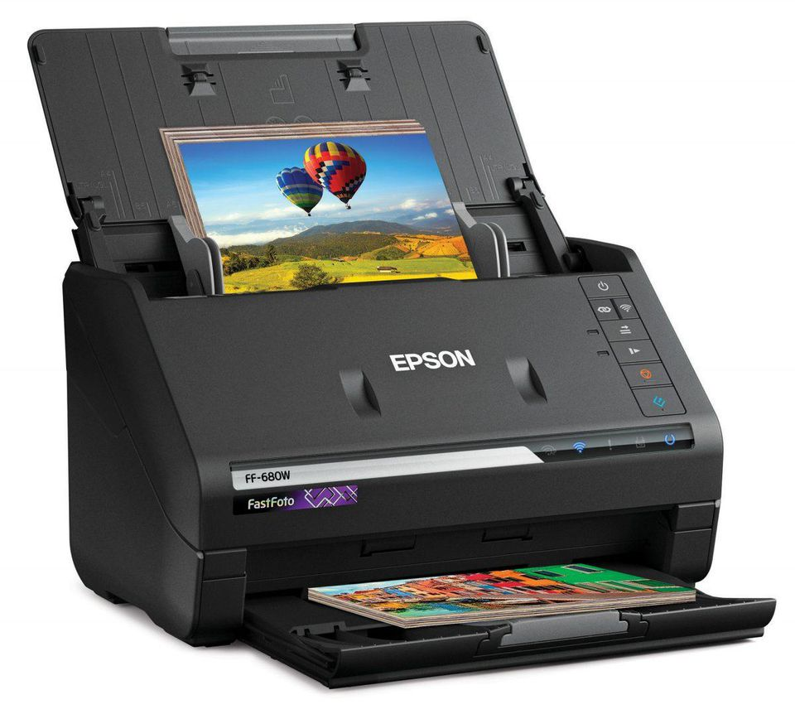
SCANNING DEVICE (NOW)

Slide 16
Audio-Input Devices (MICROPHONE)
Invented by Emile Berliner (1876)
converts sound into an electrical signal
used in many applications such as telephones, hearing aids, public address systems for concert halls and public events

Slide 17
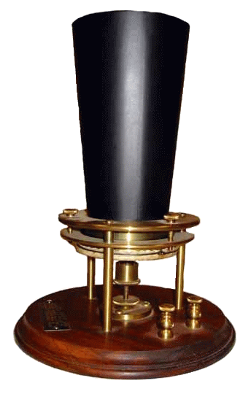
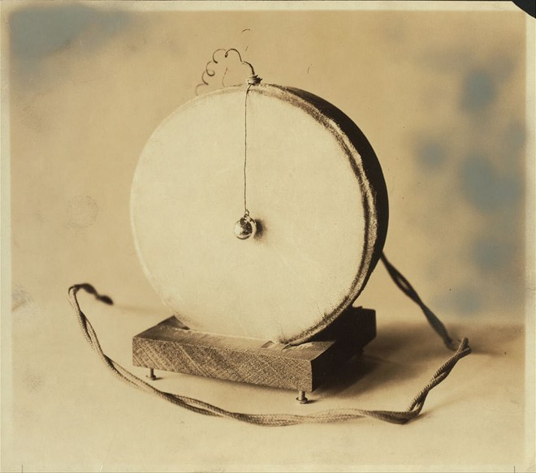
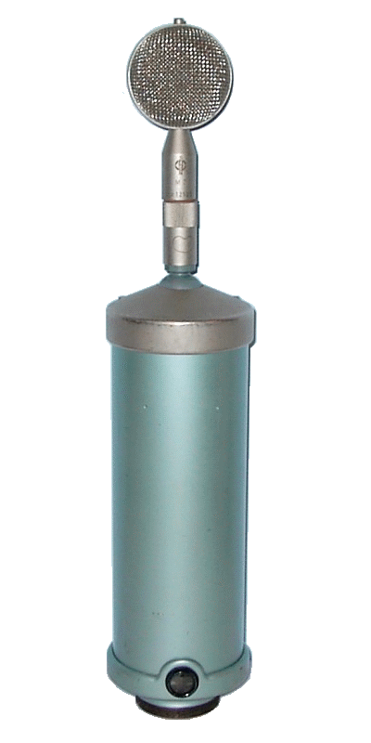
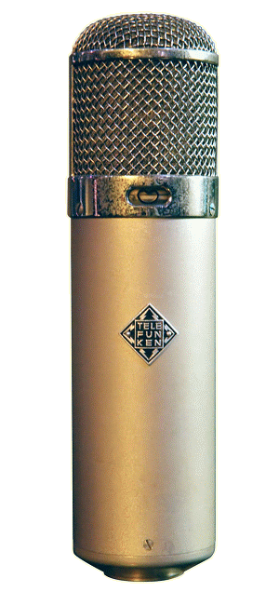
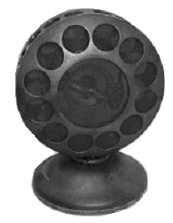
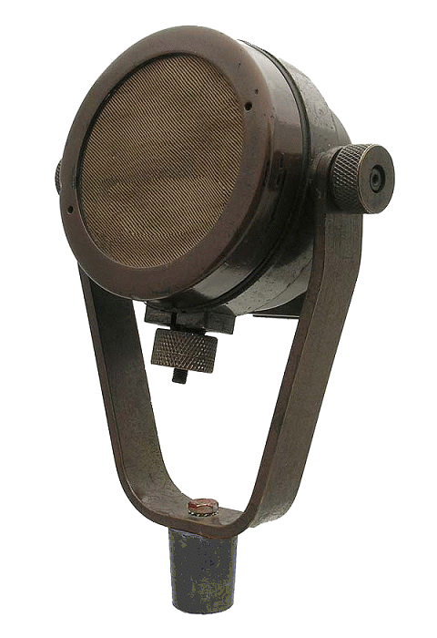
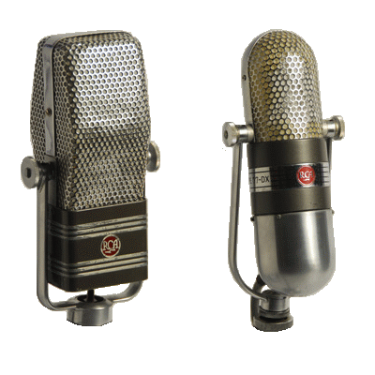
MICROPHONE (THEN)

Slide 18
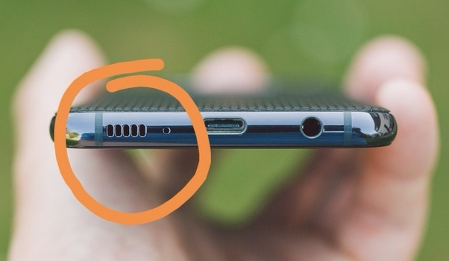
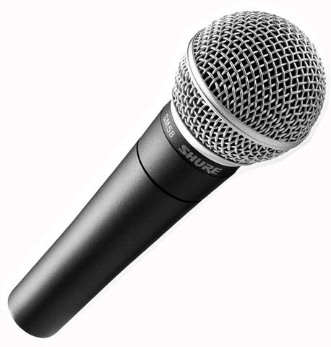
MICROPHONE (NOW)

Slide 19
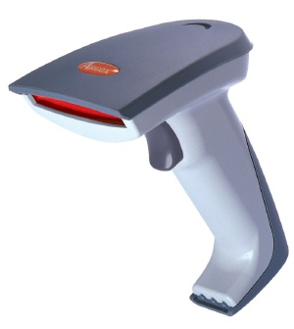
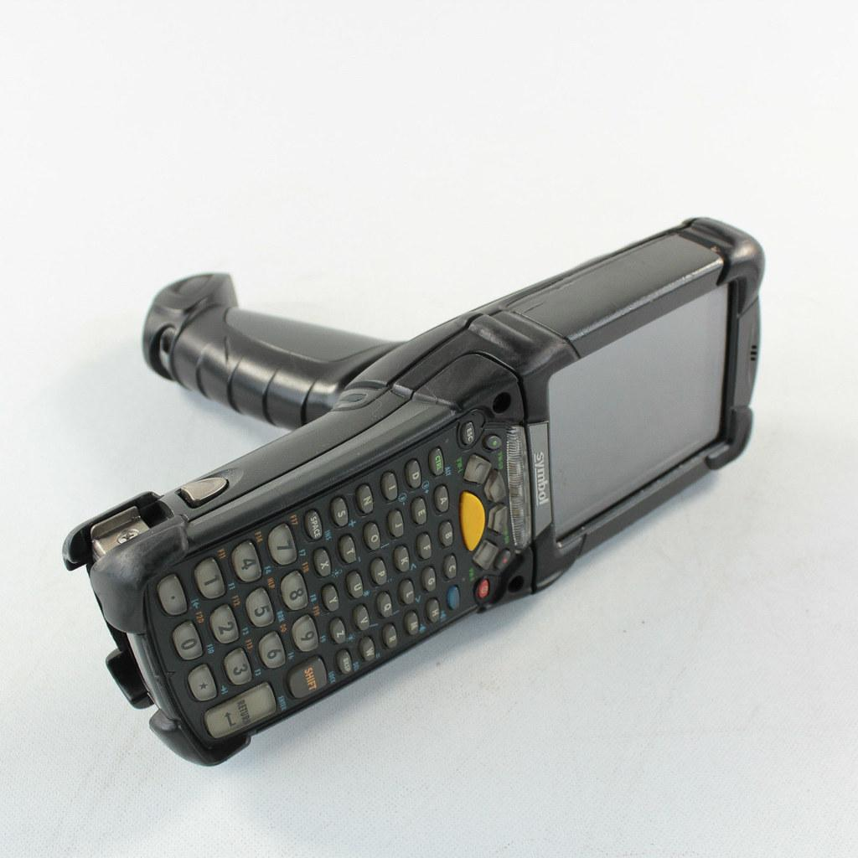
BARCODE READERS
Invented by Bernard Silver and Joseph Woodland, 1948
First used at supermarket in 1974
Barcode readers is a device that that scan or read bar codes
It decode the data contained in the barcode and send the data to a computer
There are many types of barcode readers such as: Pen types readers, laser scanner and handheld scanner

Slide 20
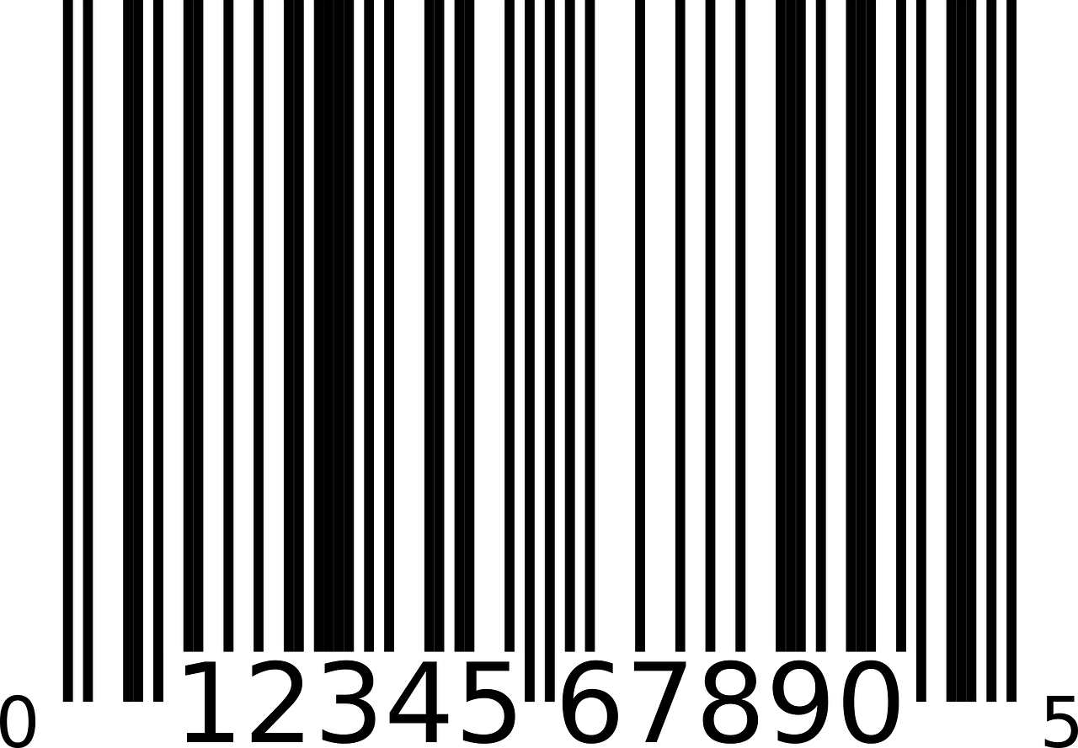
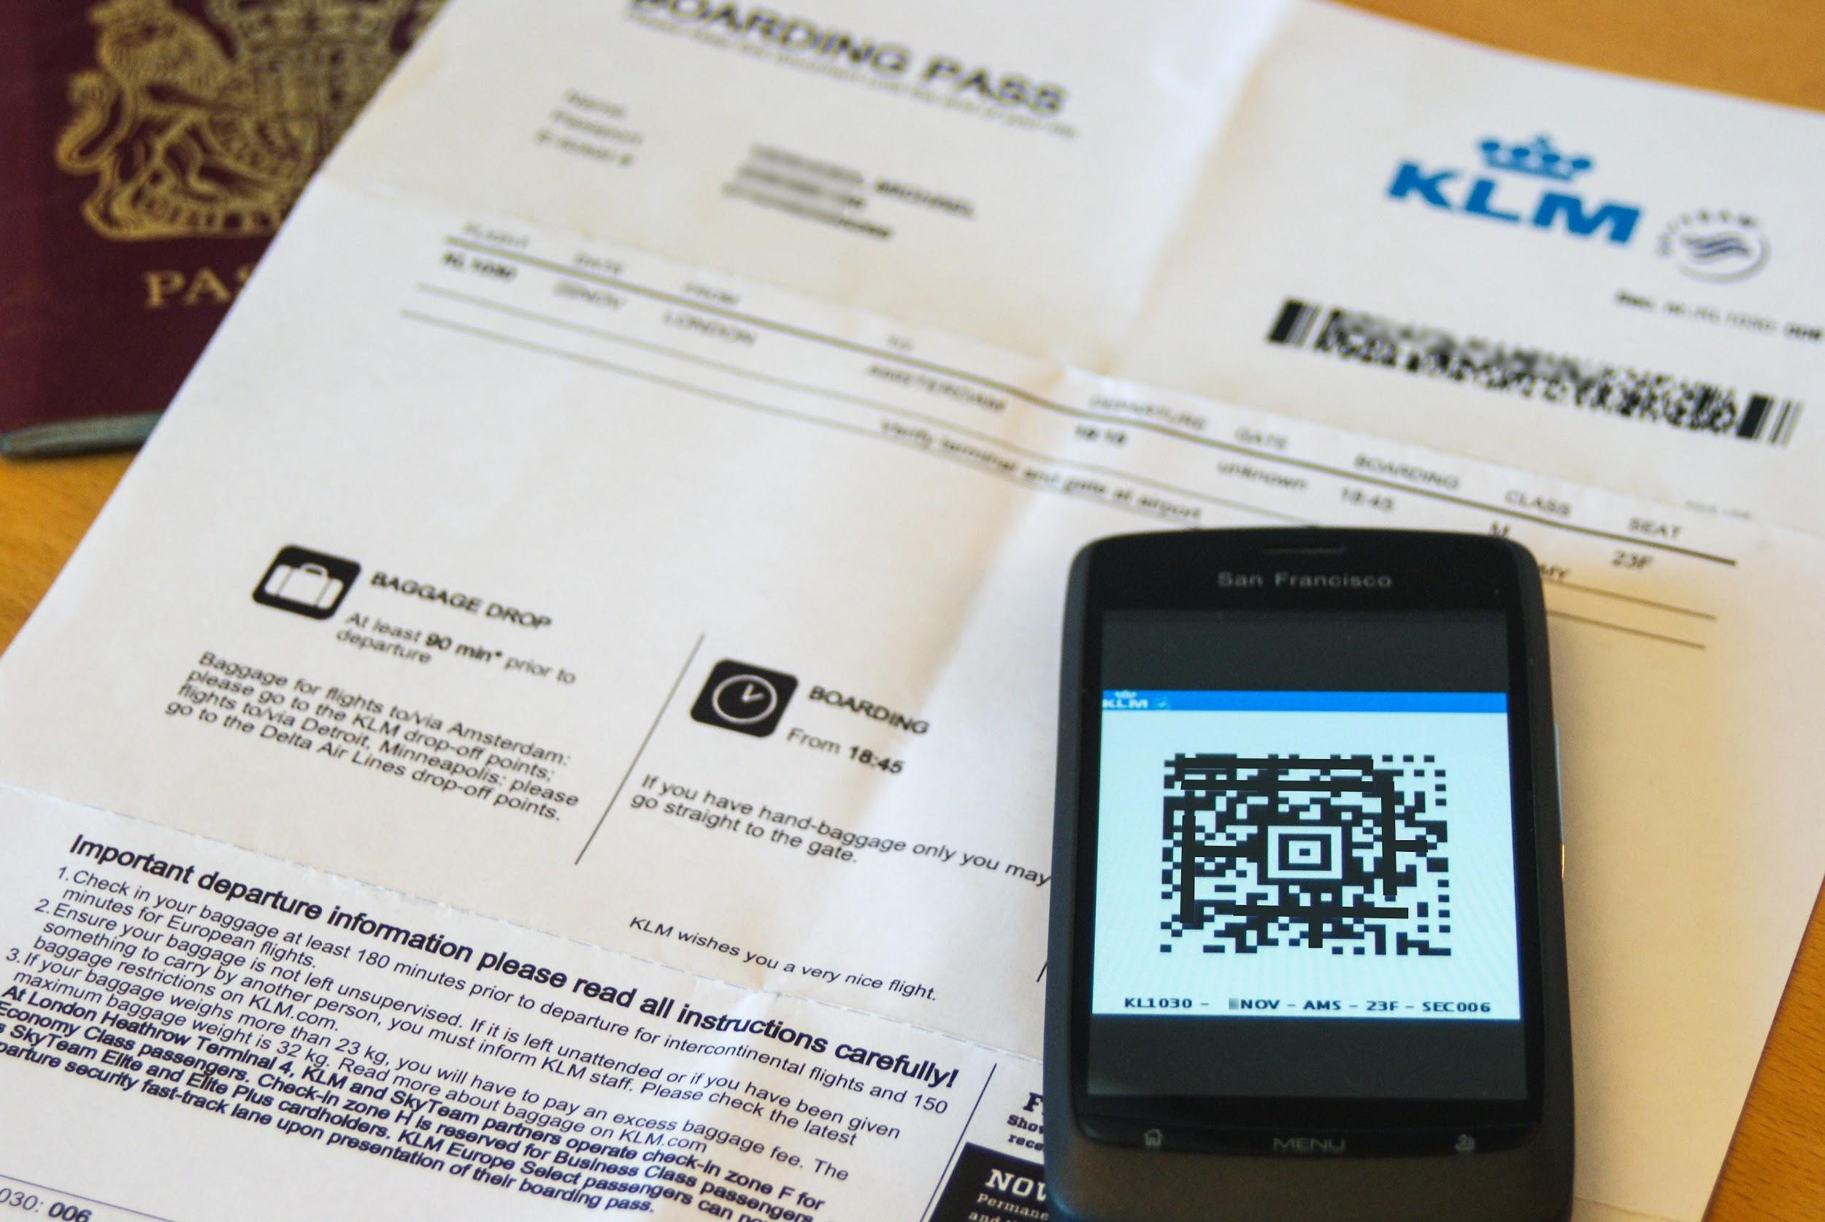

Slide 21
RFID
Radio-frequency identification
uses electromagnetic fields to automatically identify and track tags attached to objects
Active tags - have a local power source (such as a battery) and may operate hundreds of meters from the RFID reader
Passive tags - collect energy from a nearby RFID reader's interrogating radio waves
Unlike a barcode, the tags don't need to be within the line of sight of the reader, so it may be embedded in the tracked object
RFID is one method of automatic identification and data capture (AIDC).

Slide 23
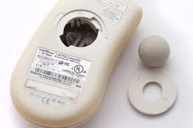
Mouse
Optical mouse
Has no moving parts
Emits and senses light to detect mouse movement
Can be used on any surface
Wireless mouse
Battery operated
Uses radio waves or infrared light waves
Touch pads
Controls pointer by moving and tapping your fingers on the surface of the pad

Slide 24
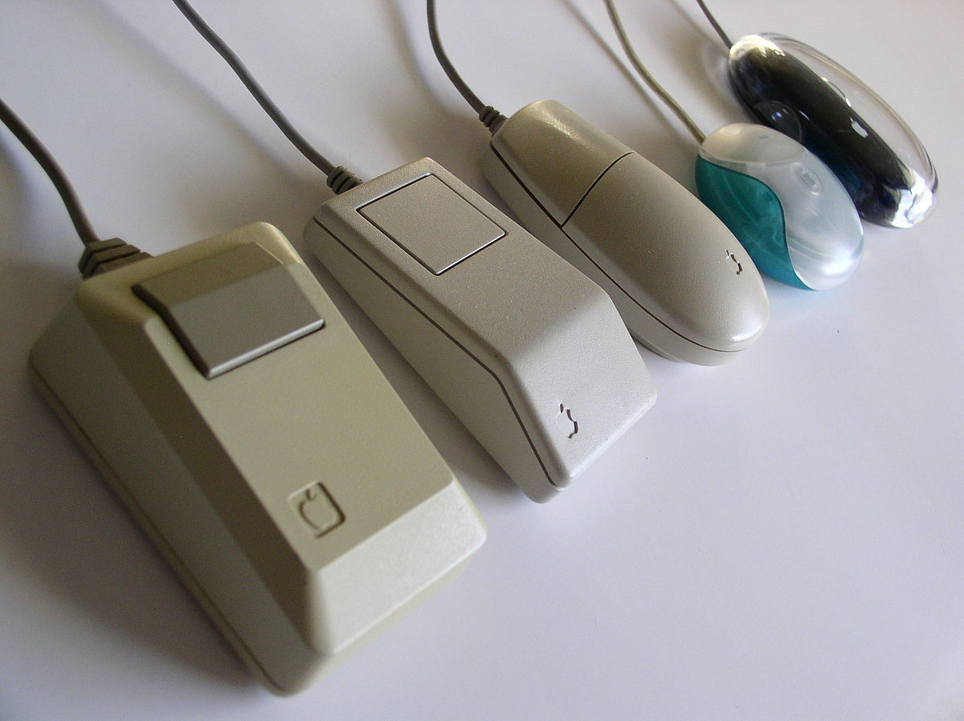

Slide 25
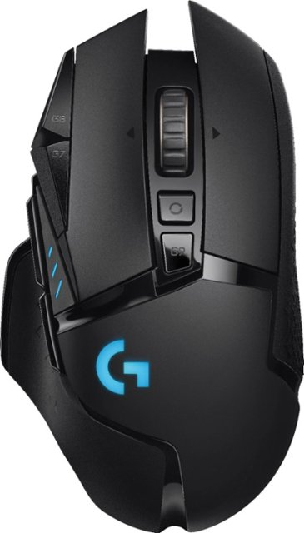
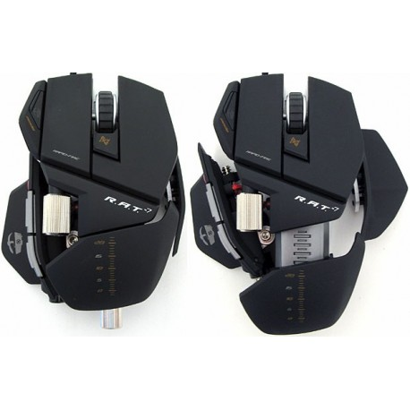
NEW ERA OF MOUSE

Slide 26
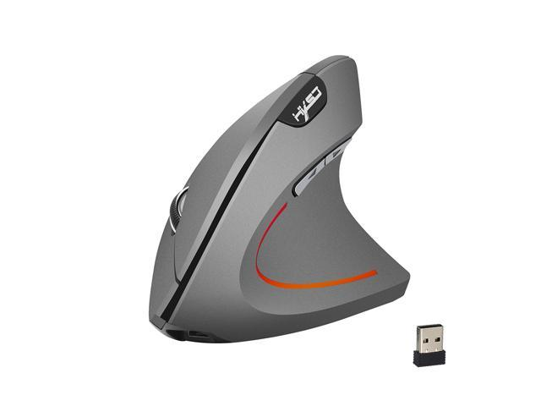

Slide 27
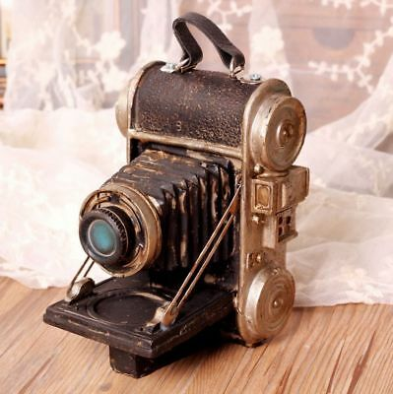
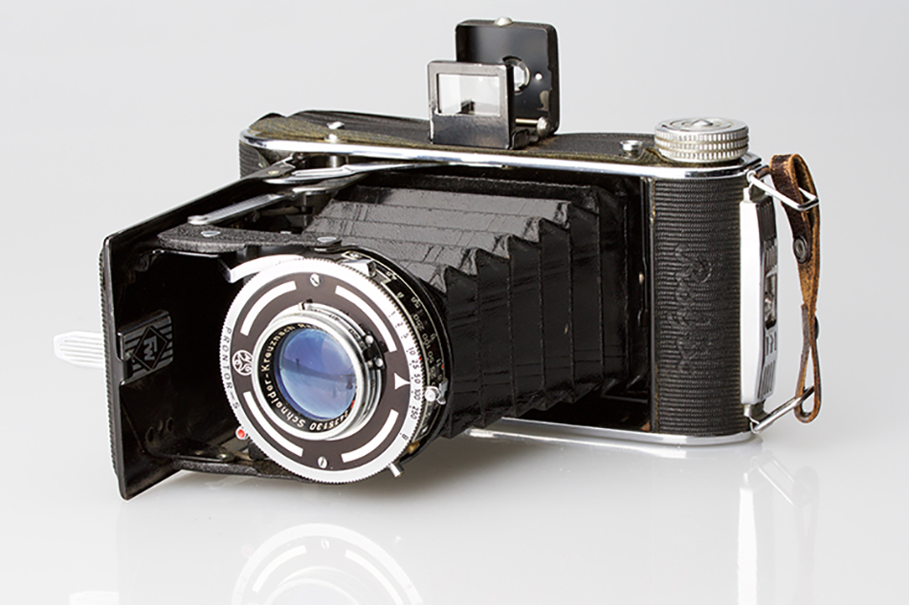
Image capturing device
Create or capture original images
Digital Camera
Capture images digitally and store in memory
Webcams
Capture images and send to a computer

Slide 28
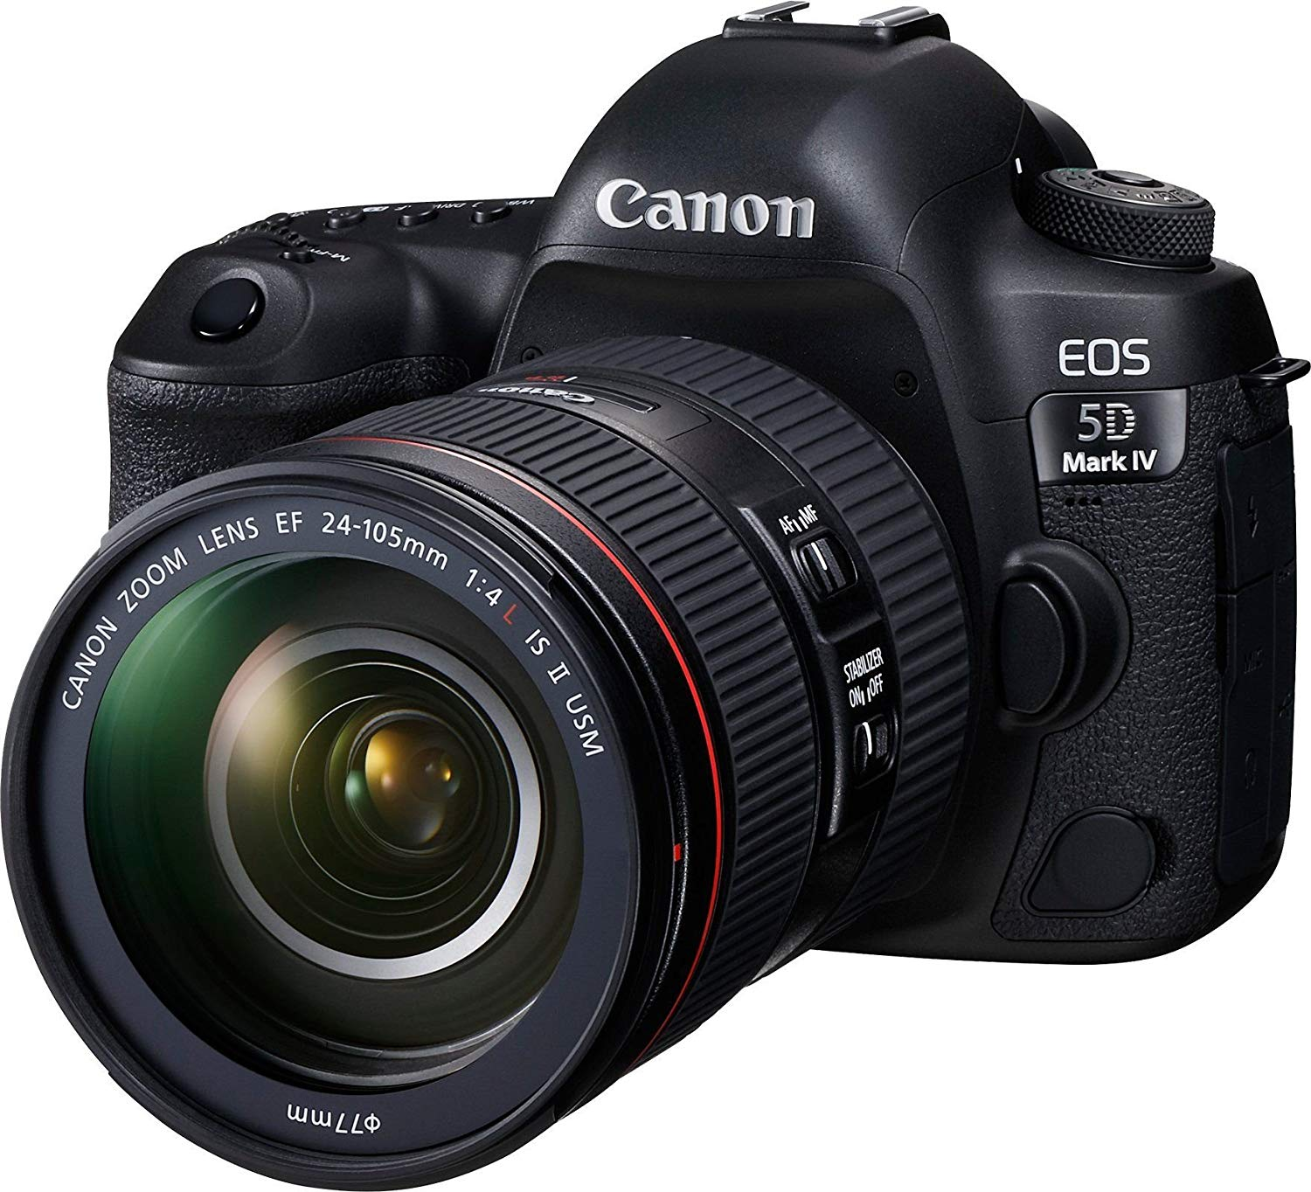
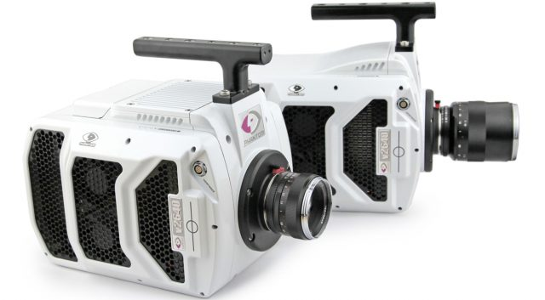

Slide 29
Character and Mark Recognition Readers
•Magnetic- Ink Character Recognition Software (MICR)
-Technology used mainly by the banking industry.
-MICR encoding, is at the bottom of cheques and others.
-The format for the bank code and bank account number is country specific.

Slide 31
Character and Mark Recognition Readers
•Optical character Recognition
-Early OCRs were mainly aimed for technology involving telegraph and creating reading devices for the blind.
•Application:
-Data entry
-More quickly make textual versions of printed documents
-Make electronic images of printed documents searchable
-Converting handwriting in real time to control a computer.
-Assistive technology for blind and visually impaired users.

Slide 33
Character and Mark Recognition Readers
•Optical mark recognition (OMR)
-Generally distinguished from OCRs by the fact that a complicated pattern recognition engine is not required.
•Applications:
-The use of 2B bubble optical answer sheets in multiple choice question examinations.
-Lotteries and voting
Data collection

Slide 34
OUTPUT
Processed data or information
Output can be in :
1. Graphics/photos
2. Text
3. Audio and Video

Slide 35
OUTPUT DEVICES
Any piece of computer hardware equipment which converts information into human-readable form.

Slide 36
Display Monitors
Cathode Ray Tube(CRT)
-First demonstrated in 1897 and commercialised in 1922(monochrome).
-Primarily used in oscilloscopes and black and white televisions.
-Coloured CRT were made commercial in 1954
-Direct View Bistable Storage Tube(DVBST) was a derivative and didn’t needed to be refreshed periodically.

Slide 38
Display Monitors
•Liquid Crystal Display (LCD)
-First working LCD was built by George H. Heilmeier(1964).
-More popular than CRT since LCDs are extremely thinner and more colour vibrant.
- LED Displays are also LCDs but are much more thinner and consume less power.

Slide 40
Display Monitor
•Organic Light Emitting Diode
- Invented by researchers at the Eastman Kodak company in 1987.
- OLED has a higher contrast compared to LCDs, since it doesn’t have any backlight , and has it’s pixels that produce their own light.
- Can produce a true blackness compared to LCDs.

Slide 41
E-Book Readers
•Dedicated mobile electronic devices that is designed primarily for the purpose of reading e-books.
•Similar to tablets but more limited.
•Using some e-reader software (apps) for Pc and Mac computers, as almost every mobile devices. E.g Amazon Kindle, Barnes & Noble Nook and iBooks.

Slide 42
Printers
First Invented by Remington-Rand in 1953
Device which makes a persistent representation of graphics or text on paper
Translates information that has been processed by the system unit and output come out as hardcopy
Ink-jet printers, Laser printers, and 3D Printers, are types of printer

Slide 44
Audio and Video Devices
Translates audio information from the computer into sounds that people can understand
As example speakers and headphones
First invented in 1876 by Alexander Graham Bell
Speakers are transducers that convert electromagnetic waves into sound waves
Speakers receive audio input from a device such as a computer or an audio receiver
Then produce audio output that can be heard by the listener

Slide 46
OUTPUT AND INPUT DEVICES

Slide 47
Drones
Drones or unmanned aerial vehicle (UAV) is an aircraft without human pilot on board
Initially drones used in military as a war asset
Drones then become non military device in 2006 and citizen use drone to record video or picture from high place
Take input from a controller and send back video and sound to the user
Drone can be very expensive

Slide 49
Robot
Robot is a machine especially programmable by a computer
Most robots are machines designed to perform a task with no regard to their aesthetics
Then the output is dependent on the use for the robot

