Slide 1
LAB 3
Part F. Lab Activities
Page 362-383

Slide 2
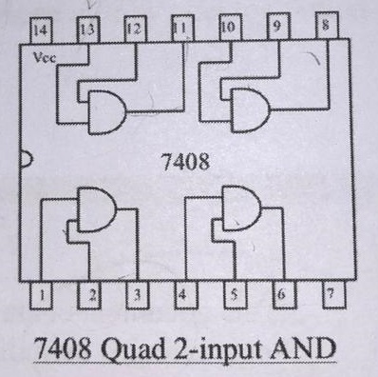
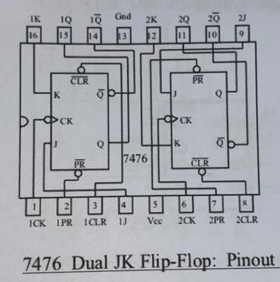
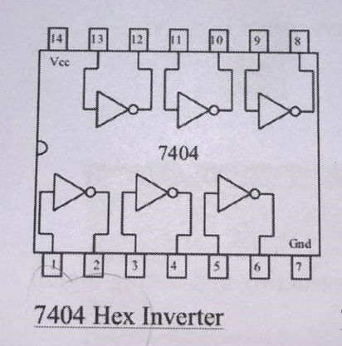
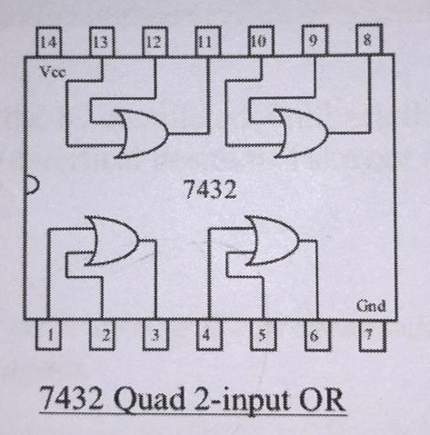
Gnd

Slide 3
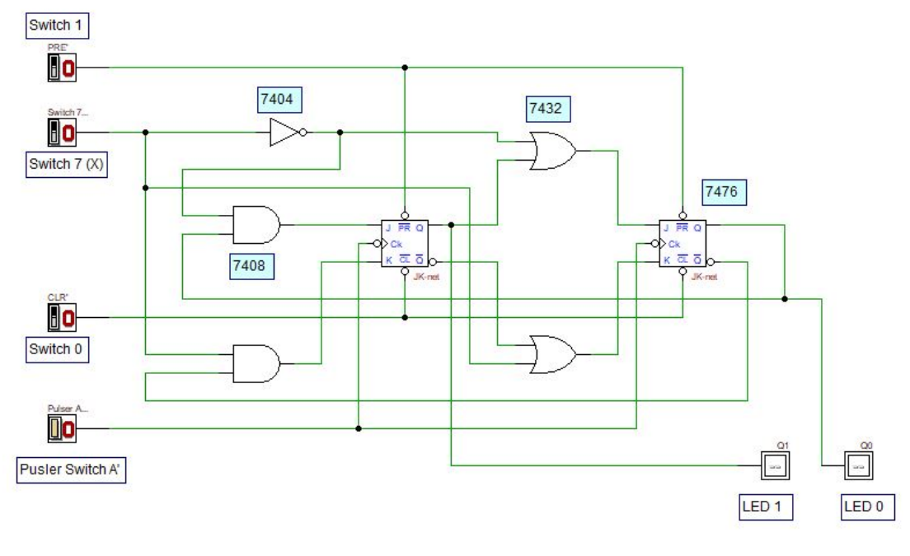
2
1
1
2
1
3
2
1
12
2
7
11
4
2
15
9
11
13
1
8
16
3
14
12
8
10
13
3
12
1
3
11
_
A
2
13
1
11
15

Slide 5
7432
OR
7476
JK FF
7408
AND
7404
NOT
Pulse
_
A
Switch 7
X
Switch 1
PRE
Switch 0
CLR

Slide 6
VCC
1 Jumper
VCC
2 Jumper
VCC & Gnd
1 Jumper
VCC
Gnd

Slide 7
Follow the instruction given by the Teaching Assistant – Miss Siti and technicians, Mr Haikal and Mr Nazri.
Good Luck

