Slide 1
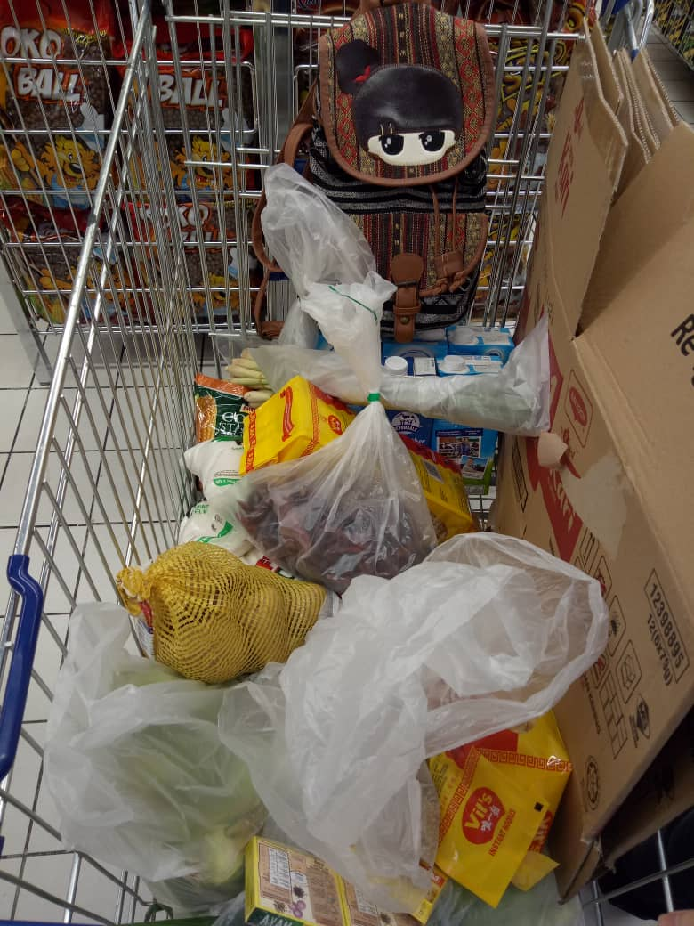
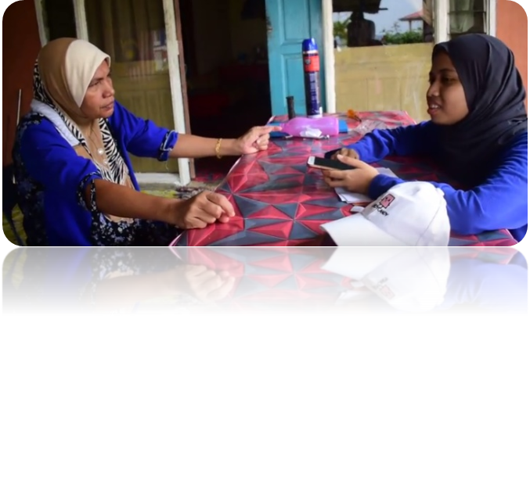
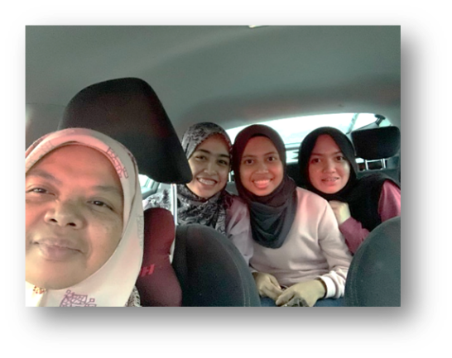
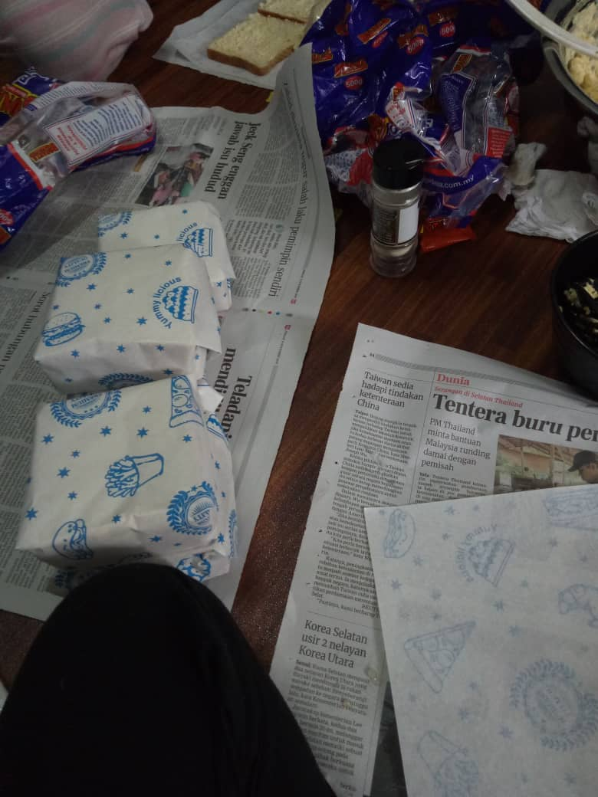
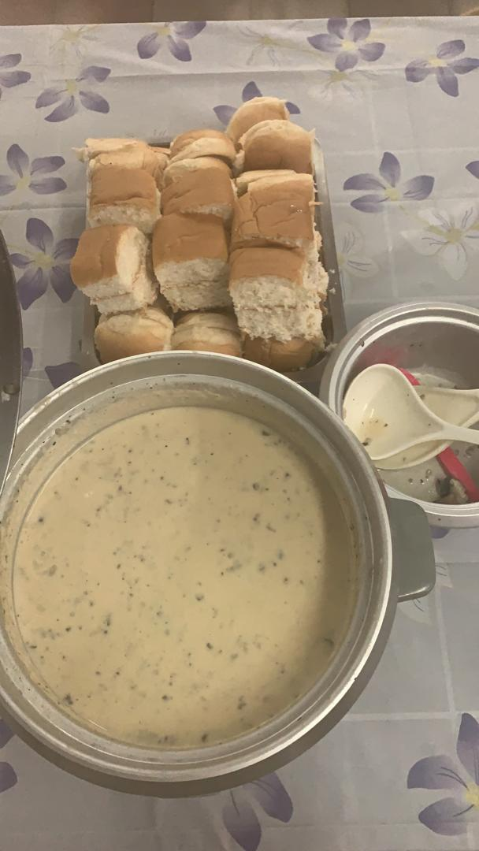
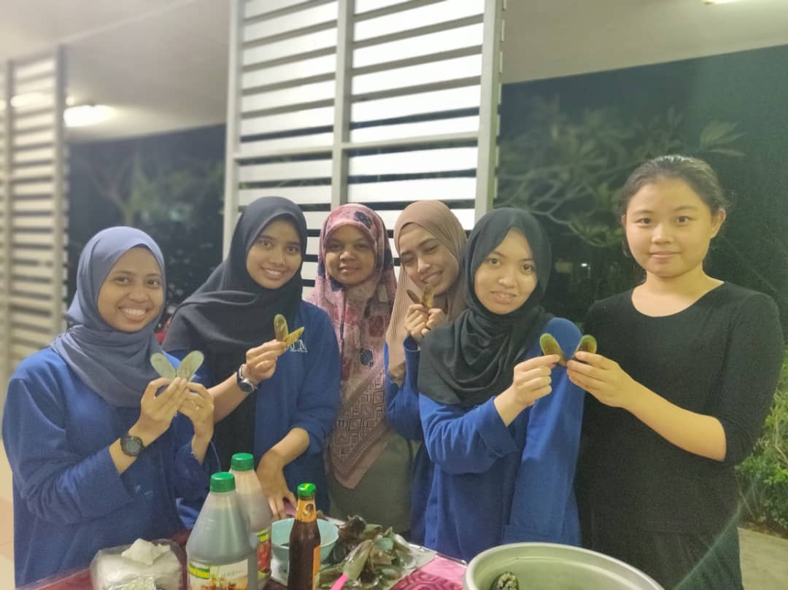
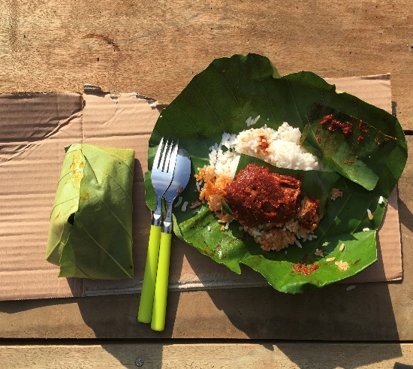
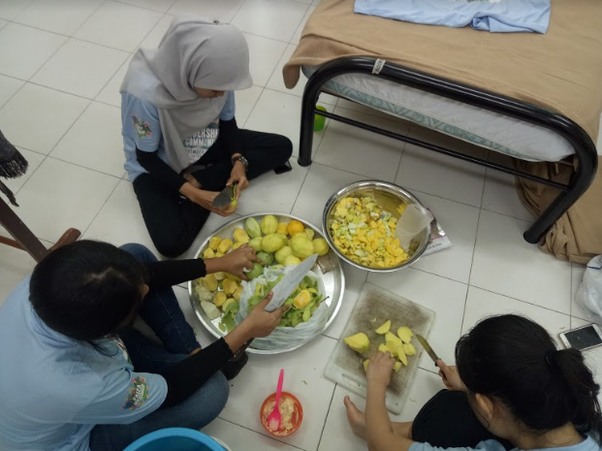
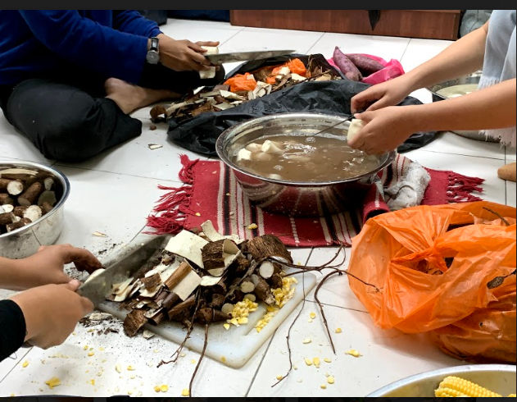
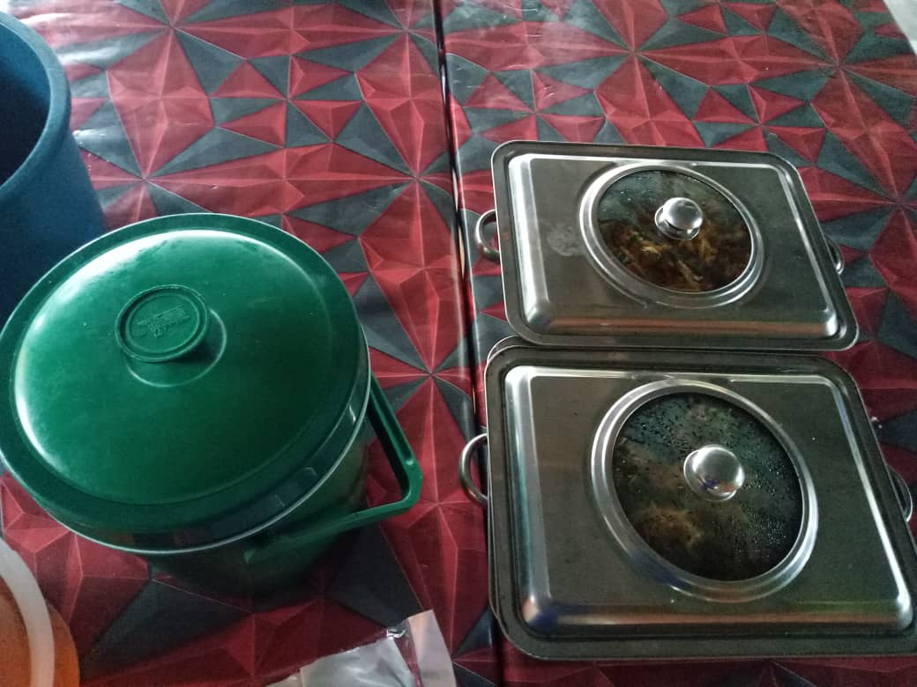
FOOD
UNIT
OBJECTIVE OF UNIT:
TO PREPARE FOOD THROUGHOUT THE PROGRAM
TO ENSURE THAT FOODS ARE WELL DISTRIBUTED AND EVERYONE GETS TO EAT
SYAZWANI
HIDAYAH
NAFISSA
EMIRA
BEFORE
Went to first site visit to Tanjung Surat and met with Mak Mun
Decide for food menu and propose to Madam Hanna
Contact Mak Mun and Mak Ngah (Jeti Tj Belungkur) to order food
Survey prices for food and quipment at different stores with the help from Dr Azurah
Buy foods and bbq equipment
Asked technical unit to borrow some cooking equipment at CCSL
DURING
Prepare eggs sandwiches for all participants
Make sure all the equipment brought to Tanjung Surat
Prepare all food in each meal time for every participants
Clean up the pantry after finish
AFTER
Return back the equipment borrowed from CCSL

