Slide 1
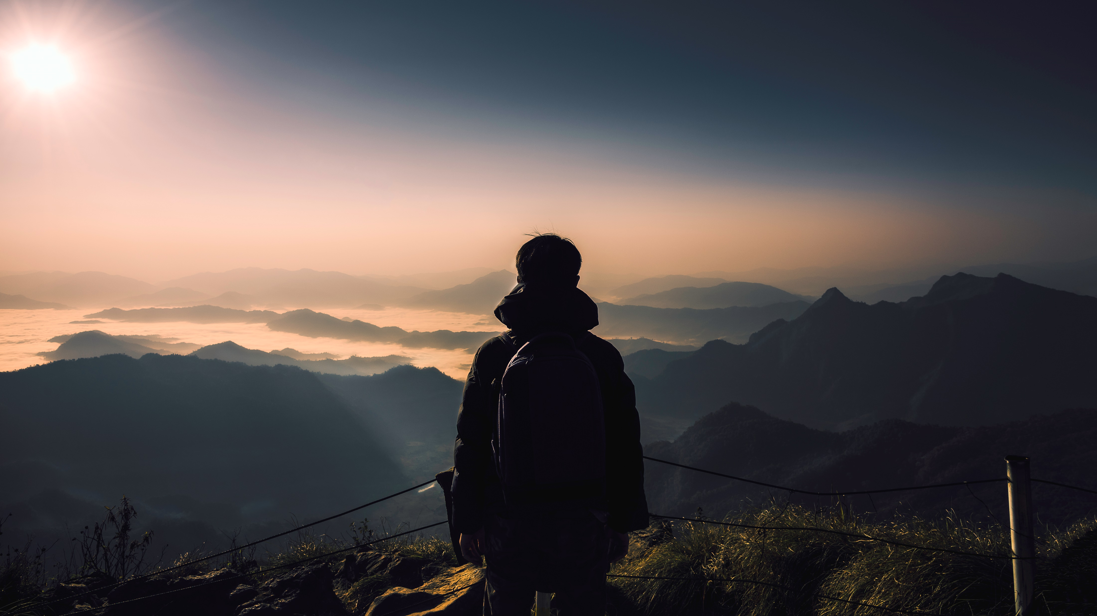
UHLB1112 SECP Group
FATIMA AZ DZIKRUN BINTI SAHROL NIZAM
MOHAMAD AMIN HAZEEQ BIN HISHAM
AZRIANA BINTI ZAINAL ABIDIN
NUR ALEEYA SYAKILA BINTI MUHAMAD SUBIAN

Slide 2
PROGRESS
INITIATE
EXECUTION
EDITING & CLOSURE
PLANNING

Slide 3
INITIATE
Syakila create group whatsapp
First group discussion
-24 November at Computer Room KTDI
Activities
-Brainstorming ideas
-diving task
Second group discussion (25 Novmber)
- Do the script for the actor
- Practice like an actor

Slide 4
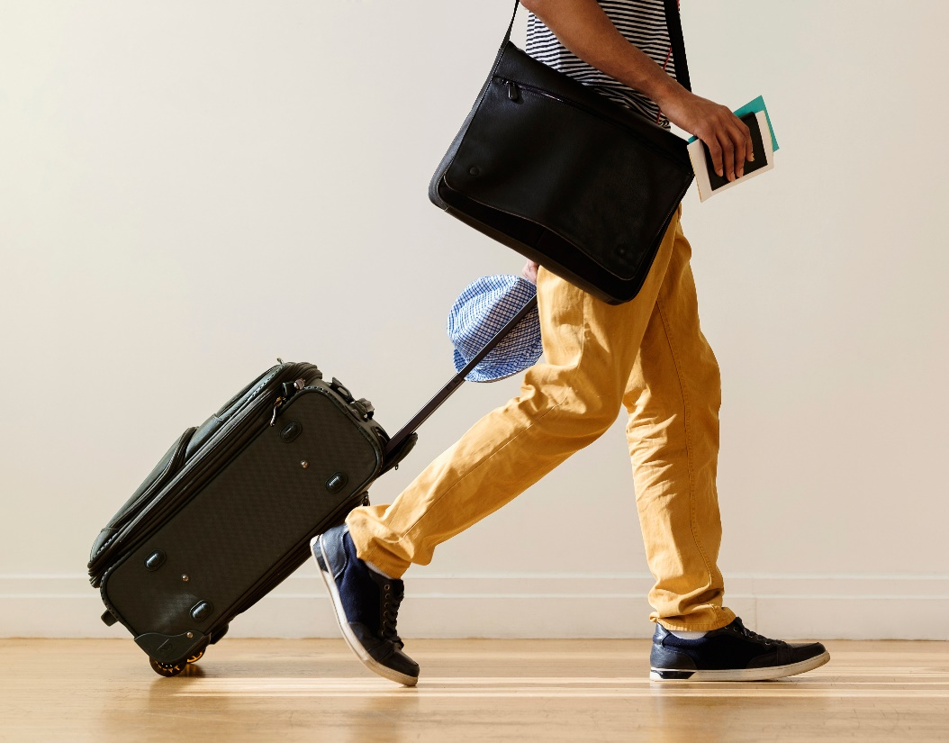
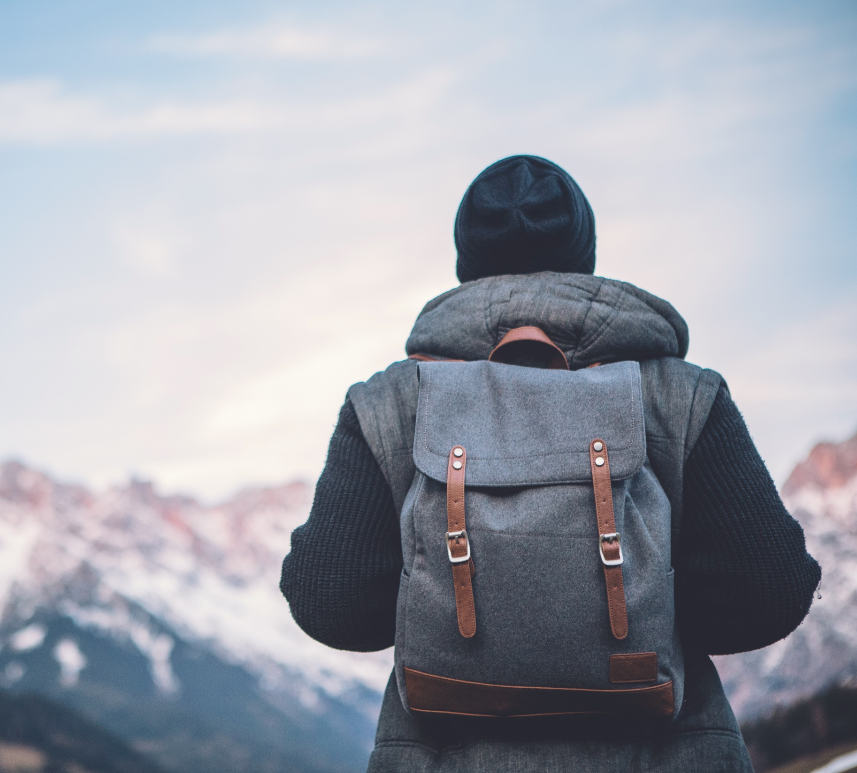
Make a Plan
Scenes playing :
- missing wallet
- hungry but no money
-buying food using qr-pay
1
Set a destination.
- FACULTY COMPUTING
- MERANTI
2
Set date and time to record:
- 26 November 2019
-2:00 pm
3
4
5
6
Duration to edit the video: .
- 27 Nov until 5 dec
Tools to edit the video:
-In Shot
Brand of phone to record the video:
-iphone

Slide 5
EXECUATION
Manage to record the first scene
Faculty computing
2:00 pm
26 November 2019
First Scenes
Go to class in a rush.
Wanted to go lunch at Arked Meranti
It tooks around 45 minutes to finish the recording

Slide 6
Manage to record the second scene
Arked Meranti
3:30 pm
26 November 2019
Second Scene
Arrived at Arked Meranti
Met Syakila and Fatima
Suddenly misplace his wallet
It tooks around 30 minutes to finish the recording
Manage to record the third scene
Arked Meranti
4:00 pm
26 November 2019
Second Scene
Fatima told about QR Pay
Hazeeq wallet in his bag.
It tooks around 45 minutes to finish the recording

Slide 7
EDITING
Use In-Shot apps to edit the video and merge it into one complete clip.
Edited once only.
Duration = it takes a week to make sure the video completed.
Trimming,importing all the videos.
Subtitile also had been include in the video to make sure there’s backup if any problem due to the sound.
Export the video

Slide 8
REFLECTION
BONDING
We get to kow each other very well.
Not all of us on same section,so we become closer.
TEAMWORK
We had a great teamwork in this group.Everyone have their own work
TIME MANAGEMENT
Time management is very important. For example,we set a time to do the recording and all of us got there on time.
We get to complete the video in 3 hours only. I think this is because all of is give a good cooperation in this project.

Slide 9
Thank you

