Slide 1
03: CONTROL STRUCTURES
Programming Technique I
(SCSJ1013)

Slide 2
Boolean and Logical Operator
In C++ logical data declared as bool data type
e.g.
bool variable_name;
There are only two values: true and false
Type-casting bool to int:
true => 1
false => 0
Example
int number;
number = 2 + true;
cout << number; //output: 3

Slide 3
Boolean and Logical Operator
Type-casting int to bool:
A Zero value => false
A Non-Zero value => true
Example:
bool b = false; // b initially is false
int number = 0;
b = -10; // Now, b is true
b = number; // Here, b is false again

Slide 4
Boolean and Logical Operator
What would be printed by this code segment
bool b;
int p;
int q = 5;
b = q;
p = b;
cout <<“The value of p is “ << p << endl;
Output:
The value of p is 1

Slide 5
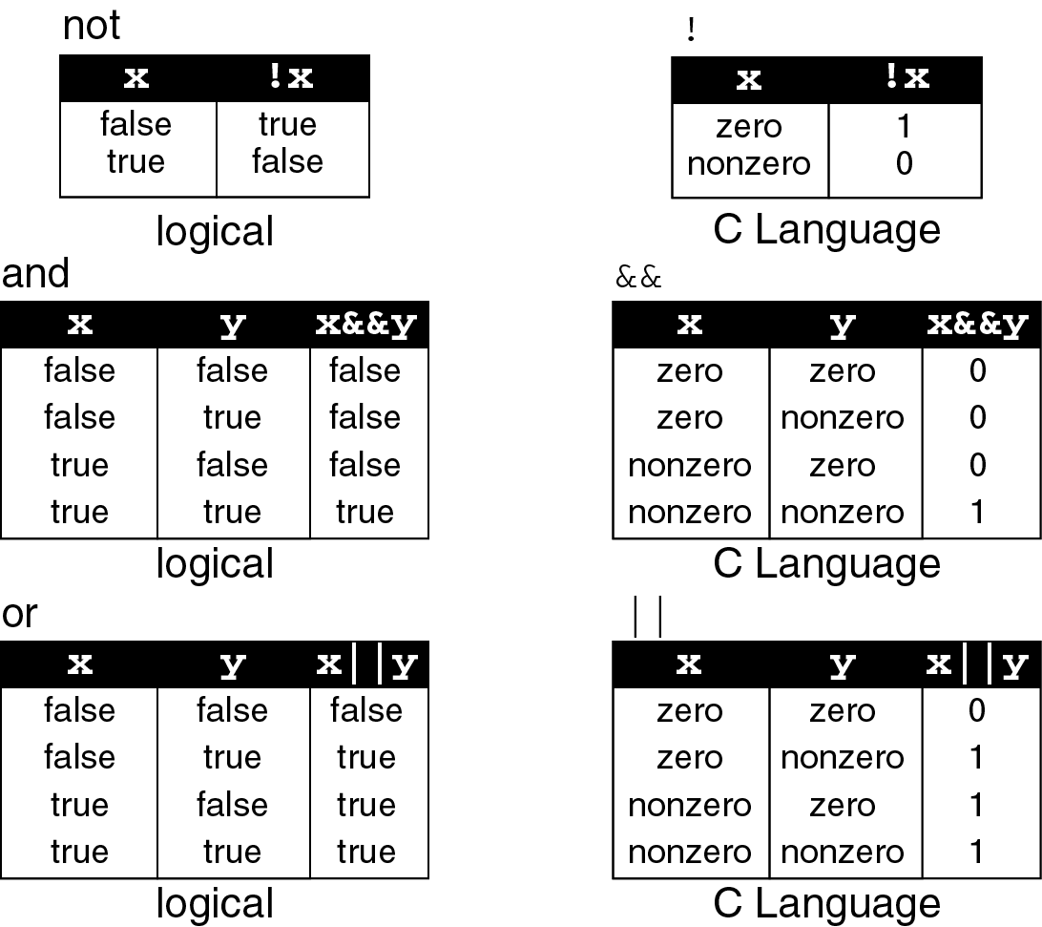
Logical operators truth table

Slide 6
Operations for logical and/or

Slide 7
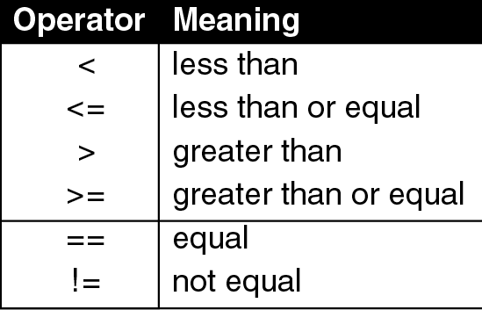
Relational operators

Slide 8
Logical expression
Example:
int a=10;
cout << a;
cout << (a==1);
cout << (a>1);
cout << (a=5);
a = (a != 5);
out << a;
Prints 10
Prints 0. Is 10==1 ? => false =>0
Prints 1. Is 10>1 ? => true => 1
Prints 5. This is not a logical expression. It is an assignment expression.
Prints 0. Is 5!=5 ? => false =>0

Slide 9
Selection / Branch
Sometimes your programs need to make logical choices.
Example:
IF score is higher than 50
THEN grade is PASS
ELSE grade is FAIL
In C++, this corresponds to if statement with three parts:
if (score > 50) //part 1
{
grade = PASS; //part 2
}
else
{
grade = FAIL; //part 3
}

Slide 10
if statement
Part 1 : the condition - an expression that evaluates to true or false.
if (score > 50)
{
grade = PASS;
}
else
{
grade = FAIL;
}

Slide 11
if statement
Part 2 : the TRUE-PART - a block of statements that are executed if the condition evaluates to true
if (score > 50)
else
{
grade = FAIL;
}
{
grade = PASS;
}

Slide 12
if statement
Part 3 : the FALSE-PART - a block of statements that are executed if the condition evaluates to false
if (score > 50)
{
grade = PASS;
}
else
{
grade = FAIL;
}
if the condition
evaluates to false,
the TRUE-PART is skipped.

Slide 13
if statement
Sometimes there is no FALSE-PART. The “else” is omitted
if ( attendance < 0.8 )
{
exam_grade = FAIL;
}

Slide 14
if statement
If the TRUE-PART (or FALSE-PART) consists of only one statement, then the curly braces may be omitted.
Example: these two statements are equivalent:
if (score > 50)
{
grade = PASS;
}
else
{
grade = FAIL;
}
if (score > 50)
grade = PASS;
else
grade = FAIL;

Slide 15
if statement
Sometimes there are more than two parts. In those cases you may use nested if-else statements:
if (score > 90)
letter_grade = 'A';
else if (score > 75)
letter_grade = 'B';
else if (score > 60)
letter_grade = 'C';
else if (score > 50)
letter_grade = 'D';
else
letter_grade = 'F';

Slide 16
Let’s look closer
It is actually a regular if-else with the FALSE-PART is another if-else statement
If (score>50)
{
letter_grade = ‘A’;
}
else {
……..
…….
}

Slide 17
if statement
Three forms of if statements are shown beside 👉
The condition must be placed in parentheses
Statement may exist either as a single statement or as a collection of statements (also called compound statement)
if(condition)
statement;
if (condition)
{ statement;
statement;
}
if (condition)
{ statement;
statement;
}
else
{ statement;
statement;
}

Slide 18
compound statement
A compound statement is one or more statements that are grouped together by enclosing them in braces , {}.
Example:
if (value>0)
cout << value;
value = value * 2;
if (value>10)
{
value = 10;
cout << value;
}
This is a single statement. The semi-colon belongs to “if” not to “cout”
a single statement
This is a compound statement which consists two single statements.

Slide 19
Related issues
The condition must be placed in parentheses
Example:
if (0<x) && (x<10) //syntax error
cout << x;
Correction:
if ((0<x) && (x<10)) // place both conditions into
// a parentheses
cout << x;

Slide 20
Related issues
But be careful when converting mathematical comparisons. Some of them are not straight forward
There is no syntax error, but this leads to a logic error due to the misinterpretation.
The condition always evaluates to true, whatever the value of x
Example: Print x only if (2<x<9)
if (2<x<9)
cout << x;
Let say x=1
(2<x<9)
(2<1<9)
(false<9)
(0<9)
true
Let say x=5
(2<x<9)
(2<5<9)
(true<9)
(1<9)
true
Correction:
if ((2<x) && (x<9))
cout << x;

Slide 21
Related issues
The condition must evaluate to a Boolean value (i.e. either true or false)
There are only two types of expression that result a Boolean value
Comparison expression (e.g. a>2 )
Boolean expression (e.g. b && false )
If the result of the condition is not a Boolean, it will be type-casted
The condition evaluates to 0. It then is type-casted to Boolean, becomes false
Example:
int n=0;
if (n)
cout << “Yes”;
else
cout << “No”;
Output:
No

Slide 22
Example:
The condition evaluates to 5. It then is type-casted to Boolean, becomes true
int n=0;
if (n + 5)
cout << “Yes”;
else
cout << “No”;
Output:
Yes

Slide 23
Example:
Remember! This is an assignment expression, not an equality.
The value of the expression is 0. It then is type-casted to Boolean, becomes false. The result is always false.
int x=0;
if (x=0)
cout << “Yes”;
else
cout << “No”;
Output:
No

Slide 24
Example:
Remember! This is an assignment expression, not an equality.
The value of the expression is 10. It then is type-casted to Boolean, becomes true. The result is always true.
int y=5;
if (y=10)
cout << “Yes”;
else
cout << “No”;
Output:
Yes

Slide 25
Example:
Remember! This is an assignment expression.
The condition always evaluates to true. The value of y is changed to 5 due to the side-effect caused by the assignment operator
int y=1;
if (y=5)
cout << y
Output:
5

Slide 26
Related issues
Be careful when using the Boolean operator NOT (!)
Example:
int n=5;
if (!n>9)
cout << “Yes”;
else
cout << “No”;
Operator ! has higher precedence then operator >. So, it is executed first.
Expression !n is evaluated as !true where n is type-casted from integer 5 to Boolean true. The result is false
The expression is further evaluated as (false>9).
The false value is then type-casted to 0, since it will be compared with an integer. The expression then looks like (0 > 9) and the final result is false
Output:
No

Slide 27
Example:
int n=5;
if (!(n>9))
cout << “Yes”;
else
cout << “No”;
(!(n>9))
(!(n>9))
(!(5>9))
(!(false))
(!false)
true
Output:
Yes

Slide 28
Related issues
Statements should be indented correctly to avoid misinterpretations
Example:
Let say x=1,
Condition => true
Output:
Let say x=3
Condition => false
Output:
if (x<3)
cout <<"Yes" << endl;
cout <<"No" << endl;
Yes
No
No
The second cout doesn’t belong to if statement. It is on its own but was indented incorrectly.
Correction:
if (x<3)
cout <<"Yes" << endl;
cout <<"No" << endl;

Slide 29
Example:
if (x<y)
cout << x;
x = y;
else
cout << y;
Syntax error – misplace else.
There must only be a single statement before else. If more than that, use a compound statement.
Correction:
if (x<y)
{
cout << x;
x = y;
}
else
cout << y;

Slide 30
Example:
Print x only if it is an odd number less than 10, otherwise print “Wrong number”
if (x%2==1)
if (x<10)
cout <<x;
else
cout << “Wrong number”;
Let say x=7,
Output:
Let say x=11,
Output:
7
Wrong Number
Correct!
Correct!
But, when x=12,
There is no output. This is incorrect.
It suppose to print “Wrong number”
There is no syntax error, but this leads to a logic error due to the misinterpretation.
The else part actually belongs to the second if (if (x<10) ), not to the first one
Correction: use braces {}
if (x%2==1)
{
if (x<10)
cout << x;
}
else
cout << “Wrong number”;

Slide 31
Related issues
Null statements are statements that do nothing
Example:
The semi-colon represents a null statement. Either the condition evaluates to true or false, there is nothing to do.
if (x<3);
cout <<"Yes";
The cout doesn’t belong to if statement. The statement has already been ended up with semi-colon previously.
The output is always:
Yes

Slide 32
Let say x=5,
Output:
Let say x=1,
Output:
Example:
No
Yes
No
if (x<3)
cout <<"Yes“ <<endl;
else;
cout <<“No” <<endl;
The semi-colon represents a null statement.
This cout doesn’t belong to else part.

Slide 33
Simplifying if statements
Simplifying conditions:
Original statement
Simplified statement
if ( a != 0 )
statement;
if ( a )
statement;
if ( a > 0 )
statement;
if ( a < 0 )
statement;
if ( a == 0 )
statement;
if ( !a )
statement;

Slide 34
Simplifying if statements
Example 1 : print a number only if it is an odd number
Original statement
Simplified statement
if ( n%2==1 )
cout << n;
if ( n%2 )
cout << n;
Example 2: print a number only if it is an even number
Original statement
Simplified statement
if ( n%2==0 )
cout << n;
if ( !(n%2) )
cout << n;

Slide 35
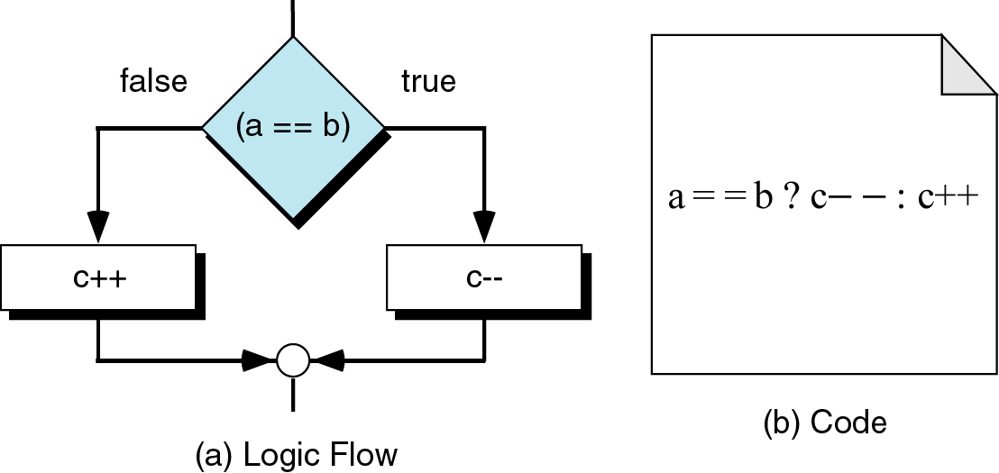
Simplifying if statements
Conditional Expressions:

Slide 36
Simplifying if statements
Conditional Expressions:
If the condition is true, take the value1
If the condition is false, take the value2
Syntax:
condition ? value1 : value2
Example:
if (p<5)
p = q + 1;
else
p = 5;
This statement means
p = (p<5) ? q + 1 : 5;

Slide 37
Activity
Your Programming Hands On

Slide 38
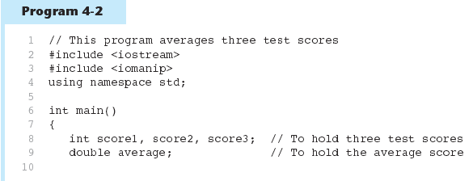
if Statement in Program 4-2
Continued…

Slide 39
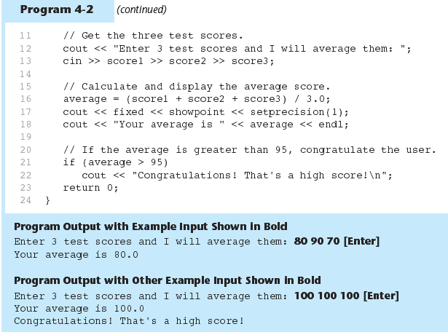
if Statement in Program 4-2

Slide 40
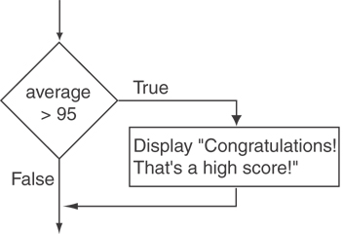
Flowchart for Program 4-2 Lines 21 and 22

Slide 41
Exercise: Program 4-2
modify the previous program so that it will produce output as the condition below:
if (average > 90)
print = 'Your grade is A';
else if (average > 75)
print = 'Your grade is B';
else if (average > 60)
print = 'Your grade is C';
else if (average > 50)
print = 'Your grade is D';
else
print = 'Your grade is F';

Slide 42
Exercise: Program 4-2
samples output as below:
Enter 3 test scores and I will average them: 90 50 45
Your average is 61.7
Your grade is C
Enter 3 test scores and I will average them: 97 95 98
Your average is 96.7
Congratulations! That's a high score!
Your grade is A

Slide 43
Formatting Output
Can control how output displays for numeric, string data:
size
position
number of digits
Requires <iomanip> header file

Slide 44
Stream Manipulators
Used to control how an output field is displayed
Some affect just the next value displayed:
setw(x): print in a field at least x spaces wide. Use more spaces if field is not wide enough

Slide 45
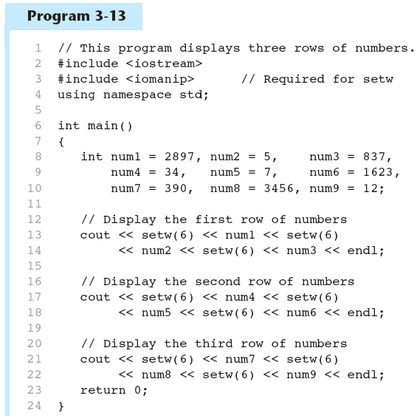
The setw Stream Manipulator in Program 3-13
Continued…

Slide 46
The setw Stream Manipulator in Program 3-13

Slide 47
Stream Manipulators
Some affect values until changed again:
fixed: use decimal notation for floating-point values
setprecision(x): when used with fixed, print floating-point value using x digits after the decimal. Without fixed, print floating-point value using x significant digits
showpoint: always print decimal for floating-point values

Slide 48
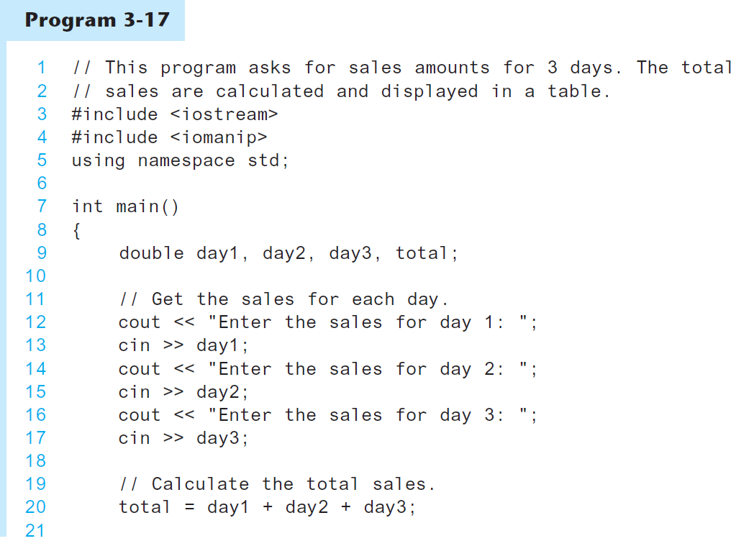
More Stream Manipulators in Program 3-17
Continued…

Slide 49
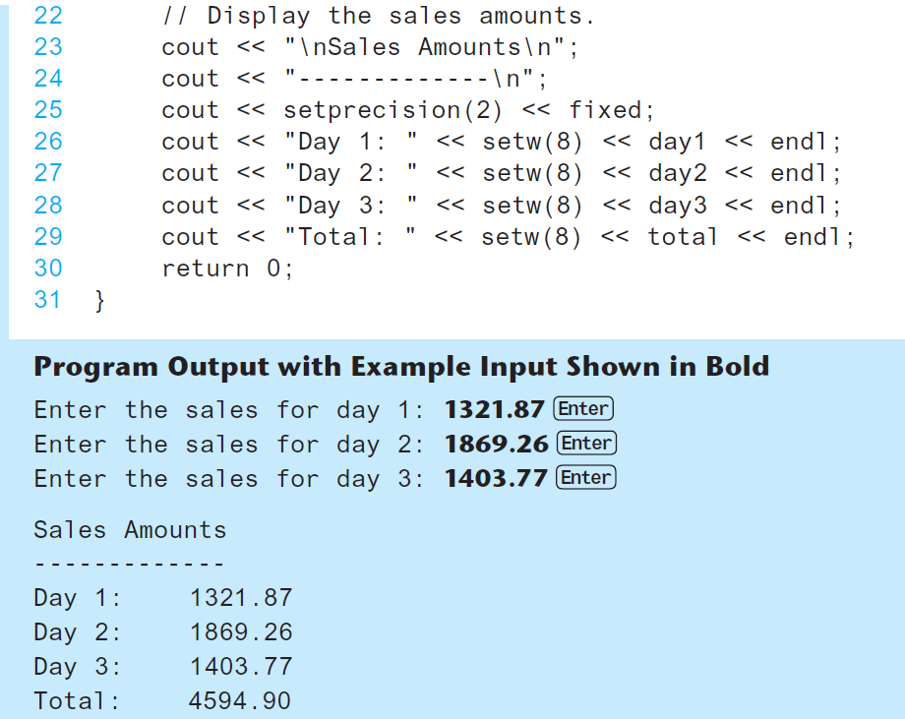
More Stream Manipulators in Program 3-17

Slide 50
Exercise: Program 4-2
further modify the previous program so that it will produce output as below:
Enter 3 test scores and I will average them: 97.5 98.6 99.8
Your test scores
----------------
Test 1: 97.50
Test 2: 98.60
Test 3: 99.80
Your average is 98.6
Congratulations! That's a high score!
Your grade is A

Slide 51
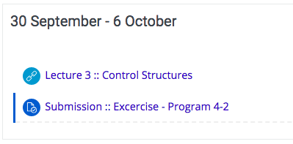
Exercise: Program 4-2
Submit your completed source code file over link provided in elearning.utm.my

Slide 52
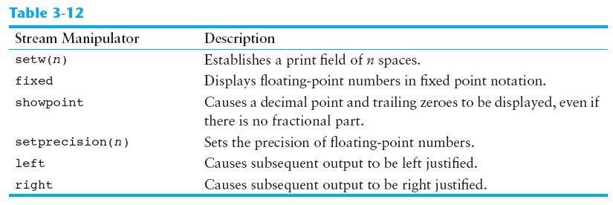
Stream Manipulators

Slide 53
Pause :: part #2

Slide 54
switch statement
If there are many nested if/else statements, you may be able to replace them with a switch statement:
switch (letter_grade)
{
case 'A‘ : cout <<"Excellent!";
break;
case 'B' : cout <<“Very good!";
break;
case 'C' : cout <<"Good";
break;
case 'D' : cout <<"Adequate";
break;
default : cout <<"Fail";
break;
}
if (letter_grade == 'A')
cout << “Excellent!";
else if (letter_grade == 'B')
cout << "Very good!";
else if (letter_grade == 'C')
cout << "Good";
else if (letter_grade == 'D')
cout << "Adequate";
else
cout << "Fail";

Slide 55
switch statement
switch (expression)
{
case value1: statements_1;
break;
case value2 : statements_2;
break;
...
default : statements;
break;
}
How the switch statement works?
Check the value of expression.
Is it equal to value1?
If yes, execute the statements_1 and break out of the switch.
If no, is it equal to value2? etc.
If it is not equal to any values of the above, execute the default statements and then break out of the switch.

Slide 56
switch statement
Example 1:
int value = 1;
switch (value)
{
case 1: cout << “One”;
break;
case 2: cout << “Two”;
break;
default : cout << “Neither One nor Two”;
break;
}
evaluates to 1
Prints One
it is equal to this case-value (i.e. 1==1). So, execute the statements of ‘case 1’.
break out of the switch
Output:
One

Slide 57
switch statement
Example 2:
int value = 1;
switch (value + 1)
{
case 1: cout << “One”;
break;
case 2: cout << “Two”;
break;
default : cout << “Neither One nor Two”;
break;
}
this expression evaluates to 2
it is not equal to this case-value (i.e. 2!=1). So, skip the statements of ‘case 1’ and move to the next case.
Prints Two
it is equal to this case-value (i.e. 2==2). So, execute the statements of ‘case 2‘.
break out of the switch
Output:
Two

Slide 58
switch statement
Example 3:
int value = 5;
switch (value)
{
case 1: cout << “One”;
break;
case 2: cout << “Two”;
break;
default : cout << “Neither One nor Two”;
break;
}
evaluates to 5
The switch expression (i.e. 5) is not equal to
both cases (i.e 5!=1 and 5!=2). So, their statements are skipped.
When the ‘default case’ is reached, its statements are always executed.
Prints Neither One nor Two
break out of the switch
Output:
Neither One nor Two

Slide 59
switch statement
What if the break statement is not written?
int value = 1;
switch (value)
{
case 1: cout << “One\n”;
case 2: cout << “Two\n”;
break;
default : cout << “Neither One nor Two\n”;
break;
}
evaluates to 1
it is equal to this case-value (i.e. 1==1). So, execute the statements of the ‘case 1’.
Prints One
No break statement here. So, no break out and move to the next line.
Prints Two
break out of the switch
Output:
One
Two

Slide 60
switch statement
The switch expression must be of integral type (i.e. int,char,bool).
The following examples would be an error
void main()
{
float point=4.0;
int mark;
switch (point)
{
case 4 : mark = 100;
break;
case 3.7 : mark = 80;
break;
default : mark = 0;
break;
}
}
void main()
{
char name[]="Ali";
int mark;
switch (name)
{
case "Ali" : mark=95;
break;
case "Aminah": mark=90;
break;
default : mark=50;
break;
}
}
Error! The switch expression cannot be a float value
Error! The switch expression cannot be a string value

Slide 61
switch statement
The case-value must be a constant (literal, memory or defined constant)
The following example would be an error
void main()
{
#define FLAGS 1
const int CONST2=2;
int var3 = 3;
int value;
switch (value)
{ case 0 : cout << "Four";
break;
case FLAGS : cout << "One";
break;
case CONST2 : cout << "Two";
break;
case var3 : cout << "Three";
break;
}
}
a literal is OK
a defined constant is OK
a memory constant is OK
Error! case-value cannot be a variable

Slide 62
Translating flowchart to C++ code
Pattern 1
if (condition)
{
statement;
}
This must be a True

Slide 63
Translating flowchart to C++ code
Example 1: Printing a number only if it is a negative
if (n<0)
{
cout << n;
}

Slide 64
Translating flowchart to C++ code
Pattern 2
if (condition)
{
statement_1;
}
else
{
statement_2;
}

Slide 65
Translating flowchart to C++ code
Example 2: If two numbers (p and q) are equivalent reset them to zero, otherwise exchange or swap their value each other and then print the new values.
if (p==q)
{
p = 0;
q = 0;
}
else
{
exchange(&p,&q);
cout << p << q;
}

Slide 66
Translating flowchart to C++ code
if (condition_1)
{
statement_1;
}
else if (condition_2)
{
statement_2;
}
else if (condition_n)
{
statement_n;
}
else
{
statement_m;
}
Pattern 3

Slide 67
Translating flowchart to C++ code
Example 3: Identifying the grade of a score
if (score > 90)
{
grade = 'A';
}
else if (score > 75)
{
grade = 'B';
}
else if (score > 60)
{
grade = 'C';
}
else if (score > 50)
{
grade = 'D';
}
else
{
grade = 'F';
}

Slide 68
Translating flowchart to C++ code
Pattern 4
The conditions must be in this form:
expression == value
switch (expr)
{
case val_1 : statement_1;
break;
case val_2 : statement_2;
break;
case val_n : statement_n;
break;
default: statement_m;
break;
}

Slide 69
Translating flowchart to C++ code
Example 4: Printing the description of a grade.
switch (grade)
{
case 'A‘ : cout << "Excellent!";
break;
case 'B' : cout << "Very good!";
break;
case 'C' : cout << "Good";
break;
case 'D' : cout << "Adequate";
break;
default : cout << "Fail";
break;
}

Slide 70
Pause :: part #2

Slide 71
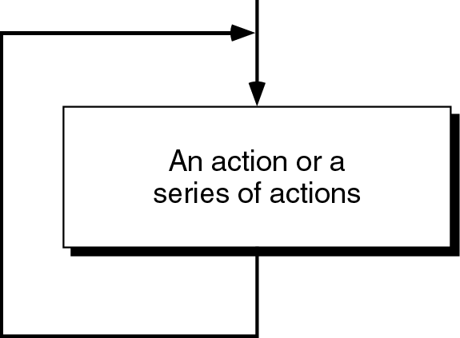
Loop / Repetition
The main idea of a loop is to repeat an action or a series of actions.
The concept of a loop

Slide 72
Loops
But, when to stop looping?
In the following flowchart, the action is executed over and over again. It never stop – This is called an infinite loop
Solution – put a condition to tell the loop either continue looping or stop.

Slide 73
Loops
A loop has two parts – body and condition
Body – a statement or a block of statements that will be repeated.
Condition – is used to control the iteration – either to continue or stop iterating.

Slide 74
Types of loop
Two forms of loop – pretest loop and post-test loop.
Pretest loop
the condition is tested first, before we start executing the body.
The body is executed if the condition is true.
After executing the body, the loop repeats
Pretest loop
Here must be a “True”

Slide 75
Types of loop
Post-test loop
the condition is tested later, after executing the body.
If the condition is true, the loop repeats, otherwise it terminates.
The body is always executed at least once.
Post-test loop
The iterating part must be a “True”

Slide 76
Parts of a loop
Beside the body and condition, a loop have two other parts – Initialization and Updating
Pretest loop
Post-test loop

Slide 77
Parts of a loop
Initialization
is used to prepare a loop before it can start –usually, here we initialize the condition
The initialization must be written outside of the loop – before the first execution of the body.
Updating
is used to update the condition
If the condition is not updated, it always true => the loop always repeats – an infinite loop
The updating part is written inside the loop – it is actually a part of the body.

Slide 78
Parts of a loop
Example: These flowcharts print numbers 10 down to 1
Pretest loop
Post-test loop
Initialize n before start the loop
Every time the loop repeats, n is updated

Slide 79
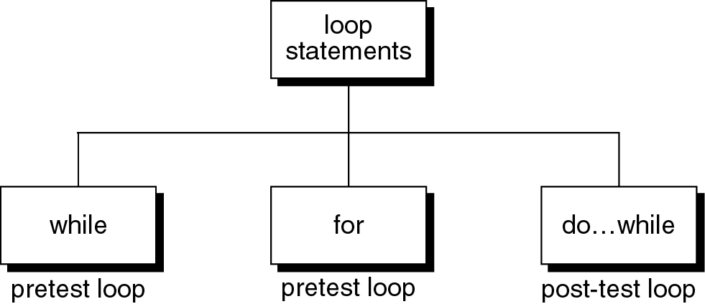
Loop statements
C++ provides three loop statements:
C++ loop constructs

Slide 80
while statement
while flowchart
while (Condition)
{
Repeated_Actions;
}

Slide 81
while statement
Example: This while statement prints numbers 10 down to 1
Note that, the first line (n=10) is
actually not a part of the loop statement.
n=10;
while (n>0)
{
cout << n <<“ “;
n=n-1;
}
Output:
10 9 8 7 6 5 4 3 2 1

Slide 82
for statement
for flowchart
for (Initialization; Condition; Updating)
{
Repeated_Actions;
}

Slide 83
for statement
Example: This for statement prints numbers 10 down to 1
for (n=10; n>0; n=n-1)
{
cout << n <<“ “;
}
Output:
10 9 8 7 6 5 4 3 2 1

Slide 84
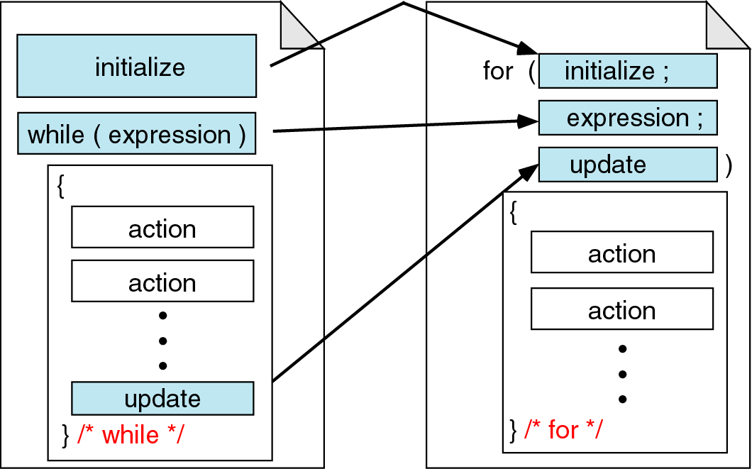
for vs. while statements
Comparing for and while loops

Slide 85
do…while statement
do
{
Repeated_Actions;
} while (Condition);

Slide 86
do…while statement
Example: This do…while statement prints numbers 10 down to 1
Note that, the first line (n=10) is
actually not a part of the loop statement.
n=10;
do
{
cout << n << “ “;
n=n-1;
} while (n>0);
Output:
10 9 8 7 6 5 4 3 2 1

Slide 87
Loop statements
If the body part has only one statement, then the bracket symbols, { } may be omitted.
Example: These two for statements are equivalent.
for (n=10; n>0; n=n-1)
{
cout << n;
}
for (n=10; n>0; n=n-1)
cout << n;

Slide 88
Pause :: part #2

Slide 89
Lab Exercise 3b
Your Programming Hands On

Slide 90
Jump statements
You have learn that, the repetition of a loop is controlled by the loop condition.
C++ provides another way to control the loop, by using jump statements.
There are four jump statements:

Slide 91
Breaking Out of a Loop
Can use break to terminate execution of a loop
Use sparingly if at all – makes code harder to understand
When used in an inner loop, terminates that loop only and returns to the outer loop
Notes:
See pr5-15.cpp

Slide 92
break statement
It causes a loop to terminate
Example:
for (n=10; n>0; n=n-1)
{
if (n<8) break;
cout << n << “ “;
}
Output:
10 9 8
Notes:
n (n<8) cout
10 10<8 = False 10
9 9<8 = False 9
8 8<8 = False 8
7 7<8 = True --- break

Slide 93
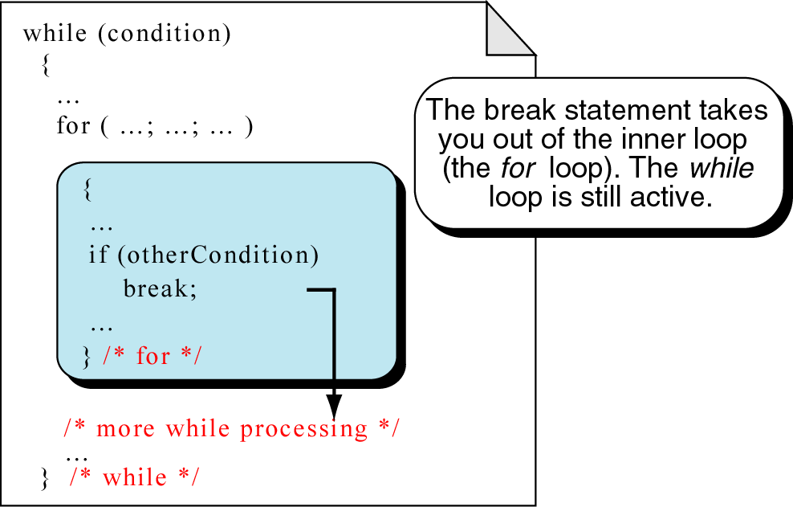
break statement
break an inner loop

Slide 94
The continue Statement
Can use continue to go to end of loop and prepare for next repetition
while and do-while loops go to test condition and repeat the loop if test condition is true
for loop goes to update step, then tests, and repeats loop if test condition is true
Use sparingly – like break, can make
program logic hard to follow
Notes:
See pr5-16.cpp

Slide 95
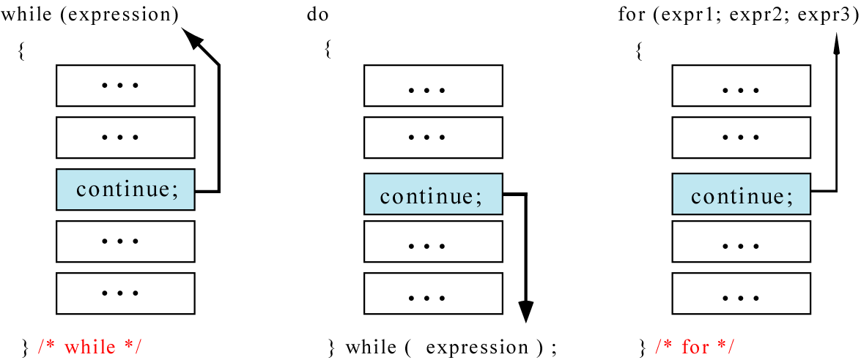
continue statement
In while and do…while loops, the continue statement transfers the control to the loop condition.
In for loop, the continue statement transfers the control to the updating part.
The continue statement

Slide 96
continue statement
Example:
for (n=10; n>0; n=n-1)
{
if (n%2==1) continue;
cout << n <<“ “;
}
Output:
10 8 6 4 2

Slide 97
continue statement
Example:
n = 10;
while (n>0)
{
cout << n << “ “;
if (n%2==1) continue;
n = n –1;
}
Output:
10 9 9 9 9 9 …………
The loop then prints number 9 over and over again. It never stops.

Slide 98
return statement
You will learn this statement in Chapter 4 – Function.
It causes a function to terminate.
Example:
void print_numbers()
{ int n=10;
int i;
while (n>0)
{
for (i=n;i>0; i--)
{
if (i%2==1) continue;
if (i%4==0) break;
if (n==6) return;
cout <<i <<“ “;
}
cout << endl;
n=n-1;
}
}
Output:
10
6
The continue statement transfers control to the updating part ( i-- )
The break statement terminates the for loop.
The return statement terminates the function and returns to the caller.
Notes:
cycle # n i i%2==1 i%4==0 n==6 cout
1 10 10 false false false 10
2 9 true - - -
3 8 false true (break) - -
4 9 9 true - - -
5 8 false true (break) - -
6 8 8 false true (break) - -
7 7 7 true - - -
8 6 false false false 6
9 5 true - - -
10 4 false true (break) - -
11 6 6 false false true (return – exit function)

Slide 99
return statement
When to use return?
Example: the following functions are equivalent
float calc_point(char grade)
{
float result;
if (grade=='A') result = 4.0;
else if (grade=='B') result = 3.0;
else if (grade=='C') result = 2.5;
else if (grade=='D') result = 2.0;
else result = 0.0;
return result;
}
float calc_point(char grade)
{
if (grade=='A') return 4.0;
if (grade=='B') return 3.0;
if (grade=='C') return 2.5;
if (grade=='D') return 2.0;
return 0.0;
}
The else part of each if statement may be omitted. It has never been reached.

Slide 100
return statement
float calc_point3(char grade)
{
float result;
switch (grade)
{
case 'A': result = 4.0;
break;
case 'B': result = 3.0;
break;
case 'C': result = 2.5;
break;
case 'D': result = 2.0;
break;
default: result =0.0;
}
return result;
}
float calc_point4(char grade)
{
switch (grade)
{
case 'A': return 4.0;
case 'B': return 3.0;
case 'C': return 2.5;
case 'D': return 2.0;
}
return 0.0;
}
The break statement of each case may be omitted. It has never been reached.

Slide 101
goto statement
It is used to translate connector symbols – jump to another part inside a program.
But, it is not recommended to use - it may cause unstructured programs.
Example:
n=10;
A:
cout <<n <<“ “;
n = n -1;
if (n>0) goto A;
Output:
10 9 8 7 6 5 4 3 2 1

Slide 102
Translating flowchart to C++ code
Pattern 1
Here must be a “False”
while (condition)
{
Repeated_Actions;
}
Here must be a “True”

Slide 103
Translating flowchart to C++ code
Example: Calculate the average of odd numbers 1 to 9
sum = 0;
i=1;
while (i<11)
{
sum = sum + i;
i = i + 2;
}
avrg = sum/5.0;

Slide 104
Translating flowchart to C++ code
Pattern 2
do
{
Repeated_Actions;
} while(condition);
The iterating part must be a “True”

Slide 105
Translating flowchart to C++ code
Example: Prints numbers 1 to 10
i=1;
do
{
cout <<i <<endl;
i = i + 1;
} while (i<11);

Slide 106
Translating flowchart to C++ code
Pattern 3
for (initialize; condition; update)
{
Repeated_Actions;
}
or
initialize;
while (condition)
{
Repeated_Actions;
update;
}

Slide 107
Translating flowchart to C++ code
Example: Print the total of numbers 1 to 10
total = 0;
for (i=1; i<11; i++)
{
total = total + i;
}
cout <<total;
or
total = 0;
i=1;
while (i<11)
{
total = total + i;
i++;
}
cout <<total;

Slide 108
Deciding Which Loop to Use
Sec 07
The while loop is a conditional pretest loop
Iterates as long as a certain condition exits
Validating input
Reading lists of data terminated by a sentinel
The do-while loop is a conditional posttest loop
Always iterates at least once
Repeating a menu
The for loop is a pretest loop
Built-in expressions for initializing, testing, and updating
Situations where the exact number of iterations is known

Slide 109
Nested Loops
A nested loop is a loop inside the body of another loop
Example:
for (row = 1; row <= 3; row++)
{
for (col = 1; col <= 3; col++)
{
cout << row * col << endl;
}
}
outer loop
inner loop
Notes:
row col
1 1
2
3
2 1
2
3
3 1
2
3

Slide 110
Notes on Nested Loops
Inner loop goes through all its repetitions for each repetition of outer loop
Inner loop repetitions complete sooner than outer loop
Total number of repetitions for inner loop is product of number of repetitions of the two loops. In previous example, inner loop repeats 9 times
Notes:
row col
1 1
2
3
2 1
2
3
3 1
2
3

Slide 111
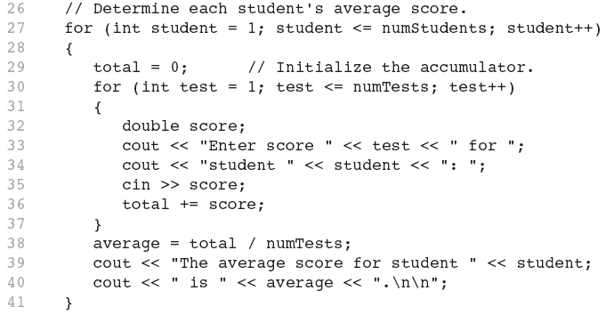
Nested for Loop in Program 5-14
Inner Loop
Outer Loop

Slide 112
In-Class Exercise
How many times the outer loop is executed? How many times the inner loop is executed? What is the output?
#include <iostream>
using namespace std;
int main()
{ int x, y;
for(x=1;x<=8;x+=2)
for(y=x;y<=10;y+=3)
cout<<"\nx = " <<x << " y = "<<y;
system("PAUSE");
return 0;}

Slide 113
Sentinels
sentinel: value in a list of values that indicates end of data
Special value that cannot be confused with a valid value, e.g., -999 for a test score
Used to terminate input when user may not know how many values will be entered

Slide 114
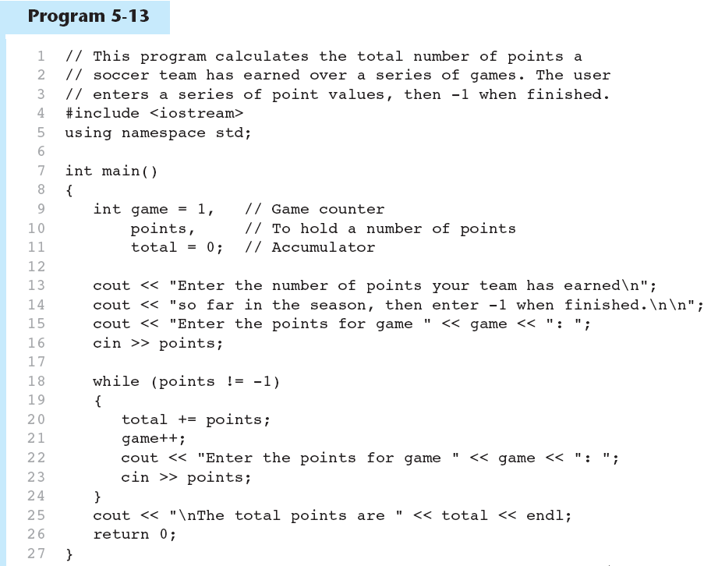
A Sentinel in Program 5-13
Continued…

Slide 115
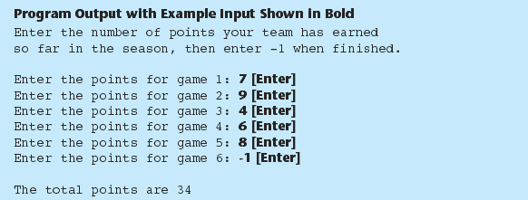
A Sentinel in Program 5-13

Slide 116
Lab Exercise 3c
Your Programming Hands On

