Slide 1
SYSTEM UNIT
PRESENTED BY:
RAGU RAJU NAIDU A/L S PALANI RAJU NAIDU
CHIA WEI HONG
HAM JING YI
FATIMA AZ DZIKRUN BINTI SAHROL NIZAM
LECTURER: DR ARYATI BINTI BAKRI

Slide 2
What is system unit??
The system unit, also known as a "tower" or "chassis," is the main part of a desktop computer.
Includes the chassis, microprocessor, main memory, bus lines, and ports.
Generally used to differentiate between the computer itself and its peripheral devices, such as the keyboard, mouse and monitor.

Slide 3
Example of system unit

Slide 4
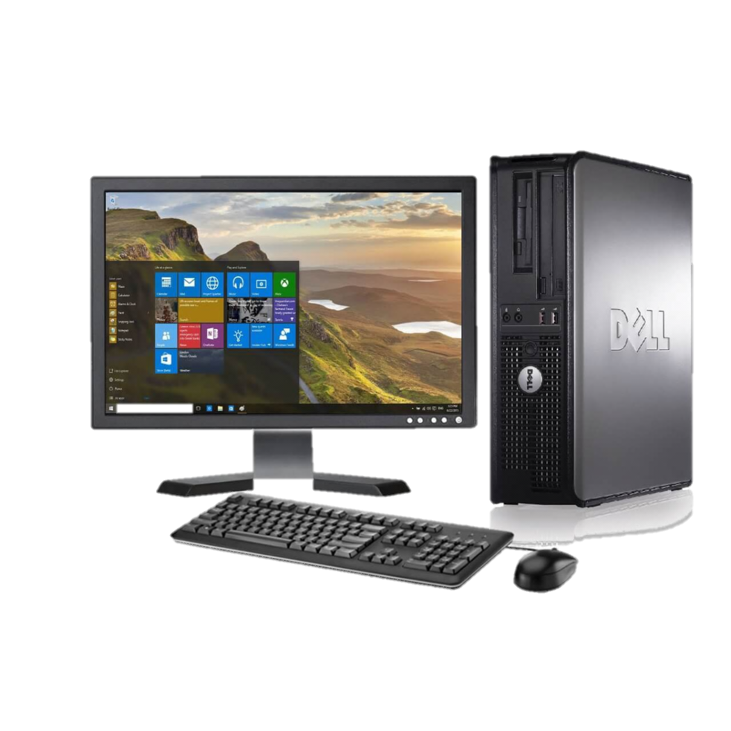
TYPE OF SYSTEM UNIT
Personal Computer / Desktop
- System unit is located in a separate device called the CPU ( Central Processing Unit ).

Slide 5
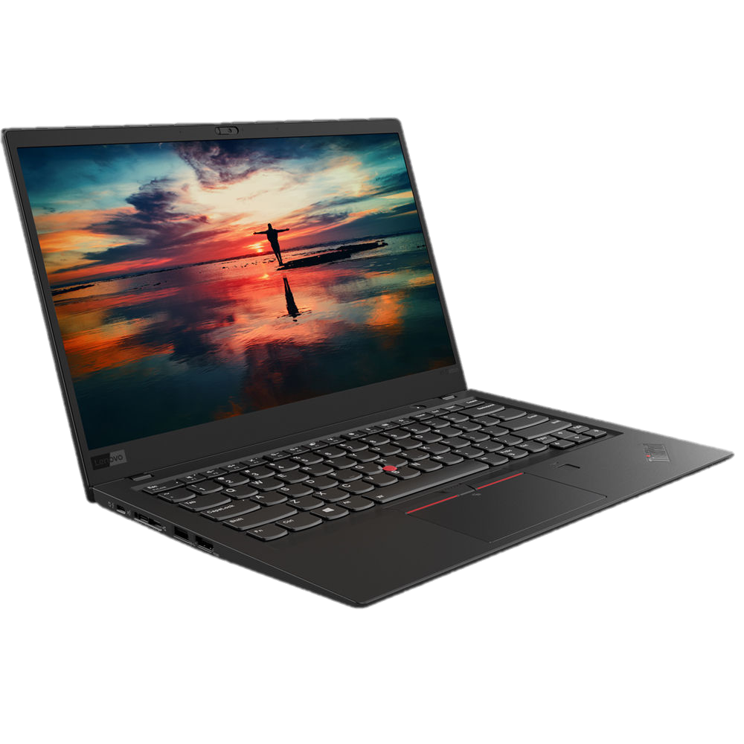
TYPE OF SYSTEM UNIT
Laptops
Easily accessible, portable and much smaller in size.
Ultrabook- 2 in 1
Gaming- with high quality of graphic

Slide 6
Type of system unit
Smartphones
Available everywhere and used by billions.
Handheld computer.
Has many functions
Embedded memory

Slide 7
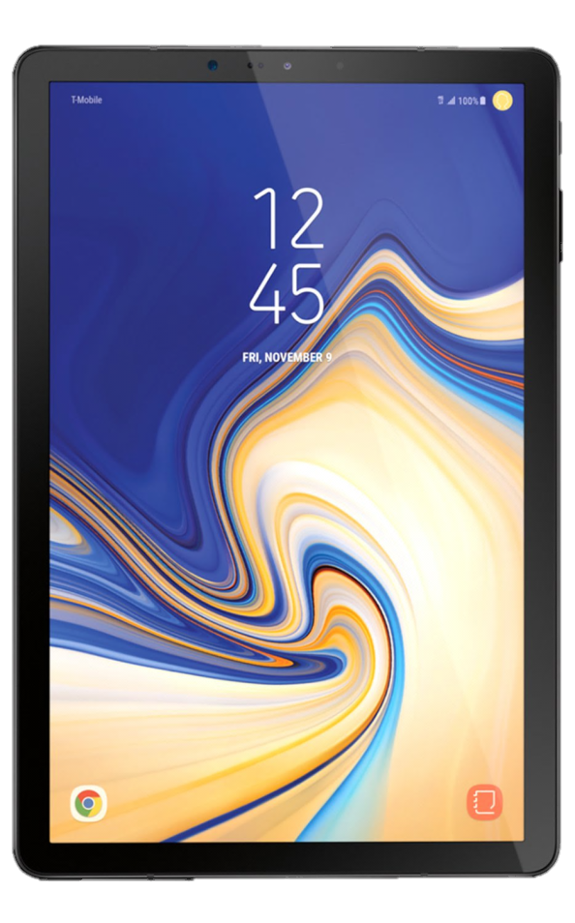
TYPE OF SYSTEM UNIT
Tablets
Uses an intuitive touchscreen control system
Can also be used to take photos, make phone calls, send messages, record videos and perform other tasks that can be performed by a smartphone as well.

Slide 8
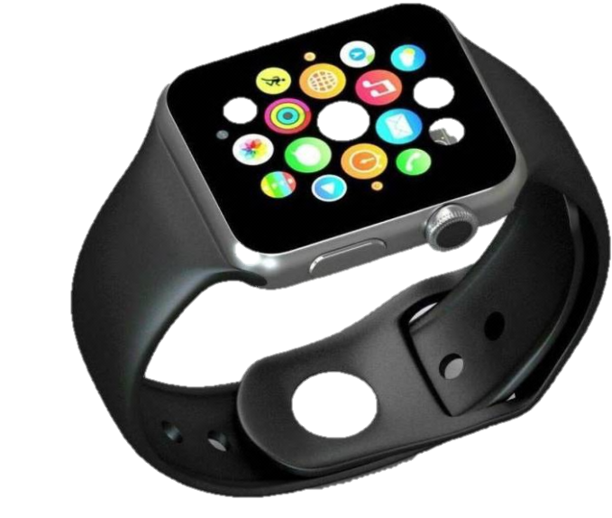
Type of system unit
Wearables
Embedded computer
Display notifications to alert you of important events or activities
Fitness tracking

Slide 9
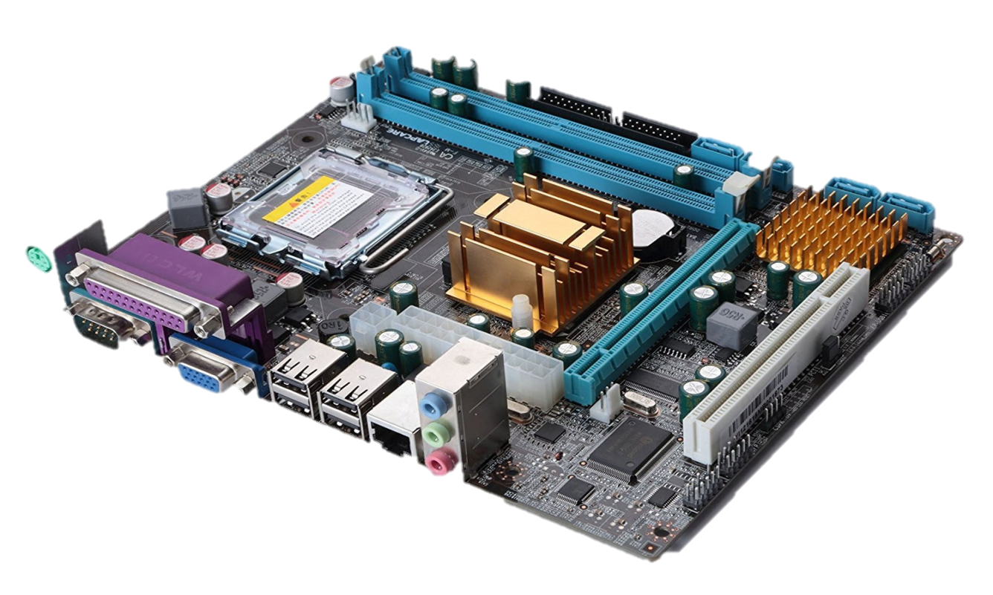
Important parts in System Unit
System board
Commonly known as motherboard which controls all the communications of the system.
Connection place
Contain lots of tiny component

Slide 10
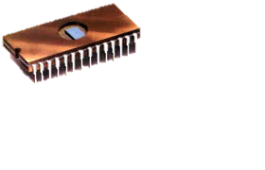
Important parts in system unit
Sockets
Physical connector on a computer motherboard that accepts a single physical chip.
Chips
Physical integrated circuit (IC) on a computer
A chip in the context of this document refers to an execution unit that can be single- or multi-core technology.

Slide 11
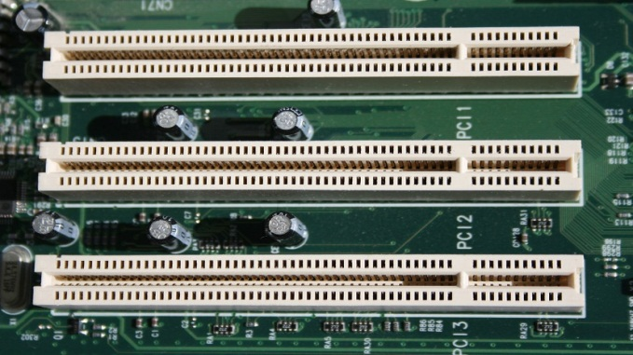
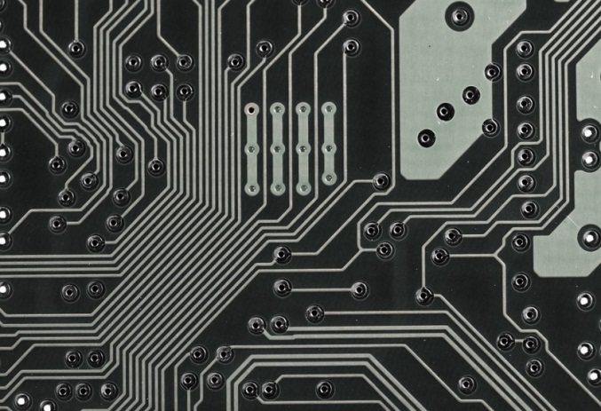
Important parts in system unit
The additional components on the system board are
1) Slots
2)Bus lines

Slide 12
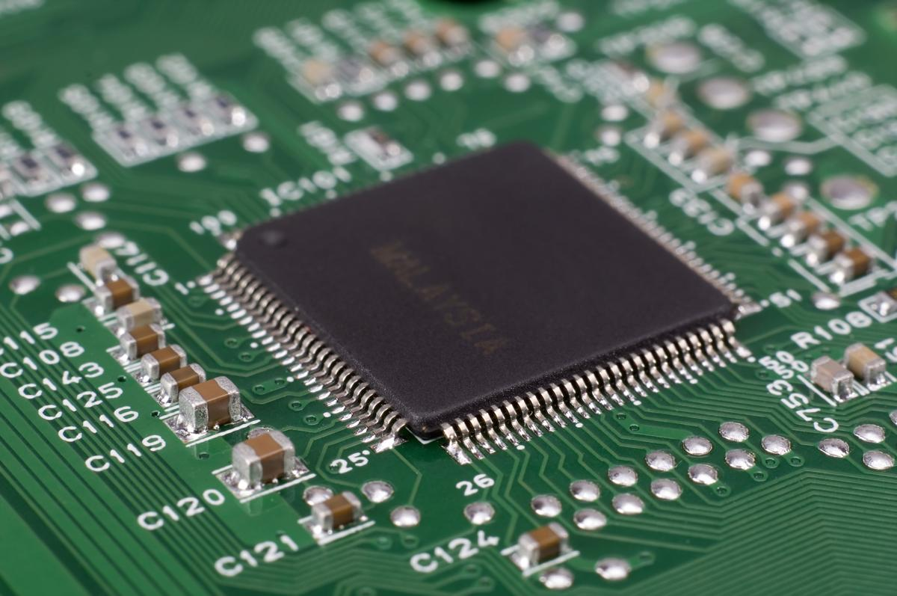
Important parts in system unit
Known as Central Processing Unit (CPU) or processor.
It is a digital devices that performs instructions and tasks in computer progressing.
It is the brain of computer.
Basic component of microprocessor:
Arithmetic and Logic Unit (ALU)
Registers
Control Unit
Buses
Cache Memory

Slide 13
IMPORTANT PARTS IN SYSTEM UNIT
Microprocessor chips
Is an electronic component consisting of small crystal of a silicon semiconductor.
Its capacity is compared in term of the length of data words.
4-bits, 8-bits, 16 bits and 32 bits.
Clock speed
How fast the CPU fetches and processes data
The faster the clock speed, the more the instructions executed per sec.
Higher clock speed, the faster the data can be processed.

Slide 14
IMPORTANT PARTS IN SYSTEM UNIT
Multicore Chip
Known as multicore processor.
2 or more processors have been attached for
Enhanced performance
Reduces the system’s heat and power consumption
Parallel processing
Method to run 2 or more CPU to handle separate parts of tasks.
Means better performances with less or same amount of energy

Slide 15
IMPORTANT PARTS IN SYSTEM UNIT
Specialty processor
COPROCESSORS
Created to handle some special tasks such as
Calculations of math
Display graphics (3D images)
Reduce burden on CPU
Much faster than CPU
Designed to improve the operations of CPU
Math coprocessor
Video coprocessor

Slide 16
IMPORTANT PARTS IN SYSTEM UNIT
Memory
Physical devices that can store information
The 3 main types of memory chips are
Random Access Memory (RAM)
Read-On Memory (ROM)
Flash Memory
MEMORY
RAM
Flash Memory
ROM

Slide 17
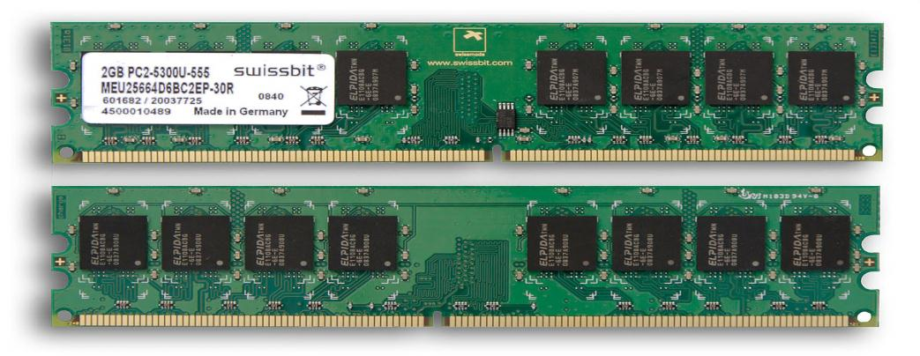
IMPORTANT PARTS IN SYSTEM UNIT
RAM
Random Access Memory(RAM) is a volatile memory.
It will lose its content when computer loses power.
Make the computer possible to access data in random order
Fast to find a specific piece of information
Stores the programs and data while CPU is presently progressing.
Cache Memory (CPU Memory)
Volatile memory
Provide high speed data

Slide 18
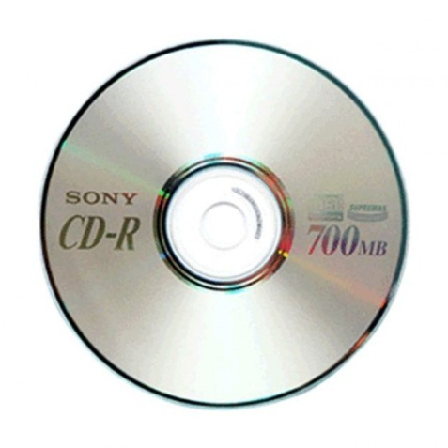
Important parts in system unit
ROM
Read-Only Memory also known as firmware.
Non-volatile
Even you turn off computer, content of ROM will remain.
Contains basic code to start the computer .
Data stored is unchangeable
Often used in optical storage media such as compact disc.
CD-ROM
CD-R
CD-RW

Slide 19
Important parts in system unit
Flash memory
There are some similarities between flash memory and :
Transmitting data between a personal computer and digital devices.
Hold control codes such as BIOS (Basic Input/ Output System)
RAM
It can be updated
ROM
It is non-volatile

Slide 20
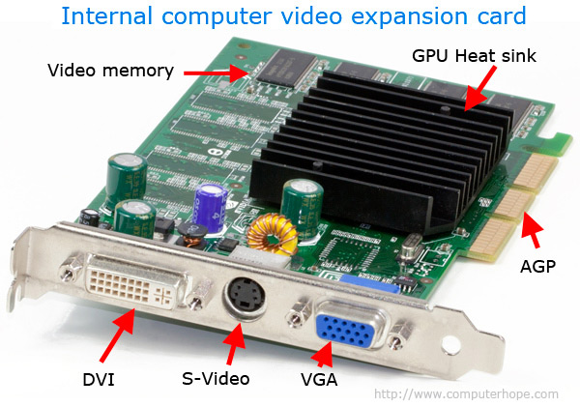
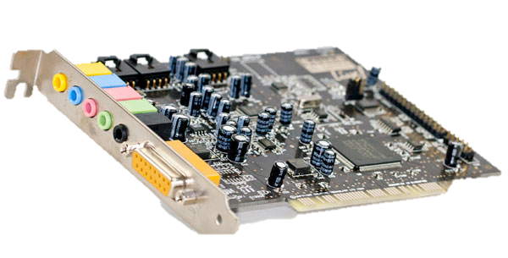
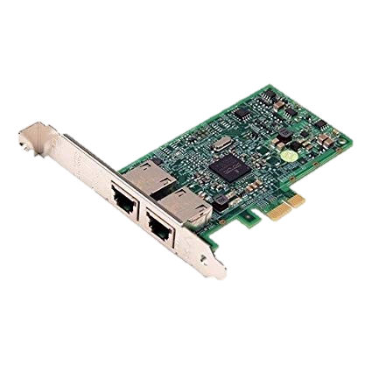
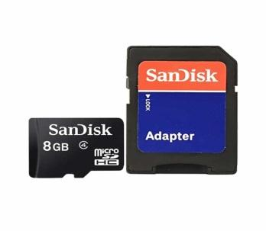
Important parts in system unit
Expansion Slots and Cards
They are used to increase system’s capabilities.
The slot is to provide a point for a card to be inserted.
Types of expansion cards are
Interface card
SD card for mobile phone
Video card
Network card
Sound card

Slide 21
Important parts in system unit
Bus lines
Connect parts of CPU to each other and various other components on the system board.
subsystem used to transfer data between the insides of a computer or between multiple computers
to reduce the number of pathways communication travels by.
Types of bus lines
System bus- Connect CPU and memory to its motherboard
Expansion bus- Connects CPU to other component

Slide 22
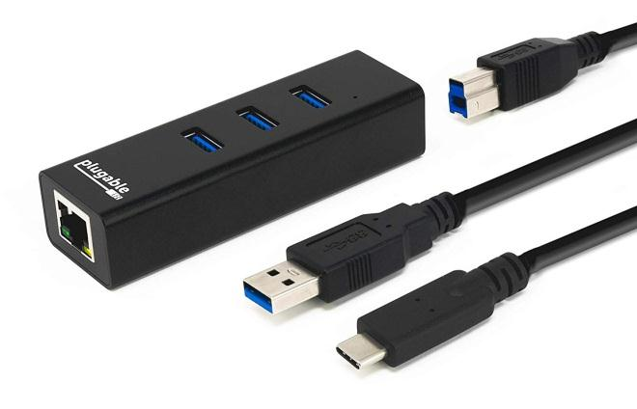
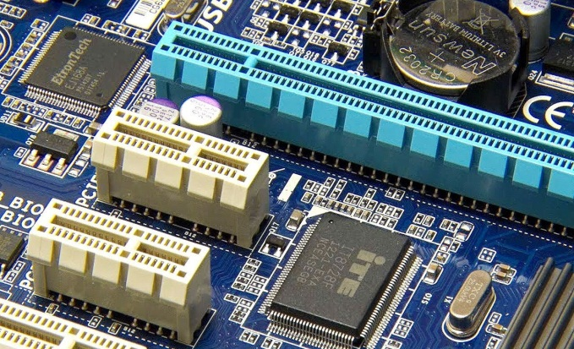
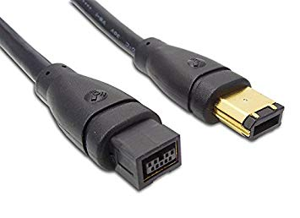
Expansion buses
Universal Serial Bus (USB)
Connects external USB devices onto the USB bus
FireWire
Primarily used to connect audio and video equipment to the system board
PCI Express (PCIe)
Single dedicated path for each connected device

Slide 23
PORTS
Physical docking point using which an external device can be connected to the computer.
Characteristic of ports
External devices are connected to a computer using cables and ports.
Ports are slots on the motherboard into which a cable of external device is plugged in.
Examples of external devices attached via ports are the mouse, keyboard, monitor, microphone, speakers, etc.

Slide 24
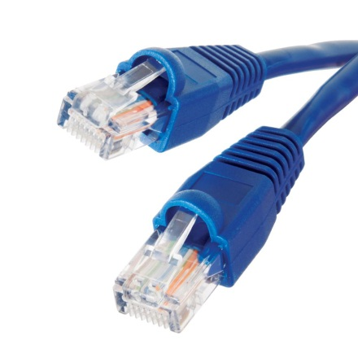
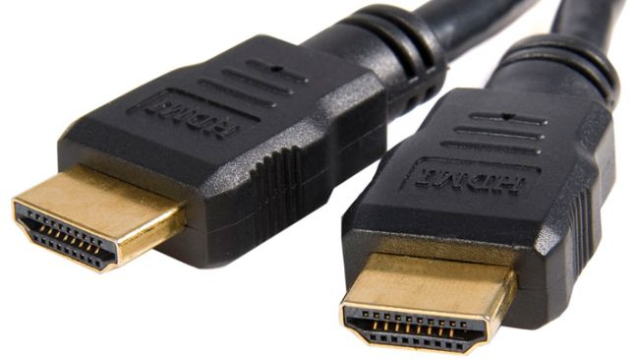
Standard ports
Type of standard ports:
USB
Normally use to connect keyboard, mouse, printer.
Ethernet
Use for fast networking
HDMI
provide a universal connection that combines both audio and visual channels into one interface.

Slide 25
SPECIALIZED PORT
MiniDP
- Connection to the large monitor
eSATA
-Provide high-speed connection for external secondary storage
MIDI
-connect musical instrument
VGA
-Connect analog and digital monitors

Slide 26
Power supply
Computer power supplies functionally in converting AC current to DC current and generally located at the rear of computer fan.
Power supply also known as power supply unit, power brick or power adapter.
Most computer power supplies include a number of switched-mode supplies, which operate independently by producing a single voltage.
These are linked together, so that they shut down as a group in case of a computer fault.

Slide 27
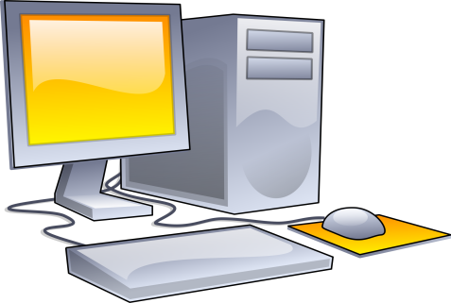
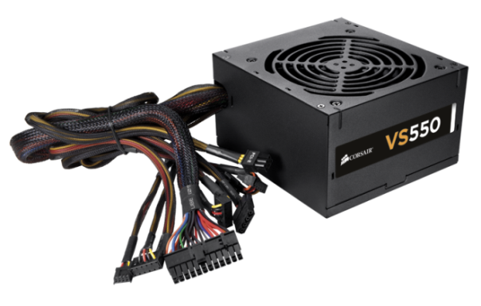
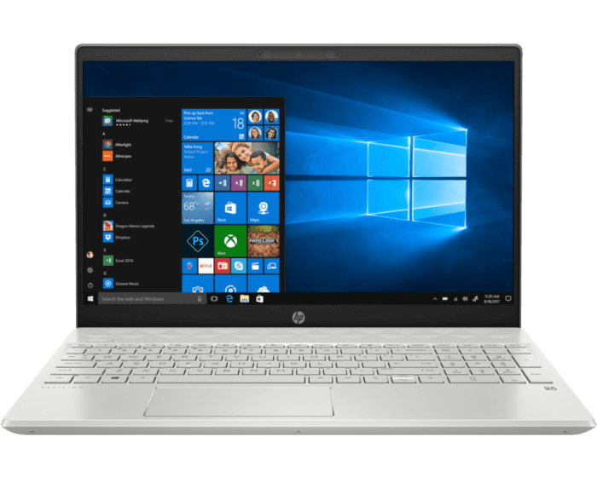
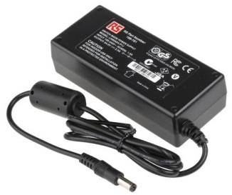
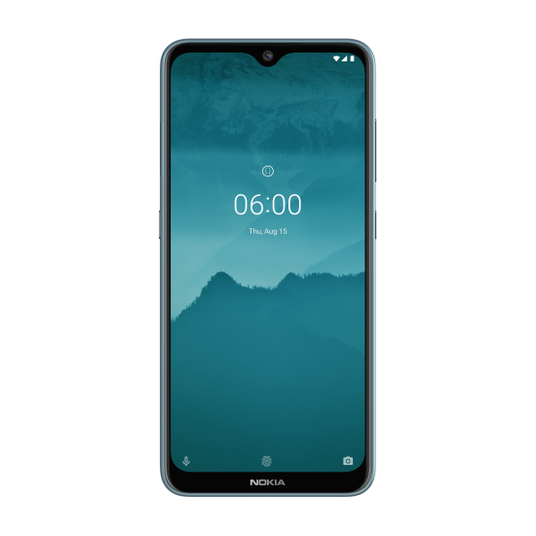
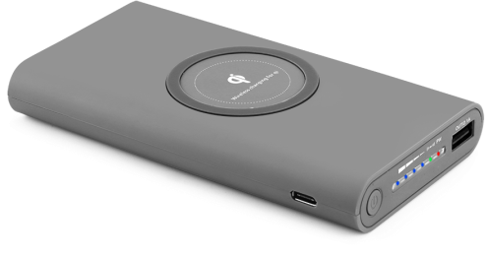
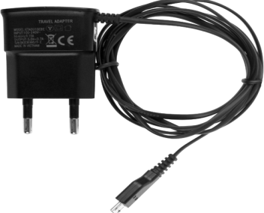
EXAMPLE

Slide 28
Electronic data and instruction
There are two types of signal in computer systems:
Digital ( recognized by computers)
Analog(continuous signal)
Conversion must take place to change analog signals to digital signals to receive by computer to process.

Slide 29
Numeric Representation
Our computer use two type of numeric representation which are
Binary
Hexadecimal
What is two-state binary system?
This system only consist “0” represent no charge while “1” represent negative charge
The code also can known as BYTE which contain 8 BITS
Hexadecimal
Use 16 digits to represent binary numbers

Slide 30
Character Encoding
Used to represent a repertoire of characters by some kind of encoding system.
ASCII
American Standard Code for Information Interchange
Use 8 bits to represent a character
EBCDIC
Extended Binary Coded Decimal Interchange Code
Use 8 bits to represent character
UNICODE
Uniform Code of representing all world’s languages
Use 16 bits to represent a character
Represent 256 character
Primarily used on PC
Represent 256 character
Primarily used on mainframe and high servers
Represent 65536 characters
Implement in several OS

Slide 31
Q&A SESSION!!
State 3 components in motherboard as stated.
Differentiate two type of memory exist in system unit.
How many types of character encoding? State the place we use these character encoding.
“ UTM SANJUNGAN BANGSA ☺”
Determine the total bits in this sentence according to :
ASCII
UNICODE

Slide 32
Thank you ☺

