Slide 1
CHAPTER 8: COMMUNICATIONS & NETWORKS
Define Network
Key network terminology
including:
-network interface cards
-network operating systems
Difference types of network including:
-local
-home
-wireless
-personal
-metropolitan
-wide area networks
GROUP’S MEMBERS:
1)NURUL HANA BINTI AZAM
2)NURUL AIN NADHIRAH BINTI SHAMSUL BAHRIM
3)NUR IZZAHTUL SYAFIQAH BINTI MOHAMAD FADZIL
4)SAFIRA NURUL IZZA
5)MD SAMSUL ALAM RONY

Slide 2
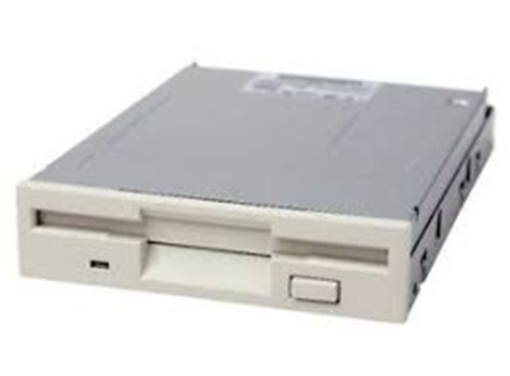
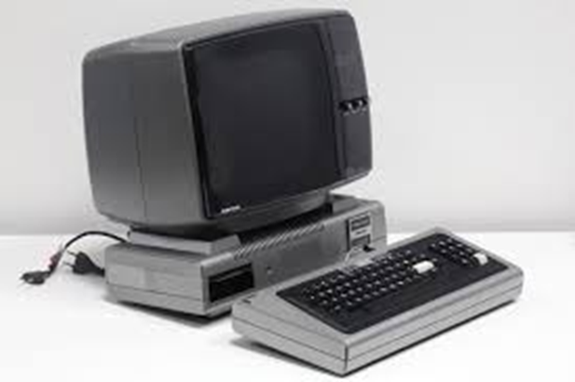
What is Network ?
A network consists of multiple devices that communicate with one another.
Can be described as a system of interconnected devices that can communicate using some common standards (called protocols). These devices communicate to exchange resources (e.g. files and printers) and services.
TRS-80 was famous in 70s
(Tandy Corporation)

Slide 3
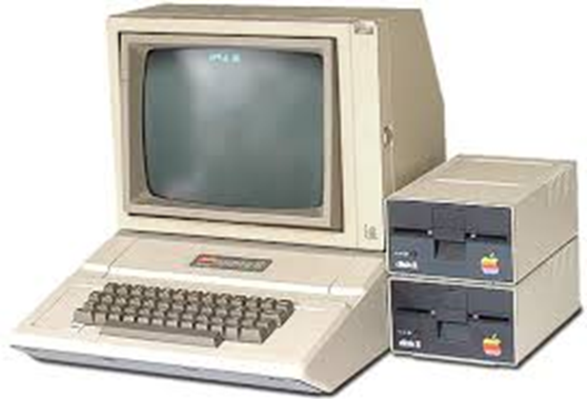
Apple II model was the beginning of personal computer in 1977.
A successful home computer in US
Had colour, high resolution graphics and impressive sound.
Use Beginner’s All Purpose Symbolic Instruction code programming language (BASIC)
Hard drive : 1 MHz with 4 kilobytes

Slide 4
Network Terminology
Including network interface (NIC) card
• What is network terminology
▪ How network works
▪ Networking components
We know that there must be an agreement between to end points on network. And the agreement should be on the protocol or language that’s in use. In network terminology we talk about the agreement and system network architecture (SNA). How network can be formed or customize is also in network terminology.
You already know the definition from my friend what network means. Simply a network means a connection. A connection that you use to share your information
The basic terms are
• Connection
• Packet
• Network interface

Slide 5
Connection:
First thing is first, Connection. In networking, connection means a piece of related information that are transferred through a network. The connection is built before the data transferred to another location. The connection deconstructed at the end of the data transfer.
Packet:
The packet is the most basic unit of data transfer in networking. When you send your data over a network, it goes there as packets. A packet is like an envelope. Envelopes carries your data one place to another. Receiver opens your envelopes to receive the data that you send.
Network interface:
Network interface is a system’s interface between two pieces of equipment or protocols. Basically interface is the point of networking communication. Interface can be associated with physical or virtual networking device. Network interface works with the network address. The address can be a port number or a unique node ID. It provides some standardized functions like messaging. Connecting or disconnecting from a network is also a function of network interface.

Slide 6
How networks work?
We can’t answer this question in a word. Because network has many components and each component have something to do with the network. So at first we need to know what the components are and what they do. Action of these components makes a complete network. Before going to the networks you must know what Ethernet is. You also need the idea of router, firewall and VPN to understand the computer network.
Ethernet :
backbone of a network. It consist of the cabling and is able to transfer data at a rate of 100mb/s.
Router:
Router is our air traffic controller. It routes all the data on our network to where it is supposed to go.
Firewall is like a wall that prevents bad things to coming on our network.
VPN:
VPN stands for virtual private network. It creates a common tunnel for two computers to share the data. This tunnel know as private server created by VPN. Whatever you share in this server no one can see except that two computer.

Slide 7
Components of networking
• Hubs
It also known as network hub. A hub is a common connection point for devices in a network. The hubs is a kind of device used to connect segments of a local area network (LAN). There are three types of hub. They are passive, intelligent and switching hub.
• Switches
Switches for Ethernet are the most common form of network switch. It is also a kind of networking device that connects devices together on a computer network by using packet switching. Multiple data cables can be plugged into a switch to enable communication between different network devices.
• Bridges
This device creats a single aggregate network from multiple network segments. This is also known as network bridging. There are four types of bridge in networking.
1. Simple
2. Multiple
3. Learning
4. Transparent

Slide 8
• CSU/DSU
Channel service unit known as CSU. Data service unit known as DSU.
CSU is responsible for the connection of telecommunication on the other hand DSU is responsible for managing the interface with DTE.
• Modem
A hardware device that is used to convert data. It allows the data to be transmitted from one computer to another over telephone wires. The goal of modem is to convert the data into a signal that can be decoded to reproduce the original data. The modem is classified by the maximum data they can send.
• NIC
Network interface card is also known as network card or Ethernet card. It is an electronic device that connects a computer to a computer network. It allows a computer exchange data with a network. To get the connection network card uses protocol.
Ethernet card operate at different network speeds depending on the protocol standard they support. An Ethernet card does not directly support wireless networking like Wi-Fi. But the broadband router we use in our home have the necessary technology to access the Wi-Fi for Ethernet card.
Old Ethernet card offers the speed of 10 mbps maximum while modern Ethernet card offers 1000 mbps.

Slide 9
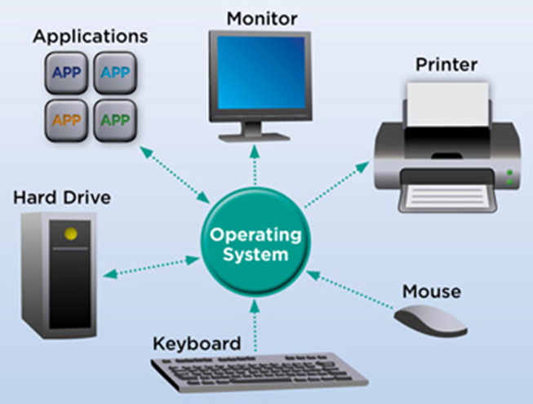
OPERATING SYSTEM
An operating system (OS) is the program that, after being initially loaded into the computer by a boot program, manages all the other programs in a computer.
The other programs are called applications or application programs. The application programs make use of the operating system by making requests for services through a defined application program interface (API).
A Software Platform for Applications
Operating systems provide a software platform on top of which other programs, called application programs, can run. The application programs must be written to run on top of a particular operating system.
Your choice of operating system, therefore, determines to a great extent the applications you can run. For PCs, the most popular operating systems are DOS, OS/2, and Windows, but others are available, such as Linux.

Slide 10
Classification of Operating systems
Multi-user: Allows two or more users to run programs at the same time. Some operating systems permit hundreds or even thousands of concurrent users.
Multiprocessing : Supports running a program on more than one CPU.
Multitasking : Allows more than one program to run concurrently.
Multithreading : Allows different parts of a single program to run concurrently.
Real time: Responds to input instantly. General-purpose operating systems, such as DOS and UNIX, are not real-time

Slide 11
Most Popular Desktop Operating Systems
Windows
Microsoft Windows is a family of operating systems for personal and business computers. Windows dominates the personal computer world, offering a graphical user interface (GUI), virtual memory management, multitasking, and support for many peripheral devices.
Mac
Mac OS is the official name of the Apple Macintosh operating system. Mac OS features a graphical user interface (GUI) that utilizes windows, icons, and all applications that run on a Macintosh computer have a similar user interface.
Linux
Linux is a freely distributed open source operating system that runs on a number of hardware platforms. The Linux kernel was developed mainly by Linus Torvalds and it is based on Unix

Slide 12
DIFFERENCES TYPES OF NETWORKS
LAN(Local Area Network)
HOME NETWORK
WIRELESS NETWORK
local area network (LAN) is a computer network that interconnects computers within a limited area such as a residence, school, laboratory, university campus or office building.By contrast, a wide area network (WAN) not only covers a larger geographic distance, but also generally involves leased telecommunication circuits.
Ethernet and Wi-Fi are the two most common technologies in use for local area networks
IPV4 address which that facilitates communication among devices within the close vicinity of a home .
A home network is two or more computers interconnected to form a local area network (LAN) within the home.
For example, if you have an older computer without a CD-ROM, you can access your newer computer's CD-ROM instead of purchasing one for your older computer.
A wireless network is a computer network that uses wireless data connections between network nodes.
Wireless networking is a method by which homes, telecommunications networks and business installations avoid the costly process of introducing cables into a building, or as a connection between various equipment locations.

Slide 14
References;
http://www.itrelease.com/2018/07/advantages-and-disadvantages-of-personal-area-network-pan/
http://www.orbit-computer-solutions.com/wide-area-network-wan-2/
http://blog.boson.com/bid/87993/Back-to-the-Basics-Networks-and-Topologies
https://ictlounge.com/html/types_of_networks.htm
https://en.wikipedia.org/wiki/Local_area_network
https://en.wikipedia.org/wiki/Wireless_network
https://en.wikipedia.org/wiki/Home_network
https://techterms.com/definition/network
https://study-ccna.com/what-is-a-network/

