Slide 1
DOMINANTS OF DOMESTIC DOGS
BY :
NOR MASYITAH BINTI GHAZALEE
NUR ANIS HANANI BINTI ROBIDAN
NUR QAMARINA BINTI TUAH
NUR AKMA NADIA BINTI SUHAIMI

Slide 2
INTRODUCTION
METHODOLOGY
Domestic dogs are Canidae species known for their high degree of sociality . Living in social groups may enhance competition for highly valued resources such as food and mates . This competition can lead to conflicts that may compromise group stability and may even result in chronic stress and physical harm .
Powerpoint
R studio
Google (https://journals.plos.org) to get data

Slide 3
DISCUSSION
SAMPLE TEST : TEST ON VARIANCE
GOODNESS OF FIT TEST
CHI-SQUARE
CORRELATION
REGRESSION

Slide 4
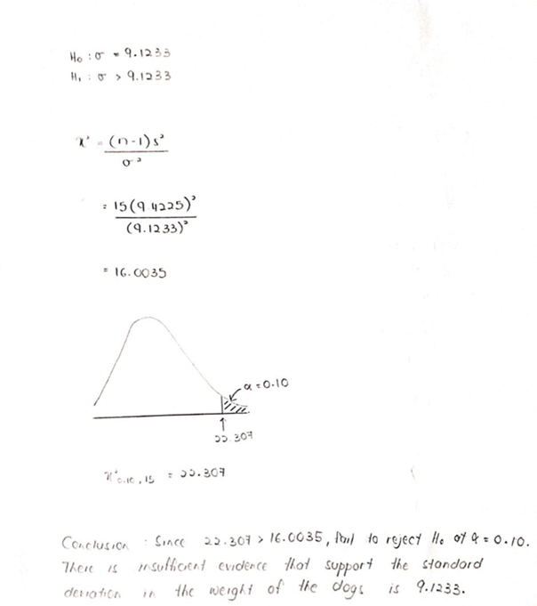
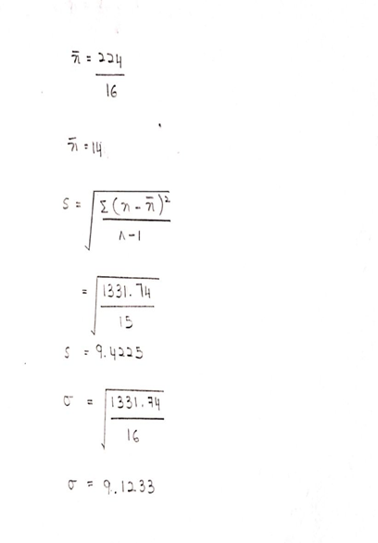
1
SAMPLE TEST : TEST ON VARIANCE
n = 16 dogs , 90% of CI ,  = 0.10

Slide 5
Chi-square
1
H0 : Variables are independent
H1 : Variables are dependent
2
r = 4 , c = 2 ,  = 0.05 , d.f = (r-1)(c-1) = 3
Age category | Male, oij | Eij | Female, oij | eij | Total
Adult | 0 | 0.5625 | 3 | 2.4375 | 3
Sub-adults | 0 | 0.375 | 2 | 1.625 | 2
Juveniles | 2 | 1.5 | 6 | 6.5 | 8
Pups | 1 | 0.5625 | 2 | 2.4375 | 3
Total | 3 |  | 13 |  | 16

Slide 6
2
3
$x^{2}$ = $\sum_{j}^{i}{\frac{{(oij −eij)}^{2} }{eij}}$
$x^{2}$ = $\frac{{(0 −0.5625)}^{2} }{0.5625}$ + $\frac{{(3 −2.4375)}^{2} }{2.4375}$ + $\frac{{(0 −0.375)}^{2} }{0.375}$ + $\frac{{(2 −1.625)}^{2} }{1.625}$ +
$\frac{{(2 −1.5)}^{2} }{1.5}$ + $\frac{{(6 −6.5)}^{2} }{6.5}$ + $\frac{{(1 −0.5625)}^{2} }{0.5625}$ + $\frac{{(2 −2.4375)}^{2} }{2.4375}$
= 1.778
$x^{2}$0.05,3 = 7.815
4
Since 1.778 < 7.815
Fail to reject H0 at  = 0.05
There is insufficient evidence that variables are dependent.
Thus, variables are independent.

Slide 7
3
Goodness of Fit Test
A study was conducted on 13 female domestic dogs. Test the claim that the number of female are in equal proportion for the 10 type of dogs breeds.
 | Beagle | Cairn Terrier | Malinois | Great Done | Doberman Pinscher | Dalmation | Labrador Retriever | German Snepherd | Dutch Snepherd | German Pointer
No.of female, oij | 5 | 1 | 1 | 1 | 1 | 1 | 1 | 1 | 0 | 1
eij | 1.3 | 1.3 | 1.3 | 1.3 | 1.3 | 1.3 | 1.3 | 1.3 | 1.3 | 1.3
$$\frac{{(oij−eij)}^{2}}{e}$$ | 10.5308 | 0.0692 | 0.0692 | 0.0692 | 0.0692 | 0.0692 | 0.0692 | 0.0692 | 1.3000 | 0.0692

Slide 8
1
H0 : PB = PC = PM = PGD = PDP = PD = PL = PGS = PDS = PGP
H1 : At least 1 of the proportion is different
2
$$x^{2}= \sum{\frac{{(oi −ei)}^{2}}{ei}}$$
$$\frac{13}{10} =1.3$$
$$E= \frac{n}{k} =$$
= 10.5308 + 0.0692 + 0.0692 + 0.0692 + 0.0692
+ 0.0692 + 0.0692 + 0.0692 + 1.3000 + 0.0692
= 12.3844

Slide 9
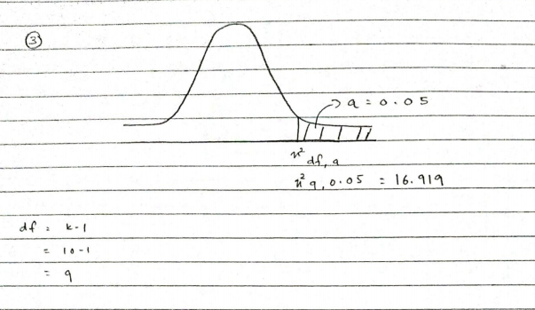
3
4
12.3844 < 16.919 fail to reject H0 at $α=0.05. T$here is insufficient evidence to support that the number of female are in equal proportion for the 10 types of dog breeds.

Slide 10
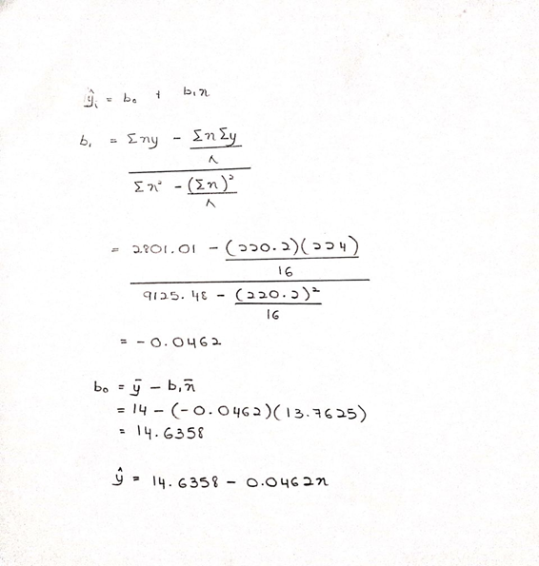
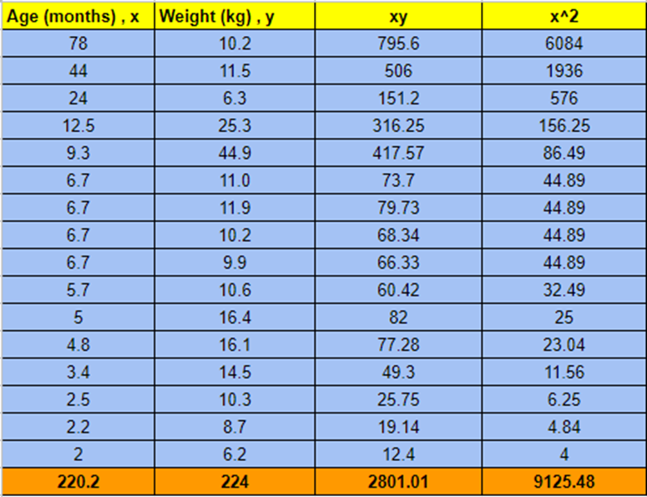
4
Regression

Slide 11
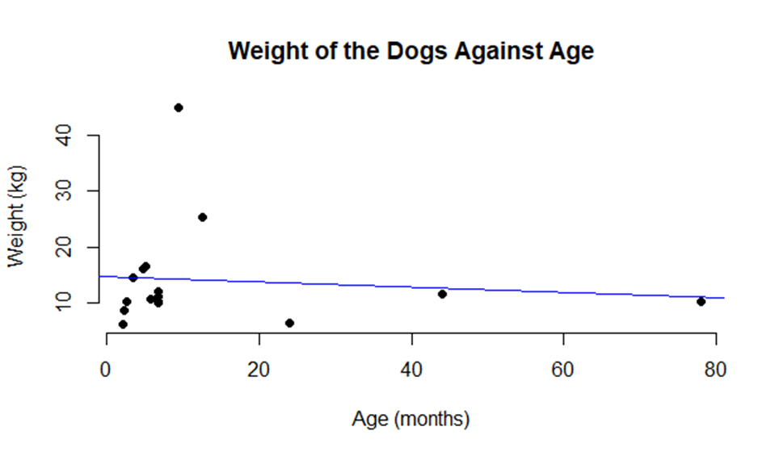

Slide 12
5
Correlation
Age (months), x | Weight(kg), y | xy | $$y^{2}$$ | $$x^{2}$$
78 | 10.2 | 795.6 | 104.04 | 6084
44 | 11.5 | 506 | 132.25 | 1936
24 | 6.3 | 151.2 | 39.69 | 576
12.5 | 25.3 | 316.25 | 640.09 | 156.25
9.3 | 44.9 | 417.57 | 2016.01 | 86.49
6.7 | 11 | 73.7 | 121 | 44.89
6.7 | 11.9 | 79.73 | 141.61 | 44.89
6.7 | 10.2 | 68.34 | 104.04 | 44.89
6.7 | 9.9 | 66.33 | 98.01 | 44.89
5.7 | 10.6 | 60.42 | 112.36 | 32.49
5 | 16.4 | 82 | 268.96 | 25
4.8 | 16.1 | 77.28 | 259.21 | 23.04
3.4 | 14.5 | 49.3 | 210.25 | 11.56
2.5 | 10.3 | 25.75 | 106.09 | 6.25
2.2 | 8.7 | 19.14 | 75.69 | 4.84
2 | 6.2 | 12.4 | 38.44 | 4
$$\sum{x=220.2}$$ | $$\sum{y=224}$$ | $$\sum{xy=2801.01}$$ | $$\sum{y^{2}=4467.74}$$ | $$\sum{x^{2}=9125.48}$$
$$r= \frac{\sum{xy −(\sum{x}} \sum{y)/n }}{√[(\sum{x^{2})−({\sum{x)}}^{2}}\text{/}\text{n}\text{] [}\sum{y^{2})−({\sum{y)}}^{2}}\text{/}\text{n}\text{] }}$$
$$r= \frac{2801.01 −(220.2 ×224)/16}{\begin{aligned}√\left[9125.48−\frac{{\left(220.2\right)}^{2}}{16}\right]\left[4467.74 −\frac{{\left(224\right)}^{2}}{16}\right] \\ \end{aligned}}$$
$$r=−0.000035 ≈0$$
r is closer to 0, therefore the linear relationship is weaker which means no correlation coefficient

Slide 13
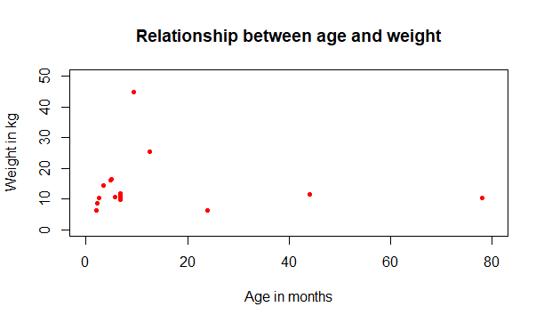
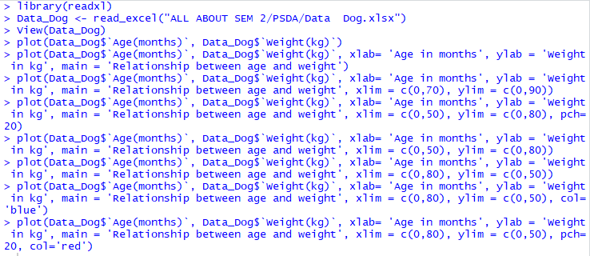

Slide 14
CONCLUSION
These findings are useful in correctly interpreting the relationship between dogs at the dyadic level regarding status as well as for the position in the group (rank order).

Slide 15
THANK YOU

