Slide 1
06: Advanced File Operations
Programming Technique II
(SCSJ1023)
Adapted from Tony Gaddis and Barret Krupnow (2016), Starting out with C++: From Control Structures through Objects

Slide 2
Content
File Operations
Passing File Stream Objects to Functions
Member Functions for Reading and Writing Files
Binary Files
Random-Access Files

Slide 3
File Operations

Slide 4
File Operations
A file is a collection of data that is usually stored on a computer’s disk. Data can be saved to files and then later reused
Almost all real-world programs use files to store and retrieve data extensively:
Word processing
Databases
Spreadsheets
Compilers

Slide 5
This chapter covers more advanced file operations and focuses primarily on the fstream data type. Table below compares the ifstream, ofstream, and fstream data types. All of these data types require the fstream header file.

Slide 6
Using Files
Requires fstream header file
use ifstream data type for input files
use ofstream data type for output files
use fstream data type for both input, output files
Can use >>, << to read from, write to a file
Can use eof member function to test for the end of input file.

Slide 7
fstream Object
The fstream object can be used for either input or output
Must specify mode on the open statement
Sample modes:
ios::in – for input files
ios::out – for output files
Can be combined on open call:
dFile.open("class.txt", ios::in | ios::out);

Slide 8
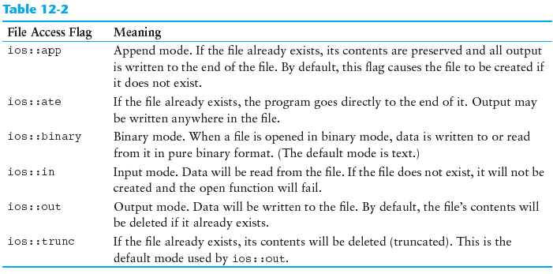
File Access Flags

Slide 9
Using Files - Example
// copy 10 numbers between files
// open the files
fstream infile("input.txt",ios::in);
fstream outfile("output.txt",ios::out);
int num;
for (int i = 1; i <= 10; i++){
infile >> num; // read from the input file
outfile << num; // write into the output file
}
infile.close(); // close the files
outfile.close();

Slide 10
Default File Open Modes
ifstream:
open for input only file cannot be written to open fails if file does not exist
ofstream:
open for output only file cannot be read from file created if no file exists file contents erased if file exists
The filename used by ifstream, ifstream and fstream objects must be a c-string (i.e., array of char).
Thus, if you pass a C++ string, you need to convert it first to a c-string by c_str() method. Example:
string filename =“input.txt”;
ifstream fin(filename.c_str());

Slide 11
More File Open Details
Can use filename, flags in definition:
ifstream gradeList("grades.txt");
File stream object set to NULL or 0 (false) if open failed:
if (!gradeList) ... // This means that it is unable to open the file.
// It is the same meaning as if (gradeList==NULL)
Can also check fail member function to detect file open error:
if (gradeList.fail()) ...

Slide 12
Passing File Stream Objects to Functions

Slide 13
Passing File Stream Objects to Functions
It is very useful to pass file stream objects to functions
Be sure to always pass file stream objects by reference.

Slide 14
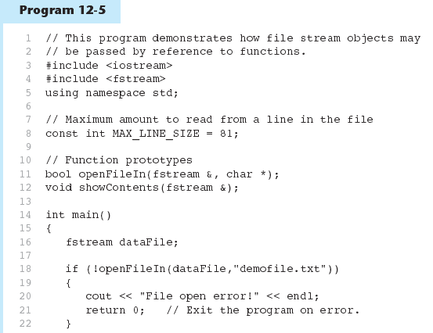
Passing File Stream Objects to Functions
Function call

Slide 15
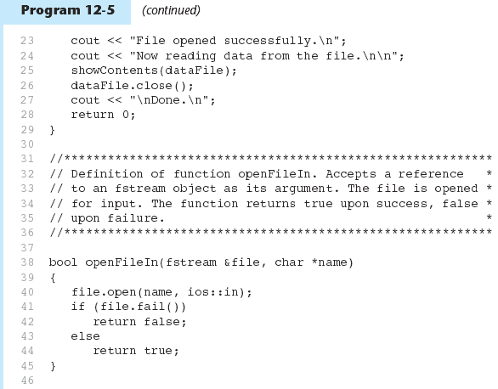
Program 12-5 (Continued)
Function call
Function definition

Slide 16
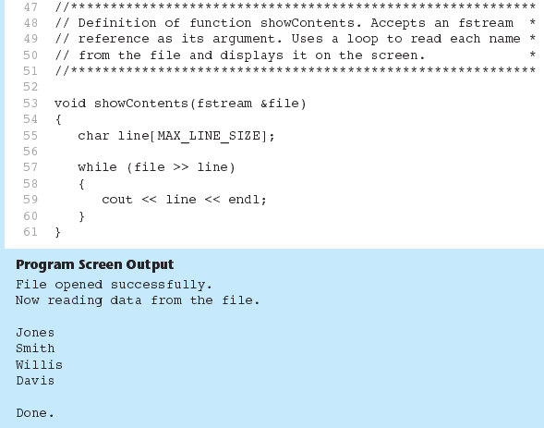
Program 12-5 (Continued)
Function definition

Slide 17
Member Functions for Reading and Writing Files

Slide 18
Member Functions for Reading and Writing Files
Functions that may be used for input with whitespace, to perform single character I/O, or to return to the beginning of an input file
Member functions:
getline: reads input including whitespace get: reads a single character put: writes a single character

Slide 19
getline Method
For working with C-strings. Three arguments needed:
A c-string (i.e., character array) to hold input
Number of characters to read
Terminator (or delimiter) to stop at if encountered before number of characters was read in
'\n' is the default delimiter (i.e, for the third argument)
Example:
ifstream myFile(“input.txt”);
char name[41], addr[41];
myFile.getline(name, 40); //using default delimiter ‘\n'
myFile.getline(addr, 40, '\t');

Slide 20
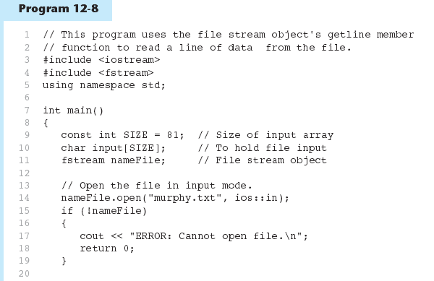
getline Member Function

Slide 21
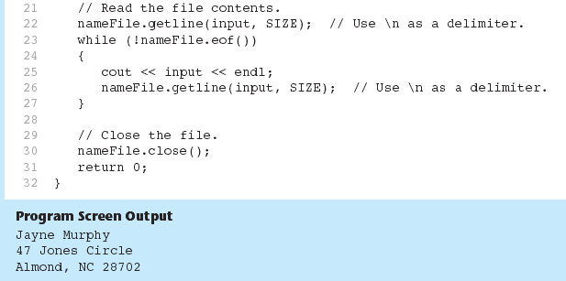

Slide 22
getline function
For working with C++ strings
Prototype:
getline(fileObject, stringBuffer, delimiter);
'\n' is the default delimiter (i.e, for the third argument)
Examples:
ifstream myFile(“input.txt”);
string name,addr;
getline(myFile, name); // using default delimiter ‘\n'
getline(myFile, addr, '\t');

Slide 23
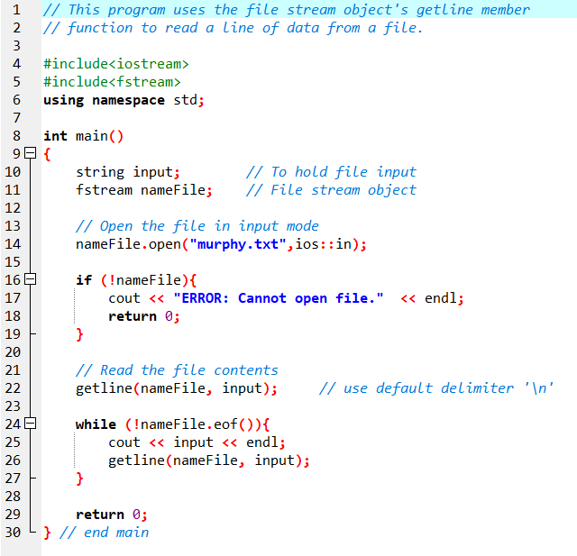
getline Function
Input file
Screen output

Slide 24
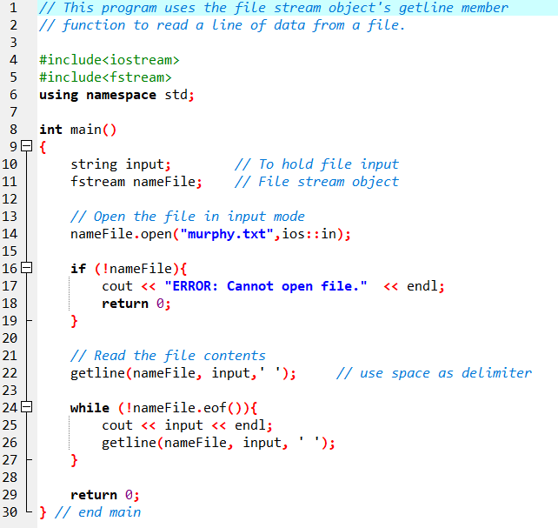
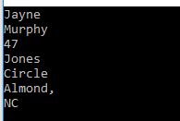
Example of using different delimiters
Input file
Screen output

Slide 25
Single Character I/O
get: to read a single character from an input file.
Example:
ifstream gradeFile(“grade.txt”);
char letterGrade;
gradeFile.get(letterGrade);
Will read any character, including whitespace
put: to write a single character to an output file.
Example:
ofstream reportFile(“report.out”);
char letterGrade;
…..
…..
reportFile.put(letterGrade);

Slide 26
Binary Files

Slide 27
Binary Files
Binary files contain unformatted and non-human-readable data.
Specified by using a binary flag on open:
Example:
inFile.open("nums.dat", ios::in|ios::binary);

Slide 28
Binary Files
Use read instead of <<, to read data from files.
Example: To read a letter from an input file
fstream fin(“input.dat“,ios::in|ios::binary);
char ch;
fin.read(&ch, sizeof(ch));
First parameter: the address of where to put the data being read in.
The function expects the data variable as char .
Thus, if other than char, it must be type casted.
Second parameter: how many bytes to read from the file.

Slide 29
Binary Files
Use write instead of >> to write data into files.
Example: To write a letter into an output file
fstream fout(“report.out“,ios::out|ios::binary);
char ch;
….
….
fout.write(&ch, sizeof(ch));
First parameter: the address of where to get the data from.
The function expects the data variable as char .
Thus, if other than char, it must be type casted.
Second parameter: how many bytes to write to the file.

Slide 30
Binary Files
To read and write non-character data, must use a typecast operator to treat the address of the data as a character address
Example: To read an integer from a file
fstream fin(“number.dat“,ios::in|ios::binary);
int num;
fin.read(reinterpret_cast<char *>&num, sizeof(num));
treat the address of num as
the address of a char
Or simply use C-style casting
fin.read((char *)&num, sizeof(num));

Slide 31
Binary Files
Example: To write an integer into a file
fstream fout(“number.dat“,ios::out|ios::binary);
int num;
cin >> num; // getting a number from the keyboard
fout.write(reinterpret_cast<char *>&num, sizeof(num));
C-style:
fout.write((char *)&num, sizeof(num));

Slide 32
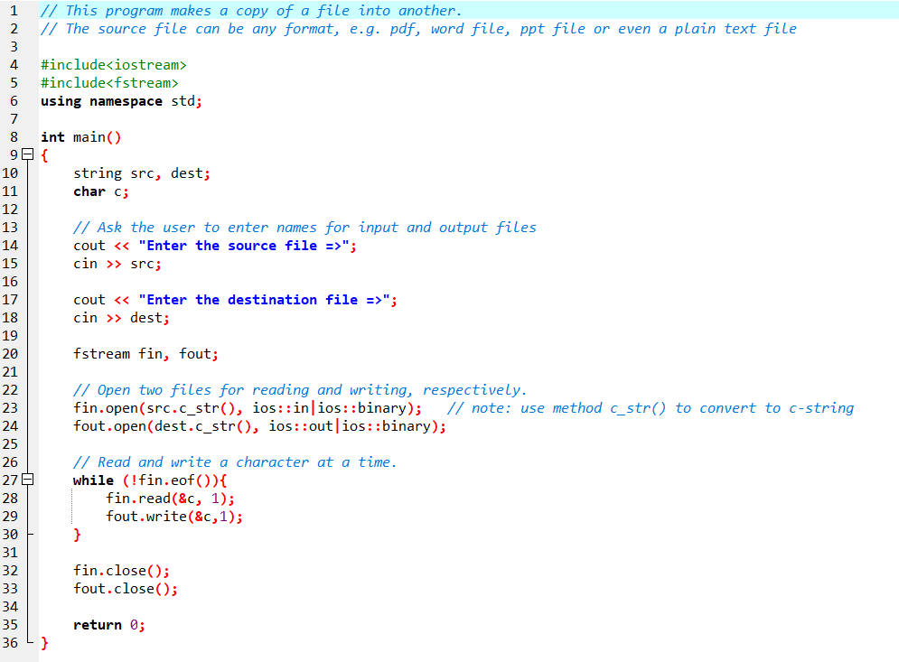
Example Application of Binary Files Copying a file

Slide 33
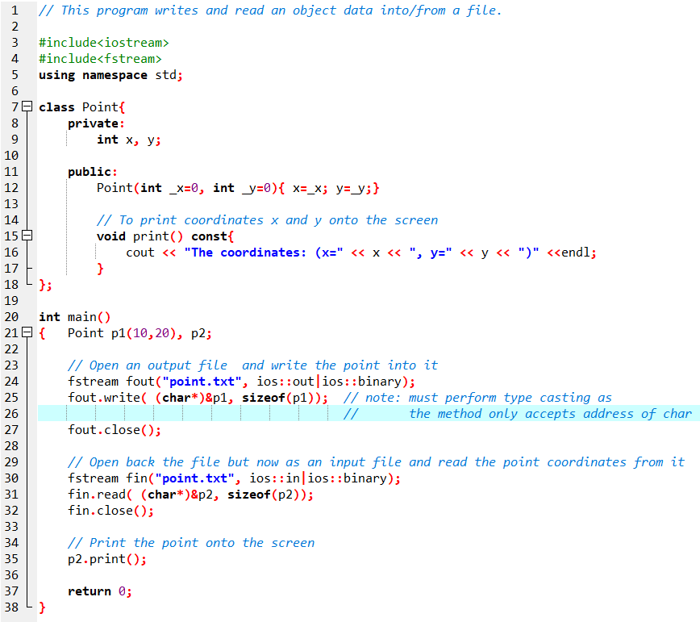
Example Application of Binary Files Writing and reading an object into/from a file

Slide 34
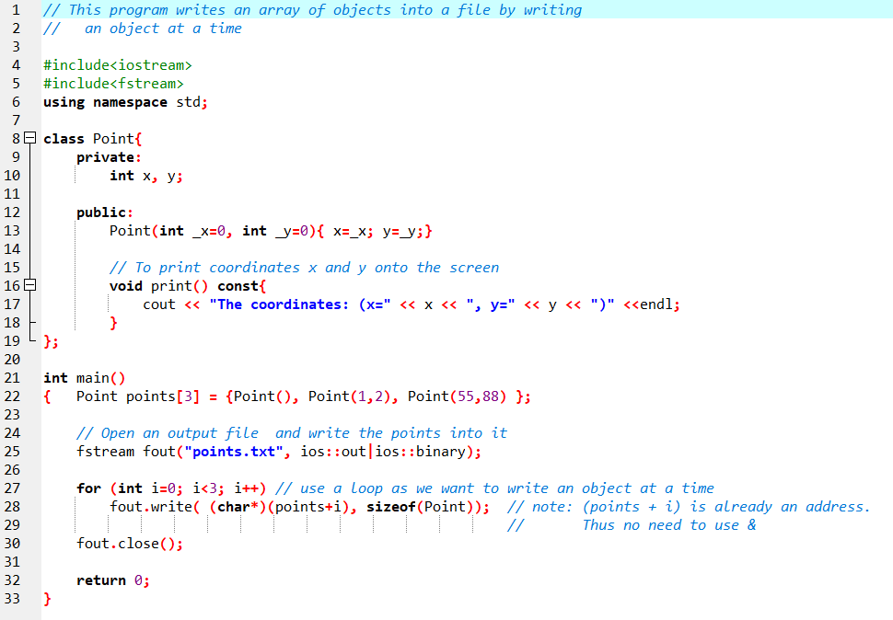
Example Application of Binary Files Writing an array of objects into a file (1)

Slide 35
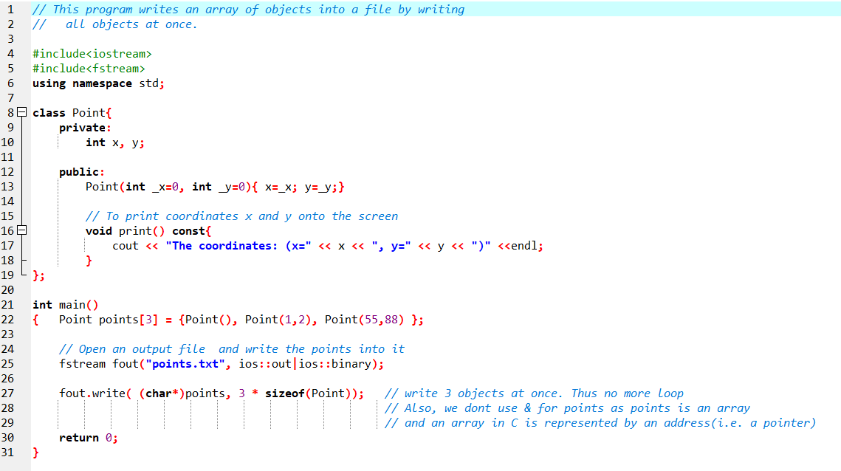
Example Application of Binary Files Writing an array of objects into a file (2)

Slide 36
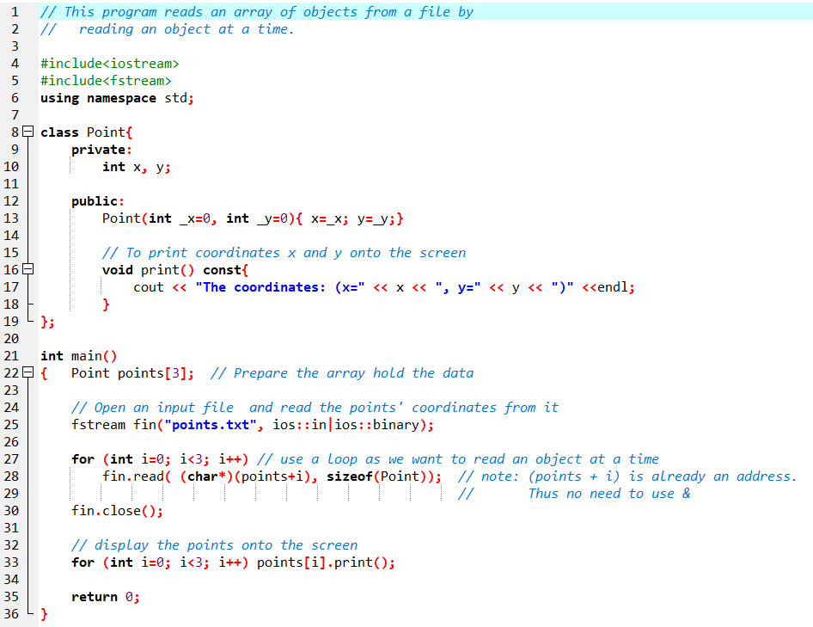
Example Application of Binary Files Reading an array of objects from a file (1)
Screen output

Slide 37
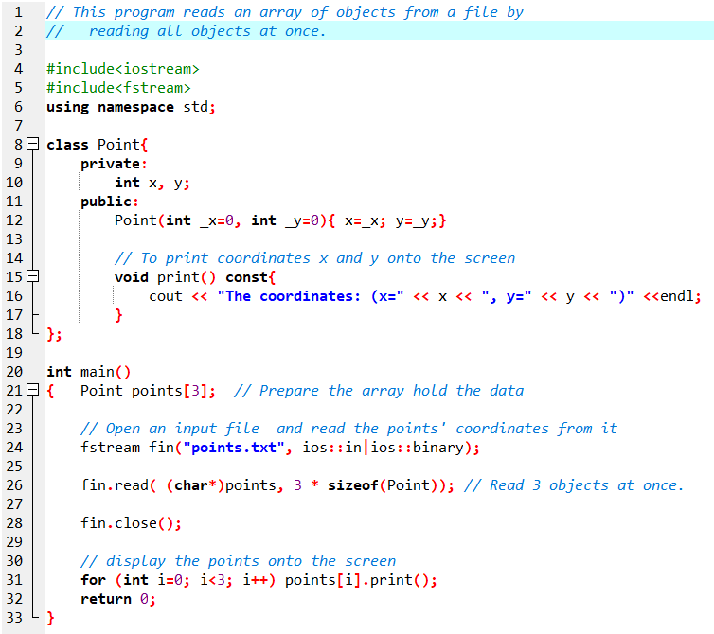
Example Application of Binary Files Reading an array of objects from a file (2)
Screen output

Slide 38
Random-Access Files

Slide 39
Random-Access Files
Sequential access: start at beginning of file and go through data in file, in order, to end
to access 100th entry in file, go through 99 preceding entries first
Random access: access data in a file in any order
can access 100th entry directly

Slide 40
Random Access Member Functions
seekg (seek get): used with input files.
seekp (seek put): used with output files.
Used to go to a specific position in a file

Slide 41
Random Access Member Functions
seekg,seekp arguments:
offset: number of bytes, as a long
mode flag: starting point to compute offset
Examples:
inData.seekg(25L, ios::beg);
// set read position at 26th byte
// from beginning of file
outData.seekp(-10L, ios::cur);
// set write position 10 bytes
// before current position

Slide 42
Important Note on Random Access
If eof is true, it must be cleared before seekg or seekp:
Example:
gradeFile.clear();
gradeFile.seekg(0L, ios::beg);
// go to the beginning of the file

Slide 43
Random Access Information
tellg member function: return current byte position in input file
Example:
long int whereAmI;
whereAmI = inData.tellg();
tellp member function: return current byte position in output file
Example:
whereAmI = outData.tellp();

Slide 44
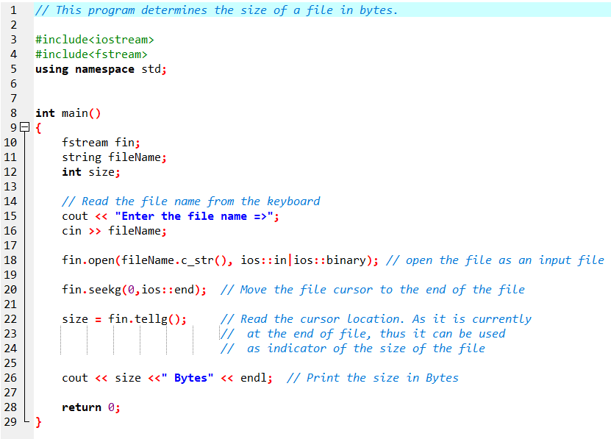
Example Application of Random-Access Determining the size of a file

