Slide 1
BINARY CLASSIFICATION OF
ACETYLCHOLINESTERASE INHIBITOR
USING GRAPH NEURAL NETWORKS
FOR ALZHEIMER'S DISEASE TREATMENT
Presentation Video: https://youtu.be/1GqxqQVFkPo
Presented by:
LOKE RUI KEE
Supervisor:
DR. NOOR HIDAYAH BINTI ZAKARIA

Slide 2
Problem Background
Despite numerous studies identifying various factors contributing to Alzheimer's disease (AD), its primary cause remains undetermined.
One prominent theory, the cholinergic hypothesis, suggests that cognitive impairments in AD are linked to damage in cholinergic neurons and reduced levels of acetylcholine (ACh), a neurotransmitter crucial for learning, memory, and other higher-order functions (Briggs, 2016).
Acetylcholinesterase (AChE), an enzyme that degrades ACh, is a common target in AD treatment, with AChE inhibitors increasing cholinergic activity by preventing ACh breakdown (Basnet et al., 2020).

Slide 3
Problem Statement
Traditional machine learning and deep neural networks face significant challenges in processing high-dimensional molecular data, such as SMILES.
Both require labor-intensive feature engineering, and one-hot encoding in deep learning loses sequential information, limiting the accurate and interpretable classification of acetylcholinesterase inhibitors.

Slide 4
Research Goal
Research Objectives
INVESTIGATE FEATURIZATION STRATEGIES
EVALUATE THE ABILITY OF GNNS
Implement GNNs for classifying AChE inhibitors using SMILES-encoded molecular data
enhance classification accuracy and preserving sequential information
Contribute to drug discovery efforts for Alzheimer’s disease treatment.
for labeled graph object generation for GNN.
to classify compounds as AChE inhibitors or non-inhibitors in terms of Accuracy, F1-score, ROC-AUC
1
3
2
IMPLEMENT A GNN MODEL
in predicting AChE inhibitors using SMILES-encoded molecular data.

Slide 5
Research Scopes
This project focuses on investigating the ability of Graph Neural Networks (GNNs) to classify potential AChE Inhibitors.
The input training dataset is SMILES-encoded molecular data of 4075 inhibitors and non-inhibitors targeting human AChE with an activity cutoff of 1 μM.
The output of the model is expected to be the classification of whether the input compound shows AChE inhibition capability.
Each compound is assigned a binary activity, specifically in binary 1 (activity value -log M ≥0.5) or 0 (activity value -log M ≤ 0.5).

Slide 6
Research Importance
Mitigate the loss of sequential information during data transformation
Unlocking new perspective for understanding molecular interactions
Accelerate drug discovery efforts by enhancing the accuracy and efficiency of classification models.

Slide 7
Related Works in AChE Inhibitor Classification with Deep Learning
Proposed Model | Dataset | Output | Performance
Graph Convolutional Network (GCN) (Sutthibutpong et al., 2024) | Bioactivity data (${IC}_{50}$) of AChE inhibition compounds for human from PubChem P22303 | Active (${IC}_{50}$≤ 10 μM) and Inactive (${IC}_{50}$≥ 10 μM) probability score from 0 to 1. | Average AUC = 0.9858 ± 0.0022
Graph Convolutional Network (GCN) with 1D CNN (Pan et al., 2024) | Selectivity assays of the ChE and inhibitors data from PubChem (Meng et al., 2021) | DTI score probability from 0 to 1. Active=DTI>0.5. | Accuracy=84%, Sensitivity=81%, Specificity=88%, F1-score=85%
Assay Central 3-Layer Deep Learning (DL) (Vignaux et al., 2023) | Bioactivity data (${IC}_{50}$) of AChE compounds for human (CHEMBL220) from ChEMBL30 and BindingDB | 1 = Inhibitor ($−\log{M}≥6$ ) and 0 = Non-inhibitor ($−\log{M}≤6$) | Accuracy=85%, Precision=84%, Recall=83%, Specificity=87%, MCC=70%
Notes:
Overall performance is quite good. However, the question of whether the sequential information and molecular features is included remains a question.

Slide 8
Related Works in AChE Inhibitor Classification with Deep Learning
Proposed Model | Dataset | Output | Performance
1D Convolutional Neural Network (CNN) (Nguyen et al., 2022) | Public compounds from ChEMBL database and previous studies (Khan et al., 2018; Uriarte-Pueyo and Calvo, 2011) | Active (${IC}_{50}$< 50 μg/mL) and Inactive (${IC}_{50}$≥ 50 μg/mL) | Accuracy= 94.3%, Precision=97.1%, Recall=95.9%, Specificity=86.2%
3-Layer Deep Neural Network (Bustamam et al., 2021) | Bioactivity data (${IC}_{50}$) of AChE compounds for human (CHEMBL220) | Active $≥1000nM$), Inactive ($≤1000nM$), and Intermediate ($≥1000nM and≤10000nM$) | Accuracy=84.1%, Sensitivity=77.6%, Specificity=92.2%, MCC=69.6%
Multilayer Perceptron (MLP) (Bustamam et al., 2021) |  |  | Accuracy=84.1%, Sensitivity=77.6%, Specificity=92.2%, MCC=66.8%
Notes:
Overall performance is quite good. However, the question of whether the sequential information and molecular features is included remains a question.

Slide 9
Types and Application of GNNs
Architecture Variation | Focus | Mechanism | Strength
Graph Convolutional Network (GCN) (Kipf and Welling, 2016) | Using convolutional approach with graph structures | Aggregate information from neighboring nodes with fixed weight | Good for capturing local graph structure and suitable for scaling
GraphSAGE (Graph Sample and Aggregate) (Hamilton, Ying and Leskovec, 2017) | Allow flexible sampling and aggregation of node features | Aggregate information from different-sized neighborhoods. | Can handle various graph sizes and structures effectively; adaptable to different tasks.
Message Passing Neural Network (MPNN) (Gilmer et al., 2017) | Flexible message passing among nodes | Nodes exchange messages among themselves iteratively based on their local neighborhood structures. | Versatile for incorporating different edge and node features; suitable for molecular property prediction
Graph Isomorphism Network (GIN) (Xu et al., 2018) | Information is aggregated irrespective of node order | Learn graph representations by integrating multiple layers of message | Able to capture structural similarities between graphs; suitable for graph classification tasks.

Slide 10
Related Works of GNN in Drug Discovery
Related Work | Description
DeepChem (Ramsundar, 2018) | Open-source library with various GNN models for drug discovery
JT-VAE (Junction Tree Variational Autoencoder) (Jin, Barzilay, and Jaakkola, 2018) | Encode molecular structure as junction tree for molecule generation
D-MPNN (Deep Graph Library) (Han et al., 2022) | Predict molecular property by passing message along directed edges of molecular graph
GraphDTA (Graph Drug-Target Interaction) Model (Nguyen et al., 2021) | Predict drug-target interaction with structural information
GraphConvModel (Duvenaud et al., 2015) | Commonly used for drug discovery by learning molecular features from graph representation. Have separate weights for nodes of different degree, an additional GraphPool operation after each graph convolution.
Attentive FP (Attentive Fingerprints) Model (Xiong et al., 2019) | Predict by capturing importance of different molecular substructure.
Notes:
This shows GNN is viable in various tasks in drug discovery

Slide 11
Research Gap
Side Effects and Limitations of Current AChEIs: Existing acetylcholinesterase inhibitors (AChEIs) like tacrine and donepezil, used in Alzheimer's disease (AD) treatment, cause significant side effects (nausea, diarrhea, vomiting, anorexia) and have limitations in efficacy, therapeutic range, and toxicity.Alternative
AChEIs remain essential: Though there are hypotheses to replace AChEIs with butyrylcholinesterase inhibitors (BChEIs) or dual inhibitors due to observed increases in BChE levels in AD patients, AChEIs remain essential due to their direct targeting of AChE, a well-defined approach for AD treatment.
Need for New AChEIs: There is a need to discover new AChEIs with high inhibition activity and low toxicity.
Underutilization of GNN-Based Models: Despite promising results from Graph Neural Network (GNN)-based models in drug-target interaction (DTI) tasks, their application in AChE inhibitor classification is limited compared to other machine learning and deep learning approaches.
Call for enhancement of GNN: There is a call to enhance the generalization of GNN models to unseen data, address data imbalance, integrate heterogeneous data for robustness, and improve the interpretability of graph-based models.

Slide 12
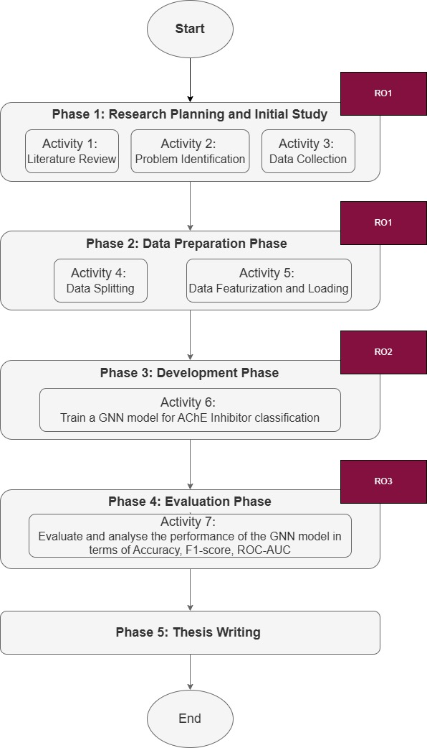
Research Framework

Slide 13
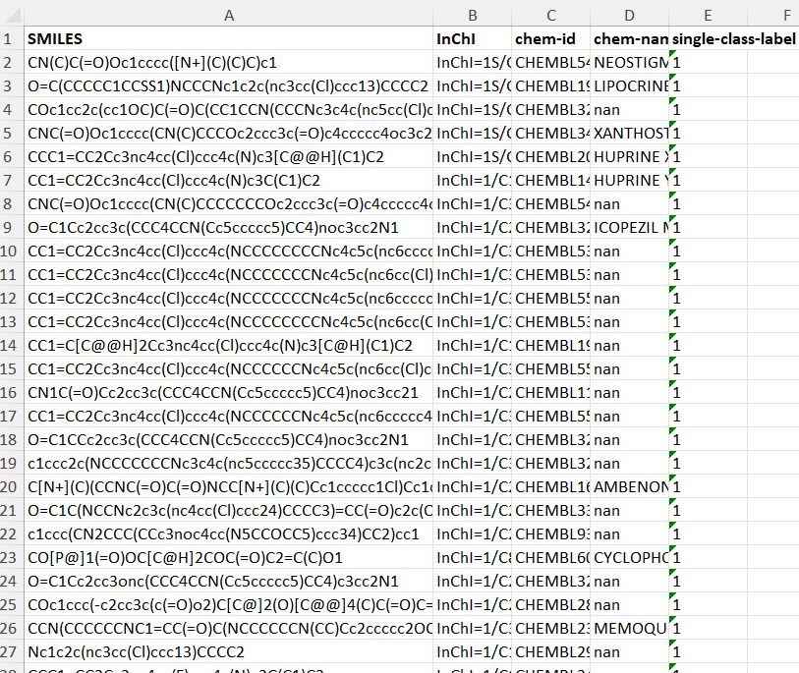
Dataset
(Vignaux et al. 2023)
Feature
Target

Slide 14
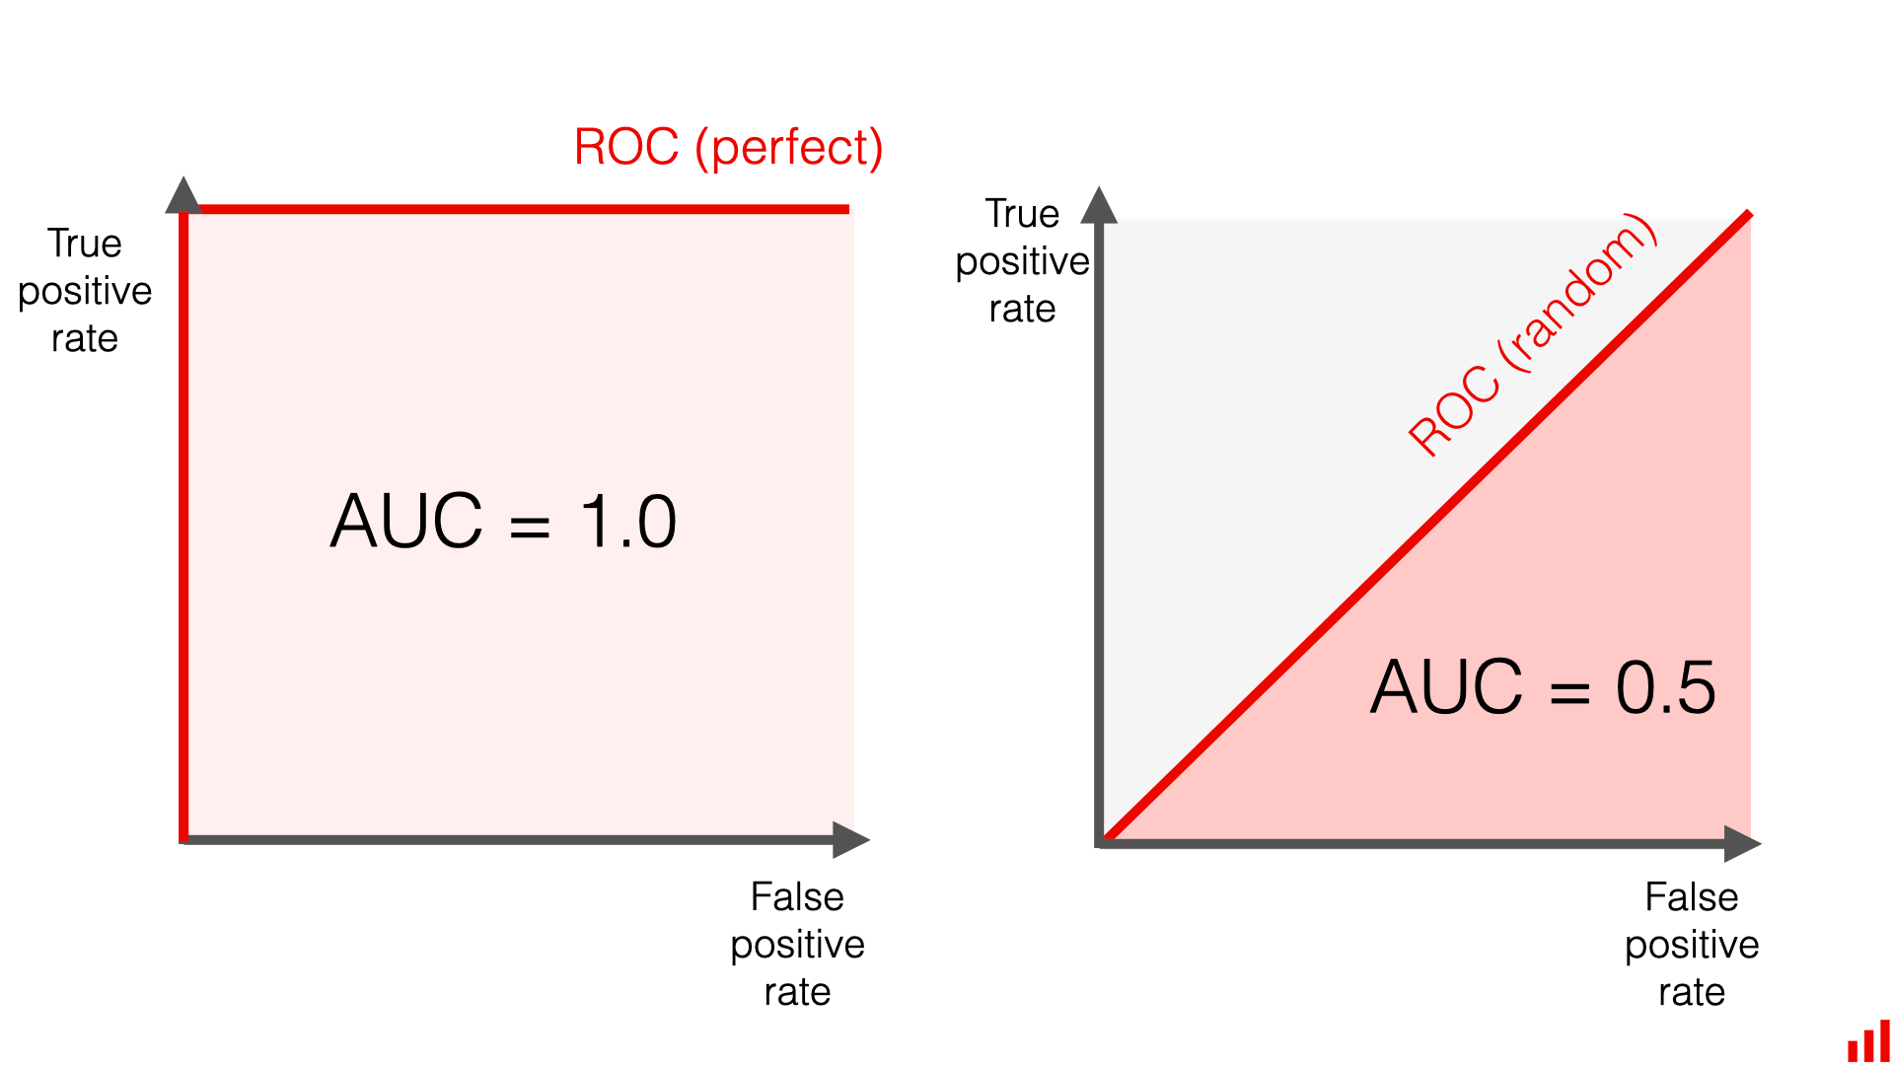
Performance Measurement
01
ACCURACY
$$ACC= \frac{TP+TN}{TP+TN+FN+FP}= \frac{TP+TN}{P+N}$$
02
F1-SCORE
$$precision= \frac{TP}{TP+FP}$$
$$F1= \frac{2 ×precision ×recall}{precision ×recall}$$
$$Recall= \frac{TP}{TP+FN}=\frac{TP}{P}$$
03
ROC-AUC
Notes:
Accuracy = Overall performance
F1-score = combining precision and recall into a single metric, suitable for imbalanced dataset
ROC-AUC = suitable for imbalanced dataset
Long answer
F1-score=balances the trade-off between precision and recall, making it a suitable metric when you need to consider both false positives and false negatives

Slide 15
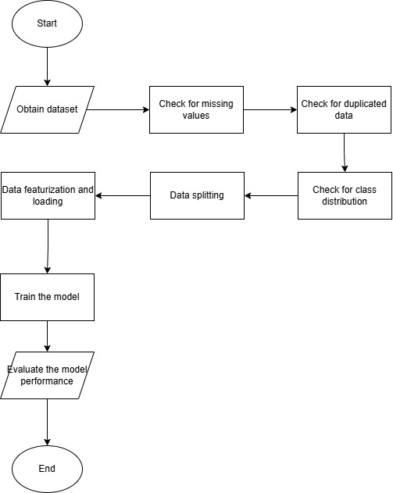
Proposed Solution
The dataset is obtained from Vignaux et al., which includes a curated list of human AChE inhibition data from ChEMBL 30.
To ensure the dataset is in ideal format for analysis and the training model specified in this study, some data preprocessing and transformation techniques are utilized.
Data splitting, featurization and loading are done as preparation to transform the dataset into vector of descriptors in format for graph convolutional model training.
This is followed by model training with the selected model architecture, DeepChem's GraphConvModel
The model is then evaluated in terms of Accuracy, F1-score, ROC-AUC.

Slide 16
Data Preparation and Processing
Checking Missing Value
Checking Duplicated Data
 | Number of Missing Values
SMILES | 0
single-class-label | 0
Duplicated SMILES | 0
Total Number of Rows | 4075
Unique Rows based on SMILES column | 4075
Notes:
2 ways to check for duplicated data: 1. use df.duplicated(). No duplicated rows detected.;
2. check total number of rows vs unique rows based on column SMILES

Slide 17
Data Preparation and Processing
Checking Class Label Distribution
Data Splitting (80 : 20 )
 | Class 0 | Class 1
Amount of Data | 2262 | 1813
 | Training Set | Testing Set
Amount of Data | 3261 | 816

Slide 18
Data Preparation and Processing
Data Featurization and Loading
The featurizer is defined using the ConvMolFeaturizer function in DeepChem. It is a featurizer specifically designed for molecular data such as the SMILES data in this case. It’s used to generate molecular graph representations suitable for processing of GNN models.
The DataLoader object is used to load CSV data, specifically the task (single-class-label), feature field ('SMILES', representing the molecular structure)
featurization function to be applied to the data.
This process is to create the train and test dataset that’s compatible with the model.

Slide 19
Data Featurization
CN(C)C(=O)Oc1cccc([N+](C)(C)C)c1

Slide 20
Data Featurization
Atom Feature
i.e. Atom 0, carbon atom:
[[0, 1, 0, 0, 0, 0, 0, 0, # Carbon atom
0, 0, 0, 0, # Formal charge
1, 0, # Chirality
0, 1, 0, # Hybridization (sp2)
0, # Not aromatic
0, 1, 0, 0, # 1 hydrogen
0, 0, 0, 1, # Implicit Valence
1, 0, 0, 0], # Degree (4 bonds)
[0, 1, 0, 0, 0, 0, 0, 0, # Carbon atom
0, 0, 0, 0, # Formal charge
1, 0, # Chirality
0, 1, 0, # Hybridization (sp2)
0, # Not aromatic
0, 1, 0, 0, # 1 hydrogen
0, 0, 0, 1, # Implicit Valence
1, 0, 0, 0], # Degree (4 bonds)

Slide 21
Data Featurization
Bond Features:
[[1, 0, 0, 0, # Single bond
0, # Not conjugated
0], # Not in ring
[0, 1, 0, 0, # Double bond
0, # Not conjugated
0], # Not in ring
...
[1, 0, 0, 0, # Single bond
0, # Not conjugated
1]] # In ring

Slide 22
Data Featurization
Adjacency List:
[[1, 2, 3], # Atom 0 connected to atoms 1, 2, 3
[0, 4, 5], # Atom 1 connected to atoms 0, 4, 5
[0, 6], # Atom 2 connected to atoms 0, 6
[0, 7], # Atom 3 connected to atoms 0, 7
[1], # Atom 4 connected to atom 1
[1], # Atom 5 connected to atom 1
[2, 8], # Atom 6 connected to atoms 2, 8
[3], # Atom 7 connected to atom 3
[6, 9, 10, 11], # Atom 8 connected to atoms 6, 9, 10, 11
[8], # Atom 9 connected to atom 8
[8], # Atom 10 connected to atom 8
[8]] # Atom 11 connected to atom 8

Slide 23
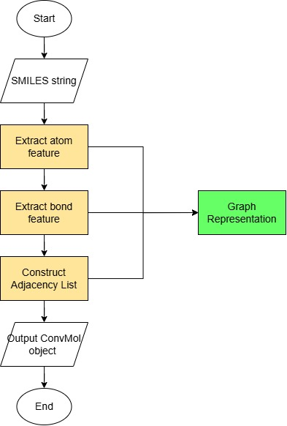
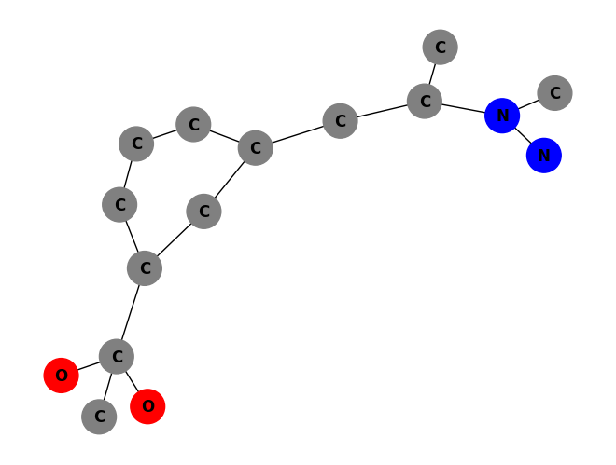
Data Featurization: Graph Representation
CN(C)C(=O)Oc1cccc([N+](C)(C)C)c1
Notes:
Explain a bit on the graph. What the color and the feature represents

Slide 24
Data Featurization and Loading
Output ConvMol Object per SMILES string:
Atom Feature Vector
Bond Feature Vector
Adjacency List
Objects are loaded and stored into variables: train_dataset, test_dataset

Slide 25
Model Training: Hyperparameter
GraphConvModel is fitted with train_dataset
Hyperparameter | Settings
ntasks | 1
graph_conv_layers | [64, 64]
dense_layer_size | 128
dropout | 0.0
mode | classification
number_atom_features | 75
n_classes | 2
batch_size | 100
batch_normalize | True
uncertainty | False

Slide 26
Model Summary
Layer | Output Shape | Number of Parameters
graph_conv | multiple | 102,144
graph_conv_1 | multiple | 87,360
batch_normalization | multiple | 256
batch_normalization_1 | multiple | 256
batch_normalization_2 | multiple | 512
graph_pool | multiple | 0
graph_pool_1 | multiple | 0
dense | multiple | 8,320
graph_gather | multiple | 0
trim_graph_output | multiple | 0
dense_1 | multiple | 514
reshape | multiple | 0
softmax | multiple | 0

Slide 27
Preliminary Result
Research | Classification Model | Result
 |  | Accuracy | F1-Score | AUC-ROC
Sutthibutpong et al., 2024 | Graph Convolutional Network | - | - | 0.98
Pan et al., 2024 | Graph Convolutional Network with 1D CNN | 0.84 | 0.85 | 0.93
Preliminary Result | Graph Convolutional Network | 0.79 | 0.79 | 0.87

Slide 28
Conclusion
RO1: To investigate featurization strategies for labeled graph object generation for GNN.
RO2: To develop a GNN model in predicting AChE inhibitors using SMILES-encoded molecular data.
RO3: To evaluate the ability of GNN to classify compounds as AChE inhibitors or non-inhibitors in terms of Accuracy, F1-score, ROC-AUC

Slide 29
Future Works
Hyperparameter Tuning: Further refinement of the GraphConv model by tuning its hyperparameters to enhance performance (Zhou et al., 2022).
Cross-Validation Techniques: Implementation of five-fold cross-validation (Sutthibutpong et al., 2024), nested five-fold cross-validation (Vignaux et al., 2023) and ten-fold cross-validation techniques (Nguyen et al., 2022) to improve model evaluation and robustness.
Graph Representation Techniques: Exploration of different graph representation techniques such as RDKit to better capture the structural information of molecules (Vik et al, 2024).
Transfer Learning Techniques: Application of transfer learning to leverage pre-trained models and enhance the performance of the GNN model on new datasets (Zhang et al., 2022).
Diverse GNN-Based Models: Evaluation of other GNN-based models such as Graph Attention Network (GAT), Graph Isomorphism Network (GIN), and Molecular Graph Convolutional Neural Network (MGCNN) to determine the most effective approach for drug-target interaction classification.
Notes:
Zhou, K., Huang, X., Song, Q., Chen, R. and Hu, X., 2022. Auto-gnn: Neural architecture search of graph neural networks. Frontiers in big Data, 5, p.1029307.
https://www.nature.com/articles/s41598-024-59620-4#Sec3
Vik, D., Pii, D., Mudaliar, C., Nørregaard-Madsen, M. and Kontijevskis, A., 2024. Performance and robustness of small molecule retention time prediction with molecular graph neural networks in industrial drug discovery campaigns. Scientific Reports, 14(1), p.8733.
Hyper: https://pubs.acs.org/doi/full/10.1021/acsomega.3c10459
Sutthibutpong, T., Posansee, K., Liangruksa, M., Termsaithong, T., Piyayotai, S., Phitsuwan, P., Saparpakorn, P., Hannongbua, S. and Laomettachit, T., 2024. Combining Deep Learning and Structural Modeling to Identify Potential Acetylcholinesterase Inhibitors from Hericium erinaceus. ACS omega, 9(14), pp.16311-16321.

Slide 30
THANK YOU
utmofficial
univteknologimalaysia
utm.my

