Slide 1
PROGRAMMING LANGUAGE DESIGN THINKING SECTION 02
AZRIANA BINTI ZAINAL ABIDIN (A19EC0027) CHUA CHEN WEI (A19EC0038) KHOR YONG XIN (A19EC0061) JAYANEYSANRAJ JAYARAJ (A19EC0038)

Slide 2
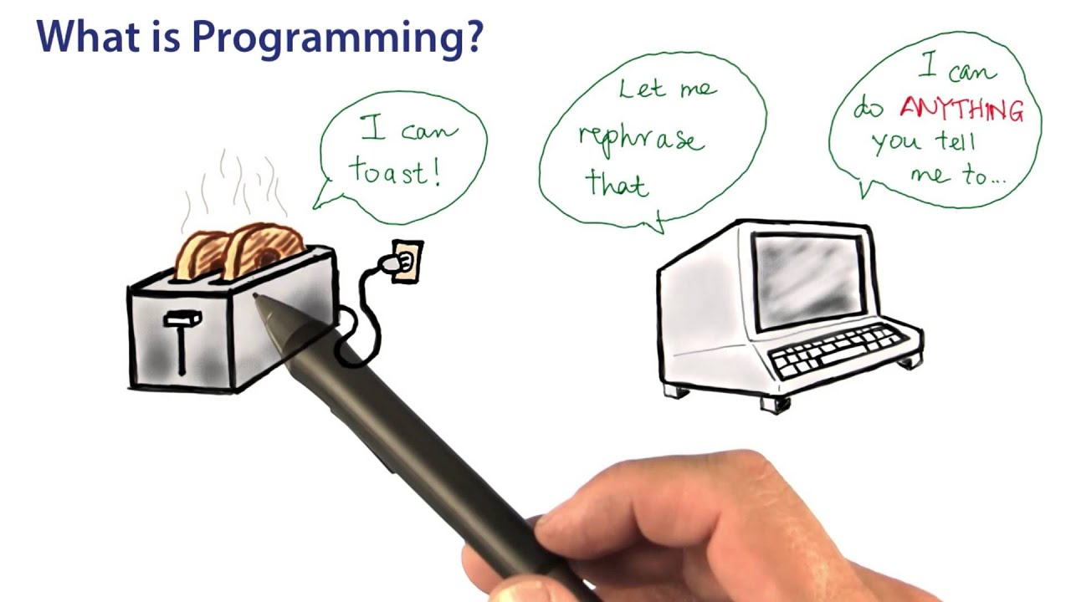
WHAT IS PROGRAMMING?
“Instruct the computer”: this basically means that you provide the computer a set of instructions that are written in a language that the computer can understand. The instructions could be of various types.
“Perform various tasks”: the tasks could be simple ones or complex ones which may involve a sequence of multiple instructions.
Hence, in summary, Programming is a way to tell computers to do a specific task.

Slide 3
SOFTWARE DEVELOPMENT
Programming is one of the step in software development
Six step procedure:
STEP 1:PROGRAM SPECIFICATION
STEP 2:PROGRAM DESIGN
STEP 4:PROGRAM TEST
STEP 5:PROGRAM DOCUMENTATION
STEP 3:PROGRAM CODE
STEP 6:PROGRAM MAINTENANCE

Slide 4
STEP 1 :PROGRAM SPECIFICATION
Also known as program definition or program analysis.
analyze problem, consists of reviewing program specifications; meeting with the analyst and users; and identifying program components.
Five steps to complete in the process
OBJECTIVES
OUTPUT
INPUT
PROCESSING
DOCUMENT
DESIGN

Slide 5
PROGRAM OBJECTIVES
Program objectives are the problems you are trying to solve.
SPECIFY OUTPUT
It is always best to specify outputs before inputs.
INPUT DATA
The source and type of data must be known.
A clear statement should be written about the problem that needs a solution.
This task defines the problem.
PROCESSING REQUIREMENTS
PROGRAM SPECIFICATIONS DOCUMENT
Sketch or write how output will look when it is done.
The input must supply the program with data to produce the correct output.
Processing that must take place to convert input data into output information must correspond with the problem definition determined in task 1.
Document the program objectives, desired outputs, needed inputs, and required processing.

Slide 6
EXAMPLE OF DESIRED OUTPUT
EXAMPLE OF INPUT DATA

Slide 7
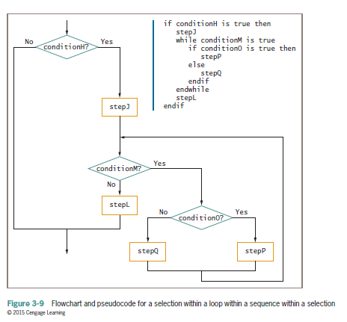
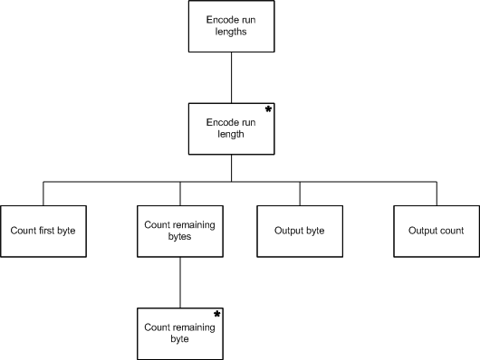
STEP 2 :PROGRAMM DESIGN
Plan a solution using structured programming techniques.
Top-down design
Pseudocode
Flowcharts
Logic structures

Slide 8
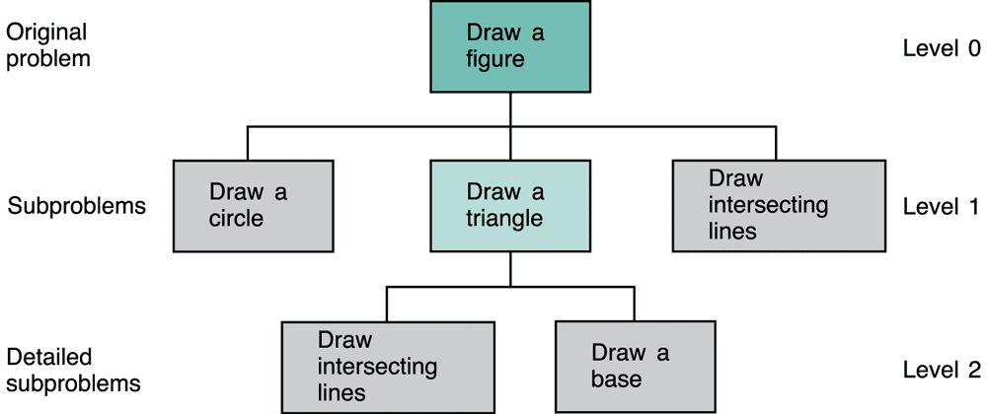
TOP DOWN DESIGN
hierarchical structure on the design of the program
It starts out by defining the solution at the highest level of functionality and breaking it down further and further into small routines
that can be easily documented and coded.

Slide 9
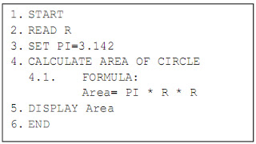
PSEUDOCODE
Another tool to describe the way to arrive at a solution.
Provide an outline of the logic and summarize the program you will write
They are different from algorithm by the fact that they are expressed in program language like constructs.
Pseudocode is sometimes used as a detailed step in the process of developing a program.

Slide 10
FLOWCHARTS
Graphically depict the sequence of steps required to solve a programming problem.
A flowchart is a formalized graphic representation of a logic sequence.
Four basic symbols in program flowchart :
-Oval: Represents any process having start or end activity. -Rectangles: Represents a process activity . -Diamonds: Used when there is a decision to be made -Arrow lines: Used to show the flow of control from one step to another. -Parallelograms: Used to represent input/output

Slide 11
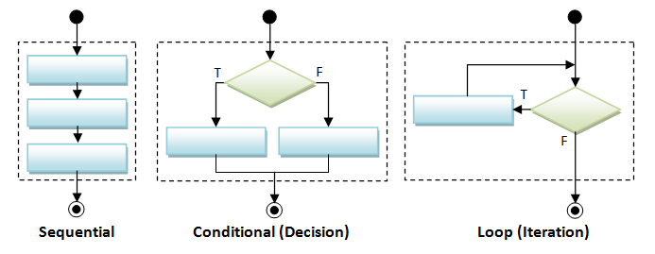
LOGIC STRUCTURE
A structure is a basic unit of programming logic;
Concatenation structure (sequence)
Selection structure
Repetition structure

Slide 12
STEP 3:PROGRAM CODE Characteristics of a good program
Work reliably
Correct output
catches common input errors
well-documented , understanable
use appropriate computer language

Slide 13
Markup Language
language that annotates text for the computer to understand that text
HTML
XML
XHTML
SVG

Slide 14
Hypertext Markup Language
use in web browser
describe the orgasation of the web
Extensible Markup Language
use to store and describe data
allow you to use your own words
Extensible Hypertext Markup Language
HTML + XML
to make HTML more flexible and extenxible
Scalable Vector Graphics
describe two dimensional graphic
display image

Slide 15
Programming languages
Language | Description
C | often associated with the UNIX operating system
C++ | extends C to use objects or program modules that can be reused and interchanged between programs
C# | extends C++ to include XML functionality and support for a new Microsoft initiative called JNET
Java | Primarily used for internet applications, runs variety of operating system (C++)
JavaScript | embedded into Web pages to provide dynamic and interactive content
Visual basic | uses a very raphical interface, making it easy to learn and to rapidly develop Windows and other applications

Slide 16
HTML
C++

Slide 17
Step 4: Program Test
Desk check
Manual test
Translate
Sample data
Beta test
Document

Slide 18
Debug
can caught by compiler
correct the errors to produce output
exp: semicolon, curly bracket
cannot caught by compiler
result is not as expected
exp: assign value to other variables, adding instead of divide
Syntax Errors
Logic Errors

Slide 19
Step 5: Program Documentation
written text to describe the program
exp : user manual , list of known bugs,design document
Guidelines to produce a document
from the point of view of the reader
no repetition
always be updated

Slide 20
Examples of Documents
User Document
Describes instructions and procedures for users to use the different features of the software.
Design Document
Overview of the software and describes design elements in detail
Testing Document
Test plan, test cases, validation plan, verification plan, test results,
Data flow diagrams, entity relationship diagrams

Slide 21
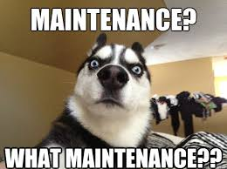
Step 6 : Program Maintenance
Ensure program is error free, effective and efficient
Program maintenance is the process of modifying a software or program after delivery to achieve any of these outcomes,
Correct errors
Improve performance
Add functionalities
Remove obsolete portions

Slide 22
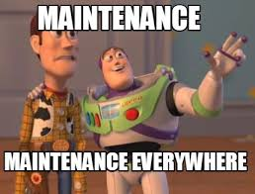
Maintenance
Corrective Maintenance
Fix errors that show up unexpectedly
Adaptive Maintenance
To accommodate changing needs,system maintenance is done from time to time
Preventive Maintenance
If possible errors can be identified and there are maintained to avoid them
Perfective Maintenance
Changes done in the existing software to incorporate new requirements from the client
Up-to-date with the latest technology.

Slide 23
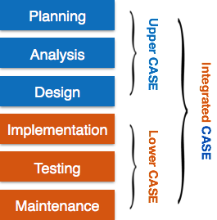
CASE Tools
CASE stands for Computer Aided Software Engineering. It means development and maintainance of software projects with help of various automated software tools
CASE tools can be categorized into 3 following levels:
· Upper — support analysis and design phases
· Lower — support coding phase
· Integrated — also known as I-CASE support analysis, design and coding phases

Slide 24
Benefits of CASE Tools
Quick development phase
Easier recognition of bugs during development
To increase productivity
Savings in maintenance resources required.
Reduction of generation of errors.
To help produce enhanced quality software at lower cost

Slide 25
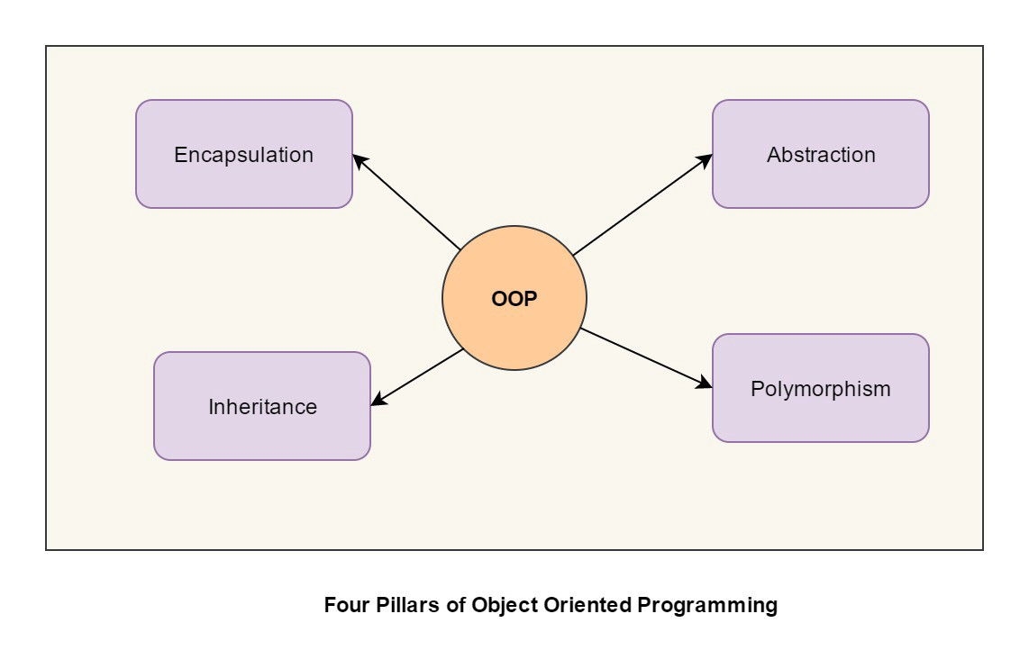
OOP Software Development
Object-Oriented Programming (OOP)
Focuses less on procedures , more on relationship between objects
Objects contain both the data and the processing operations needed to perform a task

Slide 26
Generations of Programming Languages
Occurs in generations or levels
Five generations of Programming Language
1st Generation Language (1GL)
2nd Generation Language (2GL)
3rd Generation Language (3GL)
4th Generation Language (4GL)
5th Generation Language (5GL)
Two levels of Programming Language
Low level is closer to machine language
Example : ADD,MOV
High level is closer to human-like language
Example : C++ , JAVA

Slide 27
Generations of Programming Language
1st Generation Language (1GL)
Low level language
Machine language
2nd Generation Language (2GL)
Low level language
Assembly language
Used in kernels and hardware drives
Easy to develop ,understand and modify.
Less prone to errors
3rd Generation Language (3GL)
High level language
Example : C++ , Java, JavaScript

Slide 28
Generations of Programming Language
4th Generation Language (4GL)
Consists of statements similar to statements in human language
Used in database programming and scripts
Require less time, cost and effort to develop different types of software applications.
Example : Python, Ruby, SQL
5th Generation Language (5GL)
Artificial Intelligence Language
Contain visual tools to help develop a program
Example : Mercury , Prolog

Slide 29
Careers in Information Technology
Computer Programmers
Software Engineer
Data Scientist
Data Analyst
Data Engineer
Mobile Application Developer
Cybersecurity
Cloud Architect
Database Administrator
IT Consultant

