Slide 1
DESIGN THINKING CHAPTER 5: SYSTEM UNIT
GROUP 2 MEMBERS:
ALUGE OSEI-AMAKA ELINOR
MUHAMMAD KHAIRUL AMIRIN BIN KHAIRIL
CHEONG CHIEN LI
SYAFA ILYAS AL MUZANI

Slide 2
LET’S ASSUME!!!
Assume that the system unit does not exist yet.
The goal of this project is to create a system unit via the design thinking process.
Assume that the computer has all the parts it needs to function, but they are each kept separately instead of all placed in one casing.

Slide 3
WHAT IS DESIGN THINKING?
A process of critical thinking.
Used to develop solutions to problems through collaboration, innovation and design.
Helps improve student’s skills such as teamwork, problem solving, communication, analysis, creativity and the ability to influence others.

Slide 4
5 PHASES OF DESIGN THINKING
1) EMPATHIZE
2) DEFINE
3) IDEATE
4) PROTOTYPE
5) TEST

Slide 5
Phase 1: Empathize
Interview users to understand about the problems that they are facing with the current computer.
Possible questions:
Are you currently facing any problems related to the computer in terms of its boot up (power on) process?
Are you currently facing any problems related to the computer in terms of its portability?
Do you find any problems in the current computer in terms of the safety of each of its individual parts (peripheral devices)?

Slide 6
Phase 1: Empathize
List of possible answers:
Yes. I am facing a problem with booting up the computer. Because since all the parts are not put together as one device, I have to power up each of the computer parts one-by-one whenever I want to boot up my computer and it takes me a very long time to do so. Thus, it is a big problem for me.
Yes. The portability of the current computer is a big problem to me because the computer parts are not all put together into one device. So, whenever I want to move my computer, I have to move each of the separate computer parts one by one to another location and it is very inconvenient to me.
Yes. Since the computer parts are separated, they are in great risk of being damaged easily because they are too exposed to the environment. Hence, it is a big problem to me because I have to constantly worry about my computer parts being damaged.

Slide 7
Phase 1: Empathize
Three students from UTM were interviewed.
The possible questions were combined into one general question:
The current computer has all its parts separated, do you find this to be a problem?

Slide 8
Clip 1: Empathize
Please enjoy the clip!

Slide 9
Phase 1: Empathize
Problems stated by interviewees were as expected.
That’s all for empathize phase, next phase is define.

Slide 10
Phase 2: Define
Defining the problems as stated by the interviewees (users).
Listing out the problems.
Discuss and analyse the interview clips to extract information.
Define some solutions to those problems.
Team-working process
List out clearly the problems and solutions.

Slide 11
Phase 2: Define

Slide 12
Clip 2: Define
Enjoy the clip for define phase!

Slide 13
Phase 2: Define
The problems and solutions have been defined clearly.
Onto the next phase; Ideate!

Slide 14
Phase 3: Ideate
Brainstorming to get some possible ways to integrate all the solutions into a single solution.
Pick a most efficient solution to solve all problems.
For our group: CREATE A SYSTEM UNIT!
Challenges faced: How to best place all the components inside a single casing?

Slide 15
Phase 3: Ideate

Slide 16
Clip 3: Ideate
Enjoy the clip!

Slide 17
Phase 3: Ideate
That’s all for this phase.
Onto the next phase; Prototype!

Slide 18
Phase 4: Prototype
Time to build our idea!
Make a prototype of the system unit according to our plan.
Materials: Cardboard.
Tools: Scissors, cutter knife, tape, glue, plastic bottles.
Make the idea come to life!

Slide 19
Clip 4: Prototype
Enjoy the clip!

Slide 20
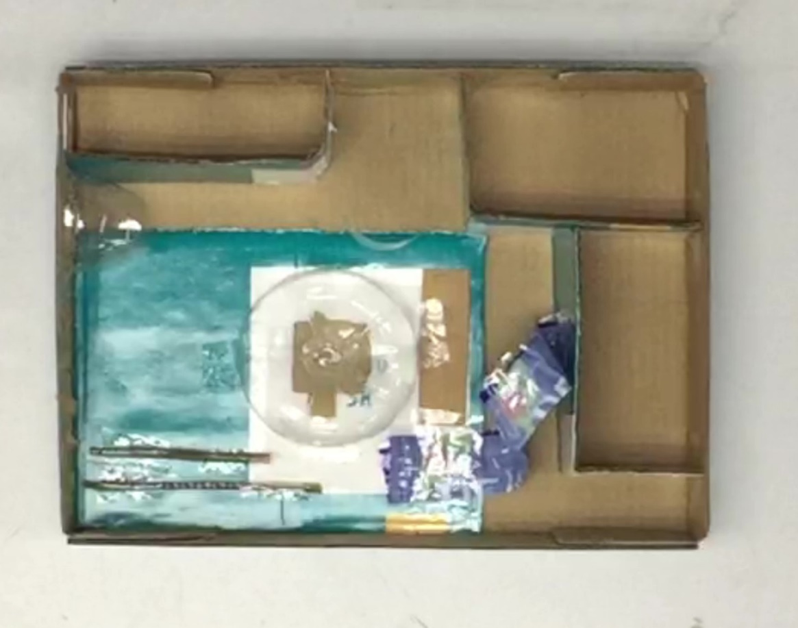
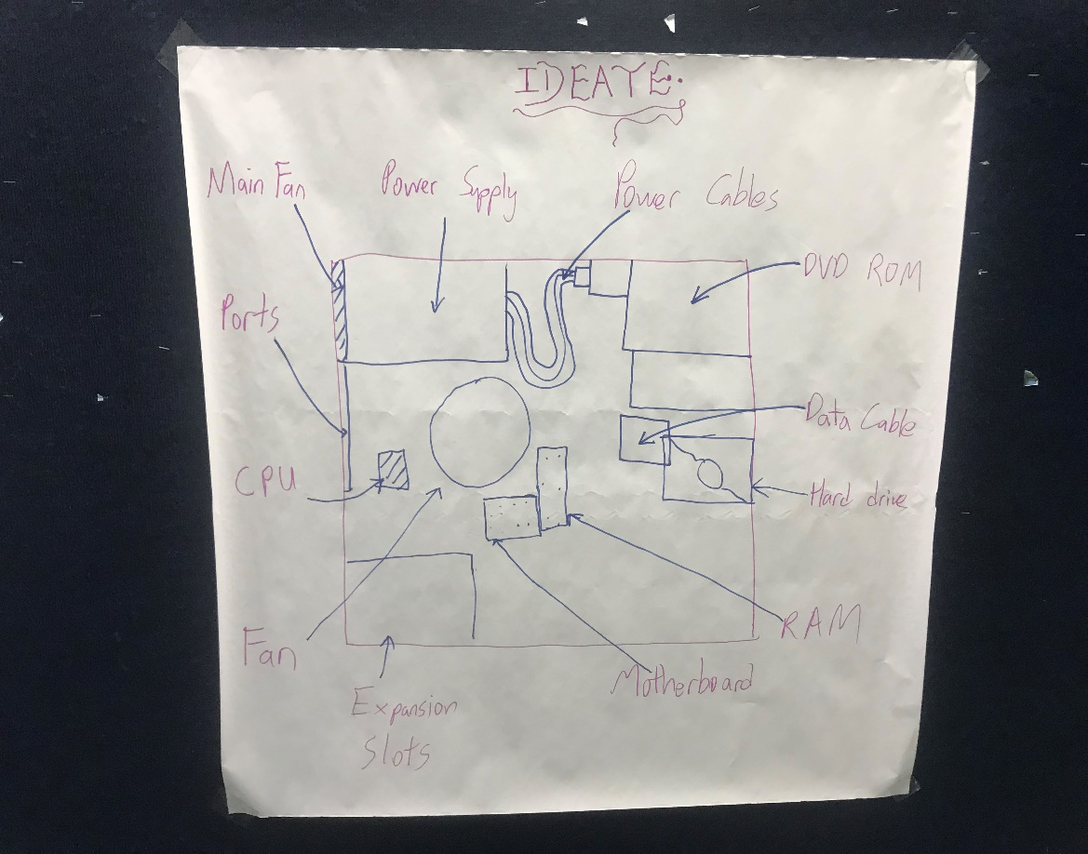
Phase 4: Prototype
Final Product:
Plan:

Slide 21
Phase 4: Prototype
Pretty close to the plan! XD

Slide 22
Phase 4: Prototype
That’s all for prototype phase.
Onto the last phase; Test phase.

Slide 23
Phase 5: Test
Allow the users to test the prototype.
Does it solve their problems?
If yes, mission accomplished!
Else, back to ideate and prototype!
Luckily for us, it solves all the problems for the users.

Slide 24
Clip 5: Test
Enjoy the clip!

Slide 25
Phase 5: Test
As you can see, our system unit works like magic!
Mission is a success, users are satisfied.
This is the end of our design thinking process!

Slide 26
Conclusion
Design Thinking (5 phases):
Empathize
Interview users.
Define
Problems & Solutions?
Ideate
Combine Solutions into one.
Prototype
Build the idea!
Test
Users satisfied?

Slide 27
Conclusion
Please enjoy the rest of the clip! (Bloopers).
Full video at: https://youtu.be/7VdWqqbq1h4

