Slide 1
CHAPTER 6
SCSI 1013: Discrete Structure
FINITE AUTOMATA
2018/2019 – Sem. 1

Slide 2
Deterministic Finite Automata (DFA)

Slide 3
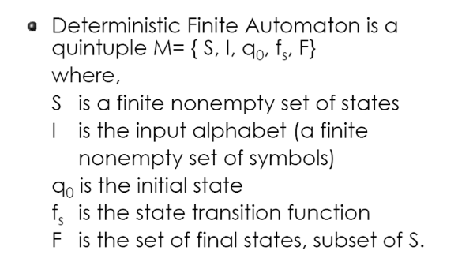
Deterministic Finite Automata (DFA)
Note:
Tuple: is an ordered list of elements.
Quintuple: five times as much in size; e.g., M = {S, I, O, q₀ , f_{s}} ;
sextuple: six time as much in size, e.g., M = {S, I, O, q₀ , f_{s} , f₀ }.

Slide 4
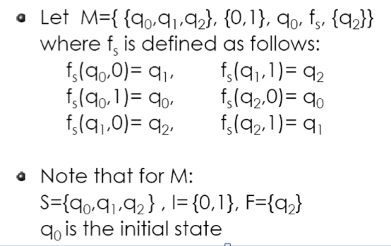
Example 1

Slide 5
Example 1 (cont.)

Slide 6
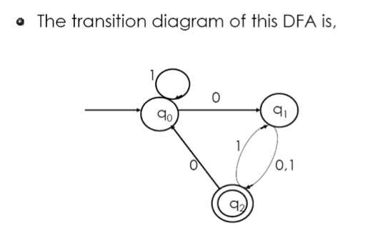
Example 1 (cont.)
The transition diagram of this DFA is,
Each state represented by a small circle labeled with the state
Initial state with incoming unlabeled arrow not originating from any vertex
Final state with a double circle

Slide 7
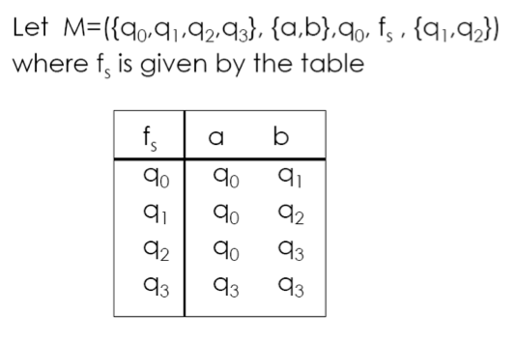
Example 2

Slide 8
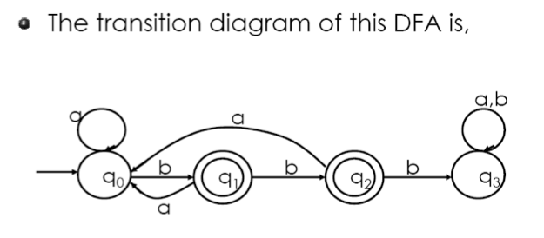
Example 2 (cont.)

Slide 9
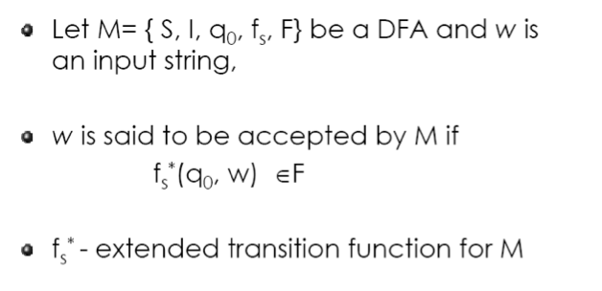
DFA – with extended transition function for M

Slide 10
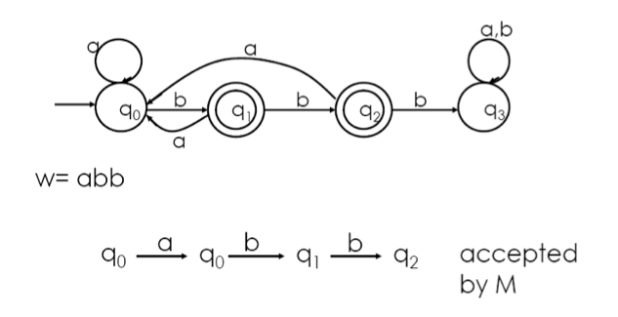
Example 3

Slide 11
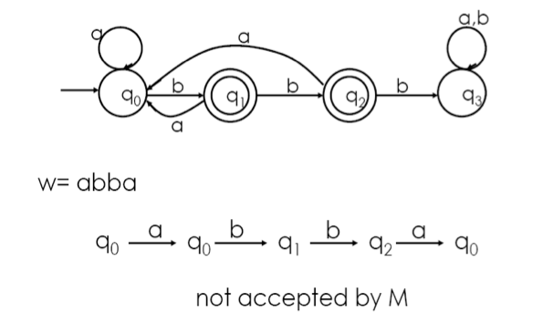
Example 4

Slide 12
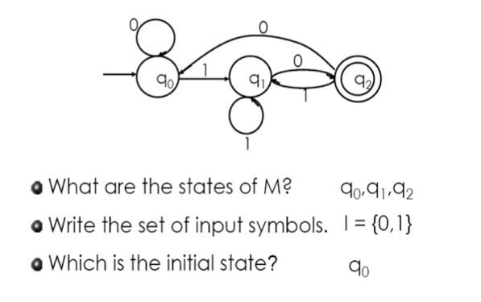
Example 5

Slide 13
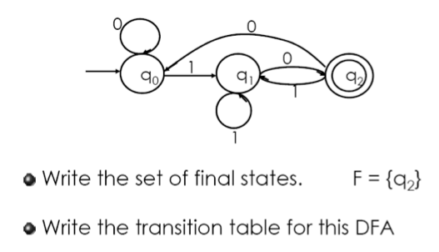
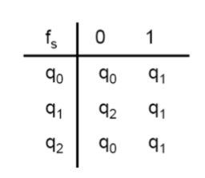
Example 5 (cont.)

Slide 14
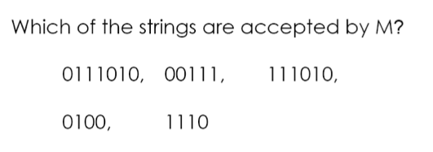
Example 5 (cont.)

Slide 15
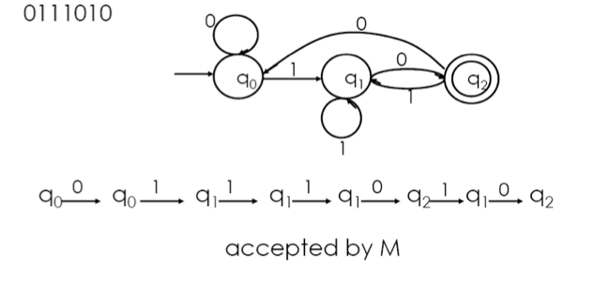
Example 5 - Solution

Slide 16
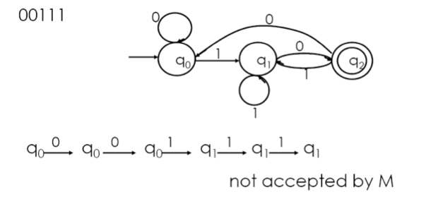
Example 5 – Solution (cont.)

Slide 17
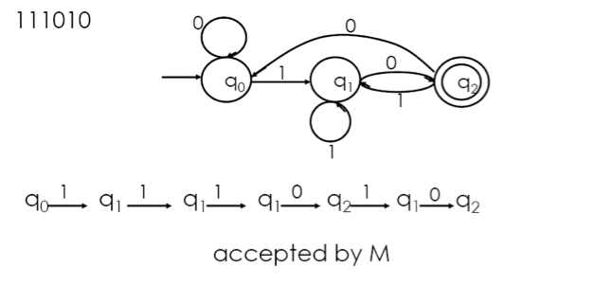
Example 5 – Solution (cont.)

Slide 18
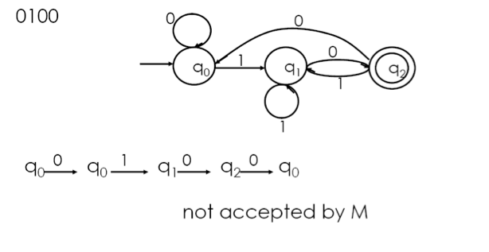
Example 5 – Solution (cont.)

Slide 19
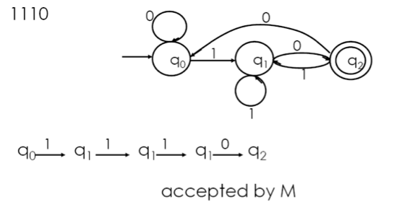
Example 5 – Solution (cont.)

Slide 20
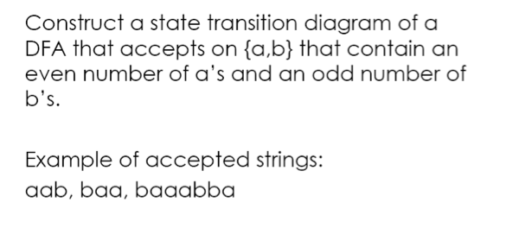
Example 6

Slide 21
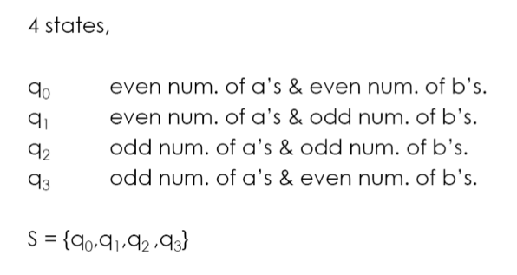
Example 6 - Solution

Slide 22
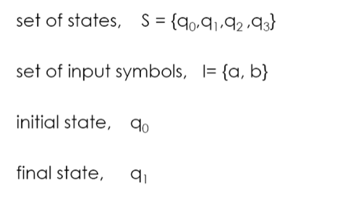
Example 6 – Solution (cont.)

Slide 23
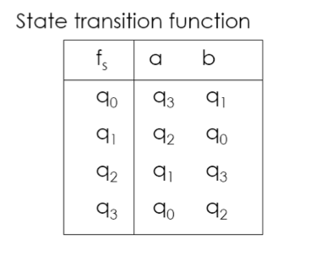
Example 6 – Solution (cont.)

Slide 24
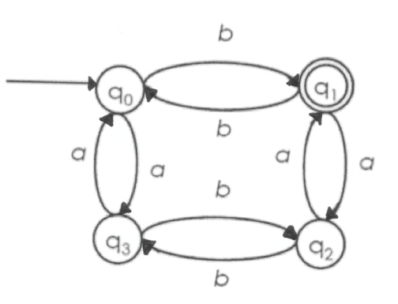
Example 6 – Solution (cont.)
State transition diagram

Slide 25
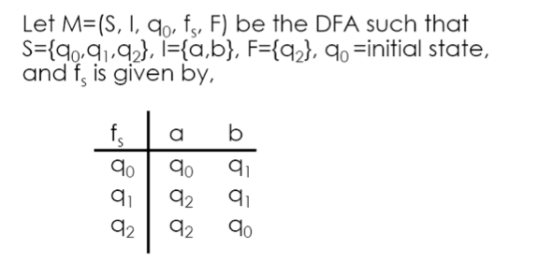
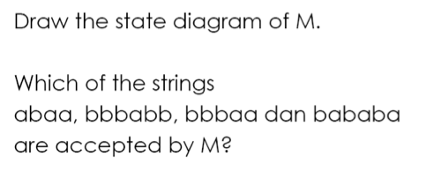
Exercise 1

Slide 26
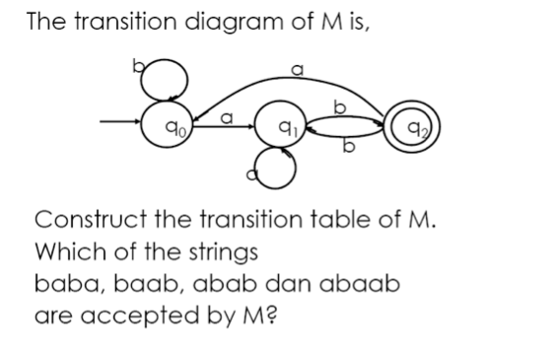
Exercise 2

Slide 27
Exercise 3
Solution:
1
q₀
1
q₁
0
q₂
0
q₃
q₄
1
0
0,1
0,1

Slide 30
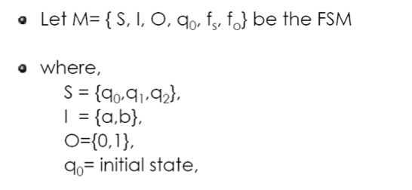
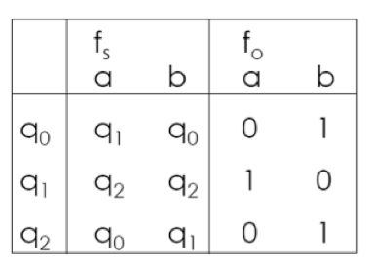
Example 1
The f_{s} and f₀ are =>

Slide 31
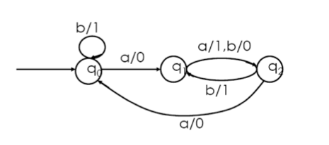
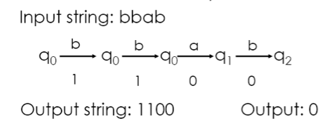
Example 1 (cont.)
The transition diagram:

Slide 32
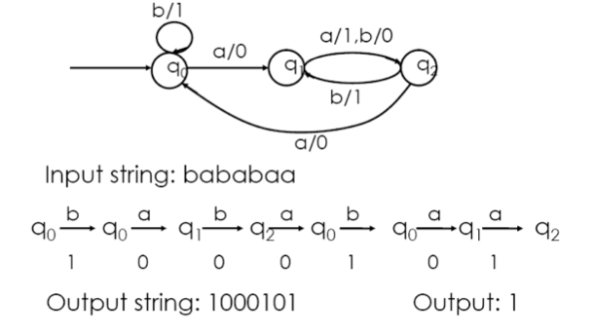
Example 1 (cont.)

Slide 33
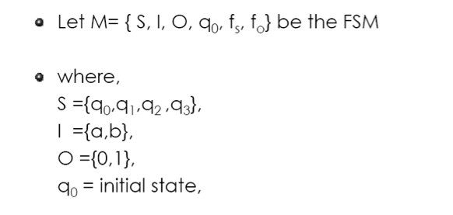
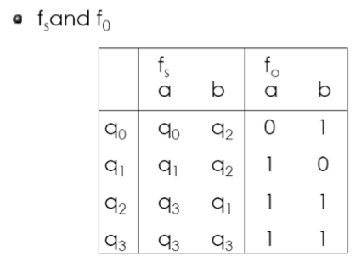
Example 2

Slide 34
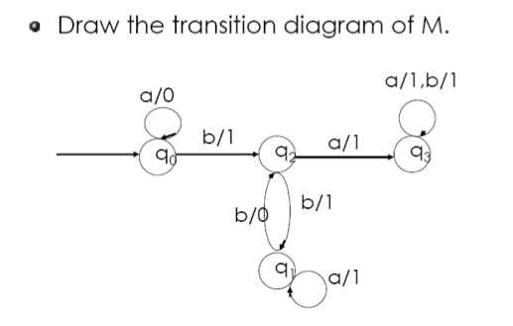
Example 2 (cont.)

Slide 35
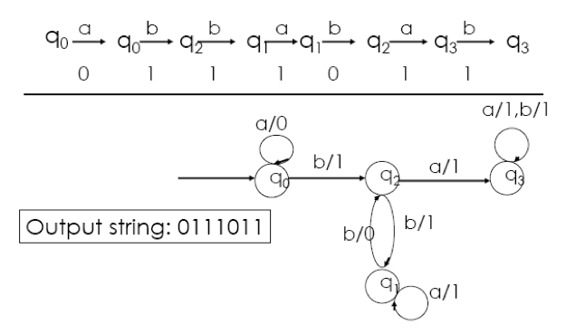
Example 2 (cont.)
Output : 1

Slide 36
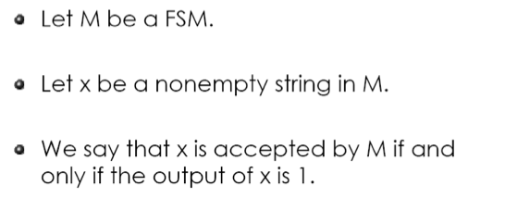
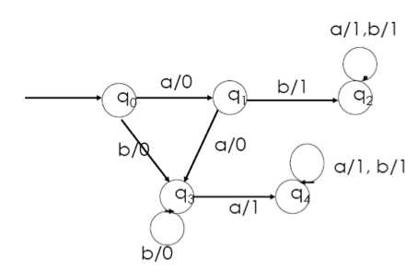
Example 3
State transition diagram

Slide 37
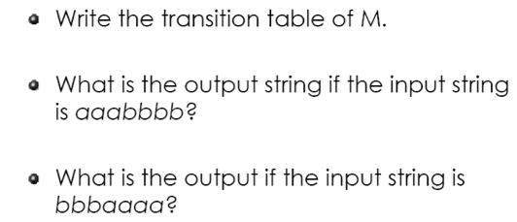
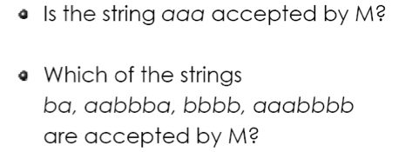
Example 3 (cont.)
Based on the given information, answer the following:

Slide 38
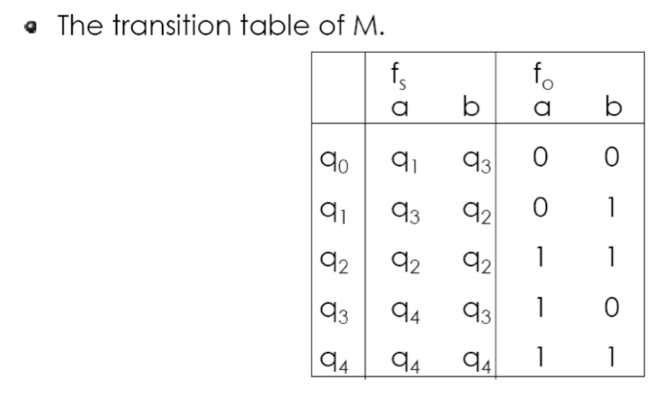
Example 3 - Solution

Slide 39
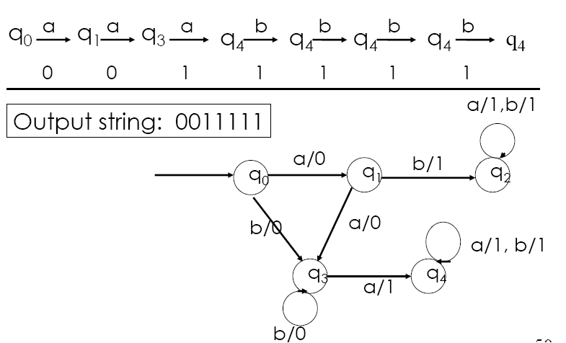
Solution (cont.)
What is the output string if the input string is aaabbbb?

Slide 40
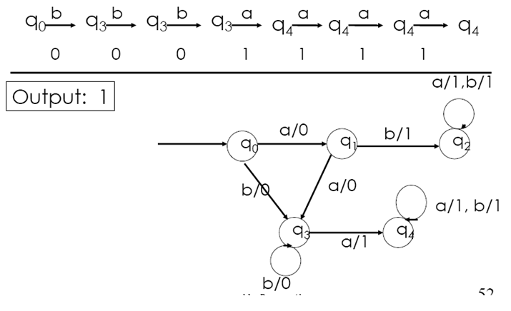
Solution (cont.)
What is the output string if the input string is bbbaaaa?

Slide 41
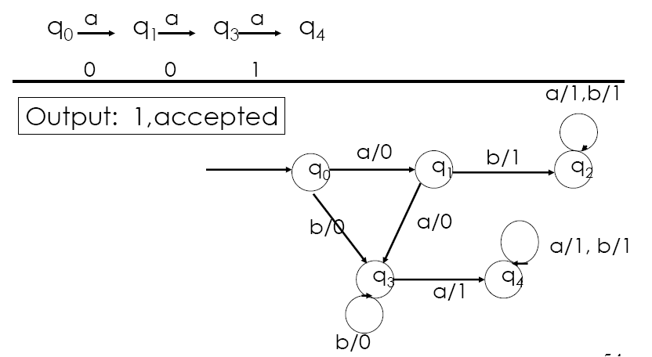
Solution (cont.)
Is the string aaa accepted by M?

Slide 42
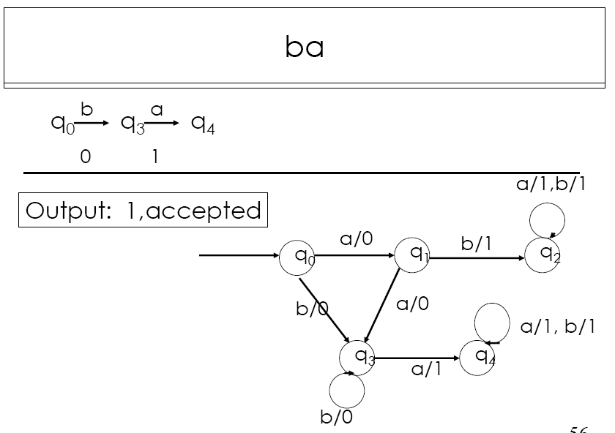
Solution (cont.)
Which of the strings ba, aabbba, bbbb, aaabbbb are accepted by M?

Slide 43
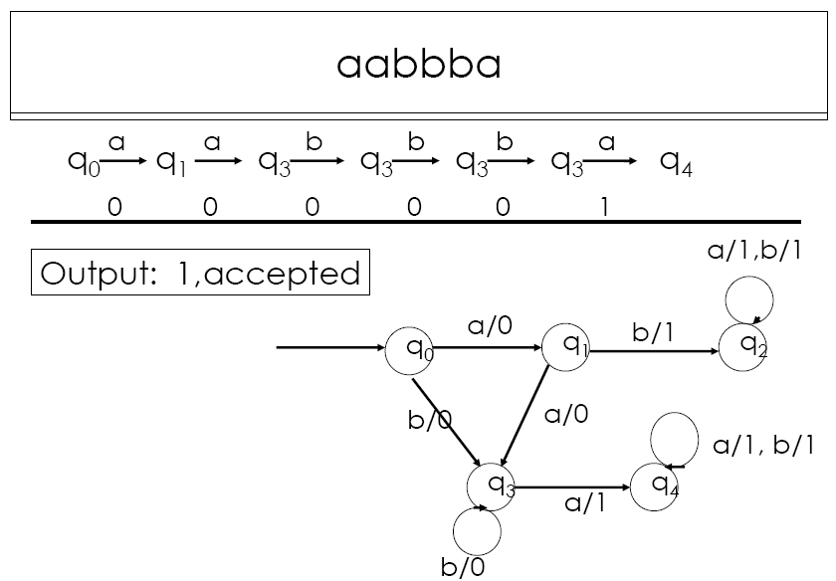

Slide 44
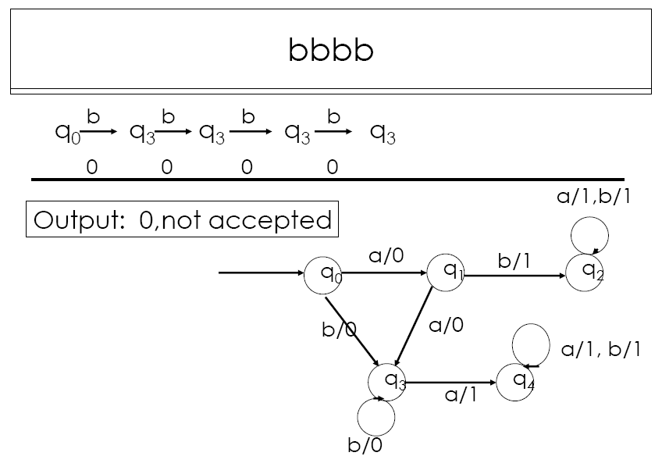

Slide 45
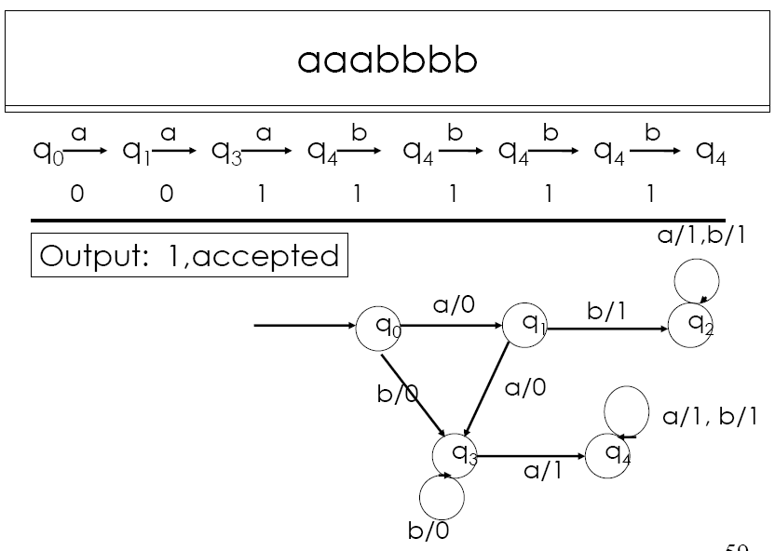

Slide 46
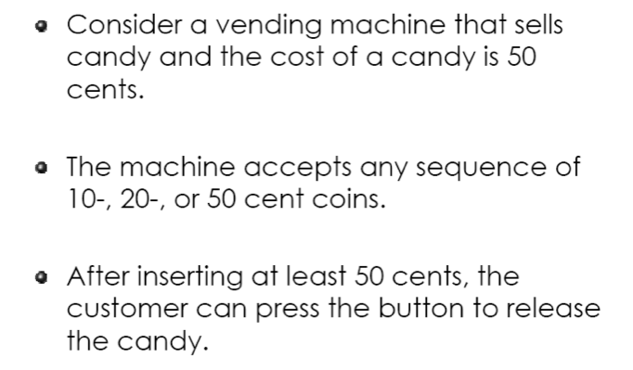
Example 4

Slide 47
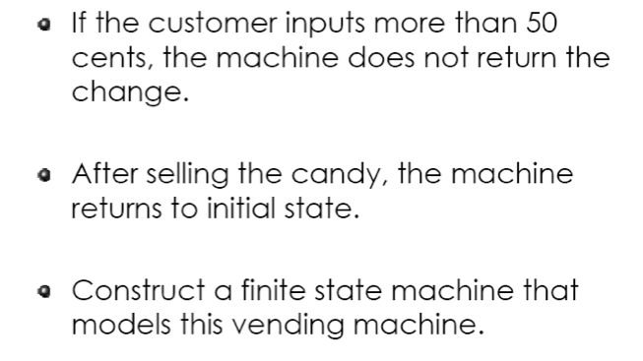

Slide 48
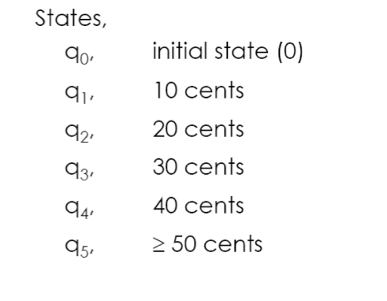
Example 4 - Solution
1. List the states, S:

Slide 49
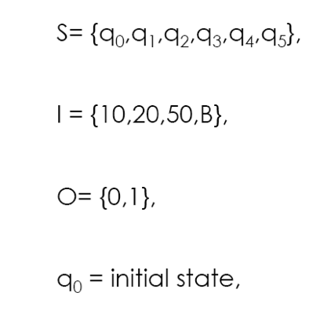
2. List the elements of M:

Slide 50
3. List the f_{s} and f₀:

Slide 51
4. Draw the transition diagram of M:

Slide 52
Exercise #1

Slide 54
Exercise #2

Slide 55
Exercise #3

Slide 56
Exercise #4

