Slide 1
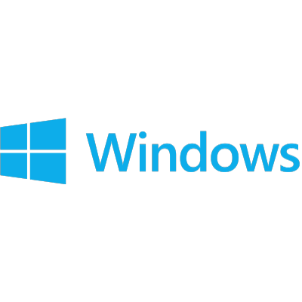
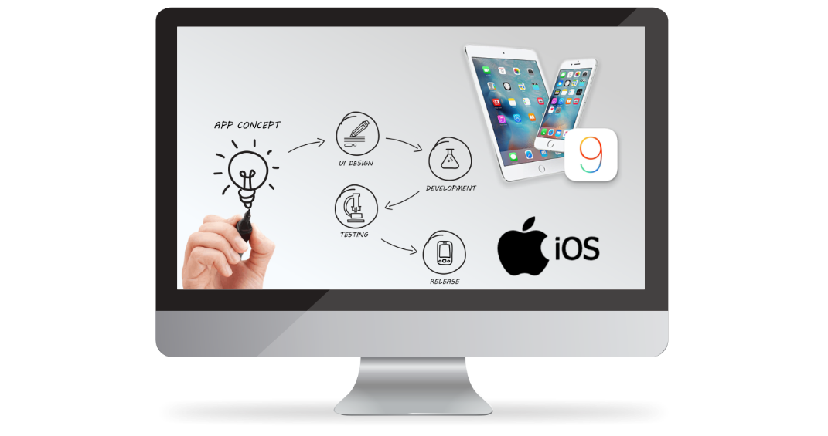
Topic: System Software

Slide 2
Our Group members:
Ali Hilmi bin Ismail
Almuhannad Lutfi Abdullah Darwesh
3. Amit Hasan Sadhin
Lecturer : Dr. Aryati binti Bakri
Group 01

Slide 3
Content
Introduction to Software
01
Types of Software
System software
02
Classification of system software & its working procedure
Operating System
03
Types of operating system, available operating system, evaluations of operating system
Virtualization
04
Its works, Types and use.

Slide 4
Introduction

Slide 5
Software means computer instructions or data. Anything that can be stored electronically is software, in contrast to storage devices and display devices which are called hardware.

Slide 6
Categories of Computer Software
Software is often divided into two categories
05
System
Software
Application
Software

Slide 7
What is System Software

Slide 8
Systems software
Are designed to control and coordinate
the procedures and functions of computer hardware. They actually enable
functional interaction between hardware,
software and the user.

Slide 9
System Software
Systems software can be categorized under the following:
04
03
02
01
Operating system
Harnesses communication between
hardware, system and other application.
Device driver
Enables device communication with the OS and other programs
Translator
Translates high-level languages to low-level machine codes.
Utility
Ensures optimum functionality of devices and applications.

Slide 10
Operating System
Operating system becomes an interface between user and machine
Functions
 Manages computer resources
 Coordinate memory, processing, storage, printers and monitors
 Monitor system performance
Provides user interface
 Graphical user interface (GUI)
 Schedule tasks
 Provide security
 Start-up the computer
.
Runs applications
Multitasking
Foreground and background applications

Slide 11
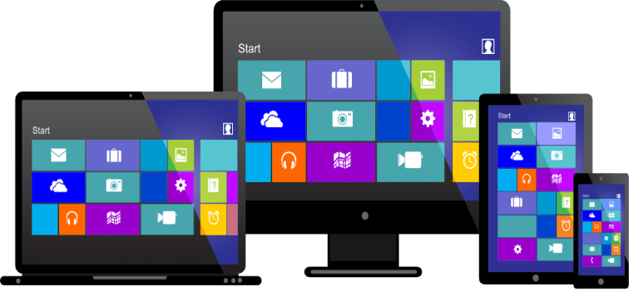
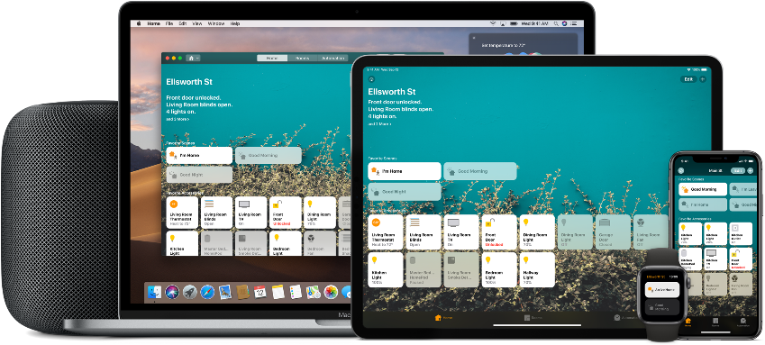
Features of an Operating System
The common features of every operating system
Memory Management
File Management
Device Management(I/O devices)
Protection and Security
Network Management
User interface/Command line

Slide 12
Categories of Operating Systems
Three basic categories
Embedded operating
systems – RTOS (real-time operating systems)
Stand-alone operating systems
Operating System
(OS)
Network operating systems (linked computers)

Slide 13
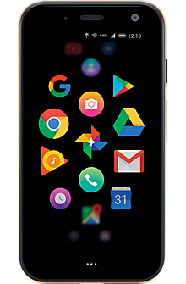
Embedded operating
systems – RTOS (Real-time operating systems)
l
A Real Time Operating System, commonly known as an RTOS, is a software component that
rapidly switches between tasks, giving the
impression that multiple programs are being
executed at the same time on a single processing core.
Examples:
Smartphones
Smart watches
Video game systems

Slide 14
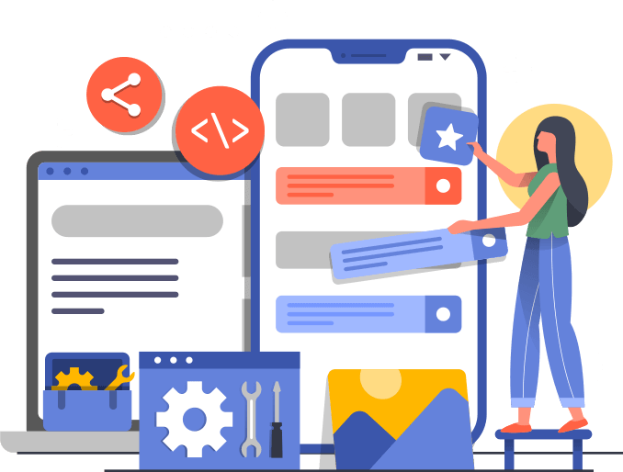
Mobile Operating Systems
A mobile operating system is the software platform on top of which other programs can run on mobile devices. The operating system is responsible for determining the functions and features available on your device, such as
Thumb wheel
keyboards
synchronization with applications
Text massages
Emails

Slide 15
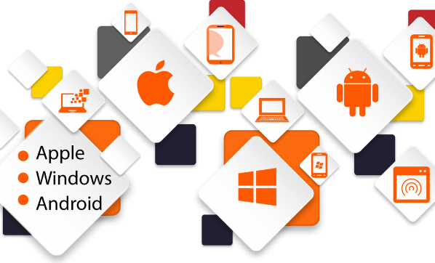
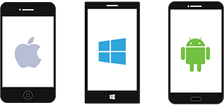
Some of the well known

Slide 16
Stand-alone operating systems
l
A standalone operating system is an operating
system that works on devices such as notebook,
desktop computer or a laptop
Examples:
Windows 95
Mac OS
Windows 2000 professional

Slide 17
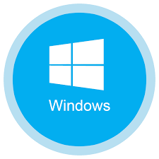
Network operating systems (linked computers)
l
Network Operating System is shortly called NOS. It is a software which allows you to communicate with multiple operating systems. Through this
operating system, you can share files and devices
with connected computers.
Examples:
Windows 2003,8,10
Linux
Unix
Mac OS X

Slide 18
Maybe you guys confused between
Stand-alone & NOS….
No worries, We will solve it.

Slide 19
Difference between Stand-Alone and Network Operatig
Systems
Basis of Distinction | Stand-Alone Operating Systems | Network Operating Systems
Definition | A complete operating program that works correctly on a computer or laptop for that specified path. | A feature of operating programs that works on several computers that maintain their origination on the server and hence, controls various users at the same time.
Examples | DOS, Windows 3.x, Windows 95, Windows NT Workstation, Windows 98, Windows 2000 Professional, Windows Millennium Edition, Windows XP Home Edition, Windows XP Professional Edition, Mac OS, OS/2 Warp Client. | Mac OS Server, Windows Small Business Server 2008, Linux FreeBSD and Solaris.
Services | Provides its services and deals with just one computer at a time even if it has a connection with other computers on the server. | Deals with all the computers on the network even if installed in just one device.

Slide 20
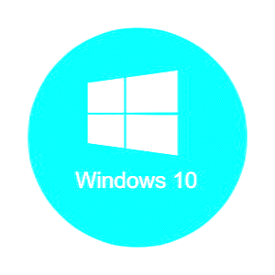
Windows Operating System
Support for all hardware
Ease of use
Software support
Plug and play feature
Desktop and touch screen
Security
Widely used
Windows

Slide 21
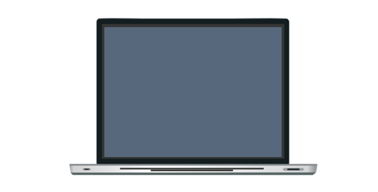
Windows - Most Used OS
Comparison of Windows 7 vs Windows 8 vs Windows 10
Factors | Windows 7 | Windows 8 | Windows 10
User Interface | User-friendly, best for laptop and desktop user | Specially designed for touch- enabled devices | Hybrid, can run effectively on all devices
Longer support | Till 14 Jan 2020 | Till 10 Jan 2023 | Till 14 Oct 2025
Performance | Robust and reliable performance | High performance | High performance
Gaming feature | Good gaming platform | Not recommended for gamers | Have gaming features like direct X12 and Xbox app
Web browsing | Uses basic internet explorer for browsing | Updated internet explorer | Bring New platform for browsing called Microsoft edge.
Search | Quick, simple search | Gives search result from bling making search annoying | Search is fine but, spread out. Need improvement

Slide 22
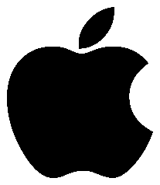
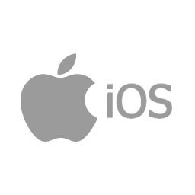
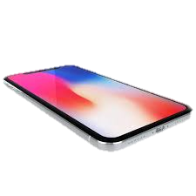
Mac iOS
Mac iOS runs on Apple devices only
Here are some benefits of Mac iOS:
Enhanced Security
Filtered Audience
Better Customer Experience
Flexible User Interface
Empower Your Business in the International Market
Higher Return on Investment
Secured Transactions
Strong Brand Value


Slide 23
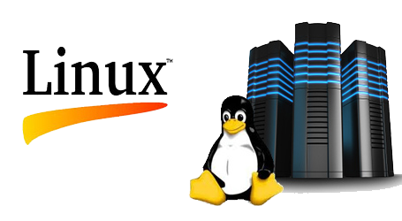
UNIX and LINUX
UNIX operating system:
Multitasking by making use of protected memory.
It has a virtual memory that is very efficient.
Accesses control as well as security.
It is a powerfully united file system.
Lean kernel that will make use of the basics:
Portable operating system.
Helps in proper development of the product
Linux Operating System:
Security
Revive older computer systems
Software Updates
Customization
Various Distributions
Free to use (Low Cost)
Large Community Support


Slide 24
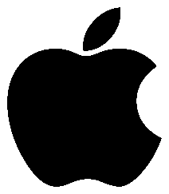
Virtualization
Ability to support multiple operating systems on a single
physical machine
Each virtual machine appears as a separate independent computer
Host operating system
Guest operating system


Slide 25
Percentage of different OS Users
40.44%
Android user worldwide
35.32%
Windows user worldwide
14.29%
iOS user worldwide
0.8%
Linux user worldwide

Slide 26
Thanks for being with us

