Slide 1
Morning Routine Among UTM Student

Slide 2
Introduction
Obesity Among Teenagers
Cause Of Obesity
Skipping Breakfast
Does Not Do Exercise
Disadvantage Of Obesity
Diabetes
Stroke
Heart Attack
Gastritis

Slide 3
Introduction
To Study Morning Behavior Among UTM Students
Lack Of Time
Busy With Academic And Work
Shift Their Breakfast To Western Style
Easy and Convenient
Save Time
Do Morning Exercise
Maintain Health And Weight

Slide 4
Methodology
Survey Heart ( Prepare questioner)
WhatsApp ( Collect The Primary Data)
R Studio ( Analyses Data)
PowerPoint ( Present Data)

Slide 5
Data Type
Nominal
Ordinal
Interval
Ratio

Slide 6
Graphical Presentation
Bar Chart
Pie Chart
Boxplot
Scatter plot
Histogram
Stem- and - Leaf
Frequency Distribution

Slide 7
Amount Of Students
Total Number Of Students
44 Students
23 Female Students (52.27%)
21 Male Students (47.73%)

Slide 8
Type Of Food & Amount Of Money Spend
Type Of Food
Breads
Cereal and Oats
Noodles
Rice
Others
Amounts Of Money Spend
RM 0
RM 1 – RM 5
RM 6 – RM 10
> RM 20

Slide 9
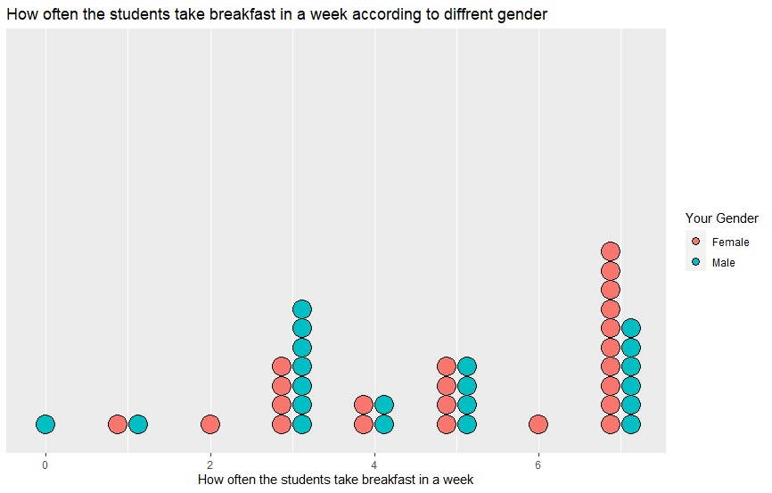
How Often The Students Take Breakfast Per Week
Most Highest
7 days per week
16 students (36.36%)
Second Highest
3 days per week
12 students (27.27%)
The Lowest
0 days, 2 days, 6 days per week
1 students per day

Slide 10
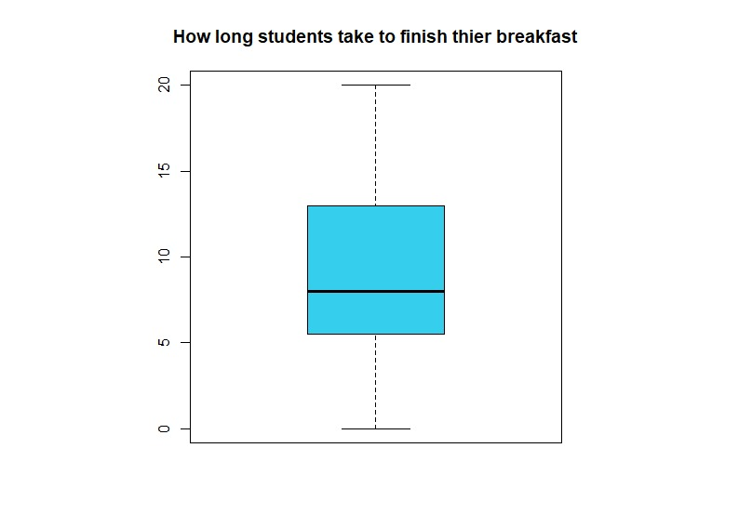
Time Spend To Finish Breakfast
Maximum
20 minutes
Minimum
0 minutes
First Quartile
6 minutes
Median
8 minutes
Third Quartile
13 minutes
Mean
8 – 13 minutes

Slide 11
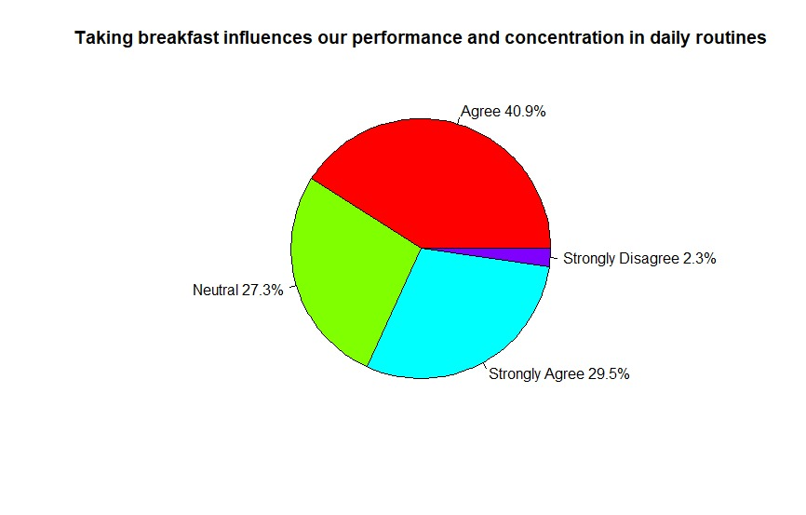
Taking Breakfast Influence Our Daily Performance
Strongly Agree
29.5 %
Agree
40.9 %
Neutral
27.3 %
Disagree
0 %
Strongly Disagree
29.5 %

Slide 12
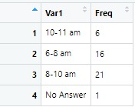
Time To Take Breakfast
6-8 am (Median)
16 students (36.36 %)
8-10 am (Highest)
21 students ( 47.73 %)
10-11 am (Lowest)
7 students ( 15.91 %)

Slide 13
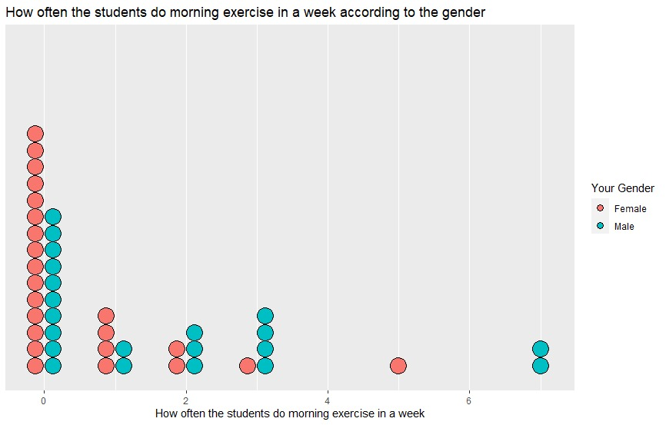
Days Spend On Exercise Per Week
Highest
0 days per week
25 students(56.82%)
Second Highest
1 days per week
6 students(13.64%)
Lowest
5 days per week
1 student (2.27%)

Slide 14
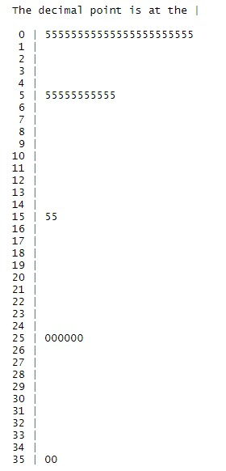
Time Spend On Doing Morning Exercise
Highest
0.5 minutes
23 students ( 52.27 %)
Second Highest
5.5 minutes
11 students (25 %)
Lowest
15.5 minutes & 35.0 minutes
2 students for 15.5 minutes (4.55%)
2 students for 35.0 minutes (4.55%)
Key: 0|5 = 0.5 minutes

Slide 15
When Do You Prefer Do Exercise
After Breakfast
15 students (34.09 %)
Before Breakfast
29 students (65.91 %)

Slide 16
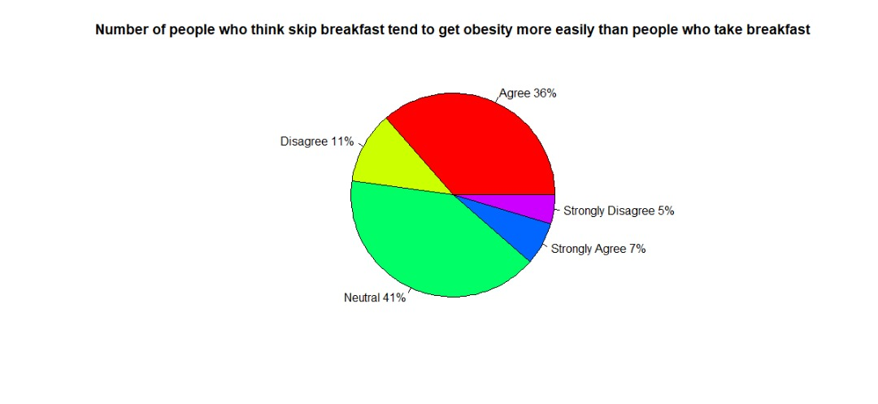
Skipping Breakfast Will Cause Obesity
Strongly Agree
7 %
Agree
36 %
Neutral
41 %
Disagree
11 %
Strongly Disagree
5 %

Slide 17
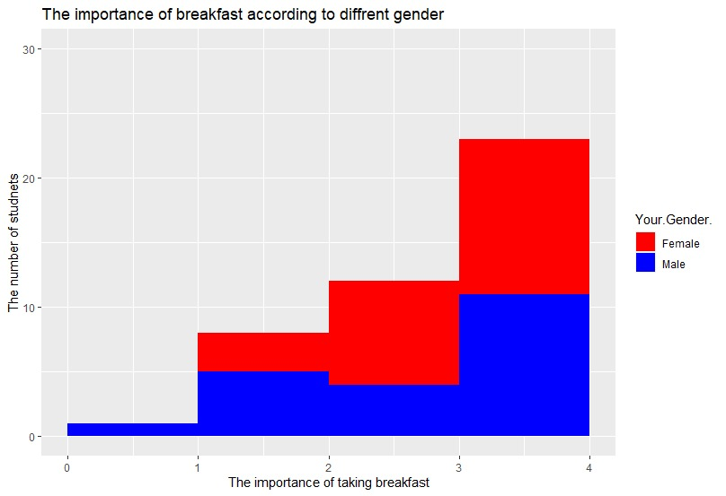
Importance Of Taking Breakfast
4 ( Very Important)
23 students (52.27%)
3 ( Important)
12 students (27.27%)
2 (Neutral )
8 students (18.18%)
1 ( Not Important)
1 students (2.27 %)
0 ( Very Not Important)
0 students

Slide 18
Conclusion
Most of the students choose bread as their breakfast and they spend about RM1 – RM5 per meal.
Most of the students take their breakfast each days or 7 days per week. They love to take their breakfast at 8-10 am and they spend 8-13 minutes to finish their breakfast.
Most of the students does not do exercise in the morning and they tend to do exercise before taking breakfast.
Most of the students agree with the statement that taking breakfast will influence their performance and concentration in daily life. Most of them agree that skipping breakfast will cause obesity.
Most of the students agree that breakfast is important in their daily life.

Slide 19
Suggestion To Encourage Students Take Breakfast
Prepare a free food counter to the students with financial problem can have their breakfast.
Students themselves need to wake up earlier and do not oversleep so they have enough time to take breakfast.
Organize a talk about the benefits of taking breakfast and invite the professional person to giving the talk.

Slide 20
THANK YOU

