Slide 2
Explain the five parts of an information system: people, procedures, software, hardware, and data.
Distinguish between system software and application software.
Discuss the three kinds of system software programs.
Distinguish between basic and specialized application software.

Slide 3
Identify the four types of computers and the six types of microcomputers.
Describe the different types of computer hardware including the system unit, input, output, storage, and communication devices.
Define data and describe document, worksheet, database, and presentation files.
Explain computer connectivity, the wireless revolution, the Internet, smartphone, and cloud computing.

Slide 4
Computer competency refers to acquiring computer-related skills.
Information systems are involved in many of the things we encounter each day.
Microcomputers are common in all areas of life.
New forms of learning online provide alternatives for people to become educated without attending a physical class.
The Web provides new ways to communicate, to find people with similar interests, and to purchase goods.

Slide 5
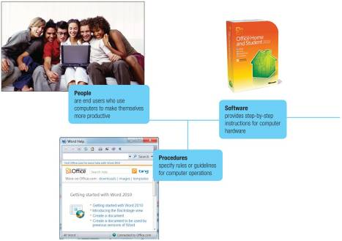
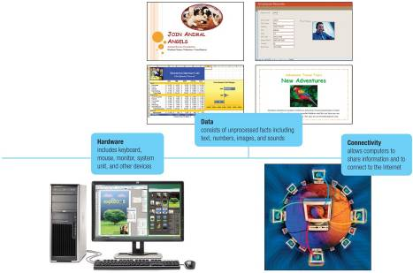
People
Procedures
Software
Notes:
An information system is a combination of people, procedures, software, hardware and data for collecting, storing, processing, and communicating information.
Some students may think of a system as pertaining to just the hardware
Remind them that a microcomputer is part of an information system
Almost all of today’s computer systems add an additional part, communication/connectivity.
To be a competent end user (Key Term), one must understand the essentials of IT
Note that IT stands for information technology (Key Term)

Slide 6
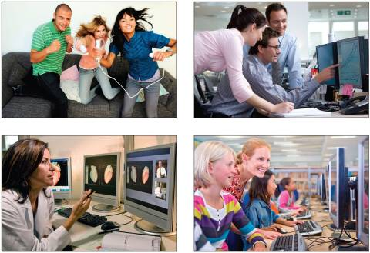
Most important part of any system
Contact is
Direct
Indirect
Computer uses
Entertainment
Business
Medicine
Education
Notes:
People are the most important part of an information system
Our lives are touched everyday by computers- many time the contact is direct and obvious, such as creating documents using a word processing program or when connecting to the internet. Other times, it isn’t as obvious and is much more indirect as shown in a couple of the pictures
Have students give examples of how they use computer applications throughout the day
Some examples are:
Instant messaging
Web-based applications
Personal Web site
Virus protection
TV tuners and video clips
Digital photography
Music
Home networking
Spyware
Job opportunities
Refer to Figure 1-3 on pg. 8 in text. It provides a partial list of applications that students can use to “Make IT work for You”

Slide 7
Notes:
Software is another name for programs
Programs are instructions that tell the computer how to process data into the form you want
Emphasize differences between application and systems software
System software
Operating system (Key Term)
Utilities
Device drivers (Key Term)
Application software
Basic applications (Key Term) or General-purpose
Specialized applications (Key Term)

Slide 8
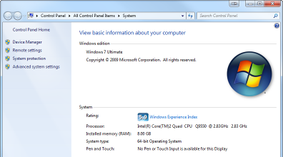
Collection of programs
Operating Systems
Utilities
Device Drivers
Enables application software to interact with the computer hardware
Background software helps manage resources
Operating System
Coordinates computer resources
Provides the user interface
Runs applications
Return
Notes:
System
Not a single program
A collection of programs
Two best known Operating systems are:
Windows 7
Mac OS X
Utilities
Service programs such as Windows Disk Defragmenter
Performs tasks related to managing computer resources
Device drivers
Programs that enable and input or output device to communicate with the rest of the computer.

Slide 9
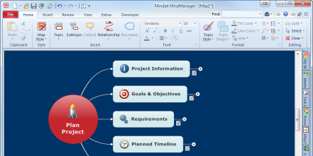
End-user software
Two major categories
Basic applications
Specialized applications
Return
Notes:
“End-user” software – these are the types of programs you have to know to be considered computer competent
An example of a basic application is a browser to navigate, explore and find information (Key Term) on the Internet
Two major categories
Basic applications - general purpose or “off-the-shelf” programs, such as Web browsers, and word processing, spreadsheet, and presentation software
Specialized application – narrow focus on specific disciplines and occupations, such as graphics, audio, video, Web authoring, and cell phone apps

Slide 10
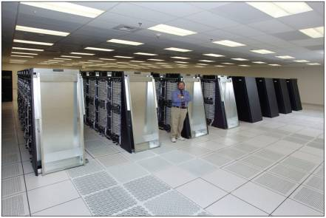
Supercomputers
Mainframe computers
Minicomputers
Microcomputers
Notes:
There are four types of computers
Supercomputers (key term) – the most powerful; special high-capacity computers used in very large corporations
Mainframe computers (key term) – are capable of great processing speed and data storage; occupy specially wired, air-conditioned rooms; insurance companies use to process information about millions of policyholders
Minicomputers (key term) - known as midrange computers (key term), are refrigerator sized machines used in medium sized companies or departments in large companies
Microcomputers (key term) – least powerful but most widely used and fastest-growing type of computers
Desktop (key term)
Media centers
Laptop or notebook (key term)
Tablet PC (key term)
Traditional tablet
Newer tablet referred to as a slate computer. Examples include Apple iPad, Motorola’s Zoon
Netbook
Handheld computers (Key Term)
Personal digital assistants (PDA) (Key Term)
Smartphones

Slide 11
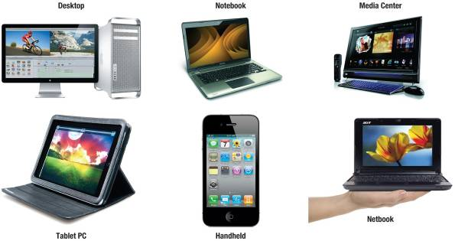
Desktop
Media center system units
Notebook or laptop
Netbooks
Tablet PC
Handheld
Return

Slide 12
Return

Slide 13
Return

Slide 14
Return

Slide 15
Return
Notes:
Discuss the limitations of netbooks.

Slide 16
Return
Notes:
Accepts handwriting
Digitized data is converted to standard text that can be further processed by a word processor.
Ask students if they are familiar with tablet PCs like the iPad.

Slide 17
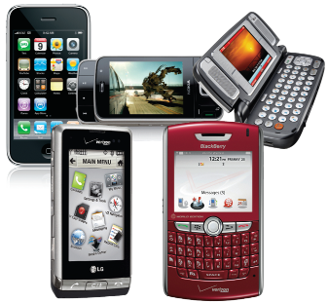
Smallest computing devices
Combine pen input, writing recognition, personal organization tools and communications
Return
Notes:
Handheld or palm computers, such as Personal digital assistants (PDAs) and smartphones, are amongst the smallest computing devices
These systems typically combine pen input, writing recognition, personal organizational tools, and communications capabilities
Smartphones are cell phones with wireless connections to the Internet

Slide 18
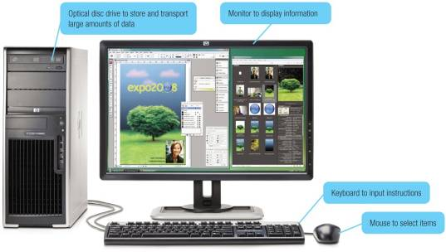
Four basic categories of equipment
System Unit
Input/Output
Secondary Storage
Communications
Notes:
System Unit is the container that houses most of the electronic components that make up a computer system.
Input/Output – Input devices (key term) translate data and programs from a form humans understand to a form computers can process;
Secondary Storage – Unlike memory (key term), secondary storage holds data and programs even after the electrical power has been turned off—examples of secondary storage include USB drives, hard drives and optical drives
Communication – one computer communicating with another computer or other computer systems using communication devices (key term) such as a modem

Slide 19
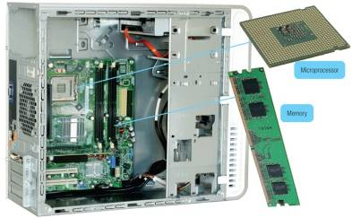
Two important components
Microprocessor
Memory
Holds data currently being processed
Holds the processed information before it is output
Temporary storage, contents are lost when power is off
Return

Slide 20
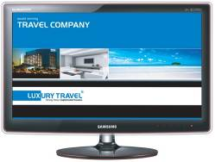
Input
Keyboard
Mouse
Output
Printer
Monitor
Return
Notes:
Input devices translate data and programs that humans can understand into a form that the computer can process.
Output devices translate the processed information from the computer into a form that humans can understand.

Slide 21
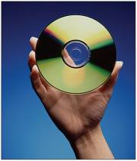
Holds data and programs even if power is off
Hard disk
Solid-state storage
No moving parts
More reliable
Requires less power
Flash memory cards, USB drives
Optical disc
Laser technology
Great capacity
CDs, DVDs
Return
Notes:
Unlike memory, secondary storage holds data and programs even if power is off
Hard disks are typically used to store programs and data files.
Solid-state storage does not have any moving parts, is more reliable, and requires less power to operate
Solid-state drives (SSDs)
Flash memory cards
USB drives
Optical disks use laser technology and have the greatest capacity.
Examples of optical disks include:
compact discs (CDs) (Key Term)
digital versatile discs (DVDs) (Key Term)
high definition (hi def) (Key Term) discs

Slide 22
Communication devices, such as modems, provide microcomputers with the ability to communicate with other computer systems
Modems modify information so that it may be sent and received across telephone or cable lines
Return

Slide 23
Raw, unprocessed facts
Processed data becomes information
Digital data is stored electronically in files
Document files
Worksheet files
Database files
Presentation files
Data
Data
Data
Information
Notes:
Data is raw, unprocessed facts, that can be stored electronically in files.
Processed data becomes information.
Four common types of files include:
Document files (key term) - created by word processors to save memos, term papers, and letters
Worksheet files (key term) - electronic spreadsheets for analyzing budgets and to predict sales
Database files (key term) - electronic database management programs to contain highly structured and organized data
Presentation files (key term) - electronic slide shows, audience handouts, and speaker notes

Slide 24
Created by word processors
Term papers
Memos
Letters
Return
Notes:
Word processors are used to prepare written documents
Create text-based documents
One of the most flexible and widely used software tools
Features to make entering, editing, and formatting documents easy

Slide 25
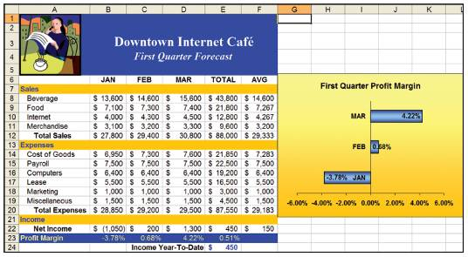
Created by electronic spreadsheets to analyze things like budgets and to predict sales
Return
Notes:
Files created by spreadsheet programs
Uses functions and formulas to analyze numeric data
Manipulates numeric data
Features include workbooks, worksheets, cells, ranges, text and numeric entries, formulas, functions, charts, recalculation, and what-if analysis

Slide 26
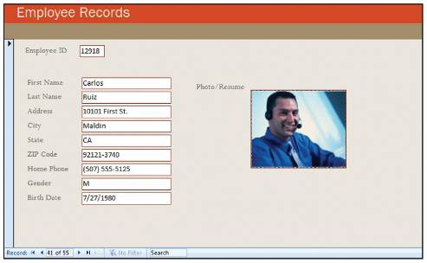
Typically created by database management programs to contain highly structured and organized data
Return
Notes:
A database management system (DBMS) or database manager is a program that sets up, or structures, a database
Files created by database management programs
Organizes data for efficient retrieval
Is the electronic equivalent of a file cabinet
It also provides tools to enter, edit, and retrieve data from the database

Slide 27
Created by presentation graphics programs to prepare presentation materials.
Can contain audience handouts, speaker notes, and electronic slides.
Return
Notes:
Used to create a variety of visual objects to create attractive, visually interesting presentations
Features include slides, AutoContent wizard, color schemes, slide layouts, special effects, master slides, and design templates
Presentation files may contain audience handouts, speaker notes, and electronic slides

Slide 28
Connectivity
Sharing of information
Wireless communication has widespread use
Computer networks
Connected communication system of computers
Largest network is the Internet
Cloud Computing
Uses the Internet and the Web to shift many computer activities from a user’s computer to computers on the Internet
Notes:
Connectivity is the capability of your microcomputer to share information with other computers
Wireless /mobile communication devices are more popular than ever
A network is central to the concept of connectivity
Ask students questions about the Internet. Here are some facts:
No one owns the Internet
There is no Internet, Inc.
The Internet is a network of networks
The Word Wide Web (key term) (WWW) provides multimedia interface to resources on the Internet
Cloud computing can be used to create and store your work, such as documents, spreadsheets, databases, and presentations

Slide 29
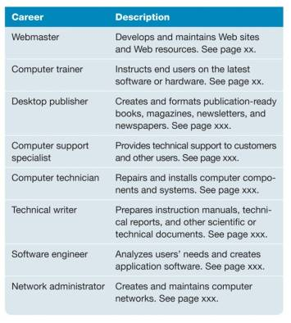
Example of career

Slide 30
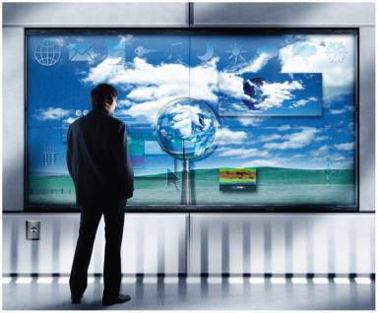
The Internet and the Web
Powerful Software
Powerful Hardware
Security and Privacy
Organizations
Changing Times
Notes:
Internet & Web - browse the Web, communicate with others, locate Information, etc.
Powerful Software - create professional looking documents, analyze massive amounts of data, create dynamic multimedia pages, and more.
Powerful Hardware – more powerful & robust, new technologies such as wireless networks & their impact to connect, equipment can be dynamic vs. essential features of devices remain static
Security & Privacy – negative impacts, potential mental & physical health risk, negative effects on the environment, etc.
Organizations – organizational information systems and their use
Changing Times – fast paced era and rapid change

Slide 31
Explain the five parts of an information system. What part do people play in this system?
What is system software? What kinds of programs are included in system software?
Define and compare basic and specialized application software.
Describe some different types of basic applications.
Describe some types of specialized applications.
Notes:
Have students turn to the end of Chapter 1 in their textbooks to view the same “Open-Ended” questions/statements

Slide 32
Describe the different types of computers.
What is the most common type?
What are the types of microcomputers?
What is connectivity? What are wireless devices and the wireless revolution? What is a computer network? What are the Internet and the Web? What is cloud computing?
Notes:
Have students turn to the end of Chapter 1 in their textbooks to view the same “Open-Ended” questions/statements

