Slide 1
UICL 2302
PEMIKIRAN SAINS & TEKNOLOGI

Slide 2
(BAB 1): MANUSIA & PEMIKIRAN
(BAB 3): EKOSISTEM KEILMUAN ISLAM
(BAB 4): AGAMA, PEMIKIRAN SAINS DAN TEKNOLOGI
(BAB 5): PEMIKIRAN SAINS & TEKNOLOGI MERENTAS SEMPADAN
(BAB 6): PEMIKIRAN SAINTIFIK SAINTIS MUSLIM
(BAB 7): PERUBAHAN PARADIGMA PEMIKIRAN SAINTIS BARAT
(BAB 8): PEMODENAN SAINS & TEKNOLOGI
(BAB 9): REVOLUSI INDUSTRI & KESANNYA TERHADAP KEMANUSIAAN
(BAB 10): ETIKA & NILAI DALAM PEMIKIRAN SAINS & TEKNOLOGI
(BAB 11): MENGINSANKAN SAINS & TEKNOLOGI
(BAB 2): PERKEMBANGAN ILMU ZAMAN PERTENGAHAN

Slide 3
TugasaN Portfolio 2
Berikan analisis secara terperinci hubungan antara sains, teknologi dan kemanusian.
Jelaskan maksud sains dan teknologi
Jelaskan bagaimana hubungan S & T dengan manusia mengalami evolusi
Pilih satu dokumentari berkenaan dengan STS dan huraikan dalam portfolio.
https://www.youtube.com/watch?v=tuEZ3NMr3jk
https://www.youtube.com/watch?v=Qo5gqkkyVAE

Slide 4
PERKEMBANGAN ILMU ZAMAN PERTENGAHAN (middle ages)
BAB 2

Slide 5
OBJEKTIF BAB 2
Di akhir bab ini, pelajar dapat:
Mengenalpasti perkembangan pemikiran saintifik Zaman Pertengahan.
Menjelaskan pertembungan antara golongan agamawan dan saintis (dualisme dalam ilmu).

Slide 6
DEFINISI ZAMAN PERTENGAHAN (MIDDLE AGES)
Abad Pertengahan di Eropah adalah sejarah yang panjang dari 500 AD hingga 1500 AD (1000 tahun).
Ia merangkumi masa dari kejatuhan Empayar Rom sehingga munculnya Empayar Uthmaniyyah.
Ini adalah zaman istana dan petani, kesatuan sekerja dan biara, gereja besar (katedral) dan Perang Salib.

Slide 7
Timeline of the Middle Ages
EARLY MIDDLE AGES
4-9 Masihi
HIGH MIDDLE AGES
10-12 Masihi
LATE MIDDLE AGES
13 M-1499 M

Slide 10
Pembahagian zaman
Zaman Klasik
Zaman Hellenistik
Zaman Gelap
Zaman Renaisans
Zaman Pencerahan
Zaman Revolusi Perindustrian

Slide 11
1. Zaman klasik (early middle ages)
Bermula di Ionia, Greek (12 buah kota)
Utamakan logos sehingga tidak serasi dengan mitos
Menekankan unsur kosmos dalam ilmu
Tokoh terkenal ialah Phythagoras (582-496SM)

Slide 12
Lahirnya Sophis
Mempunyai kebijaksanaan
Dimulakan oleh Protagoras (abad ke 5SM)
Ciri utama:
Ajar retorik
Humanisme sebagai asas berfikir
Relatif – tiada kebenaran hakiki, tiada rujukan
Skeptik – tidak percaya bulat-bulat
Kenakan bayaran tinggi

Slide 13
Penentang sophis
Diterajui Socrates, Plato dan Aristotle (SPA)
Ilmu falsafah, tolak agama pagan
Herodotus
Perang Parsi, sejarah sebagai ilmu kemanusiaan
Thucydides
Perang Peloponnesia: buang unsur mitos dan lagenda

Slide 14
2. Zaman heLlenistik
Yunani Hellenistik adalah suatu masa yang berlangsung setelah kematian Alexander the Great pada tahun 323 SM dan berakhir dengan penaklukan daratan Yunani oleh Republik Rom pada tahun 146 SM.
Kesimbungan dari Zaman Hellenik
Semua ilmu berasaskan ketuhanan
Mula bertembung antara gereja dan logos
Humanisme mula maju:
Manusia, rasional, unsur sekuler
Lahirnya Polybius (203-120SM), Livy (59-SM-17M)

Slide 15
ZAMAN HELLENISTIK
Humanisme
Restae Populi Romani
Kristian vs falsafah
Hellenistik
Rom
(abad 1 SM)
Tokoh:
Polybius
Livy
Tacitus
Bersumberkan
ketuhanan

Slide 16
3. Zaman gelap (early-high middle ages)
Mula dengan jatuhnya Rom tahun 365 M
Ada ciri tertentu: feudal dalam ekonomi dan sosial, peranan gereja yang luas
Teologi merupakan asas ilmu
Gereja vs ilmu
Wujudnya inkuisisi untuk hukum orang murtad
Wujudnya dualisme dalam ilmu
Tokoh utama: Thomas Aquinas (1225-1274 M)

Slide 17
ZAMAN GELAP
Peristiwa utama:
-Perang Salib
-ilmu dipindahkan
Gereja vs ilmu
- dualisme
-rakyat dihukum jika lawan gereja
MIDDLE
AGES
(5M – 15M)
Tokoh yang sahkan autoriti agama
- St. Thomas Aquinas
- St. Anselm
Zaman Islam
Asas ilmu hanya teologi sahaja

Slide 18
Zaman gelap
Era kemajuan dunia Islam
Beberapa peristiwa utama:
Perang Salib
Perpindahan ilmu

Slide 19
PERANG SALIB (11-13 m)
Perang Salib merupakan beberapa siri kempen peperangan yang dipengaruhi isu keagamaan dan politik sekitar kurun ke-11 hingga ke-13 Masihi.
Kempen peperangan yang direstui oleh pihak Gereja Roman Katholik ini bermula ketika Zaman Pertengahan.
Misi asal tentera salib ialah menawan Baitulmaqdis dan kawasan sekitarnya daripada orang Islam selain daripada matlamat sampingan seperti menawan Kota Constantinople (yang berjaya ditawan semasa Perang Salib Ke-4).

Slide 20
9 Siri perang salib
Perang Salib Pertama (1095-1099)
Perang Salib Kedua (1145-1149)
Kejatuhan Jerusalem (1187)
Perang Salib Ketiga (1187-1192)
Perang Salib Keempat (1202-1204)
Perang Salib Albigensian
Perang Salib Kanak-kanak
Perang Salib Kelima (1217-1221)
Perang Salib Keenam (1228-1229)
Perang Salib Ketujuh (1248-1254)
Perang Salib Kelapan (1270)
Perang Salib Kesembilan (1271-1272)
Perang Salib di Baltik dan Eropah Tengah

Slide 21
4. Zaman renaisans (14-17M)
Renaissance adalah zaman dalam sejarah Eropah yang meliputi tempoh antara abad ke-14 dan ke-17. Ia merupakan lanjutan dari Zaman Pertengahan dan dihubungkan oleh Zaman Pencerahan kepada sejarah moden. Kesan pertama Renaissance ditemui di Itali dan kedatangannya adalah untuk menampung kebanyakan negara Eropah. Ia dianggap oleh sesetengah sarjana sebagai permulaan zaman moden.
Mula dengan kesan selepas Perang Salib, faham ilmu, tubuh kerajaan di Timur.
Gerakan penterjemahan
Jatuhnya Constantinople (1453), mula belajar Greek & terjemah bahan ke Latin. Mula pindah ke Itali (Florence).
1492-Yahudi dan Muslim dihalau dan dirampas teknologi, ilmu dsb.

Slide 22
9 Faktor cepatkan Renaisans
Perubahan ekonomi daripada feudal kepada bebas
Peranan P&P: Polo, Henry
Percetakan di Guttenberg
Perkembangan intelektual
Tukar cara fikir dan budaya: pakaian, orang awam mula berperanan
Kesenian

Slide 23
SAMBUNGAN…
7. Falsafah:
humanisme; rasional, unsur sekular
Tolak agama
8. Agama:
Ikut pemikiran
Protestant; bebas fikir, terjemah, faham, tiada ketua umum, ambil kira suasana
9. Sosial; black death (1347-1350) - https://www.youtube.com/watch?v=ySClB6-OH-Q

Slide 24
KESAN RENAISANS etika vs sekular
Hidup hanya akan baik jika amalkan etika.
Boleh memahami alam dengan berfikir sahaja.
Kebebasan berfikir.

Slide 25
Sekular: DALAM ASPEK sosial
Bebas beragama
Agama tidak masuk hal politik
Pengaruh agama dikurangkan dalam hidup bermasyarakat
Agama sudah tidak penting lagi
Sains dan rasional lebih utama daripada kepercayaan karut dan agama

Slide 26
SekulAr: DALAM ASPEK politik
Asalnya politik dikawal oleh agama
Berubah dalam 4 fasa;
pisahkan agama
politik campur hal agama
Kuasa politik lebih luas
Politik kuasai agama

Slide 27
gerakan mengkritik bible
Siapa tulis?
Bila?
Siapa pembaca?
Mengapa ditulis?
Bagaimana dijaga?

Slide 28
5. Zaman pencerahan (18m) (THE ENLIGHTENMENT)
Zaman Pencerahan ialah gerakan intelektual dan falsafah yang menguasai dunia idea-idea di Eropah pada abad ke-18 yang dikenali sebagai "Century of Philosophy".
Revolusi Perancis (1789-99)
Tolak monarki, feudal
Asaskan demokrasi, sama, adil, bebas
Peranan Yahudi dalam mengembangkan ilmu yang baharu.

Slide 29
Peranan tokoh Eropah
Charles Darwin (1809-82): evolusi
Karl Marx (18-1883): material
Sigmund Freud (1856-1939): psikologi

Slide 30
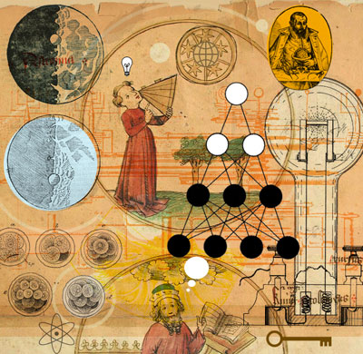
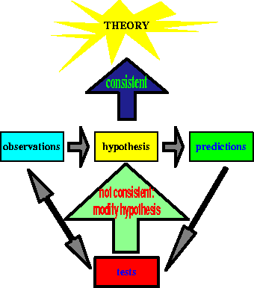
Scientific Revolution: A Changing View of the World

Slide 31
What is a Revolution?
A Revolution is a complete change, or an overthrow of a government, a social system, etc.

Slide 32
Main Ideas and Details
Scientific Revolution
A new understanding of the world
Logical Thought
Scientific Method

Slide 33
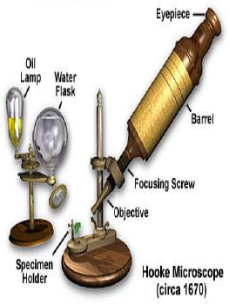
A New Understanding
Discoveries lead to doubt
Columbus’ voyage
Scholars challenge traditional thought
Copernicus, Galileo, Vesalius
Inventions
Telescope and Microscope
English Scientist Robert Hooke
c. 1675

Slide 34
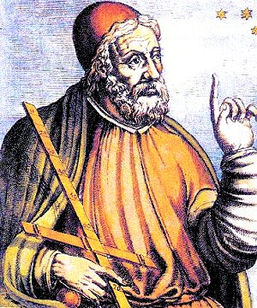
Before the Scientific Revolution…
Until the mid 1500’s, European scholars accepted and believed the teachings of Ptolemy, an ancient Greek astronomer.
Ptolemy
(87-140 A.D.)
Ptolemy taught that the Earth was the center of the universe.
People felt this was common sense, and the geocentric theory was supported by the Church.
It was not until some startling discoveries caused Europeans to change the way they viewed the physical world.

Slide 35
Before the Scientific Revolution…
Ptolemy
(87-100 A.D.)
Ptolemy’s geocentric model of the solar system:
Earth
Moon
Mercury
Venus
Sun
Mars
Jupiter
Saturn
Notice, the Earth is first, and not the sun, as it should be.

Slide 36
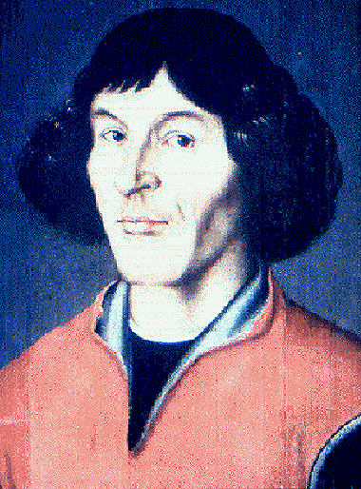
Nicolaus Copernicus
Copernicus was a Polish astronomer who studied in Italy.
In 1543 Copernicus published On the Revolutions of the Heavenly Spheres.
In his book, Copernicus made two conclusions:
The universe is heliocentric, or sun-centered.
The Earth is merely one of several planets revolving around the sun.

Slide 37
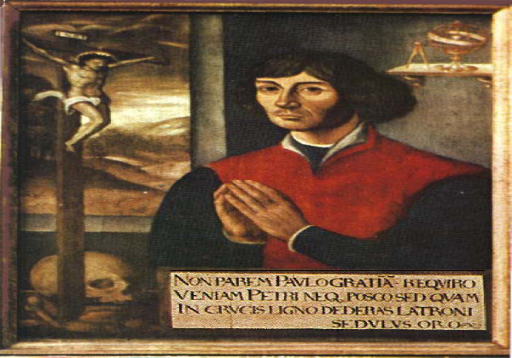
Nicolaus Copernicus 1473-1543
Heliocentric Theory
Sun is center of universe
Afraid of Catholic Church
Published work on deathbed
Copernicus System

Slide 38
Nicolaus Copernicus
Copernicus’ model of the solar system:
Sun
Moon
Mercury
Venus
Earth
Mars
Jupiter
Saturn
Notice, the sun is first, not the Earth, as Ptolemy believed.

Slide 39
Nicolaus Copernicus
Copernicus came to these conclusions using mathematical formulas.
The Copernican conception of the universe marked the start of modern science and astronomy.

Slide 40
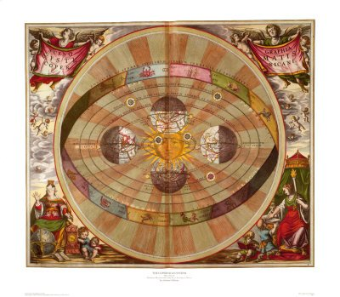
Copernicus System
Planets revolve around the sun

Slide 41
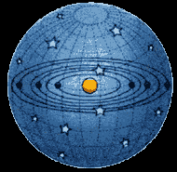
The Copernican Heliocentric Model

Slide 42
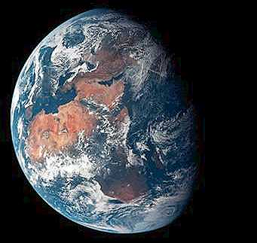
Reaction to Copernicus
Most scholars rejected his theory because it went against Ptolemy, the Church, and because it called for the Earth to rotate on its axis.
Many scientists of the time also felt that if Ptolemy’s reasoning about the planets was wrong, then the whole system of human knowledge could be wrong.

Slide 43
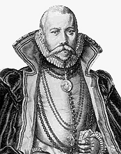
Tycho Brahe
Then, in the late 1500s, the Danish astronomer Tycho Brahe provided evidence that supported Copernicus’ heliocentric theory.
Brahe set up an astronomical observatory.
Every night for years he carefully observed the sky, accumulating data about the movement of the stars and planets.

Slide 44
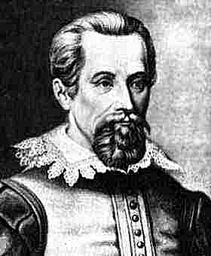
Johannes Kepler
After Brahe’s death, his assistant, the German astronomer and mathematician Johannes Kepler, used Brahe’s data to calculate the orbits of the planets revolving around the sun.
Kepler’s calculations supported Copernicus’ heliocentric theory.
His calculations also showed that the planets moved in oval shaped orbits, and not perfect circles, as Ptolemy and Copernicus believed.
Kepler’s finding help explain the paths followed by man-made satellites today.

Slide 45
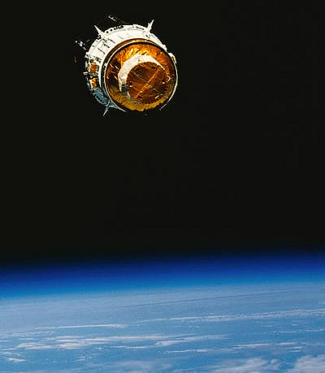

Slide 46
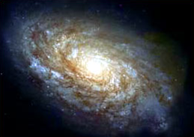
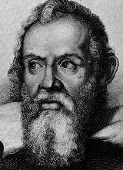
Galileo Galilei
Galileo Galilei was an Italian astronomer who built upon the scientific foundations laid by Copernicus and Kepler.
Galileo assembled the first telescope which allowed him to see mountains on the moon and fiery spots on the sun.
He also observed four moons rotating around Jupiter – exactly the way Copernicus said the Earth rotated around the sun.
Galileo also discovered that objects fall at the same speed regardless of weight.

Slide 47
Galileo Galilei
Galileo’s discoveries caused an uproar. Other scholars came against him because like Copernicus, Galileo was contradicting Ptolemy.
The Church came against Galileo because it claimed that the Earth was fixed and unmoving.
When threatened with death before the Inquisition in 1633, Galileo recanted his beliefs, even though he knew the Earth moved.
Galileo was put under house arrest, and was not allowed to publish his ideas.

Slide 48
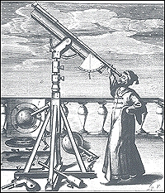

Slide 49
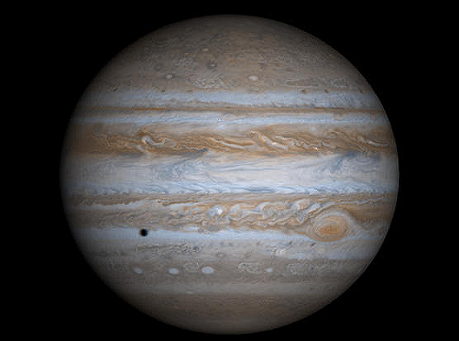

Slide 50
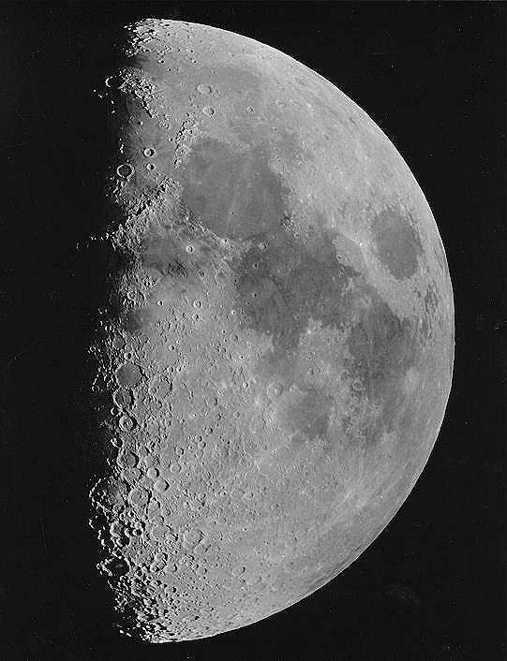

Slide 51
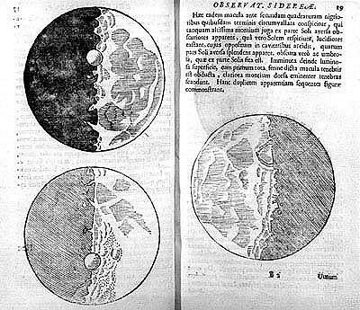

Slide 52
Scientific Method
1: What is the problem?
2: Research Information
3: Hypothesis
4: Test Hypothesis
5: Record and Analyze Data
6: Draw Conclusions

Slide 53
Logical Thought
Scientific thought applied to people
Like science, people were governed by laws
Scientific Revolution influenced equality among peoples and democratic ideals

Slide 54
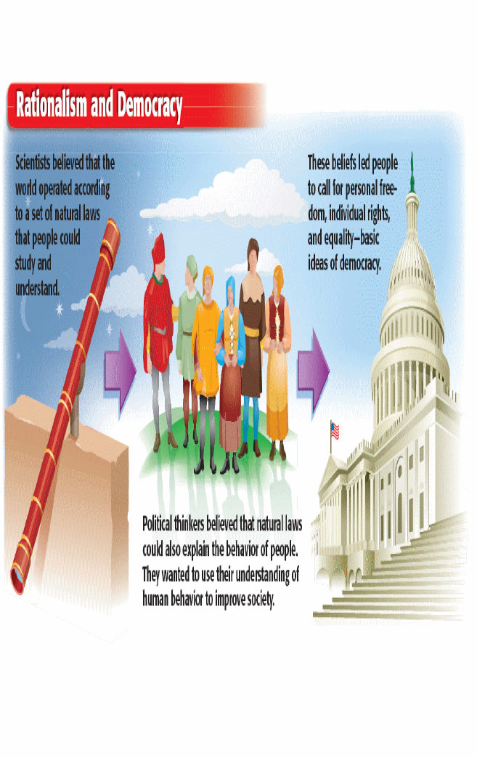

Slide 55
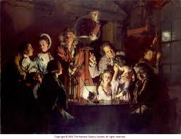
Age of Enlightenment

Slide 56
The Enlightenment
Application of the scientific method to social problems
Parallel to the scientific awakening
Foundation of Classical art and music
The world behaves according to patterns and these ought to be obeyed

Slide 57
Basic Premises
Scientific method can answer fundamental questions about society
Human race can be educated and all people are important
Emergence of the middle class
Belief in God based on reason

Slide 58
Perbincangan
Bincangkan secara berkumpulan.
“APAKAH IMPAK BESAR REVOLUSI DI EROPAH KEPADA PEGANGAN BERAGAMA MASYARAKAT EROPAH?:”

Slide 59
Science and Islam - Medieval Islam Influences
Science and Islam - Medieval Islam Influences | Scientific Knowledge Documentary | ReelTruth.Science
https://www.youtube.com/watch?v=4-lHyUYaAIU

Slide 60
Growth of Deism
Intellectuals believe in God but see him as a "watchmaker"
Deists skeptical of organized religion
Catholic church was attacked
Deists struggle with personal standards
Denial of providence (Voltaire) disputed by others (Pope, Rousseau)
Denial of evil

Slide 61
Thomas Hobbes
Empiricism
"All that is real is material, and what is not material is not real." – Hobbes

Slide 62
Thomas Hobbes
Government
"[Early man was] solitary, poor, nasty, brutish, and short... [and in a constant state of] warre, [living in] continual fear and danger of violent death.“ – Leviathan
Absolute monarchy sent by God to help mankind
Hobbes' concepts used to justify colonialization

Slide 63
John Locke
The forefather of our forefathers
Attacked by Charles II
Friend of Newton
Influential in American revolution

Slide 64
John Locke
Government
Second treatise of Civil Government
Chaos without government
God gave mankind natural rights
Life, liberty, pursuit of property
Innate goodness of mankind led to formation of governments
Governments, which were formed by the people, must guarantee the rights of the people
People have a right to rebel against tyrannies

Slide 65
"Wherever therefore any number of men are so united into one society, as to quit every one his executive power of the law of nature, and to resign it to the public, there and there only is a political, or civil society... For hereby he authorizes the society, or which is all one, the legislative thereof to make laws for him as the public good of the society shall require;... And this puts men out of a state of nature into that of a commonwealth."
– John Locke, Two Treatises of Government

Slide 66
John Locke
Theory of Knowledge
Essay Concerning Human Understanding
Reasoning puts man above animals
Rejected concept that ideas are innate
Tabula rasa
Outer ideas from experience
Inner ideas from contemplation
Mankind can attain all knowledge

Slide 67
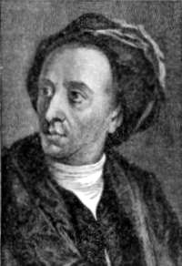
Alexander Pope
English Poet
Contributed to political thought and love of language
Believed that God was in control of the earth and that all things were ultimately for our good
Essay on Man
Essay on Criticism
Many famous sayings came from these books

Slide 68
All Nature is but art unknown to thee
All chance, direction, which thou canst not see;
All discord, harmony not understood;
All partial evil, universal good:
And, spite of pride, in erring reason’s spite,
One truth is clear, Whatever is, is right.
– Alexander Pope from Essay on Man

Slide 69
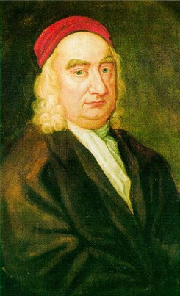
Jonathan Swift
Hated injustice
Politically active
Satirist
Gulliver’s Travels
A Modest Proposal…

Slide 70
“For of what use is freedom of thought if it does not produce freedom of action?”
Swift, “On Abolishing Christianity” (1708) [Quoted in Barzun, From Dawn to Decadence, 2000, p.273]

Slide 71
Philosophe
French name for philosopher
Enlightenment reached height in France

Slide 72
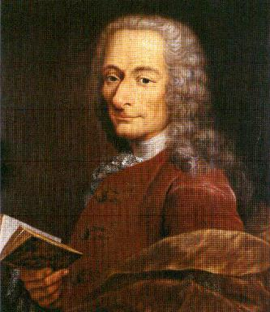
Voltaire
Pen name
Critical of Catholic church
Influenced others by letters
Denied writings to avoid problems
Exiled to England for a while
Returned to live on Swiss border
Candide
Led by Pangloss ("All Talk") who believed that all is right in God's world
Lisbon earthquake and fatalism (drowning)
"Let us all tend our garden"

Slide 73
“I do not agree with a word you say, but I will defend to the death your right to say it.”
Voltaire

Slide 74
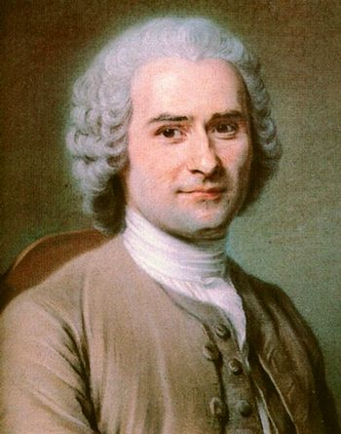
Jean-Jacques Rousseau
Contest: "Does progress in the arts and sciences correspond with progress in morality?"
No!
As civilizations progress, they move away from morality
Examples: Romans, Greeks, Egyptians
Civilization itself leads away from true fundamentals
Technology and art give false desires
Social Contract
“Noble Savage”

Slide 75
Jean-Jacques Rousseau
Influence on French and American revolutions
"Liberty, Equality, Fraternity"
Invest all rights and liberties into a society
Compare to a corporation

Slide 76
“Man is born free, yet everywhere he is in chains.”
Rousseau

Slide 77
Summary of Rousseau's Teachings
Old System (Powerful Ruler or Chaos) | New System (Social Contract Concepts)
Instinct | Justice
Strength and intelligence | People equal on moral rights
Might | Right
Natural inclinations | Reason
Personal liberty | Civil liberty

Slide 78
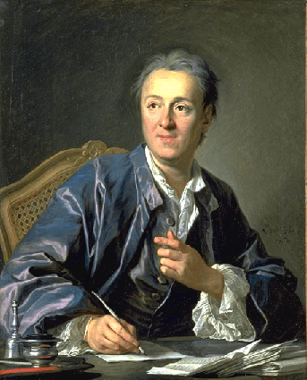
Denis Diderot
Encyclopedia
Teach people how to think critically
Solicited articles from many experts
Controversial articles brought criticism
Overall, moved forward the ideas of Enlightenment

Slide 79
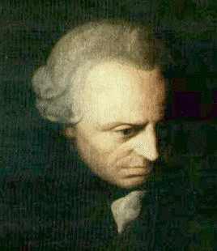
Immanuel Kant
From Germany
Strict habits
The Critique of Pure Reason and …Practical Reason
Weakness of Empiricism
Transcendentalism
Empiricism and other knowledge
Ex: infinity
Categorical Imperative

Slide 80
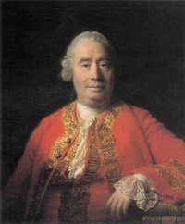
David Hume
Scottish philosopher
Leader of empiricism movement
Grew to distrust all

Slide 81
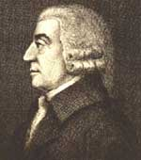
Adam Smith
Scottish professor
Wealth of Nation
Devised capitalism
Laissez Faire la nature

Slide 82
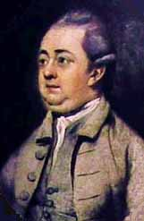
Edward Gibbon
Decline and Fall of the Roman Empire
Urged reform in England
Anti-religious bias

Slide 83
kolonialisasi
Kolonialisasi atau penjajahan dikaitkan dengan penyebaran puluhan juta dari negara Eropah Barat di seluruh dunia.
Dalam banyak jajahan yang diselesaikan, peneroka Barat membentuk majoriti penduduk.
Contohnya termasuk Amerika, Australia dan New Zealand. Koloni-koloni ini terkadang dipanggil 'neo-Europes'.
Di tempat lain, peneroka Barat membentuk kumpulan minoriti, yang sering dominan di tempat yang didudukinya.

Slide 84
Sambungan…
Apabila Britain mula menetap di Australia, New Zealand dan pelbagai pulau kecil lain, mereka sering menganggap kawasan tersebut sebagai terra nullius. yang bermaksud 'tanah kosong' dalam bahasa Latin.
Disebabkan ketiadaan teknik pertanian Eropah, tanah itu dianggap tidak diubah oleh manusia dan oleh itu dianggap tidak didiami, walaupun terdapat penduduk asli.
Pada abad ke-19, undang-undang dan idea seperti Undang-undang Kolonisasi Umum Mexico dan nasib Manifest Amerika Syarikat menggalakkan penjajahan lanjut di Amerika.
Ia adalah satu proses yang sistem deminiti kuasa menyusun tanah di sekelilingnya dan komponennya.

Slide 85
Fenomena utama kolonialisasi
Industrialisasi – bahan mentah, jual barang, ganti rempah, hamba, gula dll
Keadaan ini membawa kepada keperluan tanah jajahan
Antara aktiviti utama:
British – jadi kuasa besar maritim
Perang Plassey, 1757 bawa kepada penjajahan India.

Slide 86
6. Zaman revolusi industri 1-4: pencapaian utama
FASA PERTAMA
Textiles
Steam power
Iron making
Invention of machine tools.
FASA KEDUA
Pertambahan produktiviti secara besar-besaran
Penggunaan elektrik
FASA KETIGA
Otomatik
Komputer
elektronik
FASA KEEMPAT
jaringan internet
sistem siber

Slide 87
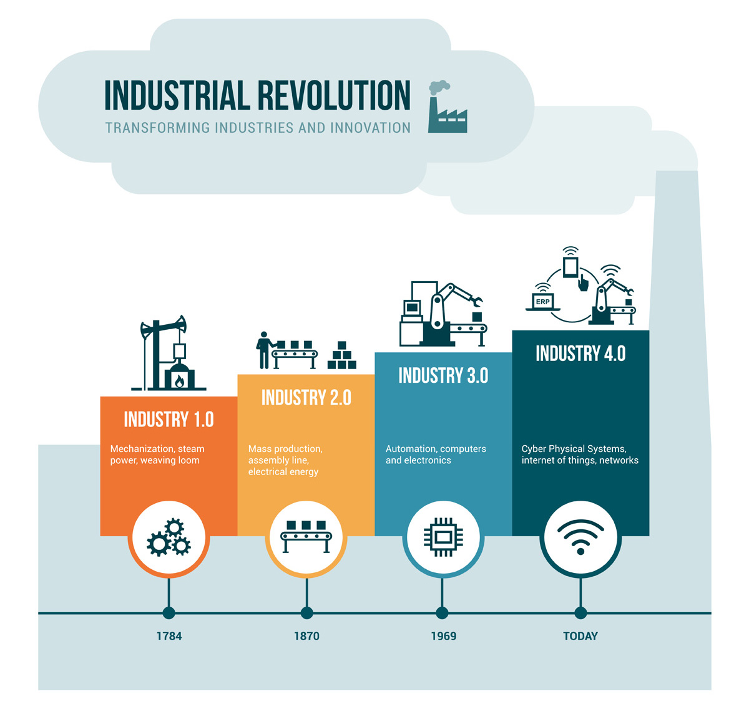

Slide 88
PERTEMBUNGAN ANTARA AGAMAWAN DAN SAINTIS (DUALISME ILMU)

Slide 89
Fahaman sekulAr
Individuilistik: semuanya pada diri masing-masing
Liberalisme
Empirikal: guna pancaindera dan ujikaji
Relatif: tiada rujukan
Rasionalis: akal sebagai penentu
Humanisme: man is the measures of all things: moral,

Slide 90
Tiga ciri utama peradaban Barat (Reason-Individual rights-S&T)
1) REASON (SEBAB)
Ilmu didapati melalui akal – logos, logik – bertentangan dgn kepercayaan – mitos, agama, dogma
Ambil masa 2000 tahun untuk bangkit dan diterima di barat
Berkuasa penuh pada abad ke 18M

Slide 91
2) Individual Rights (HAK INDIVIDU)
Iktiraf prinsip hak individu
Tugas individu bukan untuk khidmat kepada kerajaan tetapi tugas kerajaan ialah untuk kawal individu
Hak asasi untuk hidup, bebas dan dapatkan kesenangan hidup
Perhambaan dan Nazi ditentang atas nama tidak logik dan bertentangan dengan hak individu.

Slide 92
3) SAINS & TeKnologI
Kejayaan dua unsur bawa kepada kemajuan dan tingkatkan sains dan teknologi yg bawa kpd masyarakat industri
Dua unsur yang bebaskan manusia daripada kongkongan agama dan negara
Maka kemajuan dalam semua bidang tercapai.

Slide 93
Sambungan…
Manusia faham undang2 alam dan cipta produk baharu.
Kekayaan digunakan utk ciptaan dan rekaan baru serta bantu produktiviti
Kereta ganti kereta kuda, elektrik ganti lilin
Akhirnya manusia kuasai alam semesta.

Slide 94
identiti tersendiri
Agama Kristian Katholik
unik
sesuai dengan masyarakat Barat sahaja
dinamik
homogenus
Identiti budaya tersendiri

Slide 95
CIRI MODERNISME BARAT
KUASA TUHAN DITOLAK DALAM URUSAN DUNIA
AUTORITI AGAMA DIHADKAN
RASIONALISME MENDAPAT TEMPAT
EMPIRIKAL DIAGUNGKAN
INDIVIDU BEBAS
NILAI UNIVERSAL DIHORMATI
BERPEGANG PADA PERLEMBAGAAN/UNDANG2
HAK WANITA DAN KANAK-KANAK DIPELIHARA

Slide 96
TAMAT

