Slide 1
TRANSPORTATION
Prepared by:
Nur Akma Nadia binti Suhaimi
Nor Masyitah binti Ghazalee
Nur Qamarina binti Tuah
Nur Anis Hanani binti Robidan
Notes:
NOTE:
To change the image on this slide, select the picture and delete it. Then click the Pictures icon in the placeholder to insert your own image.

Slide 2
METHODOLOGY
Google form
Whatsapp
Rstudio
Microsoft Powerpoint

Slide 3
INTRODUCTION
We care about our earth that’s why awareness towards carbon footprint are very important. Carbon footprint is the amount of carbon dioxide release into the atmosphere as a result of the activities of the particular individual, organization or company.
The purpose of handling this survey is to indicate the relation between transportation and the awareness of carbon footprint among UTM.

Slide 4
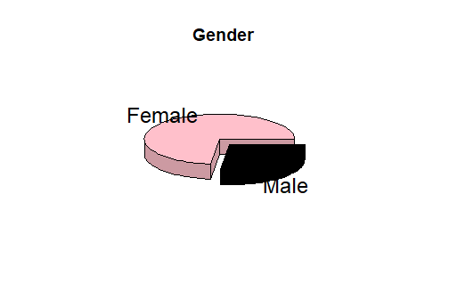
Female = 73.1%
Male = 26.9%

Slide 5
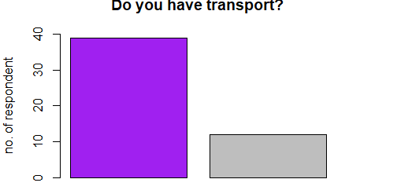
Yes
No

Slide 6
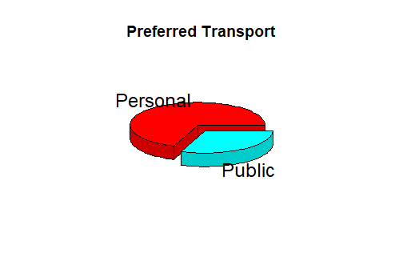
-Students prefer to use personal transport rather than public transport.
Personal = 69.2%
Public = 30.8%

Slide 7
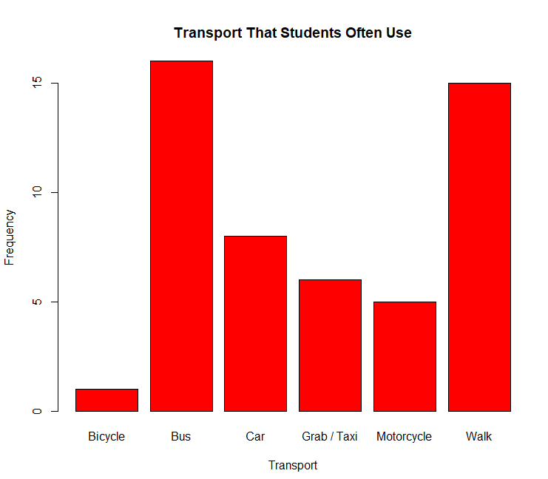
Transport that students often use.

Slide 8
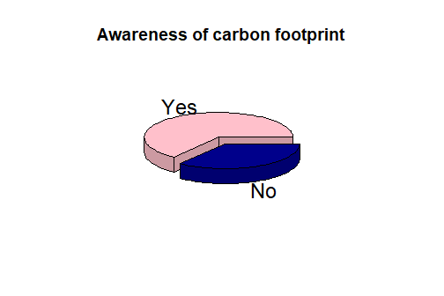
AWARENESS OF CARBON FOOTPRINT
Yes = 65.4% No = 34.6%

Slide 9
Frequency of Using Personal Transport
The decimal point is at the |
0 | 0000000000000000000
1 | 00000000000
2 | 0000000000
3 | 00
4 | 0000
5 | 000
6 |
7 | 0
8 |
9 |
10 | 0

Slide 10
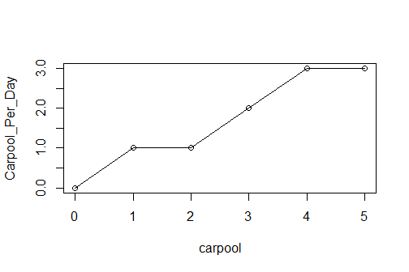
How many carpool per day?

Slide 11
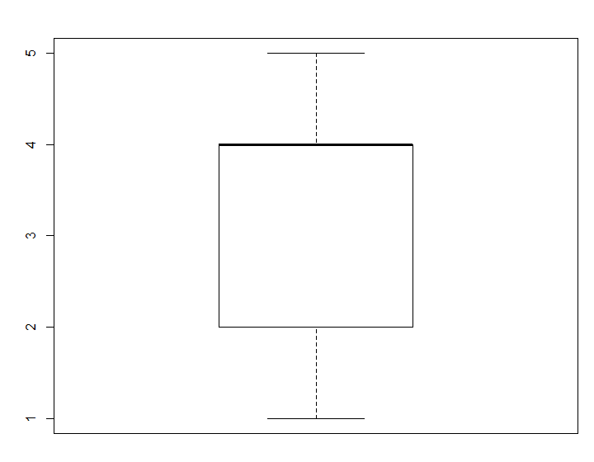
How often do you transit to class?

Slide 12
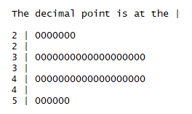
Satisfaction with transport

Slide 13
DISCUSSION & CONCLUSION

Slide 14
DISCUSSION
Most of the UTM students (65.4%) aware of carbon footprint while the rest of them(34.6%) do not aware of it.
Majority of the UTM students use transport for going to the class and the least of them use it for going back home.
36 out of 51 students (69.2%) prefer personal transport as they said it can save time and it is easier to go anywhere while the rest of them (30.8%) prefer public transport because it saves cost and keep the environment clean

Slide 15
CONCLUSION
Ways to avoid carbon foot print :
Carpooling
Use a public transport
Reason why do we avoid it :
Keep the environment green and clean
2 . To avoid global warming

