Slide 1
Design Thinking Project
CHAPTER 12 : SYSTEMS ANALYSIS AND DESIGN
Subject: Technology and Information Systems (SECP1513)
Section 07
Lecturer: Dr. Sarina binti Sulaiman
Group 9
1. Chai Ming Choy (Leader)
2. Wan Nur Atiqah binti Junaidi
3. Goh Jo Ey
4. Zaimi Mohamed

Slide 2
INTRODUCTION
What is systems analysis and design?(SAD)
Systems analysis - process of collecting and interpreting facts, identifying the problems, and decomposition of a system into its components.
Systems design - process of planning a new business system or replacing an existing system by defining its components or modules to satisfy the specific requirements.

Slide 3
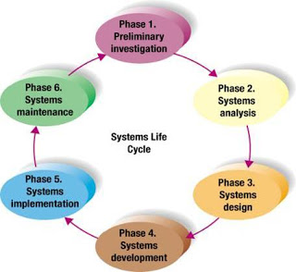
SIX-PHASES PROBLEM SOLVING PROCEDURE
SYSTEMS LIFE CYCLE
PHASE 1 : PRELIMINARY INVESTIGATION
PHASE 2 : SYSTEMS ANALYSIS
PHASE 3: SYSTEMS DESIGN
PHASE 4 : SYSTEMS DEVELOPMENT
PHASE 5 : SYSTEMS IMPLEMENTATION
PHASE 6 : SYSTEMS MAINTENANCE

Slide 4
PHASE 1 : PRELIMINARY INVESTIGATION
Identifying the problems or needs and summarized in a short report
Steps for preliminary investigation:
Defining the problem
Examining current system in use
Making observations and interviewing
Suggesting alternative systems
Preparing a short report
Summarize results of preliminary investigation and suggestions for the alternative systems
Include schedules for further development of the project
Presented to higher management

Slide 5
PHASE 2 : SYSTEMS ANALYSIS
Study the current system in depth and specify the new requirements needed from the current system
Steps for systems analysis:
Gathering data
Expands on the data gathered from Phase 1
Data obtained from observation and interviews
Analyzing data
Top-down analysis method
Grid Charts
System flowcharts
Data flow diagrams
Automated design tools
Documenting systems analysis
Documented in a report for higher management
Describes the current system, requirements for a new system, and possible development schedule

Slide 6
PHASE 3 : SYSTEMS DESIGN
Design new or an alternative system and create design report
Steps for systems design:
Designing alternative systems
Economic feasibility
Technical feasibility
Operational feasibility
Selecting the best system
Will system work with the organization’s overall information system?
Will the system be flexible enough so it can be modified in the future?
Can it be secure against unauthorized use?
Are the benefits worth the costs?
Writing the Systems Design report
For higher management
Describe alternative designs

Slide 7
PHASE 4 : SYSTEMS DEVELOPMENT
Develop and test the new hardware or software
Steps for systems development:
Acquiring software
Being purchased as off-the-shelf packaged software
Modified or custom-designed
Acquiring hardware
Install new equipment
Testing new system
Processed information is evaluated to see the results
May take several months

Slide 8
PHASE 5 : SYSTEMS IMPLEMENTATION
New information is installed and people are trained to use it
Steps for systems implementation:
Types of conversion
Direct
Parallel
Pilot
Phased
Training
Show people on how to operate the system

Slide 9
PHASE 6: SYSTEMS MAINTENANCE
The system is periodically evaluated and updated as needed.
Is a very important ongoing activity which includes a system audit and a periodic evaluation
A system audit is a disciplined approach to evaluate and improve the effectiveness of a system.
Audits are carried out in order to verify that the individual elements within the system are effective and suitable in achieving the stated objectives.
A periodic evaluation is an evaluation that is scheduled to reoccur.
This evaluation type is often used for weekly, monthly or annual evaluations.

Slide 10
HOW WE CARRY OUT THE DESIGN THINKING FOR THE TOPIC OF SYSTEMS ANALYSIS AND DESIGN?

Slide 11
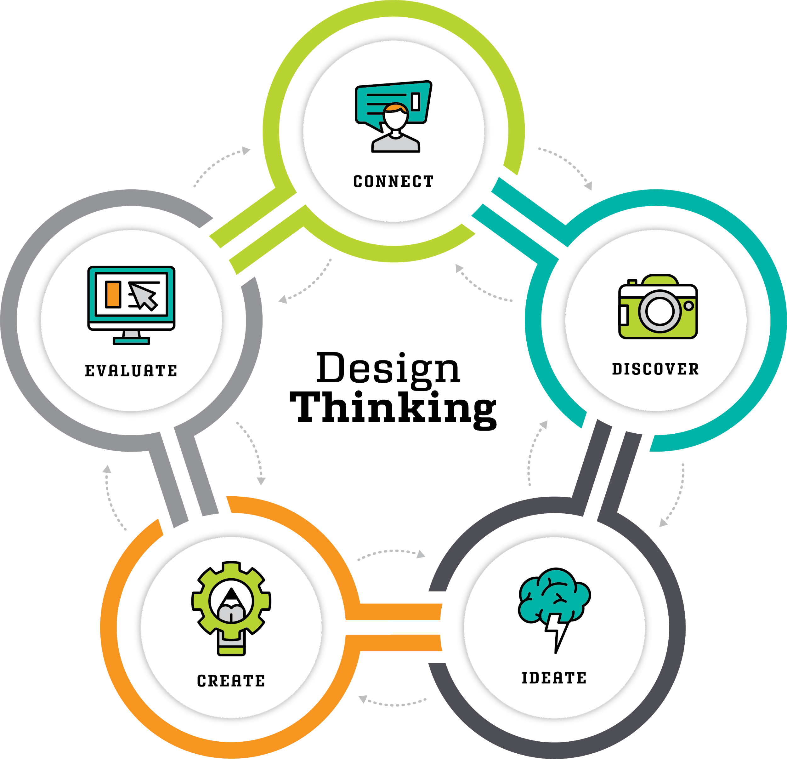
FIVE STAGES IN DESIGN THINKING
STAGE 1: Empathy
STAGE 2: Define
STAGE 3: Ideate
STAGE 4: Prototype
STAGE 5: Test

Slide 12
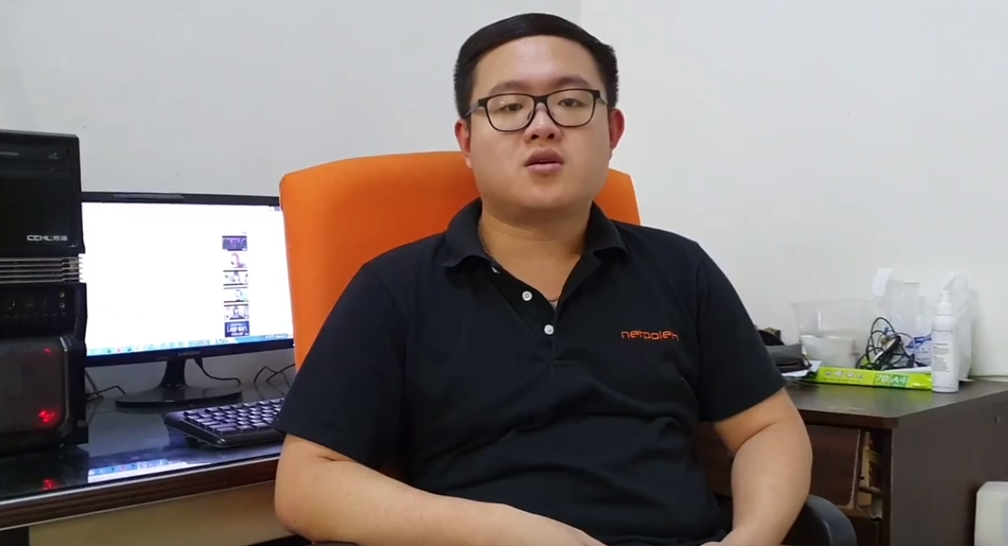
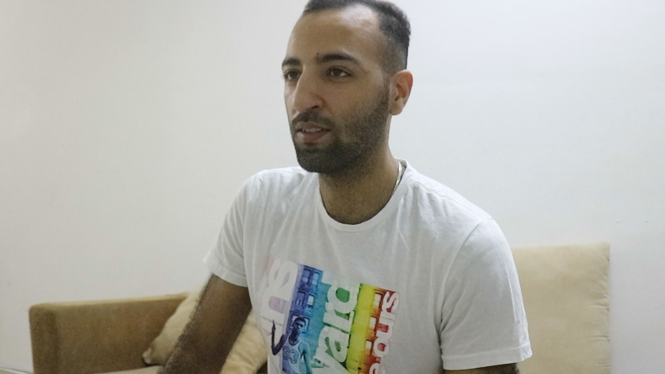
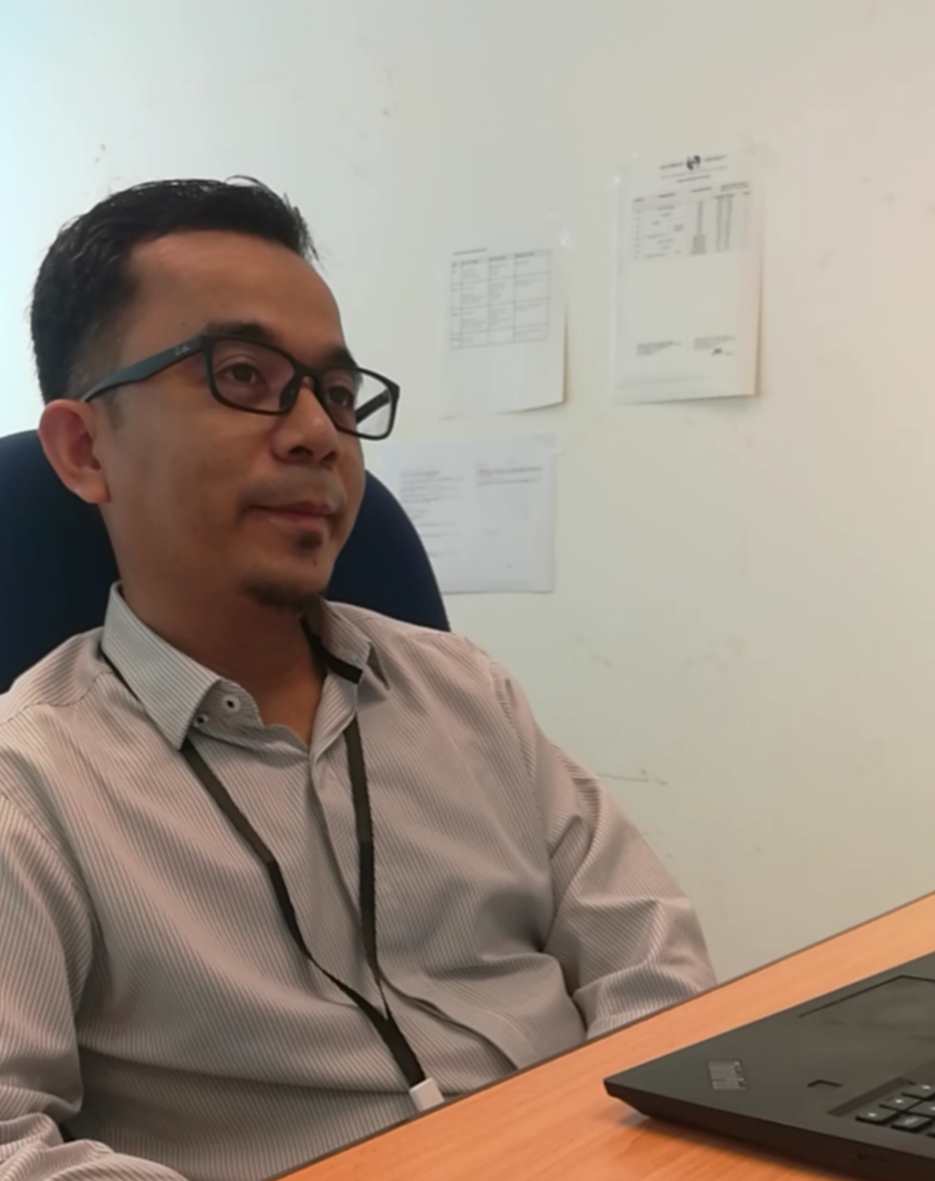
EMPATHY: INTERVIEW
Interview with project manager
Interview with client or user
Interview with programmer

Slide 13
DEFINE : What are the common or core problems that the interviewees have faced

Slide 14
A. Communications between the project manager, project programmers and client

Slide 15
B. Hard to trace the progress of the project

Slide 16
C. Running a lot of applications at the same time for a project

Slide 17
IDEATE : BRAINSTORM PROCESS TO GENERATE SOLUTION
A forum for programmers to connect and communicate with each other in solving a program
Templates for common problems and solutions in programming
Design an application which combines the functions for multiple applications into a single application

Slide 18
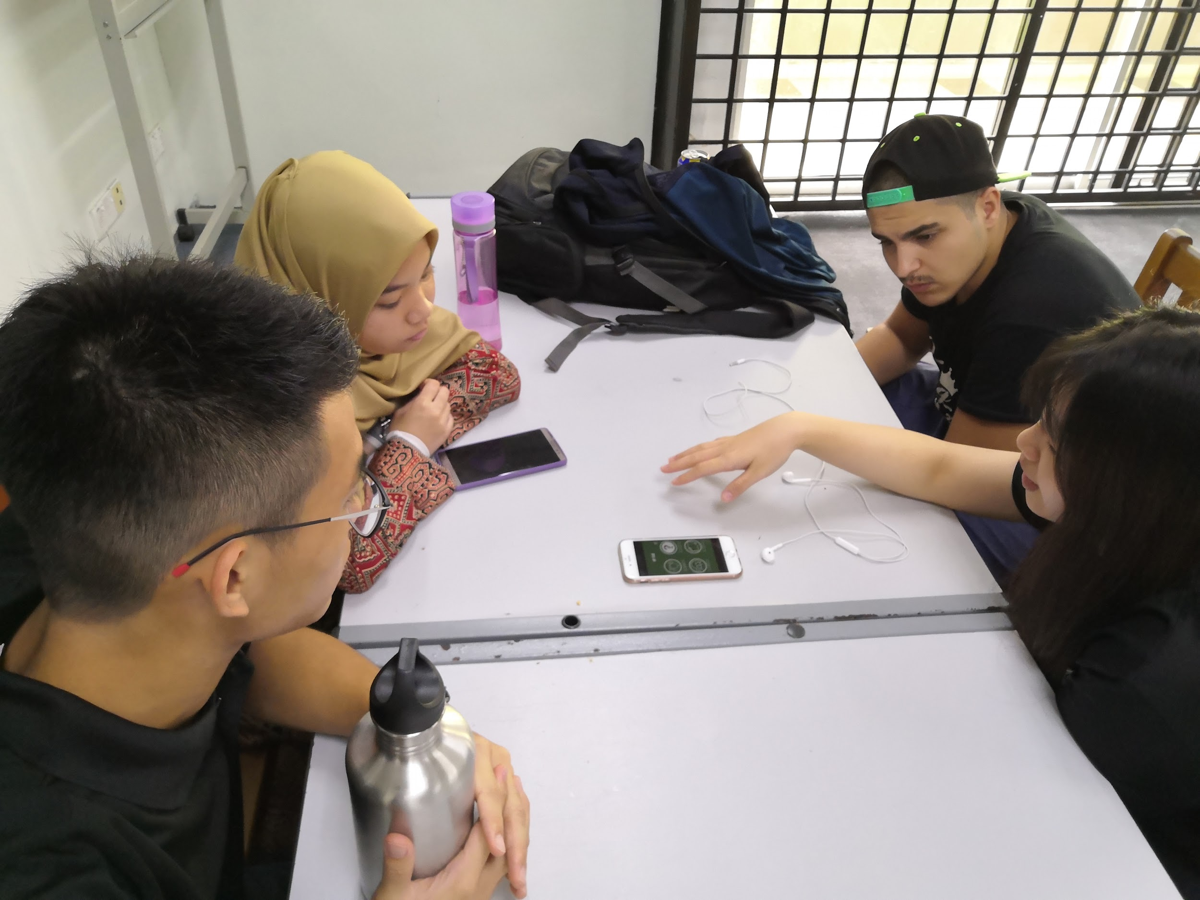
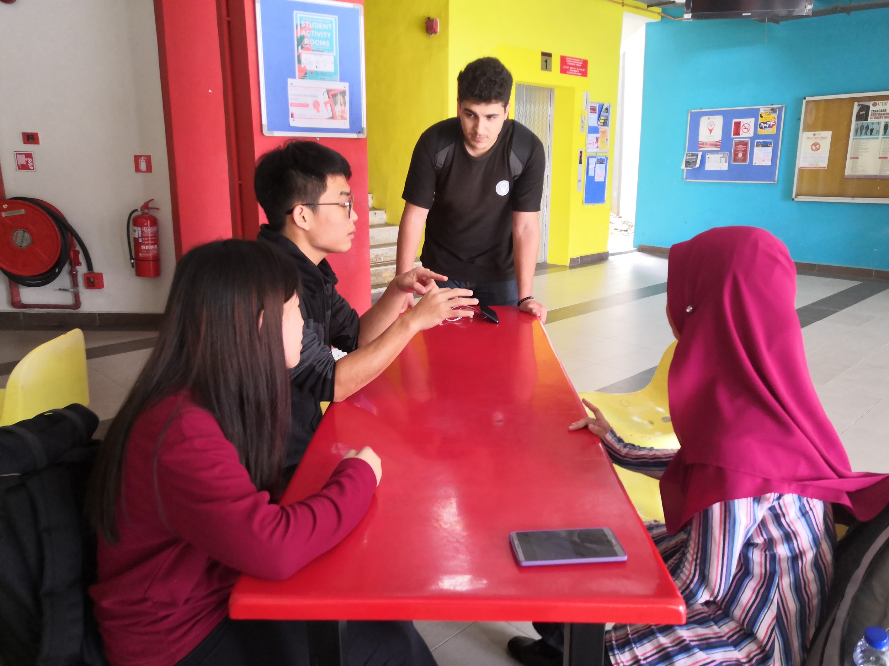
Brainstorm process

Slide 19
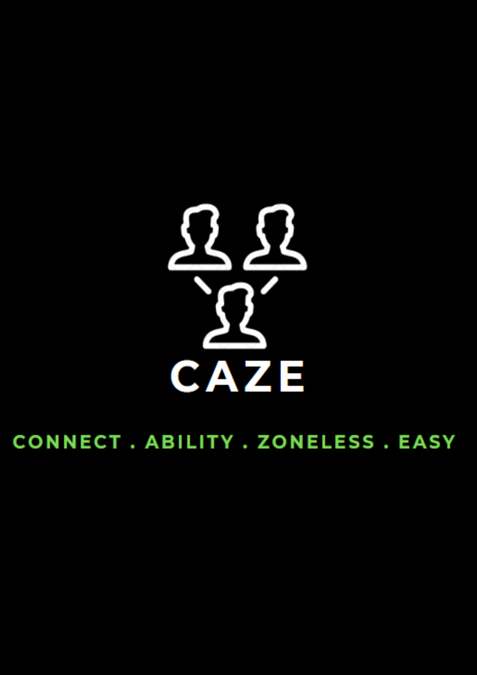
PROTOTYPE
Application : CAZE
Connect(C) - Connect all the phases involved
Ability (A) - Ability to connect and speed up the process
Zoneless (Z) - Can do the work anywhere
Easy (E) - Make the work easier

Slide 20
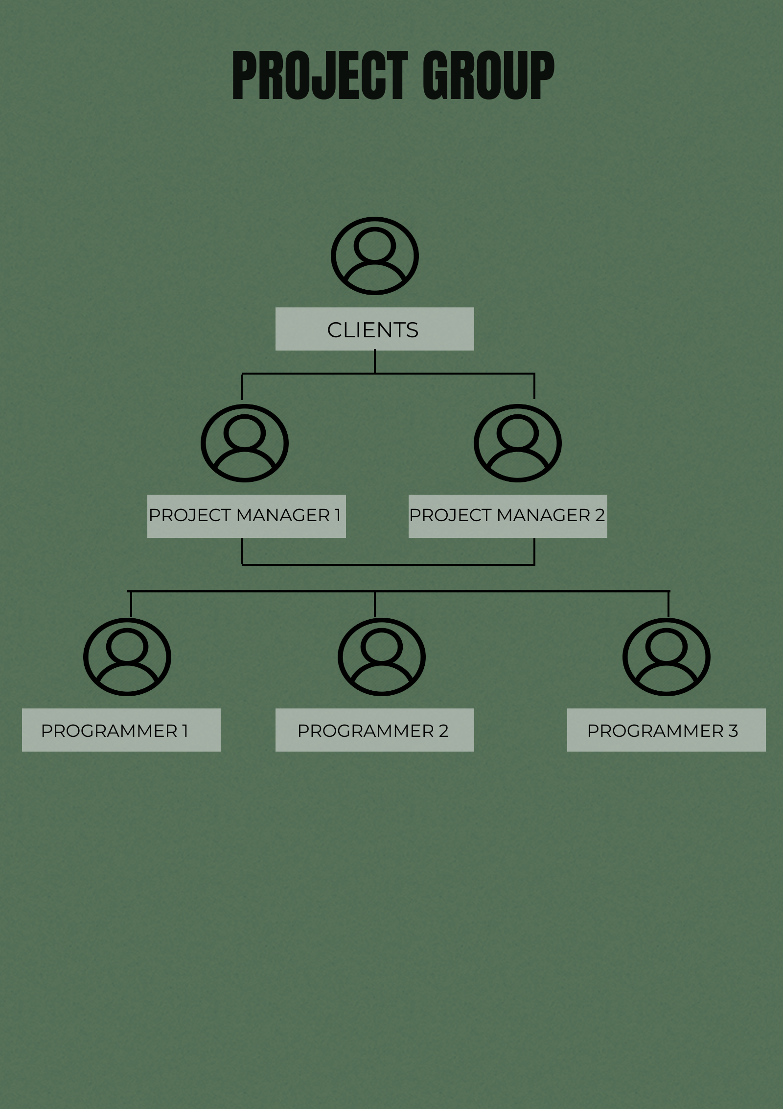
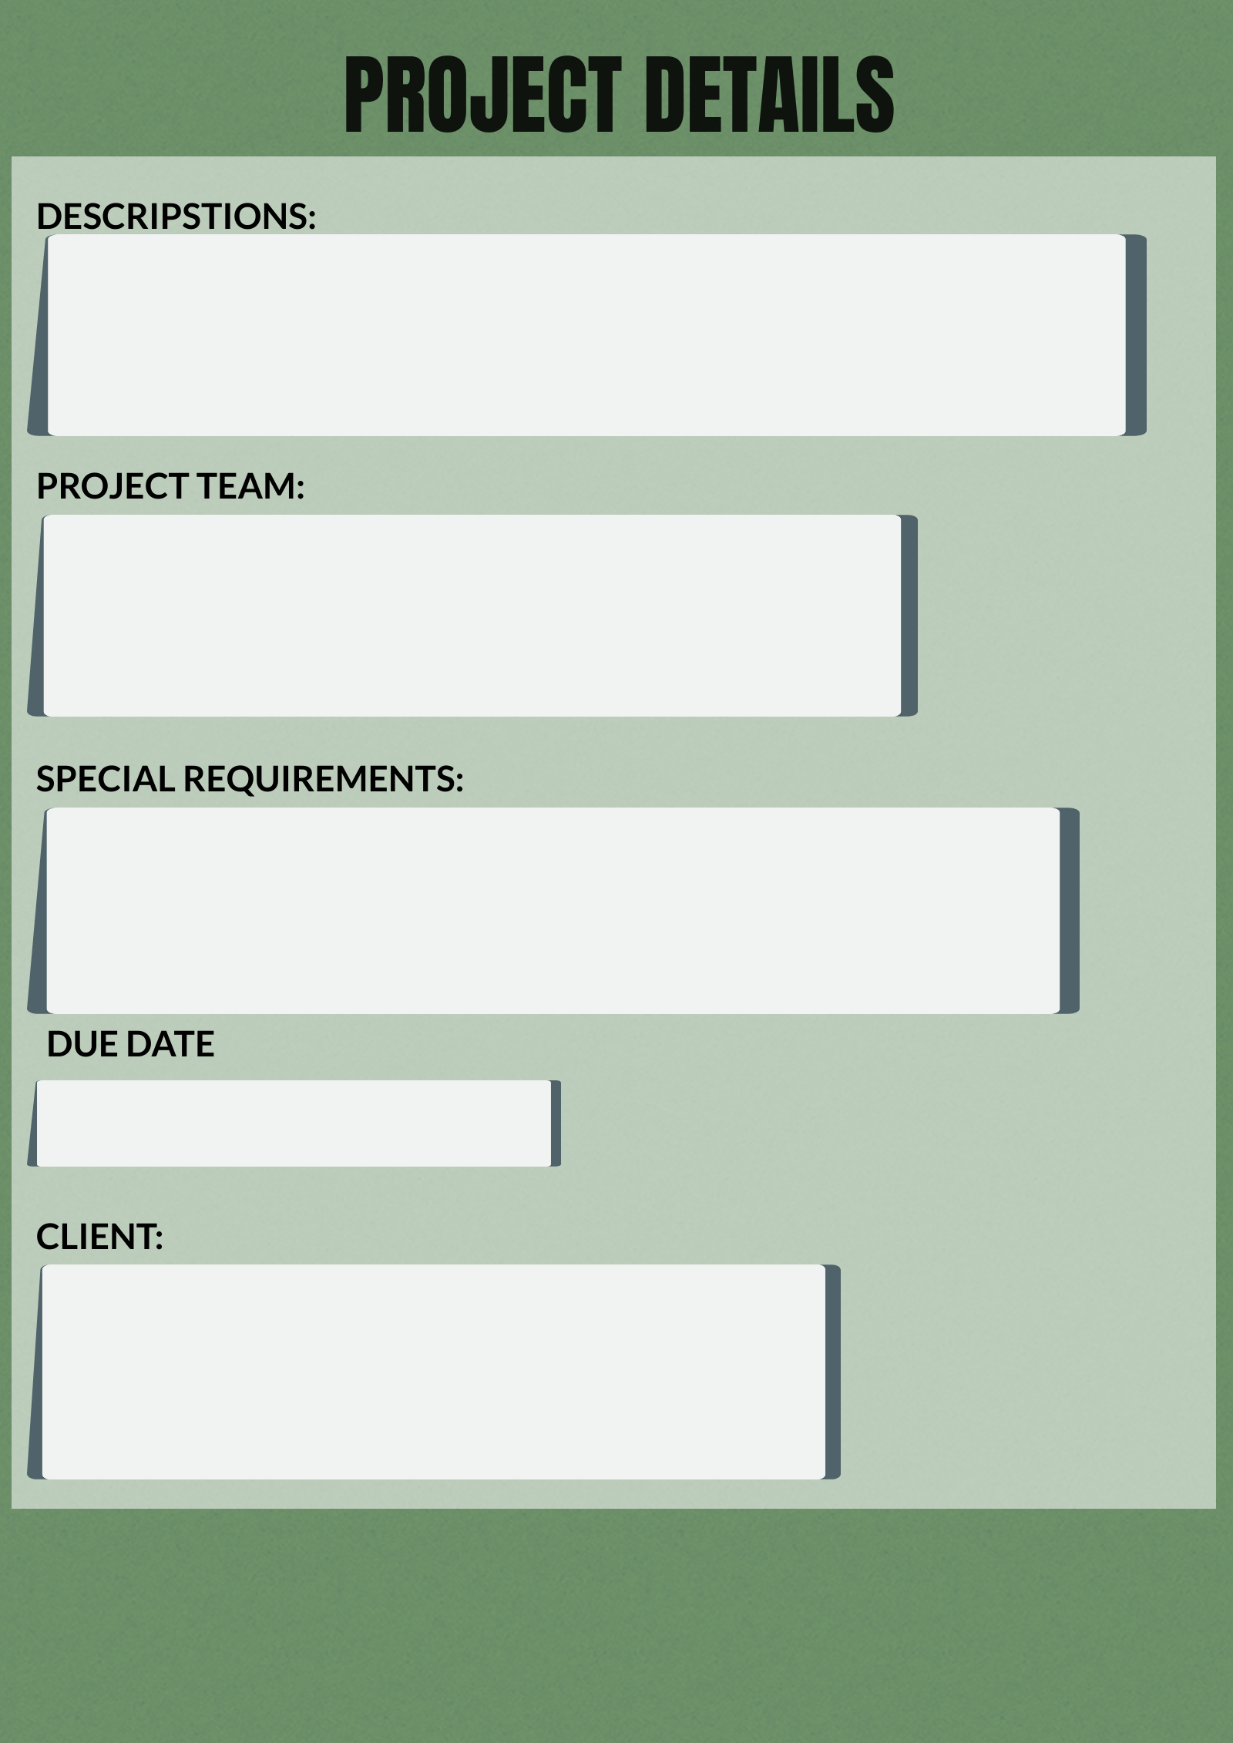
INFORMATION OF THE PROJECT
PROJECT GROUPS - The members in the project will be shown once the project started
PROJECT DETAILS - All the details of the project has been clearly stated. It can ensure the special requirements of the clients can be fulfilled.

Slide 21
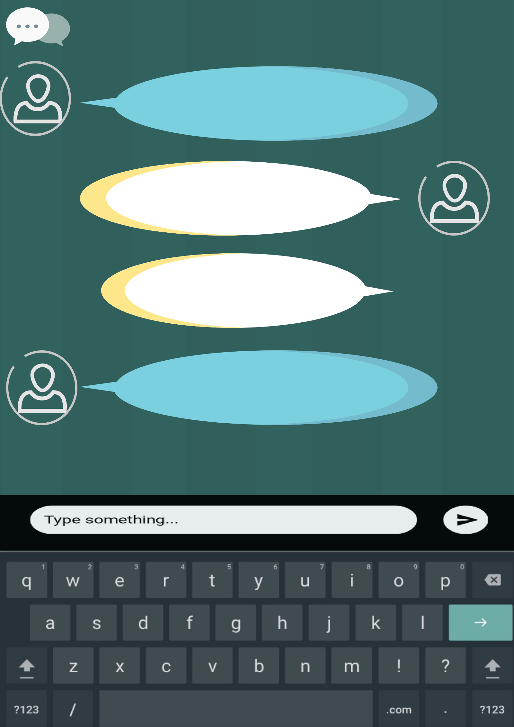
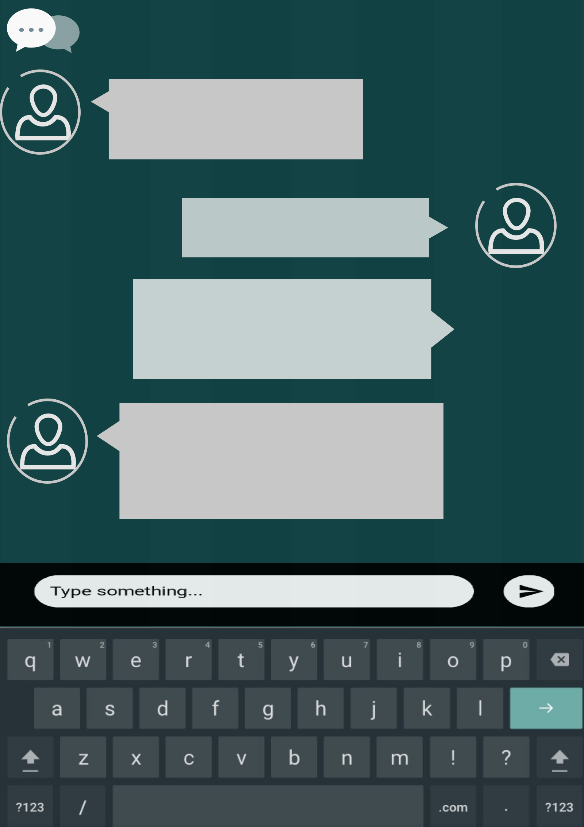
COMMUNICATION
Project manager can easily communicate with programmers and client once the project has started

Slide 22
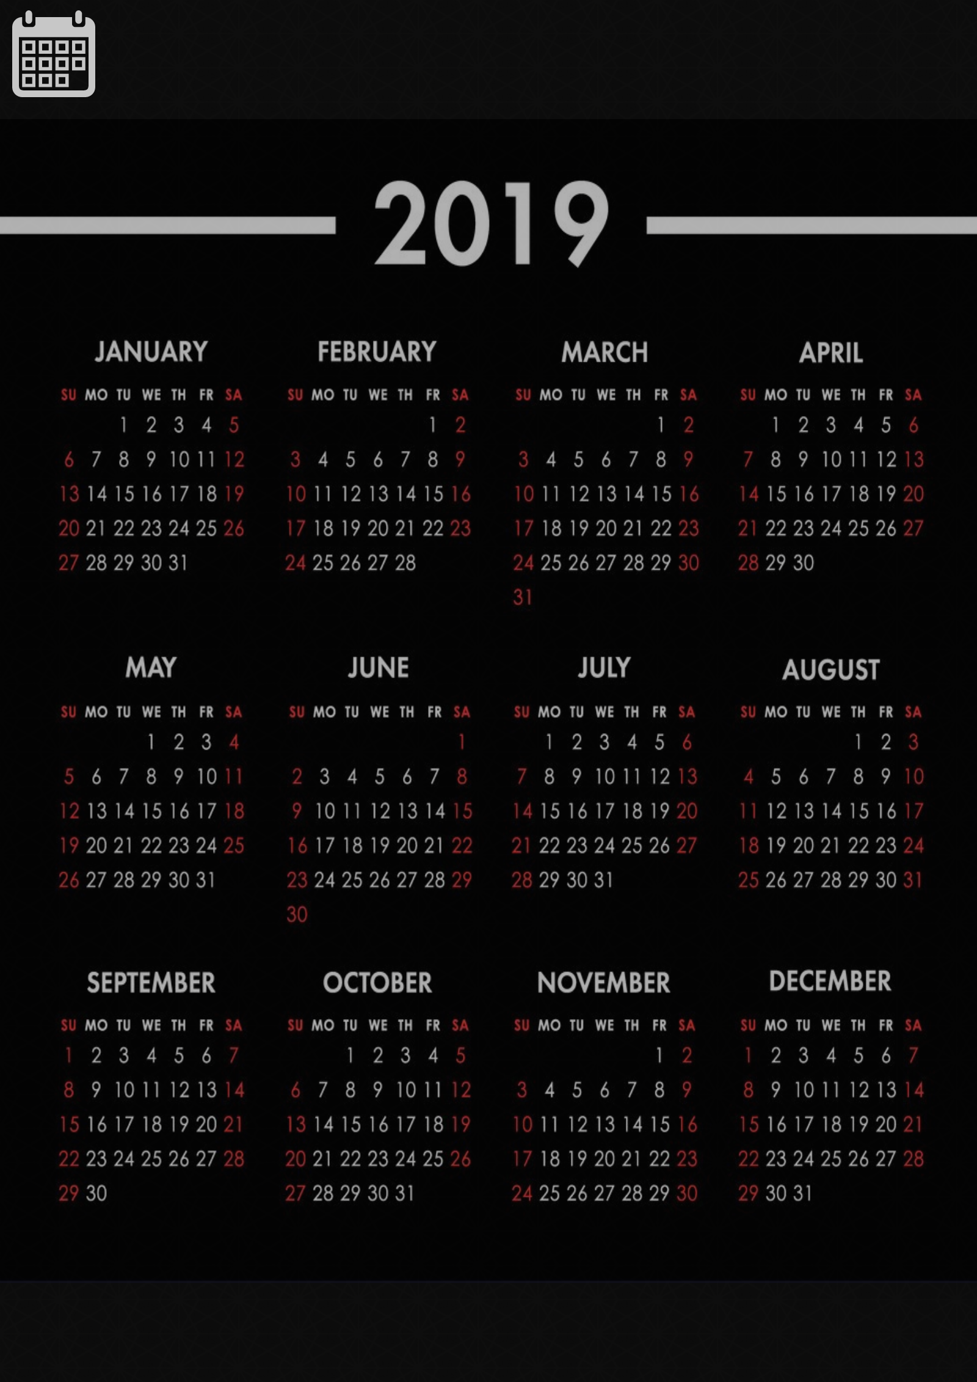
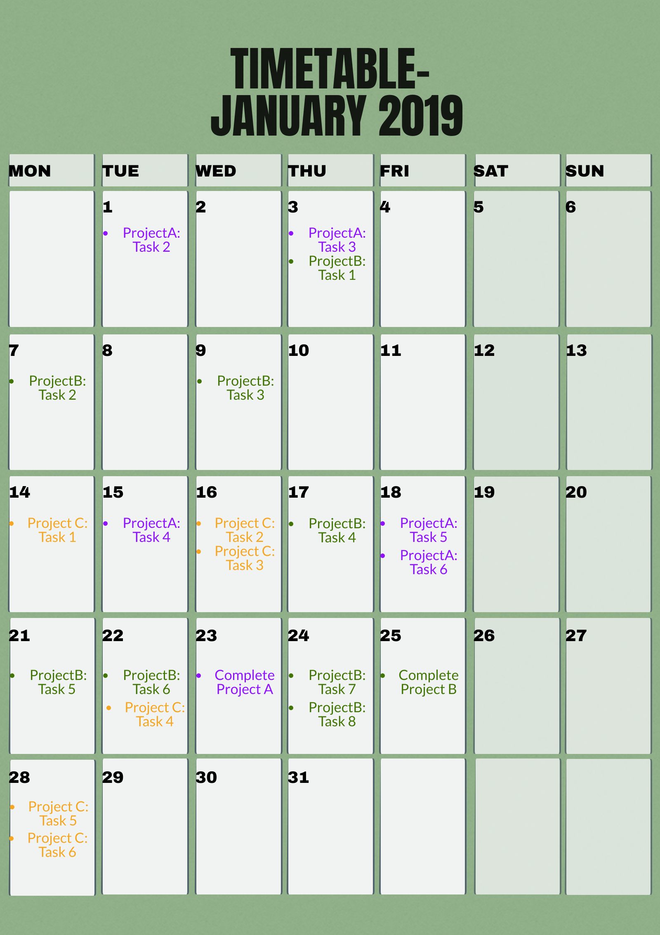
TIMETABLE
The timetable of the programmer can be viewed by the project manager to prevent the task that has been assigned will not overlap with other tasks or activities and will be completed on time.

Slide 23
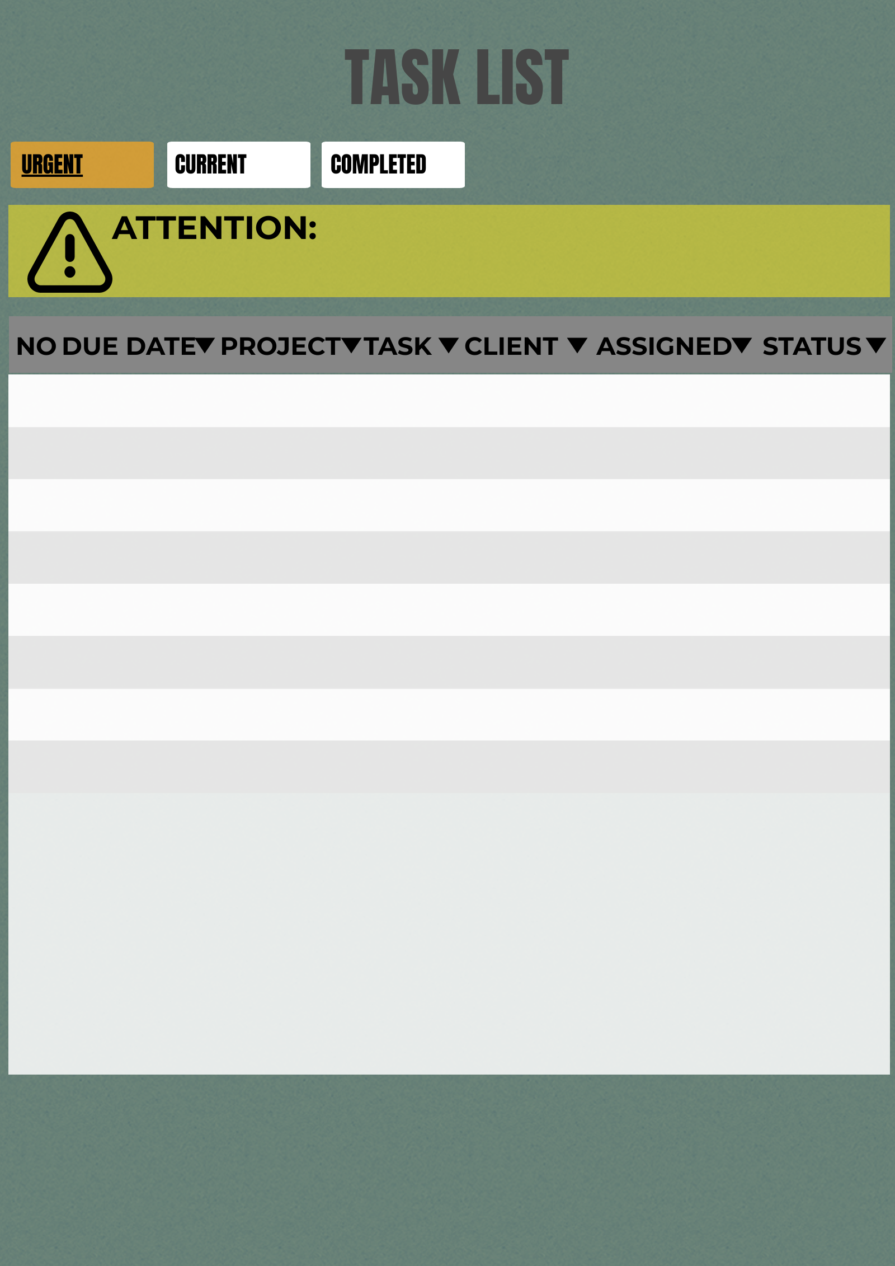
TASK LIST
All the tasks are listed with the details such as due dates, clients, and status of the task. The task that are delayed will be reminded by showing an alert sign on the top.

Slide 24
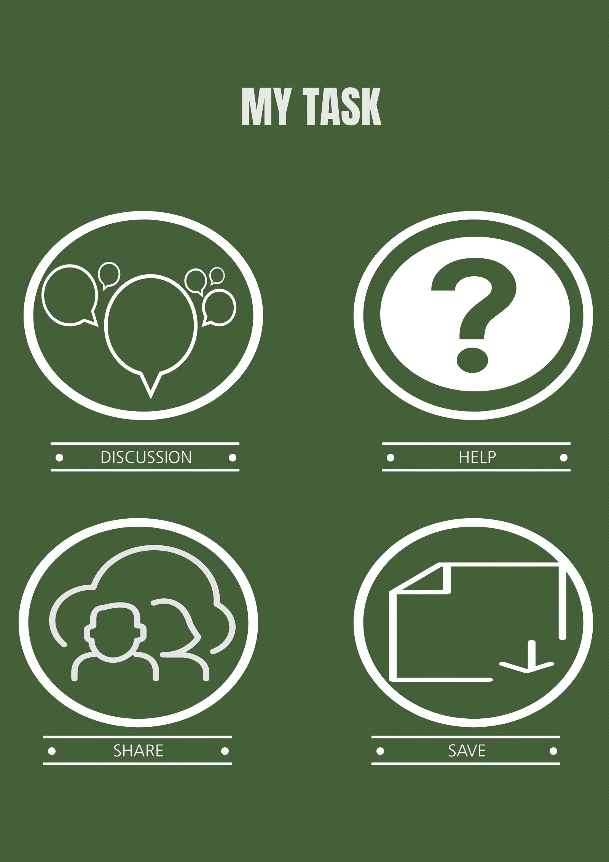
HELP STATION
The programmers can discuss all the tasks by using this interface and complete their tasks together. It can prevent the delaying of tasks. They can also save useful data and share the data to each other.

Slide 25
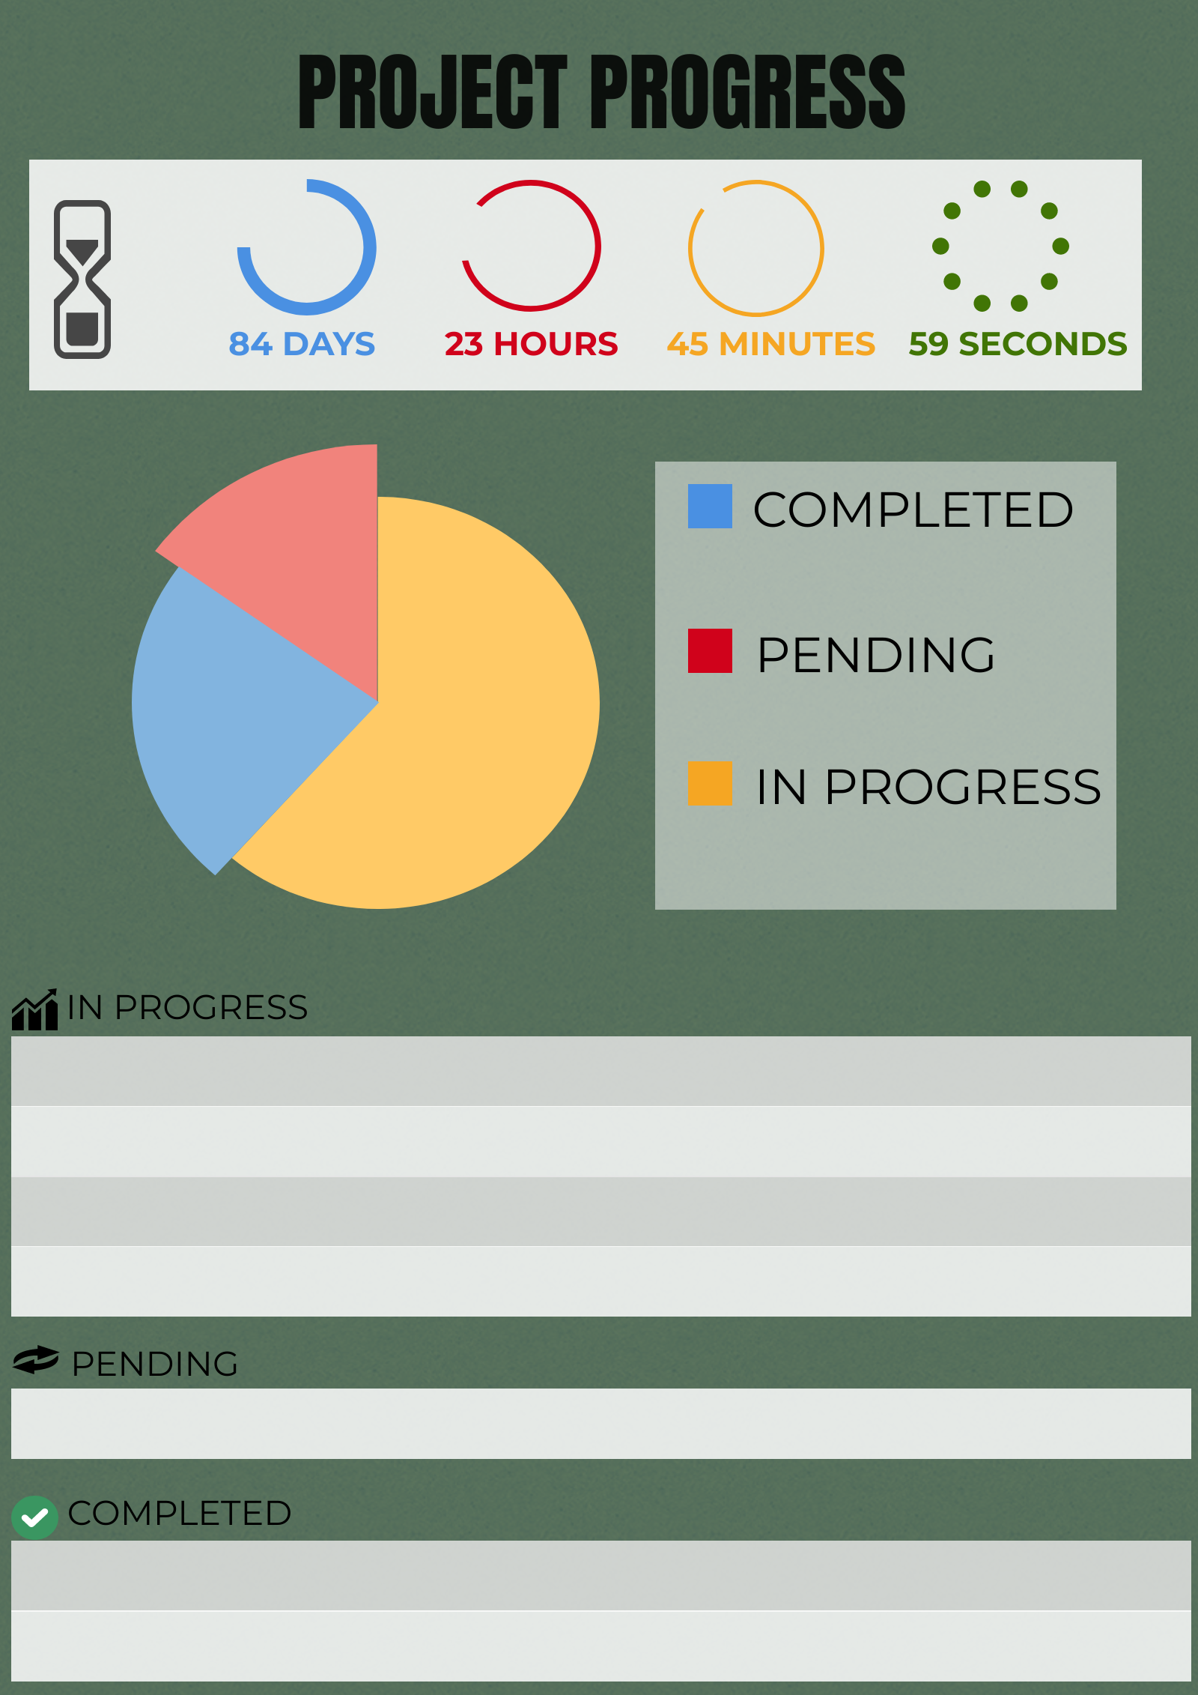
TRACE THE PROGRESS
The progress of every task in the project can be viewed easily by the user and project manager in this interface.

Slide 26
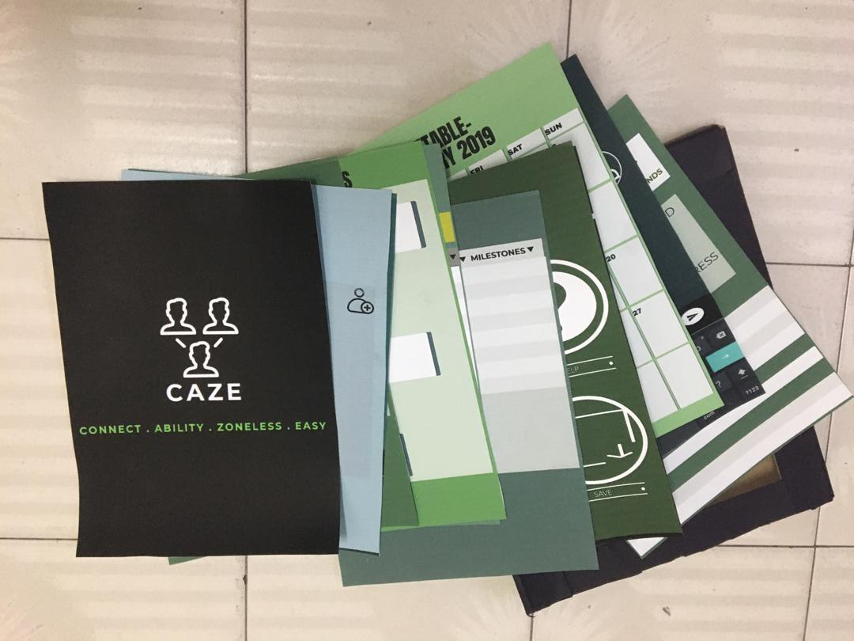
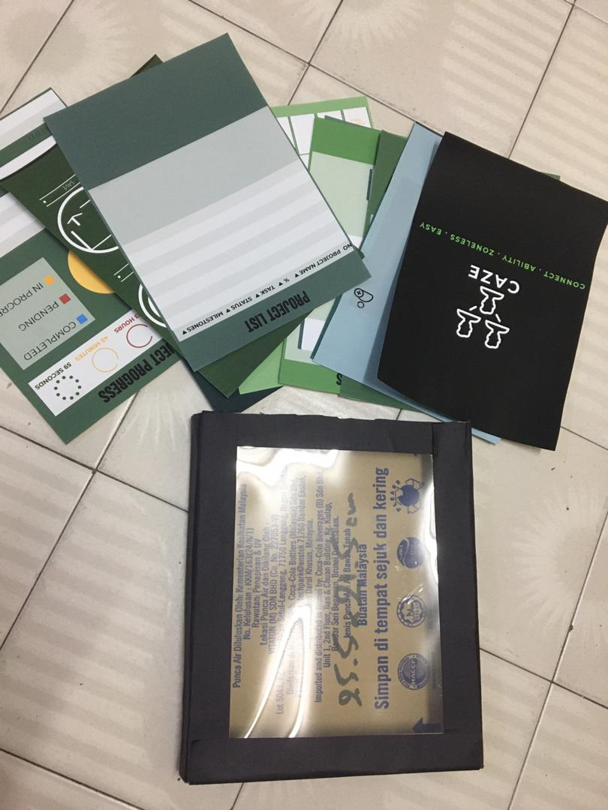
Paper Prototype

Slide 27
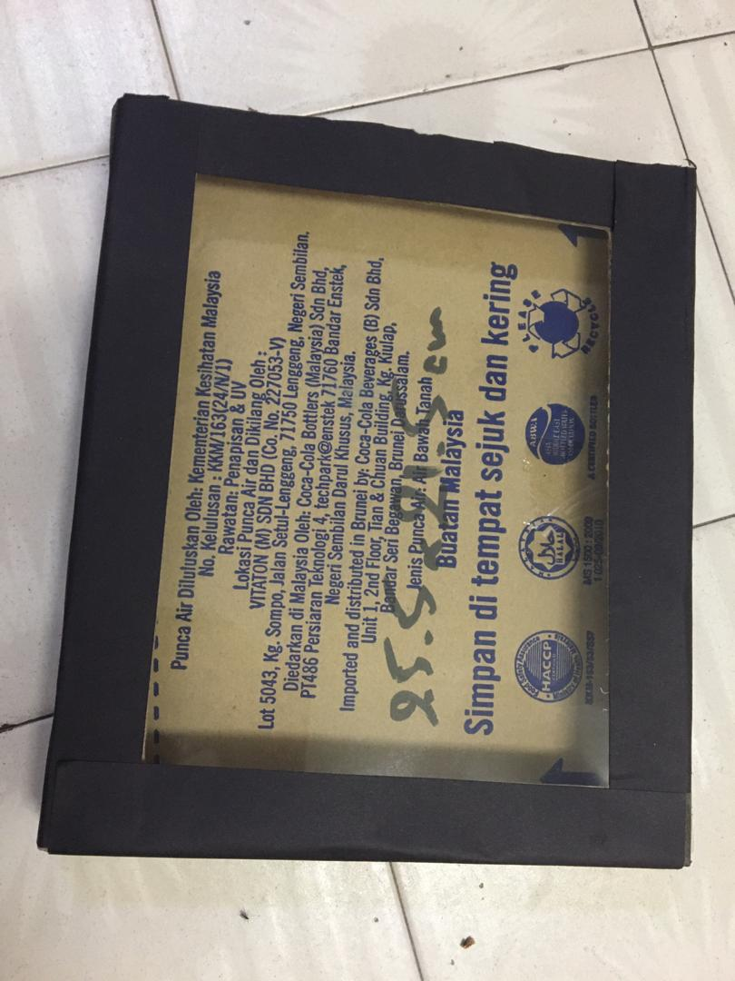
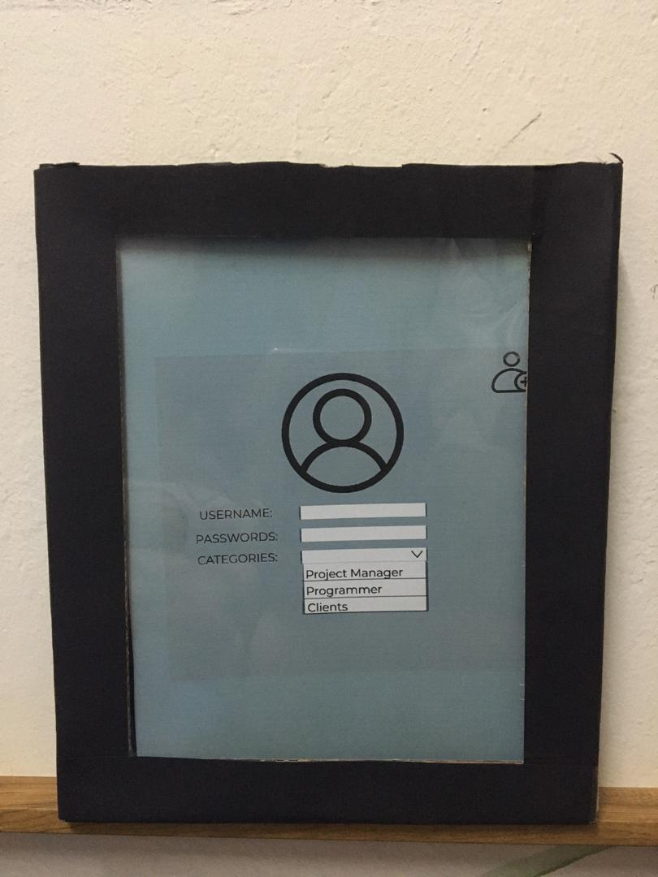

Slide 28
TEST - WHAT SHOULD WE IMPROVE
Privacy problems - a suggestion from the user to make our application to have more privacy for users. The user can set permission to decide and allow who can view their timetables.
Alarm - a suggestion from the user to have alarm system in our application. The alarm system can be set by the user to alert them on some specific task.
Online conferences call - a suggestion from the user to add on the function of video call meeting as face-to-face communication is more comfortable and direct

Slide 29
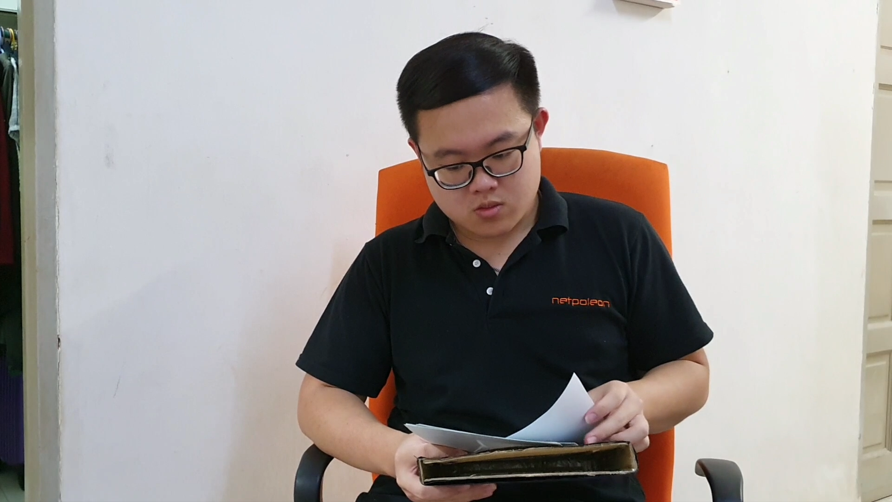
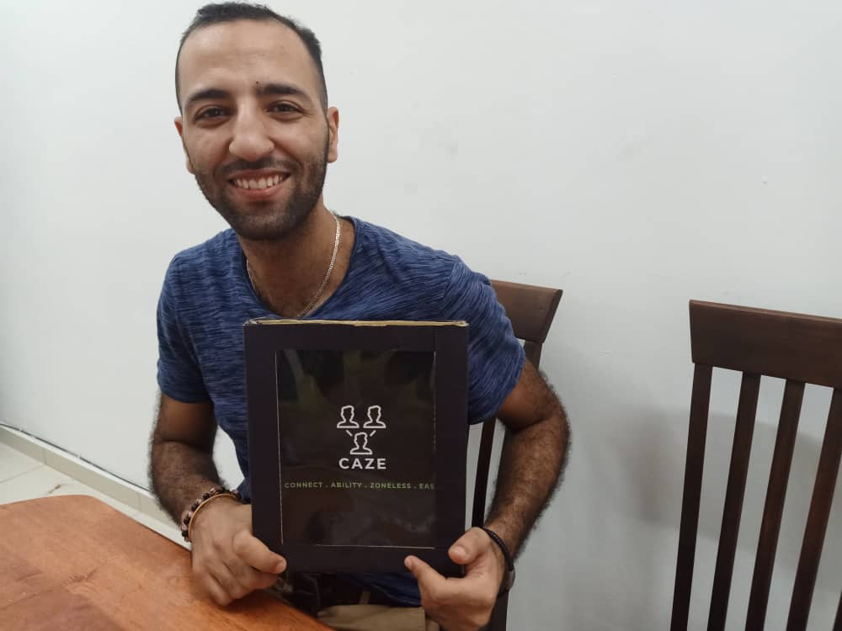
The interviewees viewing and giving their opinions on the prototype.

Slide 30
References
tutorialspoint.com. (2019). System Analysis and Design - Overview - Tutorialspoint. [online] Available at: https://www.tutorialspoint.com/system_analysis_and_design/system_analysis_and_design_overview.htm
[Accessed 5 Nov. 2019].
Anon, (2019). [online] Available at: https://www.ispatguru.com/system-audits-and-the-process-of-auditing/
[Accessed 5 Nov. 2019].
Employee evaluation and profitability analysis software - AssessTEAM. (2019). What is a periodic evaluation? - AssessTEAM. [online] Available at: https://www.assessteam.com/knowledgebase/what-is-a-periodic-evaluation/
[Accessed 5 Nov. 2019].
O'Leary, T., O'Leary, L. and O'Leary, D. (n.d.). Computing essentials 2015. New York: MC GRAW HILL Education, pp.304 - 315.

Slide 31
THANK YOU

