Slide 1
The System Unit
5
Chapter 5

Slide 2
Learning Objectives
Differentiate between the five basic types of system units.
Describe system boards, including sockets, slots, and bus lines.
Recognize different microprocessors, including microprocessor chips and specialty processors.
Compare different types of computer memory including RAM, ROM, and flash memory.
Explain expansion slots and cards.
Describe bus lines, bus widths, and expansion buses.
Describe ports, including standard and specialized ports.
Identify power supplies for desktop, laptop, tablet, and mobile devices.
Explain how a computer can represent numbers and encode characters electronically.

Slide 3
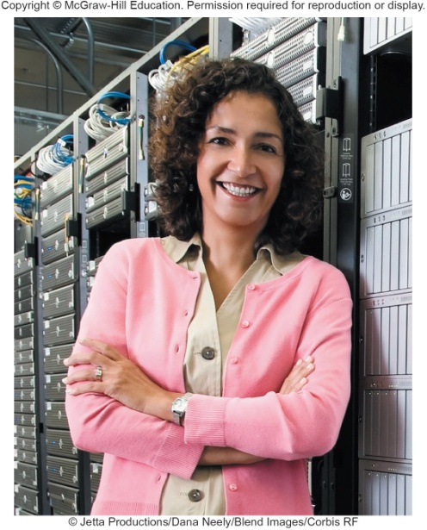
Introduction
Speed, capacity, and flexibility determine the power of personal computers.
Knowledge of a computer’s power allows you to make good buying decisions and to determine if your current system will run new applications.
Competent end users need to understand the functionality of the basic components of the system unit
Notes:
Inform students about the Computer Buyer’s Guide at the end of the book which provides additional information on purchasing a computer.

Slide 4
System Unit
System Chassis
Container that houses most of the electronic components that make up a computer system
System Unit
Contains system’s electronic components and selected secondary storage devices
Notes:
System unit (key term) is also referred to as the system chassis(Key Term)

Slide 5
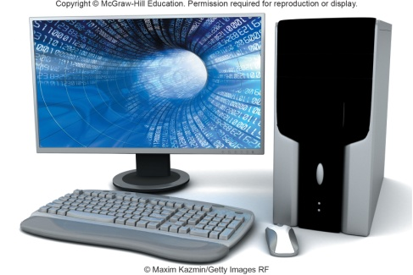
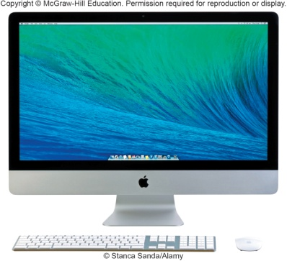
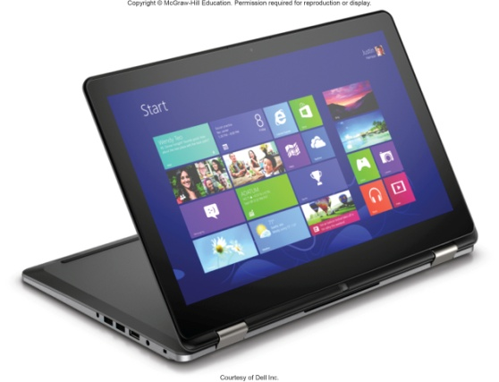
System Unit Types
Desktops
System unit is in a separate case
Tower Units
All-in-Ones
All components including monitor
Laptops
Portable and much smaller
Ultrabooks – laptop and tablet in one
Gaming – high end graphics
Notes:
All computers have a system unit
Desktop (key term) – contains electronic components and selected secondary storage.
System units are placed in tower units (key term) or tower computers (key term)
Laptop (key term) – contains electronic components, secondary devices, and input devices – often called notebook computers (Key Term)
Ultrabook or Ultraportables (key term) or mini notebook (key term) are very portable laptops.
Lighter, thinner, longer battery life

Slide 6
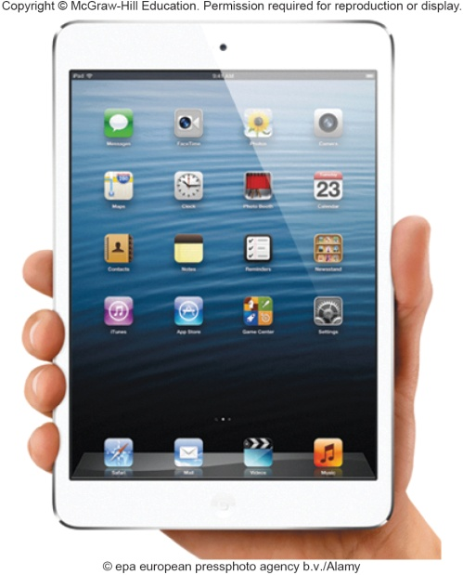
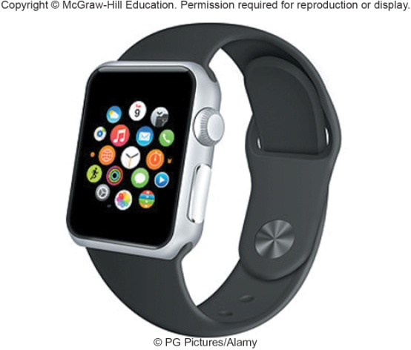
System Unit Types cont.
Tablets
Mini tablet
Smartphone
Most popular device – handheld computer
Extend the capabilities of cell phones
Wearables
Contain embedded computers
Notes:
Tablet (Key Term) or tablet computer – flat screen and typically do not have a keyboard.
Operating system controls their operations
Smartphones (key term) or Hand-held computer systems (key term) – entire computer system is contained in the device. Most popular
Wearables (key term) contain embedded computers
Smartwatches and Activity Trackers

Slide 7
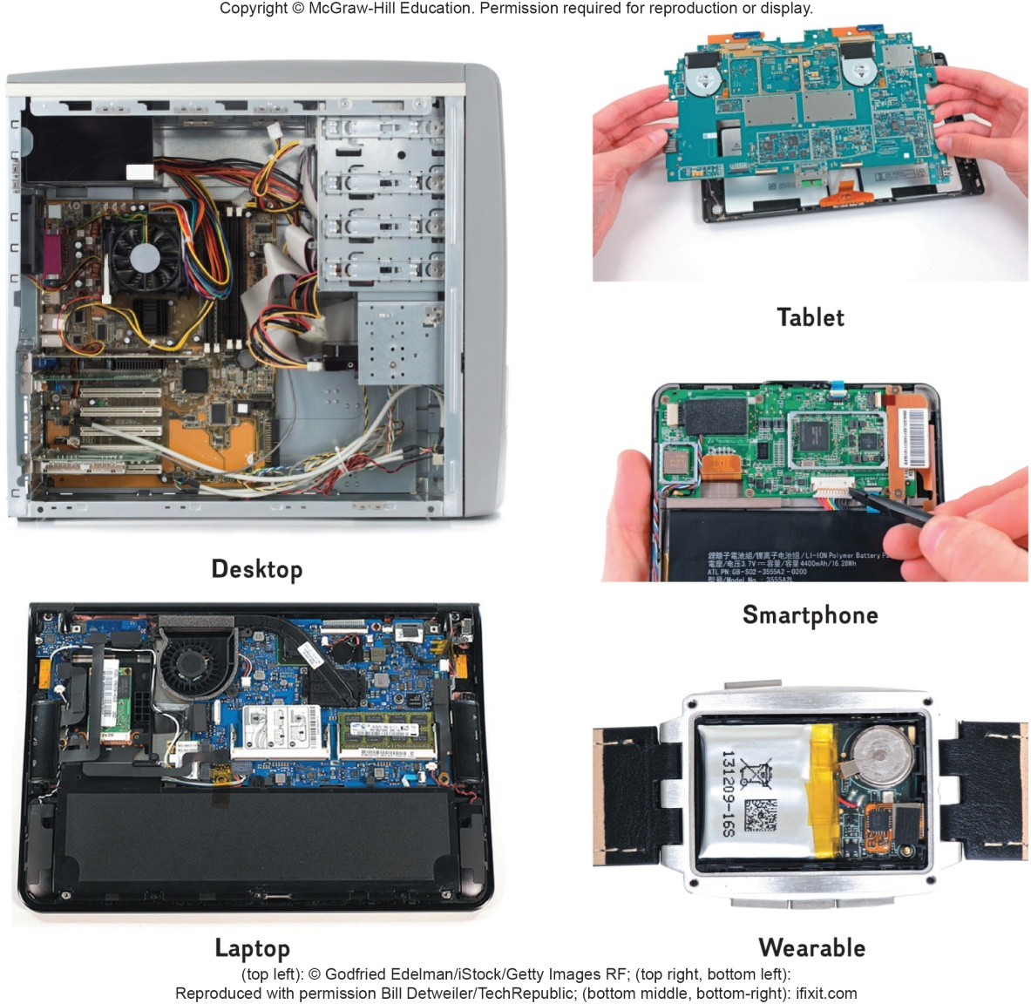
Components
Although all devices come in many shapes and sizes they have similarities such as
System boards
Microprocessors
Memory
Notes:
Components are very similar on different devices.

Slide 8
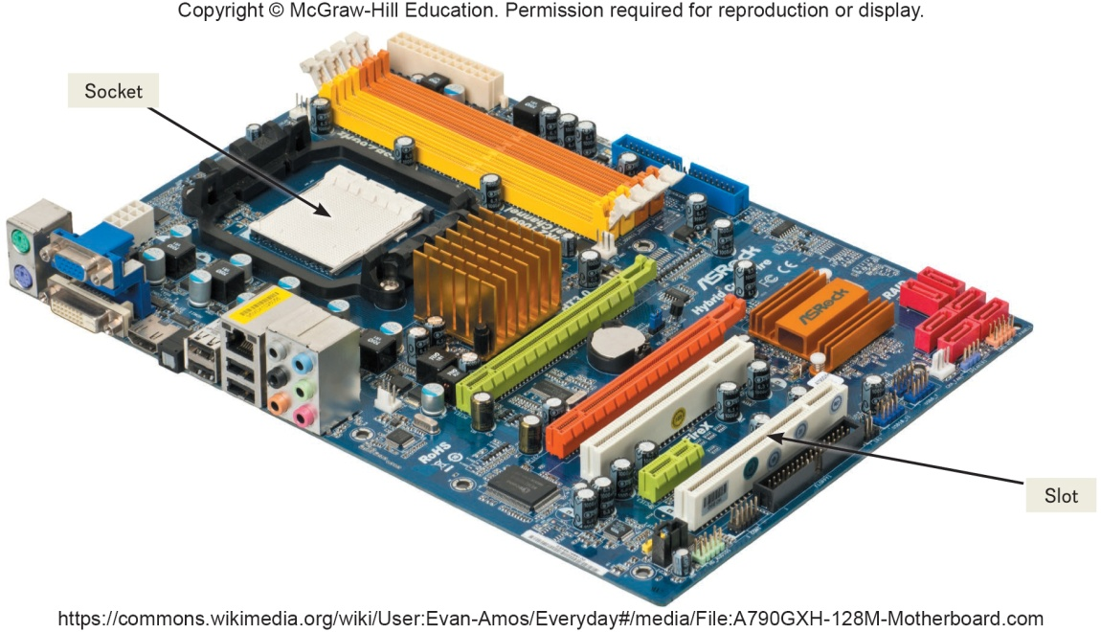
System Board
System board or main board or motherboard controls communication for the entire computer system
All components and devices connect to the system board
Data path and traffic monitor
Allows various components to communication efficiently with one another
Notes:
System board (key term) or mainboard (key term) or motherboard (key term) – controls communication for the entire computer system
All devices and components connect to the system board
Acts as a data path and traffic monitor that allows the components to communicate with each other.

Slide 9
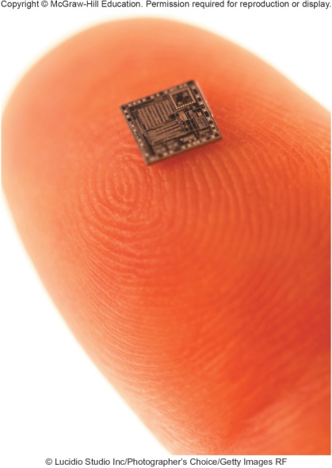
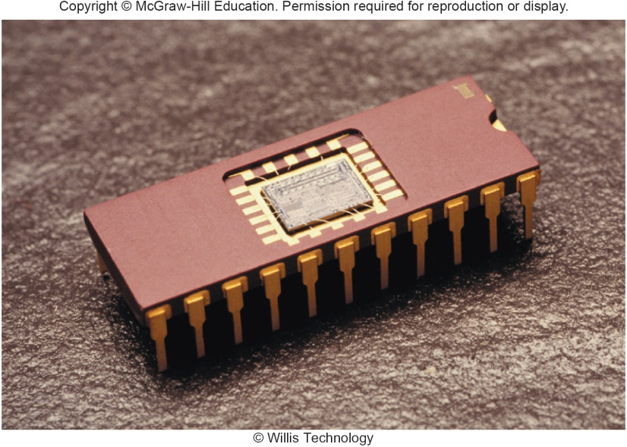
Sockets and Chips
The system board contains a variety of electronic components
Sockets – the connection point for chips
Chips
Tiny circuit boards etched onto squares of silicon
Also called silicon chip, semiconductor, or integrated circuit
Mounted on chip carriers
Notes:
Sockets (key term) – connection point for chips
Chips (key term) contain numerous circuits etched on a small wafer of layers of silicon and other materials
Chips are mounted on carrier packages (Key Term)
Chips are also referred to as a silicon chip (Key Term), semiconductor (Key Term), or integrated circuit (Key Term)

Slide 10
Slots and Bus Lines
Additional system board components:
Slots
Provide a connection point for specialized cards or circuit boards
Provide expansion capabilities for the computer
Bus lines
Connecting lines that provide pathways to support communication among electronic components
Notes:
Slots (key term) – connection point for specialized cards or circuit board
Provides expansion capability
Bus lines (key term) –connecting lines that provide pathways that support communication

Slide 11
Microprocessor
Central Processing Unit (CPU) or Processor
Contained on a single chip call a Microprocessor
Brains of the computer
Two Basic Components of the CPU
Control unit
Tells the computer system how to carry out a program’s instruction
Arithmetic-logic unit (ALU)
Performs arithmetic and logical operations
Notes:
Central Processing Unit (CPU) (key term) or processor is located on the microprocessor (key term) chip and has two components - the control unit and the arithmetic-logic unit
Control Unit (key term)
Program instructions
Directs flow between memory and Arithmetic-Logic Unit
Directs flow between CPU and I/O devices
Arithmetic-Logic Unit – ALU (key term)
Two types of operations
Arithmetic operation (Key Term) such as addition, subtraction, multiplication and division
Logical operation (Key Term) comparisons such as equal to, less than and greater than

Slide 12
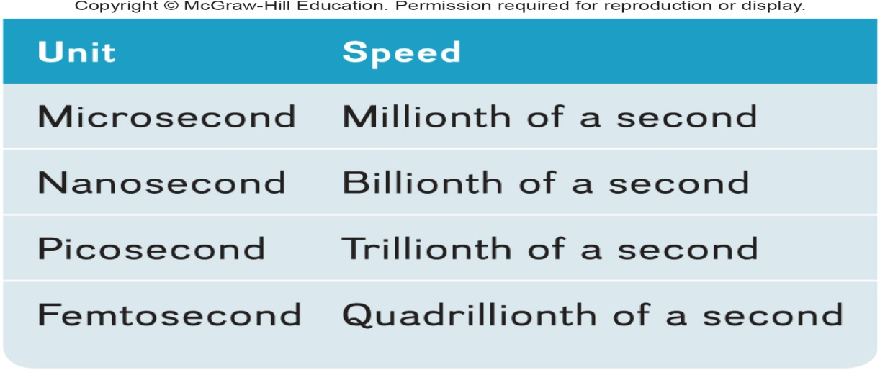
Microprocessor Chips
Chip capacities are expressed in word size
Word is the number of bits that can be processed at one time: 16, 32 or 64
Clock Speed
Processing speed or the number of times the CPU fetches and processes data or instructions in a second
Notes:
A word (Key Term) is the number of bits that can be accessed at one time by the CPU
8 bits group together to form a byte
32 bit word computer can access 4 bytes at a time
64 bit word computer can access 8 bytes at a time
Clock speed (key term) – number of times the CPU can fetch and process data and instructions in a second
Older computers measured in millionth of a second – microsecond
Newer computers measured in billionth of a second – nanosecond
Super computers measured in picoseconds

Slide 13
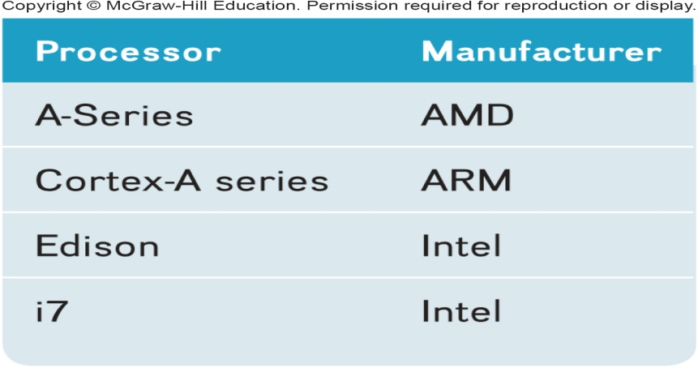
Multicore Chips
Multicore Processors
Two or more separate and independent CPUs within a system unit
Quad-core supports 4 core processes
Parallel Processing
Computer’s ability to divided tasks into parts that can be distributed across each core
Windows 8 and Mac OS X support parallel processing
Notes:
Multicore processors (key term) – allow a single computer to run two or more operations at the same time
Example: quad-core processor could have one core computing a complex Excel spreadsheet while the other is running a multimedia presentation while the third is running Word and the fourth is running Acess.
Parallel Processing (key term) – dividing tasks into parts that can be distributed across each core

Slide 14
Specialty Processors
Coprocessors
Designed to improve specific computing operations
Graphics Processing Unit (GPU) / Graphics coprocessors
Designed to handle a variety of specialized tasks
3D images
Encrypting data
Standard features in gaming computers
Notes:
Specialty processors are designed to handle special functions
Coprocessor (key term) chips designed to improve specific computing operations
Graphics coprocessor (key term), Graphics Processing Unit
Displaying 3-D images and encrypting data
Cars may have up to 70 specialty processors now.

Slide 15
Memory
Holding area for data, instructions, and information
Contained on chips connected to the system board
Three well-known types of memory chips:
RAM
Random Access Memory
ROM
Read Only Memory
Flash Memory
Notes:
Memory (key term) – holding area for data, instructions and information
RAM (Random-access memory) (Key Term)
ROM (Read-only memory) (Key Term)
Flash (Key Term)

Slide 16
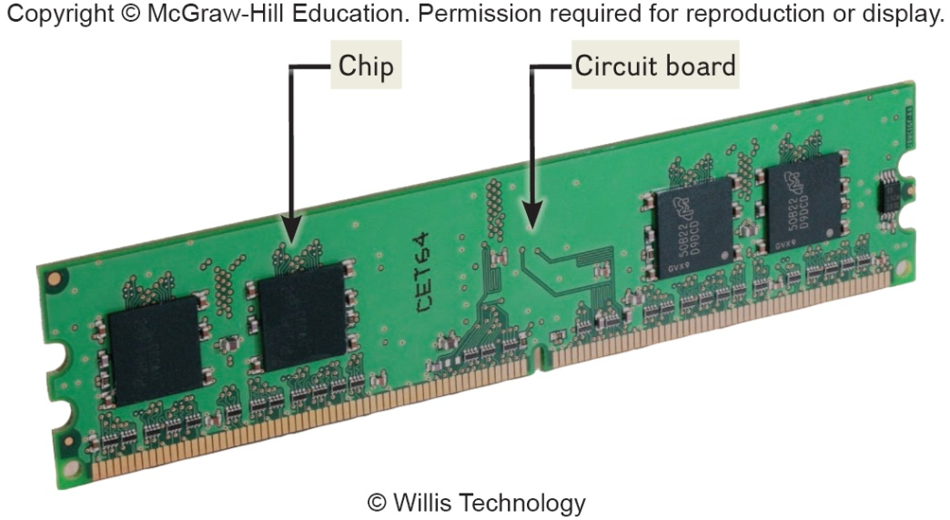
RAM
Random Access Memory (RAM) chips hold programs and data that the CPU is presently processing
Volatile or temporary – contents are lost when computer is powered off
Cache memory – temporary, high-speed holding area between the memory and CPU
Additional RAM can be added using an expansion module called a DIMM (Dual in-line memory module)
Notes:
Temporarily holds data and programs being processed by the CPU
Volatile - when power shuts off, contents of RAM are emptied
Exception - flash RAM can retain data when power disrupted, used in high end portable computers
Cache memory (key term) – improves processing by acting as a temporary high-speed holding area between the memory and CPU
Area in RAM set aside to store information frequently accessed
DIMM (dual in-line memory module) (key term) – additional RAM
RAM is also referred to as temporary or volatile storage
It is a good idea to save your work in progress to a second a secondary storage device. which is permanent or nonvolatile storage

Slide 17
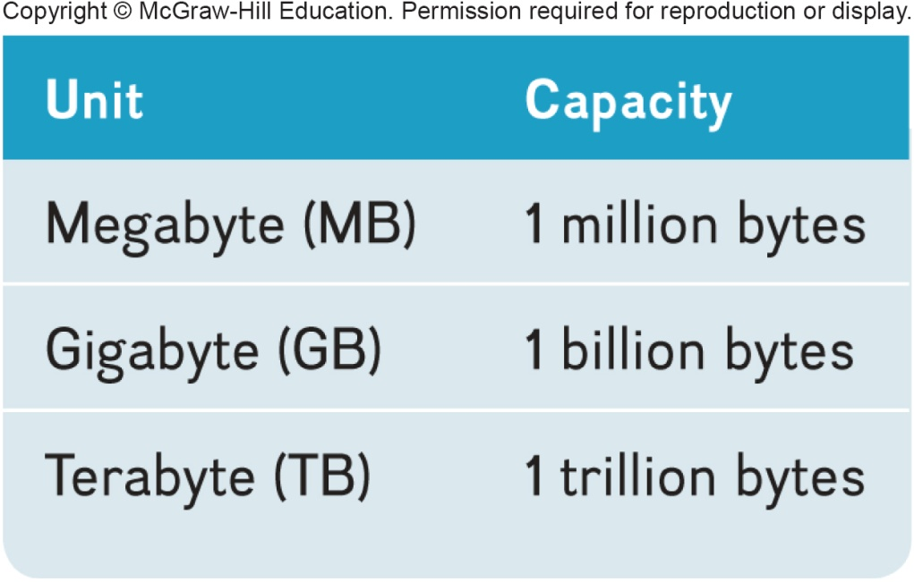
RAM continued
Virtual Memory
Dividing a program between memory and storage enabling the system to run very large programs
Memory is expressed in bytes
Notes:
Virtual memory (key term) – dividing a program between memory and storage enabling the system to run very large programs

Slide 18
ROM
Read-only memory (ROM)
Information stored by the manufacturer
Non-volatile and cannot be changed
CPU can read, or retrieve data and programs in ROM but the computer cannot change ROM
Contain special instructions
Start the computer
Access memory
Handle keyboard input
Notes:
ROM is used for special instructions such as starting the computer, accessing memory and handling keyboard input.
Many ROM chips have been replaced by flash memory by many applications

Slide 19
Flash Memory
Flash memory combines of the features of:
RAM, it can be updated
ROM, it is non-volatile
Contains startup information
BIOS (basic input/output system)
Amount of RAM
Type of keyboard, mouse, and secondary storage devices connected
Many ROM chips are being replaced by flash memory
Notes:
Used for a wide-range of applications
Used to store start-up instructions; BIOS (basic input/output system) (key term)
Flash memory – can retain data even if the power is disrupted
Most expensive type of RAM
Used for digital telephones, digital video cameras, and portable computers

Slide 20
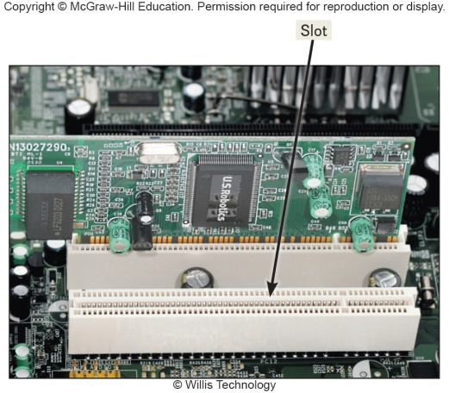
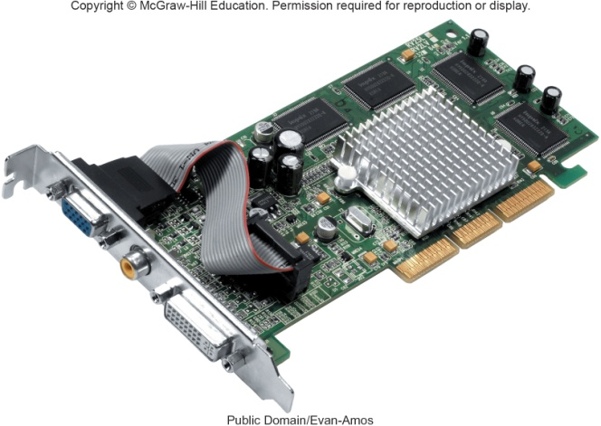
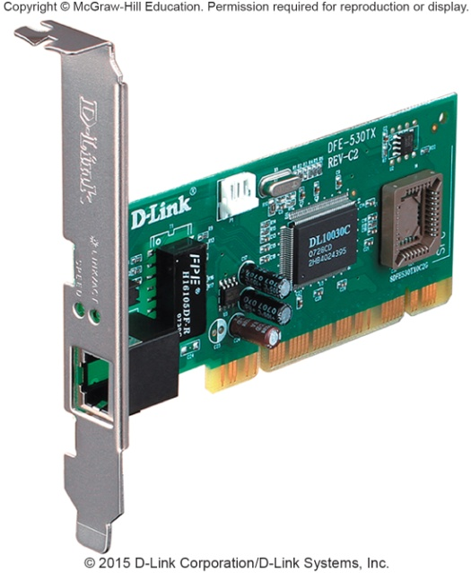
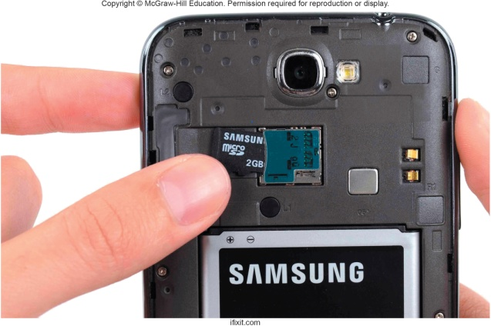
Expansion Slots and Cards
Expands your system’s capabilities
Graphics cards for high quality 3D graphics
Network interface cards (NIC) connect devices to networks via cables
Wireless network cards connect devices to networks without cables
SD cards
Expansion cards for mobile devices
Notes:
Expansion slots (key term) used to insert expansion cards (key term)
Graphics cards (Key term) - provides high quality of 3-D graphics
Network Interface Cards (Key Term) (NICs) or Network Adapter Cards) – attaches a user to a network
Wireless network cards (key term) – allow computers to be connected to a network without cables
SD Cards (key term) – expansion cards for laptops, tablets and smartphones.

Slide 21
Bus Lines / Bus
Connect parts of the CPU to each other and various other components on the system board
Pathway for bits representing data and instructions
Bus width
Number of bits that can travel simultaneously down a bus
Architecture and design are tied to the speed and power for the computer
Two basic categories of buses
System bus – connects CPU to memory
Expansion bus – connects CPU to other components
Notes:
Bus lines provide (key term) data pathways that connect various system components
A bus line is also called a bus (Key Term)
Bus width (key term) is the number of bits that can travel at once
It is a pathway for bits representing data and instructions
A bus is similar to a multilane highway.
Every computer has two basic categories of buses
System bus (key term) – connects the CPU to memory on the system board
Expansion bus (key term) – connects the CPU other components and to slots on the system board

Slide 22
Expansion Buses
Principle types:
Universal Serial Bus (USB)
Connects external USB devices onto the USB bus
FireWire
Primarily used to connect audio and video equipment to the system board
PCI Express (PCIe)
Single dedicated path for each connected device
Notes:
Universal Serial Bus (USB) (key term) – most widely userd
FireWire buses (key term) – similar to USB but more specialized.
used primarily to connect audio and video equipment to the system board
PCI Express (PCIe) (key term)– widely used in many of today’s most powerful computers; provides a single dedicated path for each connected device (unlike other buses which share a single bus line or path with several devices.

Slide 23
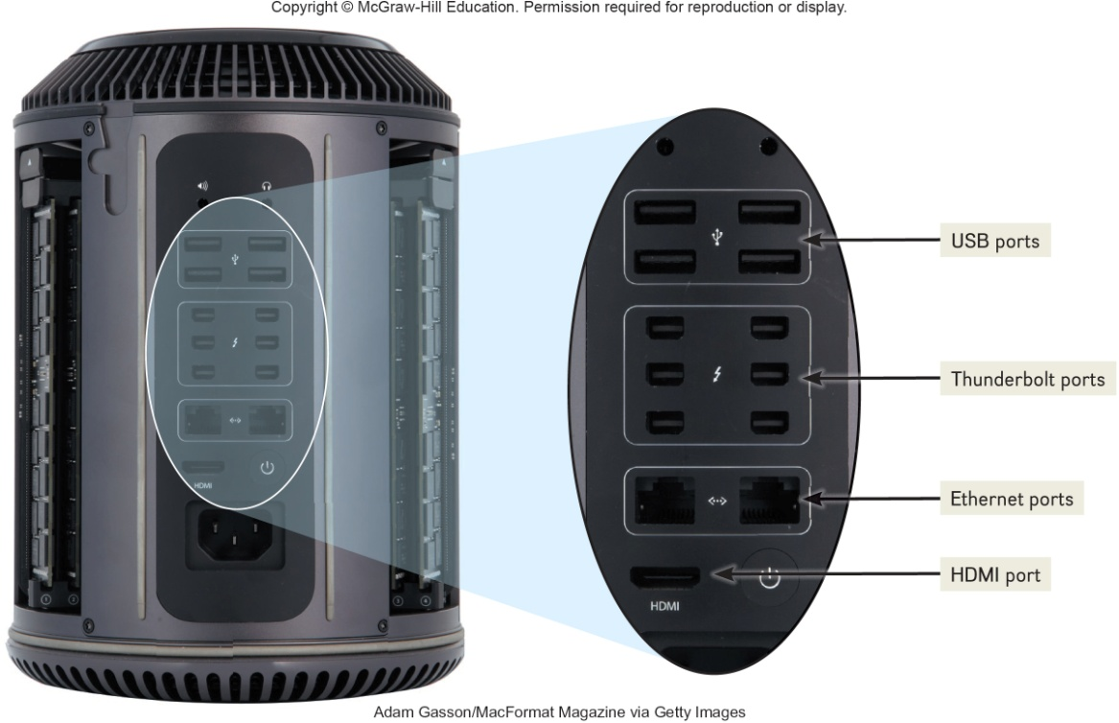
Ports
Socket for connecting external devices to the system unit
Ports connect directly
To the system board
To cards inserted into slots on the system board
Two Types
Standard Ports
Specialized Ports
Notes:
Ports are connecting sockets on the outside of a system unit
Ports are often standard features of computer systems and others are more specialized
Two types of ports:
Standardized
Specialized

Slide 24
Standard Ports
USB
Keyboards, mice, printers, storage devices
Ethernet
High speed networking
HDMI – High Definition Multimedia Interface
High definition video and audio
Thunderbolt
Provides high-speed connections
Can connect up to 7 separate devices through 1 port
Notes:
Port (key term) – socket for external devices
USB (universal serial bus) (key term) - connects several devices to the system unit
Ethernet (key term) – standard for networking, allows you to connect multiple computers for sharing files, or to a DSL or cable modem for internet access
HDMI (key term) – High-Definition Multimedia Interface – provides high-definition video and audio
Thunderbolt – identified by Apple’s MacBook Pro and provides a high-speed connection
Promises to replace a number of ports such as Mini Display port.

Slide 25
Specialized Ports
External Serial Advanced Technology Attachment (eSATA)
High-speed connection for external secondary storage
Musical Instrument Digital Interface (MIDI)
Connect musical instruments
Mini DisplayPort (MiniDP or mDP)
Connection to large monitors
VGA & DVI
Connections to analog and digital monitors
FireWire
High-speed connections to FireWire devices
Notes:
External Serial Advanced Technology Attachment (eSATA) (key term) – provides a very high-speed hard drive connection
Musical Instrument Digital Interface (MIDI) (key term) – special ports for connecting musical instruments
Mini DisplayPort (MiniDP or mDP) (key term) – Provides a connection for a large monitor
VGA and DVI – connections to analog and digital monitors
FireWire ports (key term) connects camcorders and storage devices

Slide 26
Cables
Used to connect external devices to the system unit via the ports
One end of the cable is attached to the device and the other end has a connector that is attached to a matching connector on the port
Notes:
Cables (key term) physical connections for devices to the system unit via ports

Slide 27
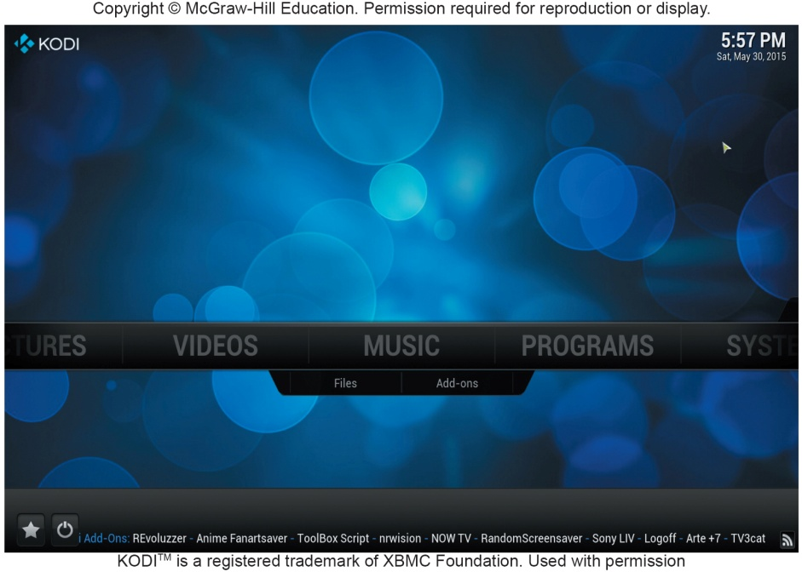
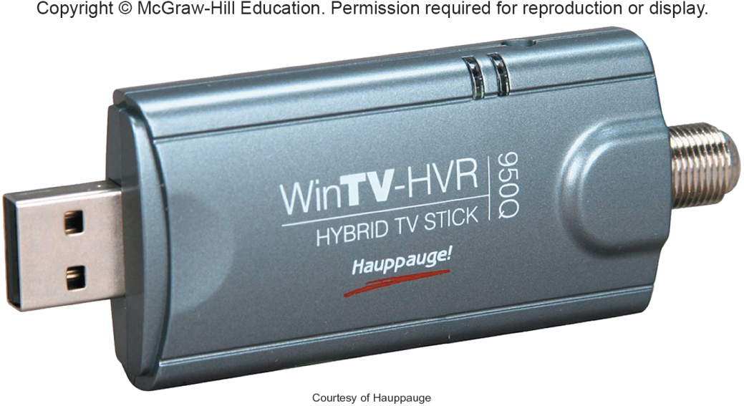
Making IT Work for You ~ TV Tuners
Using Windows Media Center as a DVR
Install TV Tuner to connect your computer or cable to your computer

Slide 28
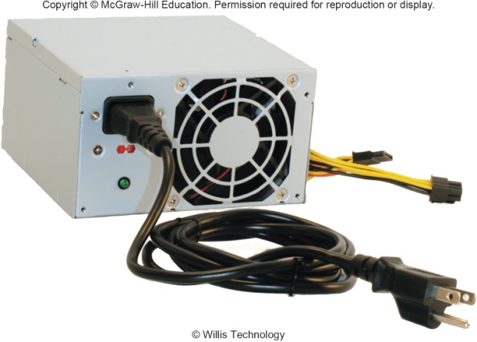
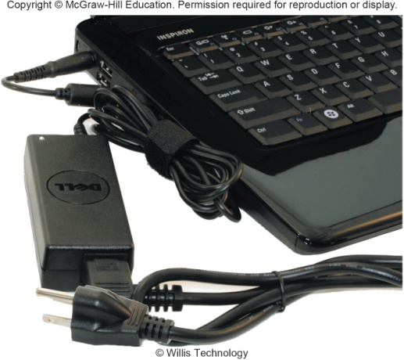
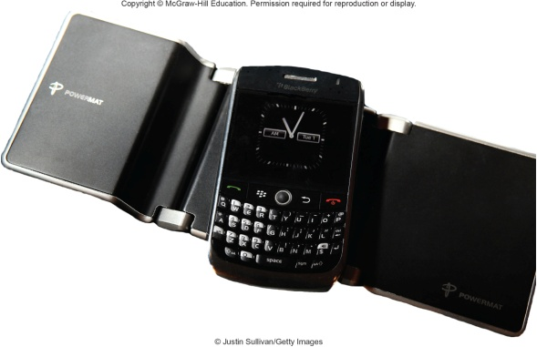
Power Supply
Computers require direct current (DC) power converting alternating current (AC) from wall outlets or batteries
Desktop computers have a power supply unit in the system unit
Laptops use AC adapters in the system unit
Tablets and mobile devices use internal AC adapters
Smartphones can use wireless charging platforms
Notes:
Direct current (DC) powers computers
Desktop computers have a power supply unit (key term) unit located within the system unit
Laptop computers use AC adapters (key term) that are located outside the system unit
Tablets and mobile devices use AC adapters
Smartphones use a wireless charging platforms

Slide 29
Electronic Data and Instructions
Digital electronic signals
Recognized by computers
Analog signals
Continuous signal
Created by voices
Conversion must take place from analog to digital before processing can occur
Notes:
Digital signals (key terms) – electronic signals only recognized by computers
Analog signals (key terms) – created by voice

Slide 30
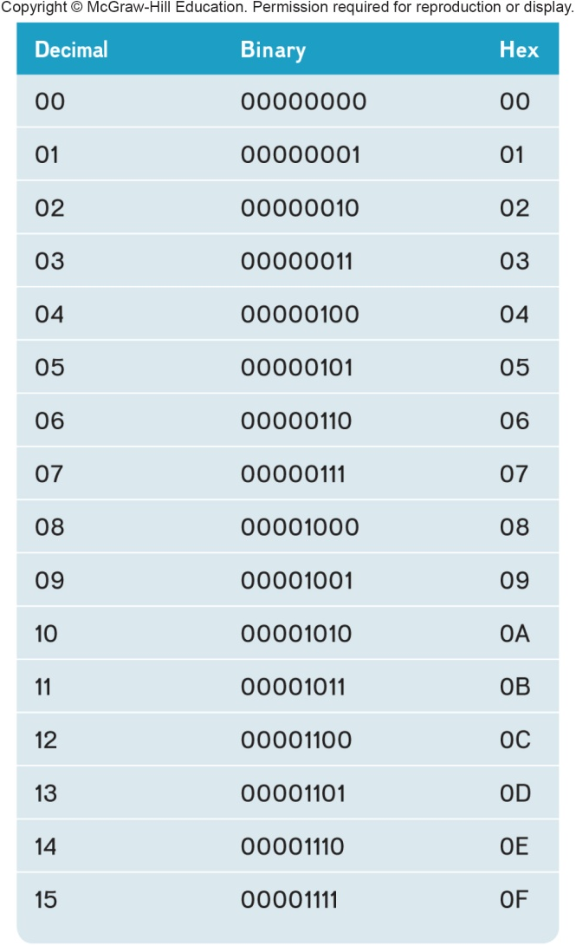
Numeric Representation
Two-state binary system consists of only two digits called bits
On = 1; negative charge
Off = 0; no charge
Byte = 8 bits grouped together
Hexadecimal system
Uses 16 digits to represent binary numbers
(0, 1, 2, 3, 4, 5, 6, 7, 8, 9, A, B, C, D, E, F)
Notes:
Binary System (key term) – consists of only two digits, 0 and 1. Each 0 or 1 is called a bit (key term) which is short for binary digit
8 bits grouped together is a byte (key term)
Binary numbers are difficult to read so they are represented in a hexadecimal system (key term) or hex using 16 digits to represent binary numbers

Slide 31
Character Encoding
Character encoding standards assign a unique sequence of bits to each character
ASCII
American Standard Code for Information Interchange
Used by personal computers
EBCDIC
Extended Binary coded Decimal Interchange Code
Used by mainframe computers
Unicode
New encoding due to explosion of the Internet
Uses 16 bits
Recognized by virtually all computer systems
Notes:
Character encoding standards (key term) assign a unique sequence of bits to each character
Historically used ASCII (key term) for microcomputers and EBCDIC (Extended Binary coded Decimal Interchange Code) (key term) for mainframes
Unicode (key term) is a new character encoding using 16 bits
Uses a variable number of bits to represent each character.

Slide 32
Careers In IT
Computer technicians repair and install computer components and systems
Employers look for:
Certification or associate degree in computer repair
Communication skills
Continued education is required
Computer technicians can expect to earn an annual salary of $37K to $47K
Notes:
Opportunities for advancement typically come in the form of work on more advanced computer systems
Some computer technicians move into customer service positions or go into sales

Slide 33
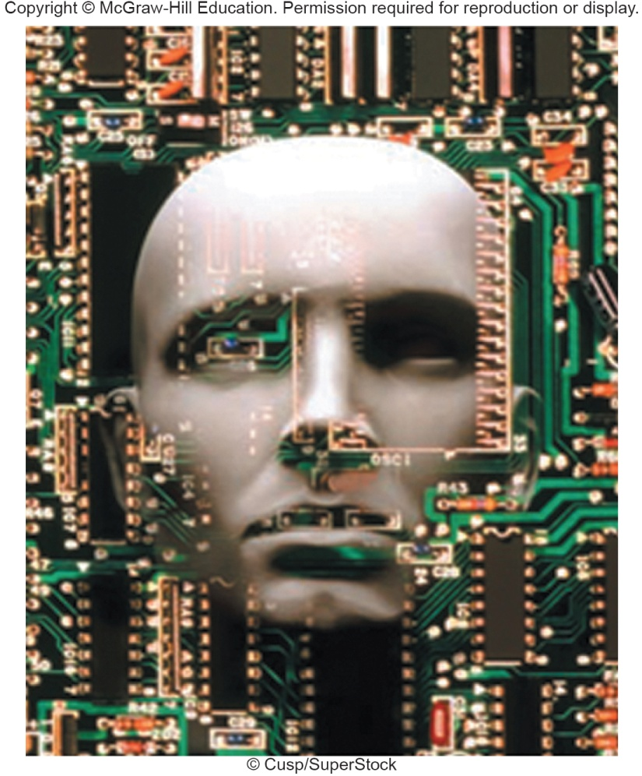
A Look to the Future
Wearable computers
Send and receive email while jogging
Maintain your personal schedule book
Remember the names of people at a party
Notes:
Wearable computers already exist for the military
In the future, will be used by surgeons in operating rooms

Slide 34
Open-Ended Questions (Page 1 of 3)
Describe the five most common types of personal computers.
Describe system boards including sockets, chips, chip carriers, slots, and bus lines.
Discuss microprocessor components, chips, and specialty processors.

Slide 35
Open-Ended Questions (Page 2 of 3)
Define computer memory including RAM, ROM, and flash memory.
Define expansion slots, cards, including graphics cards, network interface cards, wireless network cards, and SD cards.
Describe bus lines, bus width, system bus, and expansion bus.

Slide 36
Open-Ended Questions (Page 3 of 3)
Define ports including standard and specialized ports. Give examples of each.
Describe power supply including power supply units and AC adapters.
Discuss electronic data and instructions.

